Slide 1
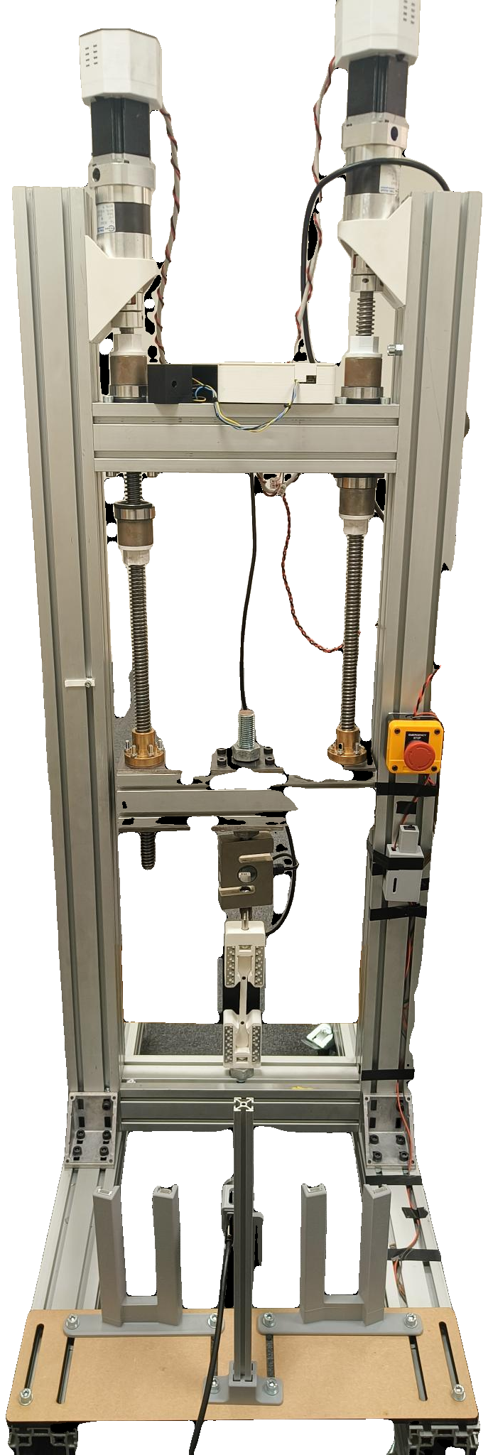
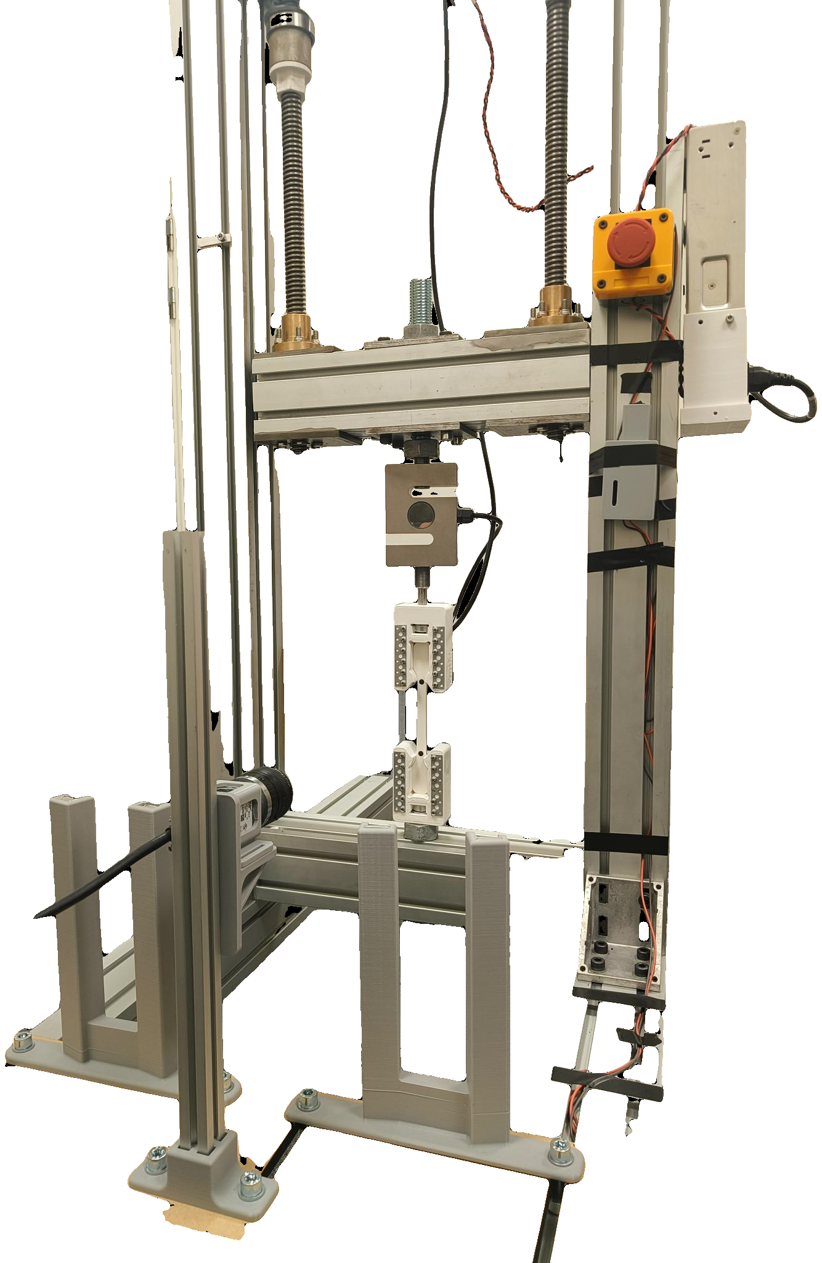
SMART UTM — PROGRESS REPORT
Jönköping University · School of Engineering — status to 9 September 2026 · automated tensile testing with camera-based strain
18 of 20 features rig-validated; the strain channel matches a certified extensometer.
Two sessions in the materials-testing laboratory closed the validation: on the XT-205's own frames the rig's DIC agrees to 0.07 % in scale. PLA, PETG and TPU are characterised, the moisture and carbon-footprint studies are written up, and the project report is drafted. Five roadmap items remain, none of them code.
18 / 20
6 / 6
30
0.99928
5
features rig-validated
(+2 verified offline)
test protocols
validated
specimens tested,
36 indexed runs
scale vs the XT-205
on the same frames
open roadmap items —
rig time and one email
WHERE THE PROJECT STANDS
RESULTS WORTH REPORTING
The rig is no longer a manual machine, and its strain channel is no longer unproven. A test is: pick a recipe, follow the wizard, press Start — the software runs the protocol, watches the specimen through the camera, stops itself at fracture and writes a linked record the post-processor can re-measure. The channel is validated against itself (noise 11.9 µε, scaling as predicted), against the literature (three polymers in band) and against a certified XT-205 video extensometer — within 1 % on yield and fracture strain, 0.07 % in scale on the same frames.
The strain channel is validated against a certified instrument
On the XT-205's own frames: scale 0.99928, R² 0.9999964, fracture strain 5.21 vs 5.22 %, a constant -55 µε offset (0.069 px) that vanishes from every slope. On separate specimens: yield +1.0 %, fracture strain -0.8 %. The -7.7 % UTS gap is pull rate (2.21×), grips and batch.
The rig ranks materials correctly across two decades of modulus
The rig — built in-house, every control loop closed in software
PLA 46.2 MPa / 3.17 GPa, PETG 41.8 MPa / 1.81 GPa, TPU 0.024 GPa to 18.9 % strain unbroken — all inside their published bands. The 50 % infill knockdown is 2.4, a matched pair repeats to 0.2 %.
Strength repeatability is publication-grade
100 % infill, n = 5: UTS 46.2 ± 1.2 MPa — 2.5 % scatter, and the only n > 2 result we own. Two fracture protocols landed 0.9 % apart, but on DIFFERENT specimens (n = 1 each), so that bounds protocol and specimen scatter together, not the protocol alone.
The camera is not a nicety — it changes the answer
Two steppers (1.85 Nm, 20:1) drive 5 mm lead screws against a fixed base. An ANYLOAD 3 t cell measures force; a Basler camera measures strain optically at 20.8 px/mm from two markers on the 80 mm gauge. The ESP32 runs STEP/DIR/ENABLE only and knows nothing of test protocols — every protocol, guard and measurement here lives in the PyQt6 app, closing the loop at ~11 Hz.
Over the same cycles the crosshead reads 4 % STIFFER while the specimen's true modulus falls 26 %. Without strain measured on the specimen itself, this test reports the opposite of what actually happened.
Fatigue and creep, each resolved at n = 1
Residual strength −6.8 % after 16 cycles at 79 % of fracture load; creep +1080 µε at 41× the noise floor with the rig's own drift subtracted first.
WHAT HAS BEEN DELIVERED
DECISIONS I NEED FROM YOU
June
100 % infill quintet, n = 5
The laboratory's load or crosshead channel — one email
August
UTS 46.2 ± 1.2 MPa, scatter 2.5 % — publication-grade repeatability.
With either channel the strain comparison can be made at matched force, which cancels compliance and turns it into a pure scale check. One request to Jacob Steggo at the Department of Materials and Manufacturing.
All six protocols validated
Including both destructive protocols; two landed 0.9 % apart on ultimate strength, though on different specimens.
August
Fatigue and creep resolved
Rig time and a drying step for the moisture study
Residual strength after cycling is −6.8 % against the same-protocol virgin run; creep resolved at 41× the noise floor.
The literature predicts −8.5 % strength after 24 h of ambient exposure; the rig resolves better than 1 % on a matched pair. Three conditioned sets from one spool, one session, and a filament dryer.
August
Laboratory cross-validation, two sessions
80 mm and 45 mm gauge on the Zwick/Roell Z100 + XT-205; the laboratory's footage re-measured by the rig's own post-processor: scale 0.99928, R² 0.9999964.
Poisson's ratio — needs optics, not code
The four-marker maths is written and self-tested, but the gauge is too narrow to resolve a transverse pair at the present 20.8 px/mm. A gauge-zoomed lens (or a second camera) plus a matte backdrop unblocks true stress and Poisson's ratio. Until then every stress reported is engineering stress, which is stated on every figure.
August
PETG and TPU, black PLA, the 45 mm gauge
Three polymers in their bands; the Otsu-vs-fixed threshold question settled; noise scaling 1.78× predicted, 1.78× measured.
More specimens before publication
September
SF17–SF20, moisture and footprint studies, report
Creep and fatigue are each n = 1 at one condition. The measurement is proven; the material constants are not. 3–4 stress levels for creep and 3 repeats for fatigue would make both publishable.
Capture, post-processing, noise capture and manual blob selection; the humidity and PCF sections; the 393-slide diary and the project report drafted.
NEXT
Now
One pull at 2 mm/min
One specimen, one run, no new code — separates the rate effect from specimen scatter in the -7.7 % UTS gap.
Now
Rig sessions for SF19 and SF20
Noise capture and manual blob selection are built and verified offline; each needs one real pull to be carded as rig-validated.
Next
The controlled moisture experiment
Dried / 24 h / one week from one spool, pulled in one session — prices the batch term and closes the laboratory comparison.
Every number on this page is recomputed from the rig CSVs and the laboratory records by the documentation/scripts analysis suite and the test registry — nothing is transcribed by hand. Full detail: the 393-slide progress diary and the project report in documentation/, and ROADMAP.md for the complete task list.

