Slide 1
AUE 8930 MACHINE PERCEPTION AND INTELLIGENCE- FINAL PROJECT
SEMANTIC SEGMENTATION USING FCN AND VGG16 WEIGHTS ON FRANCE DATASET
Problem Statement: The detection of drivable, non-drivable and the environment spaces in a dense environment based on highly populated cities like Hyderabad, India and Paris, France.
Research Mentors:
Dr. Bing Li
Ziyue Feng
Team Members:
Adithya Suresh
Prajval Vaskar

Slide 2
Methodologies
The project was approached by implementing the semantic segmentation on a dataset to visualize the objects and the drivable space present in an image frame.
There were many datasets for consideration and some of them included the France dataset and the Indian Driving Dataset.
The Indian Driving Dataset was initially tried with the implementation of VGG-16 Deep Learning Network Architecture where the object classes that involved the color coding including the drivable and non drivable spaces.
The second methodology was to implement the 2D semantic segmentation on the France Dataset which contains 400 images with 12 channels for the image.
On the other hand, the Indian Driving Dataset has 3250 images with 256 color channels.

Slide 3
Methodology 1- 2D Semantic Segmentation on Indian Driving Dataset
The Indian Driving Dataset contains 3250 images with the split up of 1500 images for training, 1000 images for validation and 750 images for testing.
This dataset was trained using the VGG-16 architecture with the epoch numbers 100 and 200 for training and the batch size was set to 8 and 16.
The network was trained on various cloud computing platforms like the Google Colab and the Clemson University’s Palmetto Cluster (V100 GPU).
We had considerable amount of problems faced with this methodology which made us to work on the France Dataset.
Some of the problems include the computational complexity which was experienced with the Palmetto Cluster where training for one epoch had 508 seconds with 25 seconds per step.

Slide 4
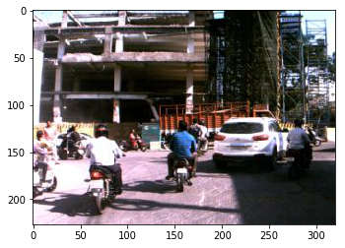
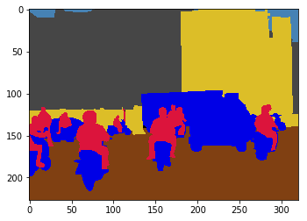
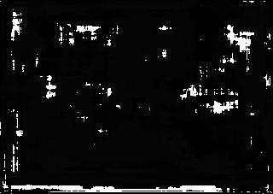
Results using the VGG-16 network for Indian Driving Dataset
Image before segmentation
Image before training with color coding split up
Image after segmentation
The project was expected to involve 2 categories like the drivable and non-drivable spaces but the result after segmentation was not convincing because of the noise in color channel.

Slide 5
FINAL METHODOLOGY- SEMANTIC SEGMENTATION USING FCN AND VGG16 WEIGHTS ON FRANCE DATASET
CONTENTS:
The motivation of this work.
The challenges of this work.
The elaboration of your proposed or used methodology.
The experiment setup and the result.
The contribution of each member statement.

Slide 6
The motivation of this work
What is semantic segmentation?
Semantic Segmentation partitions an image into regions that represent meaningful objects, which serves as an important tool for the subsequent image analysis such as scene understanding. In recent years, autonomous driving system has gained much popularity, in which sematic segmentation has played an important role in detecting obstacles and recognizing road conditions.

Slide 7
The motivation of this work
Why semantic segmentation?
Self-driving cars require a deep understanding of their surroundings. To support this, camera frames are used to recognize the road, pedestrians, cars, and sidewalks at a pixel-level accuracy.
Good segmented results in autonomous driving system will help it precisely understand the scene, and thus leading to safe decision-making and vehicle control.
Modern camera systems can produce high quality images at high rates at very low costs, allowing them to be placed in many commodity items ranging from mobile phones to surveillance systems and automotive vehicles. This increases the demand for systems that can understand this data. The advent of deep learning enabled great strides towards better visual understanding of the surrounding.
Semantic segmentation is a powerful tool for deep learning, as it makes images easier to analyze by assigning parts of the image semantic definitions.
Semantic segmentation achieves fine-grained inference by making dense predictions inferring labels for every pixel, so that each pixel is labeled with the class of its enclosing object are region.

Slide 8
The challenges of this work
Scale was a major issue as we need to handle both close-by objects with fine detail and far away objects captured by only a few pixels.
We also need to be able to handle illumination changes in the scene. However, semantic segmentation also has a major problem specific difficulty. This difficulty is caused by an ambiguity of boundaries in image space, especially for thin objects such as poles, similar looking objects such as a road and a sidewalk and far away objects.
Source code implementation
Understanding the layers of neural network
Training the neural network
Implementation the code in IDD

Slide 9
Architecture of semantic segmentation network.
A general semantic segmentation architecture can be broadly thought of as an encoder network followed by a decoder network:
The encoder is usually is a pre-trained classification network like VGG/ResNet followed by a decoder network.
The task of the decoder is to semantically project the discriminative features (lower resolution) learnt by the encoder onto the pixel space (higher resolution) to get a dense classification.
Unlike classification where the result of the very deep network is the only important thing, semantic segmentation not only requires discrimination at pixel level but also a mechanism to project the discriminative features learnt at different stages of the encoder onto the pixel space.
In an image for the semantic segmentation, each pixel is usually labeled with the class of its enclosing object or region. For example, a pixel might belong to a road, car, building or a person. The semantic segmentation problem requires to make a classification at every pixel.

Slide 10
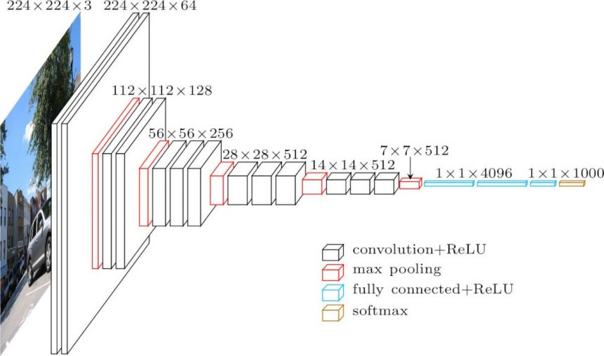
VGG- 16 Deep Learning Network Architecture

Slide 11
Role of Fully Convolutional Network (FCN) in VGG-16
The original Fully Convolutional Network (FCN) learns a mapping from pixels to pixels, without extracting the region proposals. The FCN network pipeline is an extension of the classical CNN. The main idea is to make the classical CNN take as input arbitrary-sized images. The restriction of CNNs to accept and produce labels only for specific sized inputs comes from the fully-connected layers which are fixed. Contrary to them, FCNs only have convolutional and pooling layers which give them the ability to make predictions on arbitrary-sized inputs.
One issue in this specific FCN is that by propagating through several alternated convolutional and pooling layers, the resolution of the output feature maps is down sampled. Therefore, the direct predictions of FCN are typically in low resolution, resulting in relatively fuzzy object boundaries.

Slide 12
Key feature of FCN architecture
FCN transfers knowledge from VGG16 to perform semantic segmentation.
The fully connected layers of VGG16 is converted to fully convolutional layers, using 1x1 convolution. This process produces a class presence heat map in low resolution.
The up sampling of these low-resolution semantic feature maps is done using transposed convolutions (initialized with bilinear interpolation filters)
At each stage, the up-sampling process is further refined by adding features from coarser but higher resolution feature maps from lower layers in VGG16.
Notes:
The IoU is the area of overlap between the predicted segmentation and the ground truth divided by the area of union between the predicted segmentation and the ground truth,

Slide 13
The elaboration of the proposed or used methodology
In the used dataset, there are 12 segmentation classes and the image is from a driving car.
To simplify the problem, we reshaped all the images to the same size: (224,224). Why (224,224)? This is the image shape used in VGG and FCN model uses a network that takes advantage of VGG structure. The FCN model becomes easier to implement when the image shape is (224,224). However, FCN does not require the image shape to be (224,224).
VGG are originally designed for classification task. The network stacks convolution layers together with down-sampling layers, such as max-pooling, and then finally stacks fully connected layers. Appending a fully connected layer enables the network to learn something using global information where the spatial arrangement of the input falls away.
For the segmentation task, however, spatial information should be stored to make a pixel-wise classification. FCN allows this by making all the layers of VGG to convolutional layers.

Slide 14
The elaboration of the proposed or used methodology
The model used is FCN8 from Fully Convolutional Networks for Semantic Segmentation. It deplicates VGG16 net by discarding the final classifier layer and convert all fully connected layers to convolutions.
Fully Convolutional Networks for Semantic Segmentation appends a 1 x 1 convolution with channel dimension the same as the number of segmentation classes (in our case, this is 12) to predict scores at each of the coarse output locations, followed by up sampling deconvolution layers which brings back low resolution image to the output image size. In our example, output image size is (output_height, output_width) = (224,224).

Slide 15
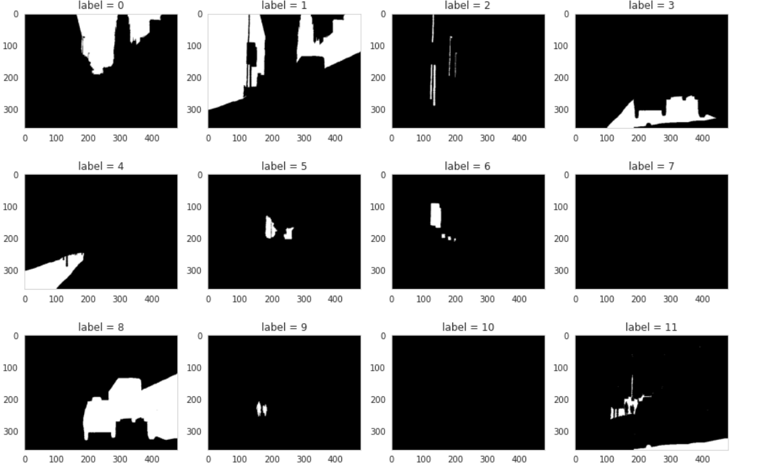
Labels used in the dataset

Slide 16
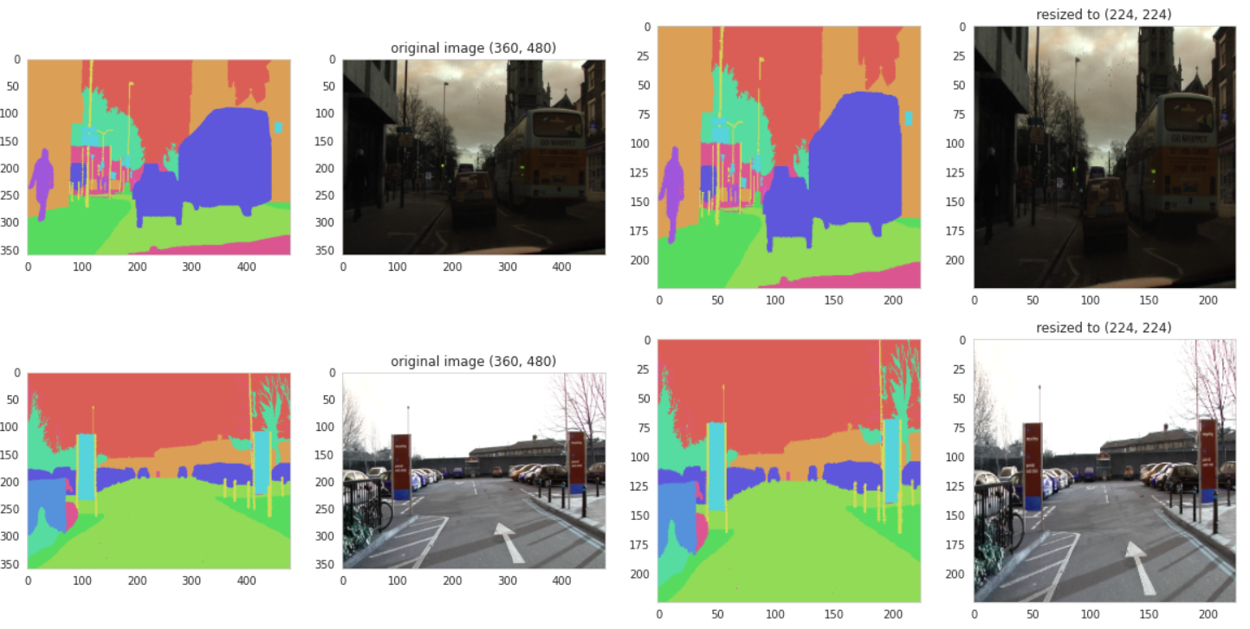
The experiment setup and the result
Expected output before and after resizing of an image

Slide 17
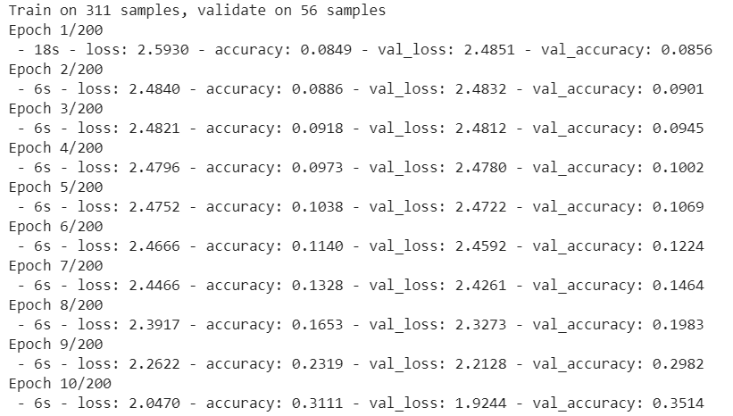
Training the neural network
Epochs used = 200
Training 311 samples
Validation on 56 samples
Time required for each epochs 6-7 seconds

Slide 18
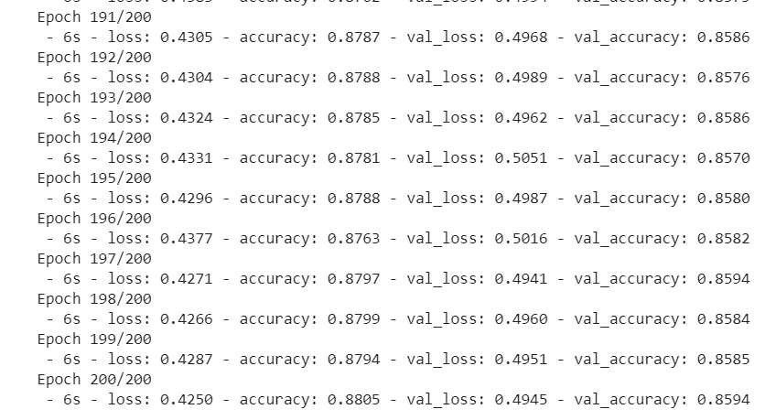
Training the network
After running for 200 epochs
Accuracy : 88.05%
Validation accuracy = 85.94 %

Slide 19
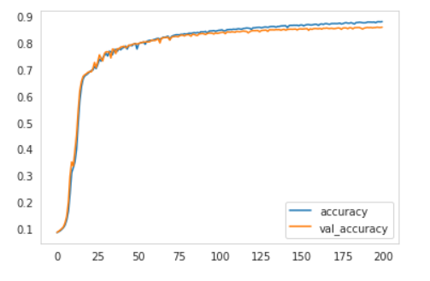
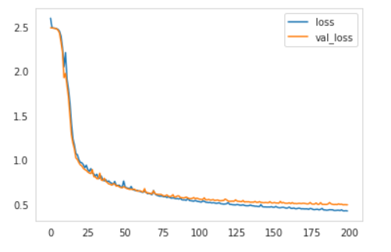
Plots of accuracy and loss
Plot of accuracy and validation accuracy vs number of epochs
Plot of loss and validation loss vs number of epochs

Slide 20
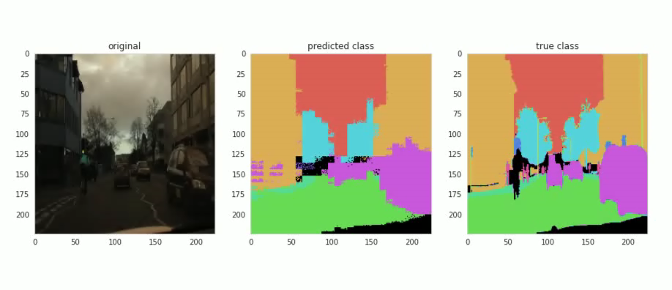
Result of the segmented images in image sequence- Demonstration

Slide 21
Take away from the project and future work
Throughout this project work, we were able to understand the importance of semantic segmentation in the autonomous vehicle.
We understood how the neural network works and the concept of convolution, pooling, strides, filters etc.
We understood how to implement the neural network on different dataset.
Future work
Implement the different neural network architecture (R-CNN, SEGNET, etc.) on the same dataset and compare the result of it.

Slide 22
References
https://idd.insaan.iiit.ac.in/evaluation/leader-board/
https://github.com/mohanrajmit/IDD/blob/master/seg_updated_vgg16.ipynb
https://github.com/anishmadan23/semantic-segmentation-indian-driving-dataset
https://github.com/RamKaushikR/IDD
https://medium.com/analytics-vidhya/indian-driving-dataset-instance-segmentation-with-mask-r-cnn-and-tensorflow-b03617156d44
https://nanonets.com/blog/how-to-do-semantic-segmentation-using-deep-learning/
https://medium.com/@karol_majek/self-driving-car-road-segmentation-514ae80e103a
https://fairyonice.github.io/Learn-about-Fully-Convolutional-Networks-for-semantic-segmentation.html

Slide 23
THANK YOU!
ANY QUESTIONS?

