Slide 1
Walmart SCT Hackathon Round 2
Team OG
M Adithya Vardan
K Tara Krishna Trishule
N Hashish Reddy

Slide 2
Problem Understanding
About the Problem statement
The problem statement revolves around predicting hard drive failure, ahead of time. By anticipating these failures, organizations can take proactive measures to prevent or mitigate the impact of such failures.
This predictive maintenance approach helps in reducing downtime, preventing unexpected issues, and saving costs associated with equipment replacement or repair.
The dataset likely contains information about various hard drives, including attributes such as temperature, SMART (Self-Monitoring, Analysis, and Reporting Technology) attributes, and failure status.
Advantages of solving this problem
Cost Reduction
Improved Operational Efficiency
Safety and Risk Mitigation
Better Equipment Reliability
Business Advantage
Business use cases where similar problems exist
Manufacturing Industry
Transportation and Logistics
Healthcare Industry
Telecommunications
E-commerce
Energy Sector

Slide 3
Data Processing
Attributes used
The following are few of the attributes used Model Training and Evaluation(ex: X_train, X_test, y_train, y_test), Model Tuning(ex: random_grid), Random Forest Classifier(ex: n_estimators) Function Parameters(ex: root, drive_file, ignore_cols, resample_data, smote_data) and etc.
Attributes Understanding
There are many attributes used, but we will take up a few attributes to give an idea about them. Firstly X_train, X_test, y_train, y_test- These are variables representing the training and test data split for model training and evaluation. Then Random_grid is a dictionary containing hyperparameter values for Random Forest model tuning and there are many more.
Data challenges
This is the largest data we have ever worked with. Faced few challenges while downloading and computing the data due to our limited computational powers, but other than that we were successful in understanding the dataset.
Data Insights
The data had various columns giving us the factors affecting the hdd’s failure. The main columns that we have used is S.M.A.R.T (5, 187, 188, 197, and 198) as given on the “backblaze” website.
Train , Validation , Test data splits
Train, validation, test spit is 60, 20,20.

Slide 4
Feature Engineering
What kind of feature engineering is done on top of raw data?
We utilized principal component analysis initially on the raw data to only find out that if there is very minimal variation in S.M.A.R.T statistic values between working and failed hard drives. So we carried on with the S.M.A.R.T statistics (5, 187, 188, 197, and 198) that were mentioned on the Backblaze webpage. And evidently the second method worked better than PCA. This observation was consistent across various machine learning algorithms employed in the analysis.

Slide 5
Model Building
Choice of model and reason
We chose Supervised learning as the data was clearly labelled and then went on with the Random Forest Classifier, as it is much faster than others(SVM) and also flexible.
Models that were thought of or explored
We came across a research paper by a company called interpretable.ai, who devised optimal survival trees and optimal classification trees, the thought process very interesting and convincing but their libraries were not public so we weren’t able to use it and then we tried it out with LSTM, but the accuracy wasn’t satisfying which made us settle with Random Forest Classifier which we thought of initially.

Slide 6
Model Evaluation
Definition of accuracy
We used “accuracy_score and f1” function from the library sklearn.metrics.
Any forecast window/ cutoffs
We had to RandomizedSearchCV for tuning RandomForest(F1 being the metric) as when we even took a window of 10/20 days there were very less rows for those that failed as compared to the rows for disks that did not fail(we selected a specific hard drive as it was the most failed and most appeared throughout the data) . And then we had to do upsampling and hp tuning to improve the recall which was low initially as “failing” was a rare event

Slide 7
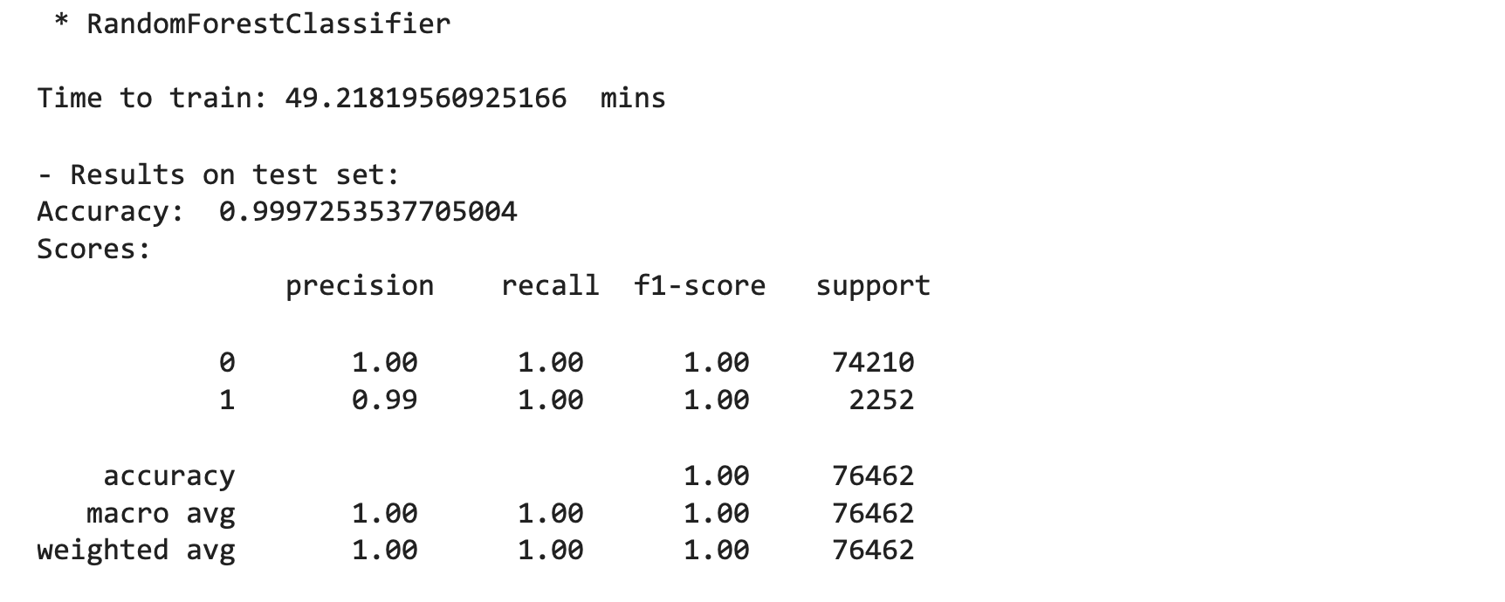
Model Accuracy for hard drive model:-SM12000NM0007

Slide 8
Conclusion
Further directions to improve
We only used some percent of the data due to our limited computational capacity. Working with improved hardware could have significantly better outputs.
Things thought of and not implemented
As mentioned above we thought of trying OST or OCT but as their libraries were not public, we did not have a chance to try them out.
Concluding remarks
It was a great experience working with this project which involves such large datasets. This gave us a chance to go beyond our ML experience and explore more unconventional methods.

