Slide 1
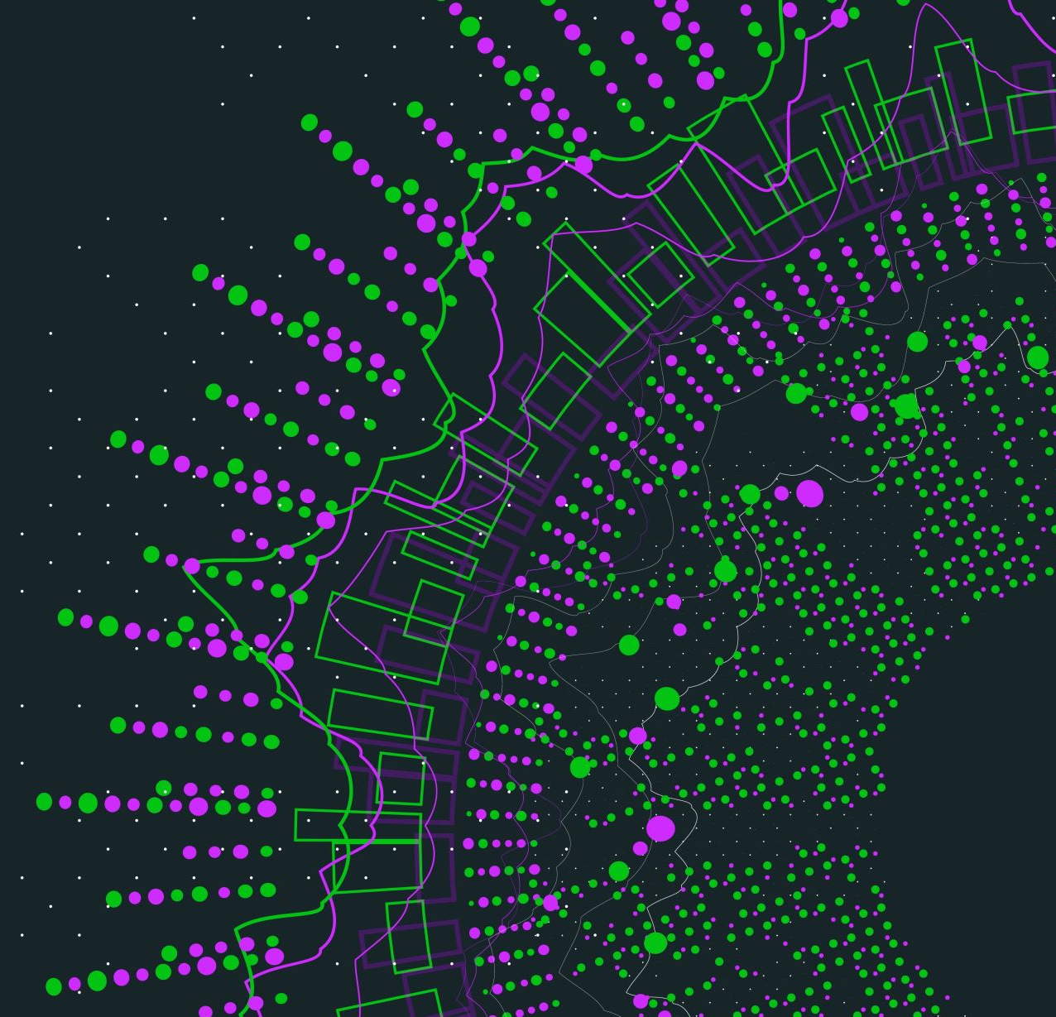



Asteroid Threat Classification
Adithya Viswanathan
CS 4375.001
Professor Rishabh Iyer
Spring 2022

Slide 2
Motivation
Astronomy
Classification
Multiple models

Slide 3
Dataset
Asteroid Threat
16 columns
Over 15635 rows

Slide 4
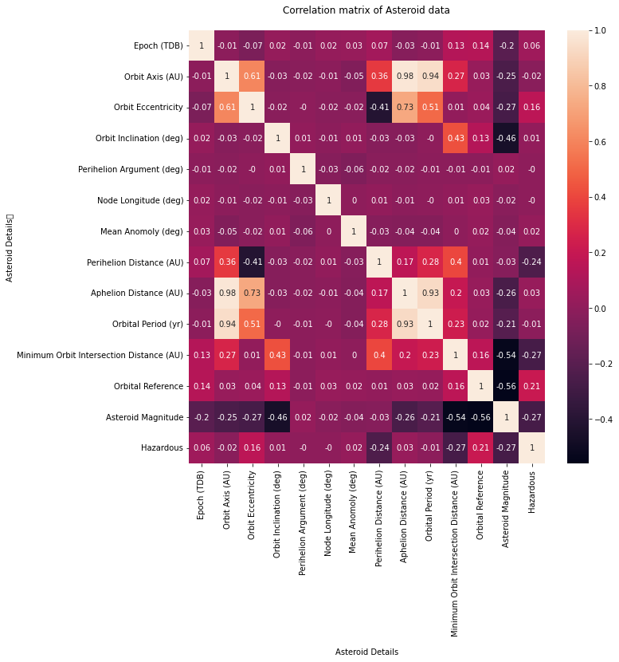
Approach
Convert CSV to DataFrame
Clean data (Remove NULL values)
Correlation Matrix and Corner plot
Visualize feature relationships

Slide 5
Approach
Split data
K-Nearest Neighbors
Decision Tree
Naïve Bayes
Logistic Regression
Neural Network

Slide 6
Results
Highly imbalanced dataset (11% true, 89% false)
Accuracy not a good metric
Normalization did not improve models

Slide 7
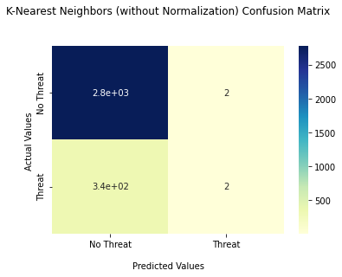
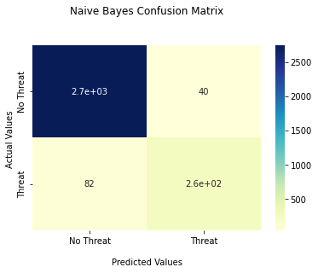


Results
K-Nearest Neighbors
Naïve Bayes
Logistic Regression
Neural Network

Slide 8
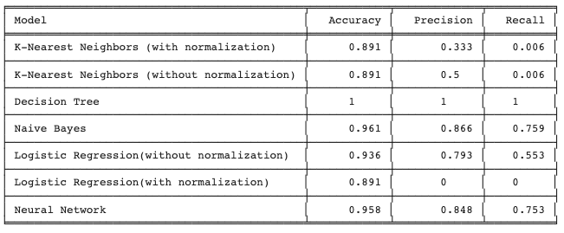
Results
←
←

Slide 9
Lessons
Data is not as widely available as you think
Data is not clean
Some results don’t make sense

Slide 10
Lessons
Accuracy is not always a good metric
Don’t underestimate simple models
Be passionate and enjoy the journey

Slide 11
Resources
https://www.kaggle.com/shrushtijoshi/asteroid-impacts
https://www.kaggle.com/nasa/asteroid-impacts
https://pandas.pydata.org/docs/index.html
https://seaborn.pydata.org/tutorial.html
https://matplotlib.org/stable/api/index
https://www.javatpoint.com/classification-algorithm-in-machine-learning

