Slide 1
TutorUTD
By Jack Wittenbrook, Mason Kuehne, Chloe Lee, Sam Salinas, Vincent Tran-Bui, and Adithya Viswanathan
Notes:
(Presentation Notes)
This semester, each team will have ~10 minutes for the oral presentation and no more than 5 minutes for Q&A and/or a short demo.
For the oral presentation, the first team member speaking:
Could introduce all the team members, and
give an overview of the project, the mission given, the objective, the approach, etc.
Then the other team members will talk about their own contribution, issues you may had to overcome, etc.
There is no need to be too technical, but few buzzwords are OK though.
Make sure to have the presentation ready and agree on who will say what.
The above are just suggestions, please talk to your team mates, and feel free to ask feedback from your technical mentor and faculty advisor

Slide 2
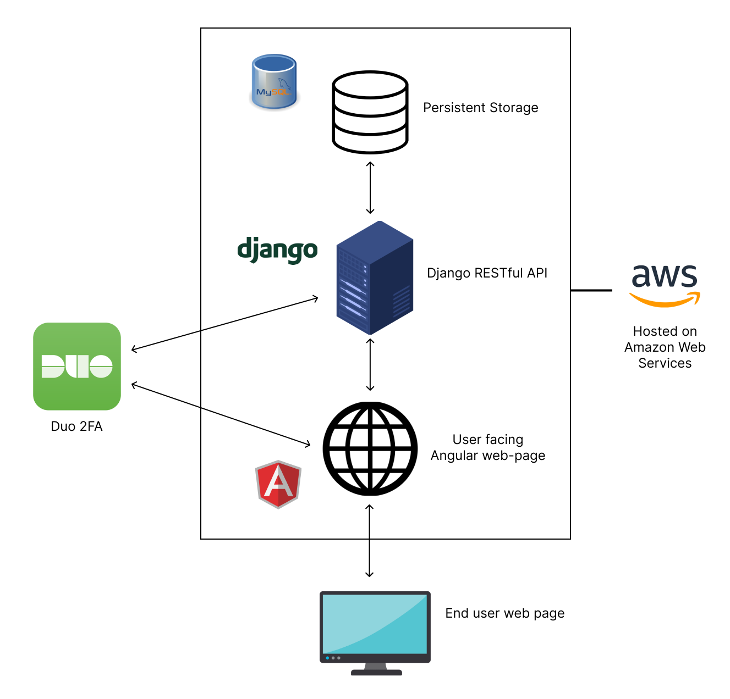
Overview and Goal:
TutorUTD is a web based application where students can find and book appointments with tutors specializing in the classes they need.
Approach:
Online web application
Angular front end application
Django back end application
RESTful API to connect
MySQL database
Authenticate using Duo
Host on AWS

Slide 3
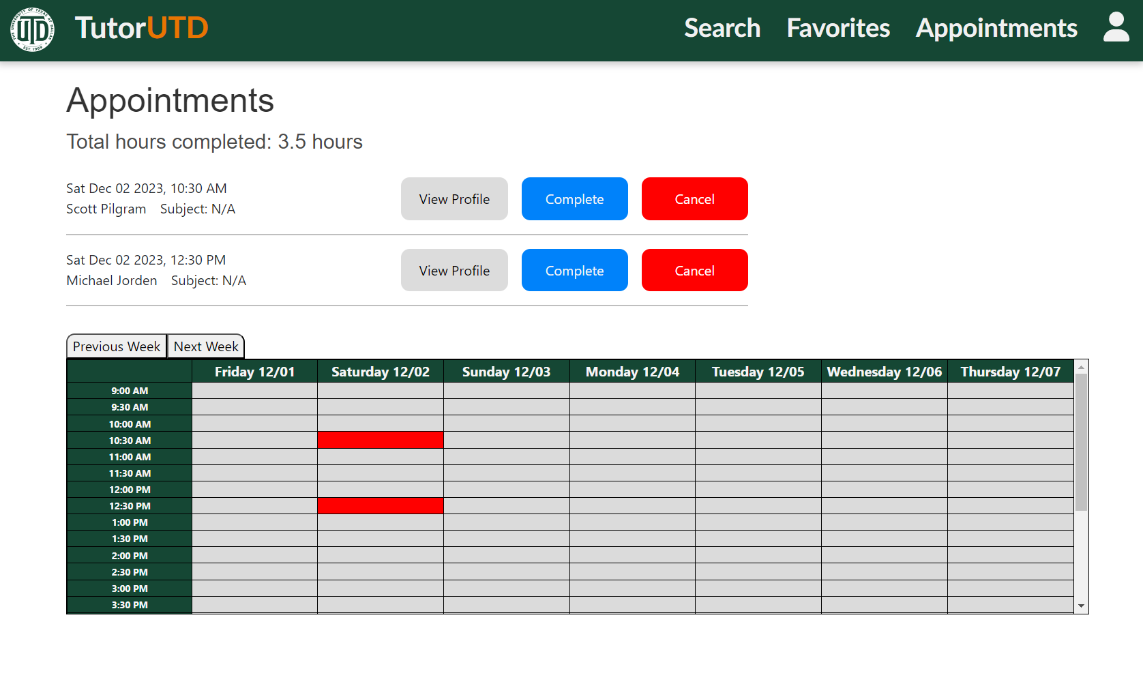
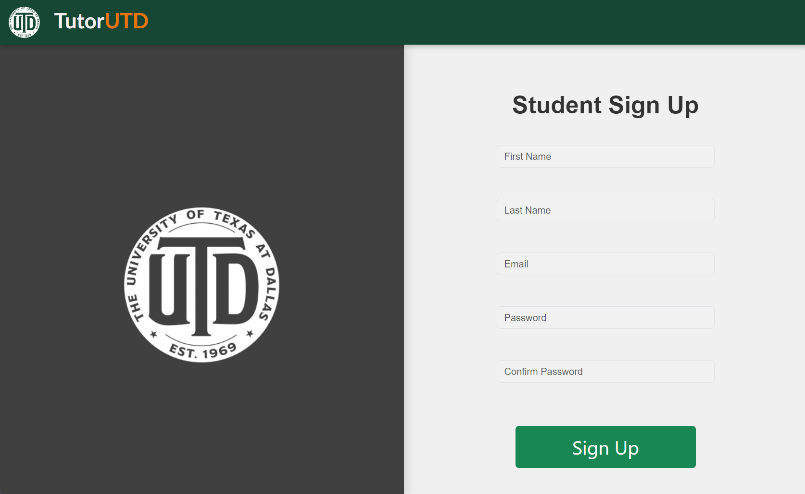
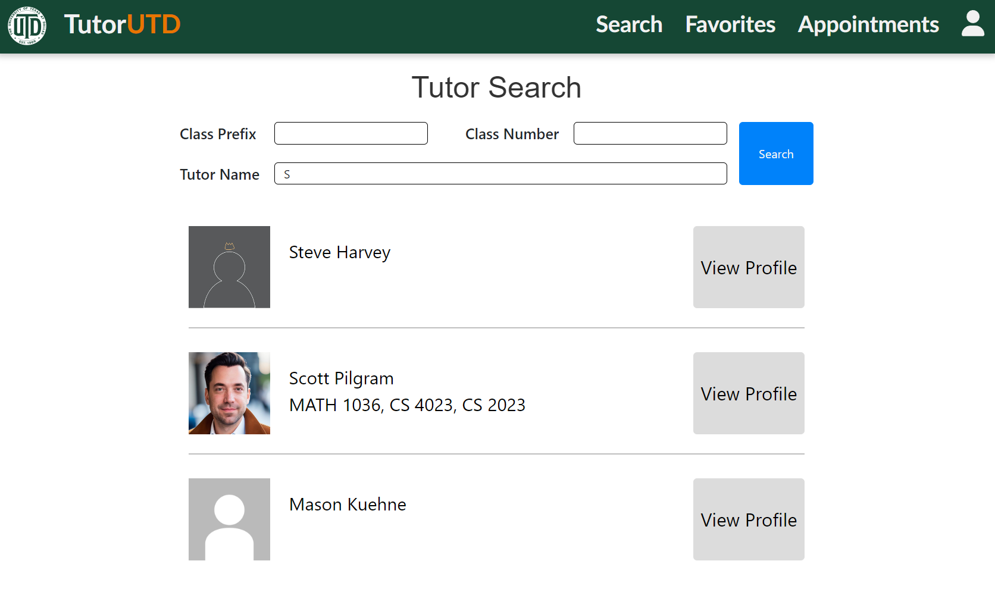
Jack
Front end general:
Initial design
HTTP connections
Route guarding
Pages / components
Register
Search
Appointments
Time table

Slide 4
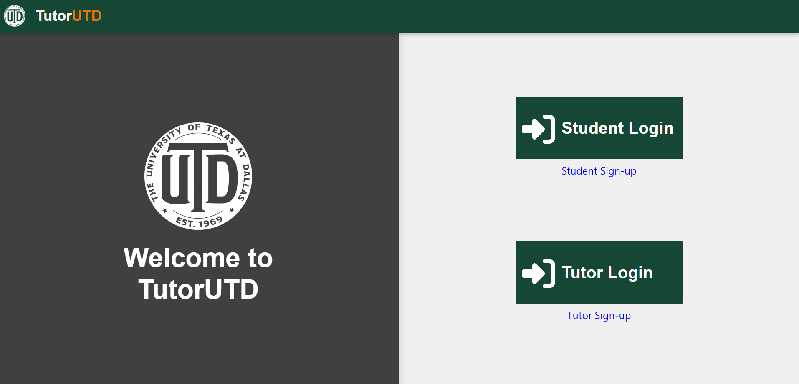
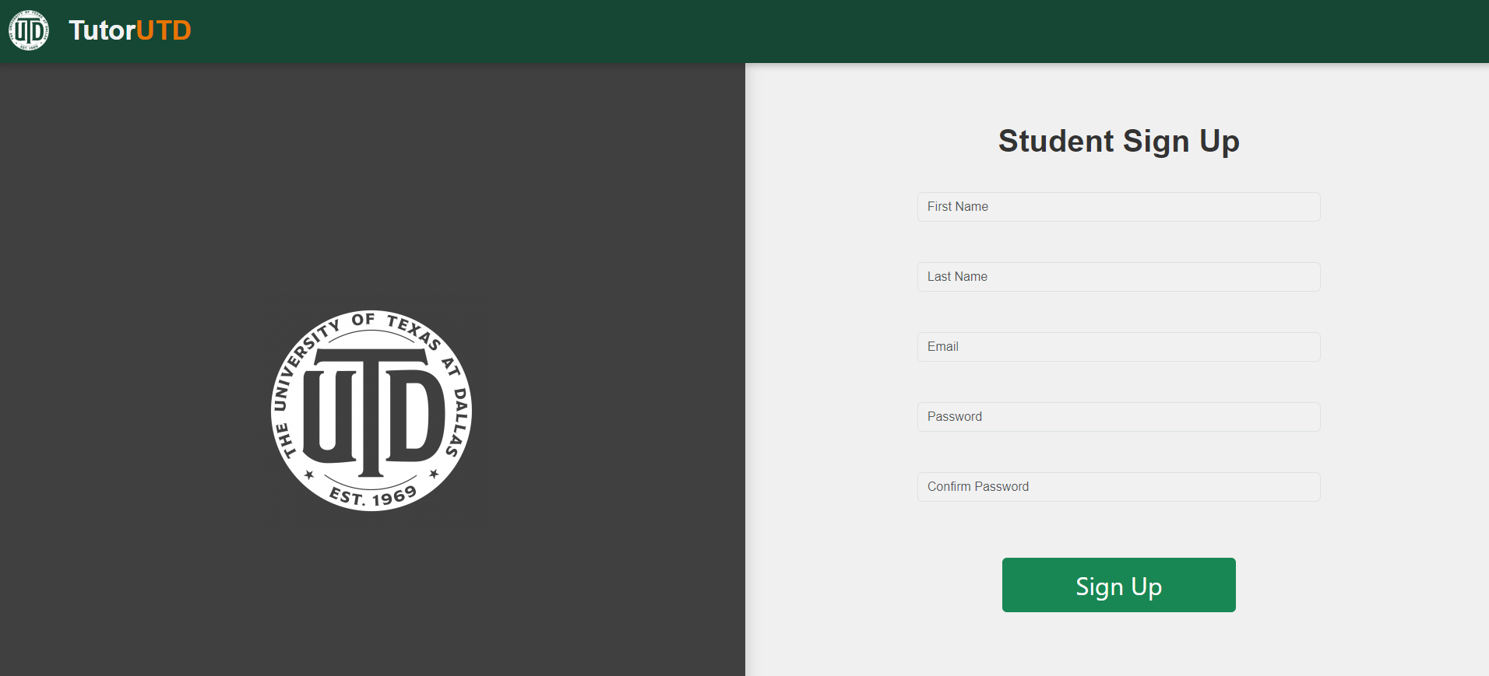
Mason
Front end:
Profile design/modal
Website redesign
Navbar

Slide 5
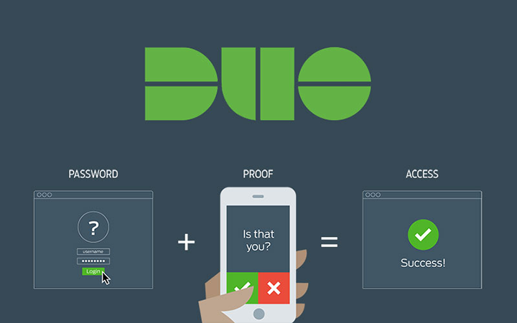
Chloe
Backend
Login/Registration Outline
Duo 2FA
Enroll users into Duo
Push functionality
Source: https://itwiki.wpunj.edu/index.php/Multifactor_Authentication

Slide 6
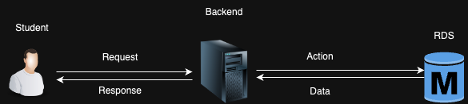
Sam
Backend
Student API
Making/Cancelling/Fetching appointments
Favoriting/Deleting/Fetching favorite tutors
AWS
Managing RDS database and EC2 instances

Slide 7
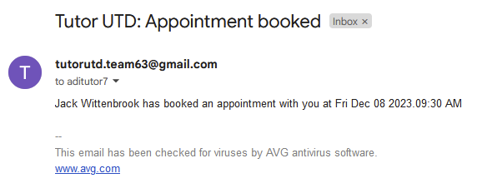
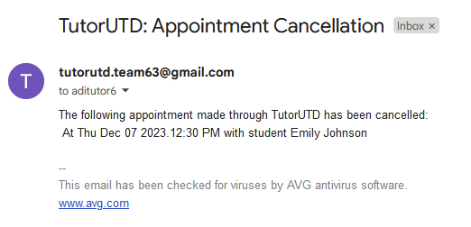
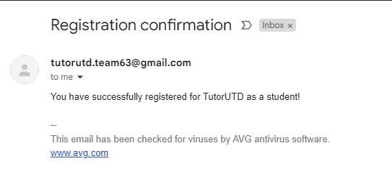
Vincent
Backend
Email system
Confirmation emails sent when registering account and when booking and cancelling appointments
Time based daily check to send reminder emails to each student and tutor with an upcoming appointment

Slide 8
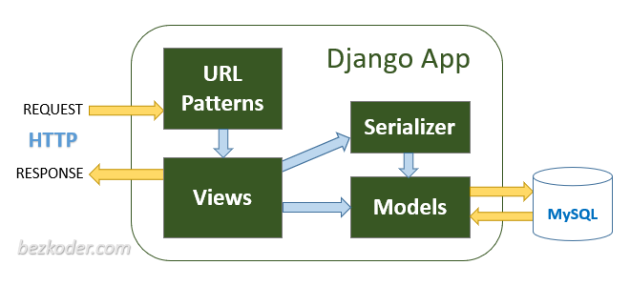
Adithya
Database Design
AWS RDS Connection
Django REST API
Login/Register API
Tutor API
AWS S3 Storage
Source: https://www.bezkoder.com/django-crud-mysql-rest-framework/

Slide 9
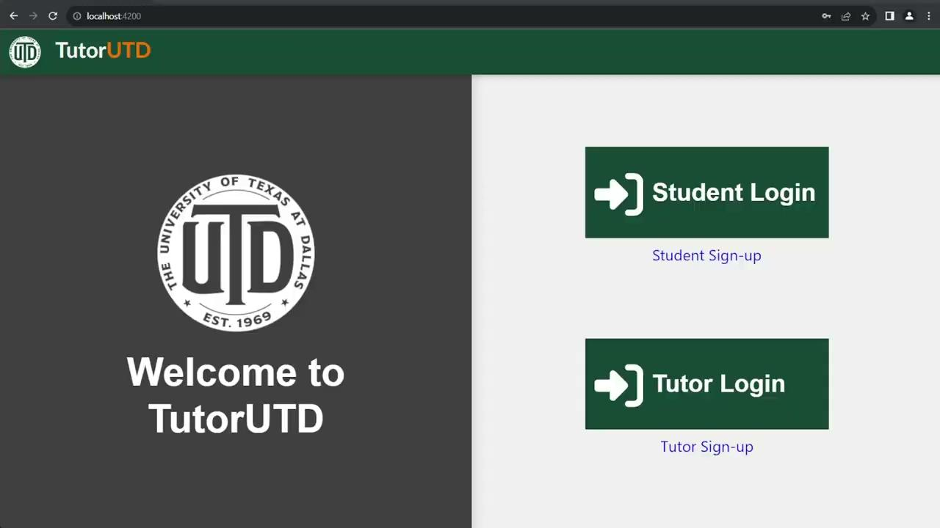
Demo

Slide 10
THANK YOU!

