Slide 1

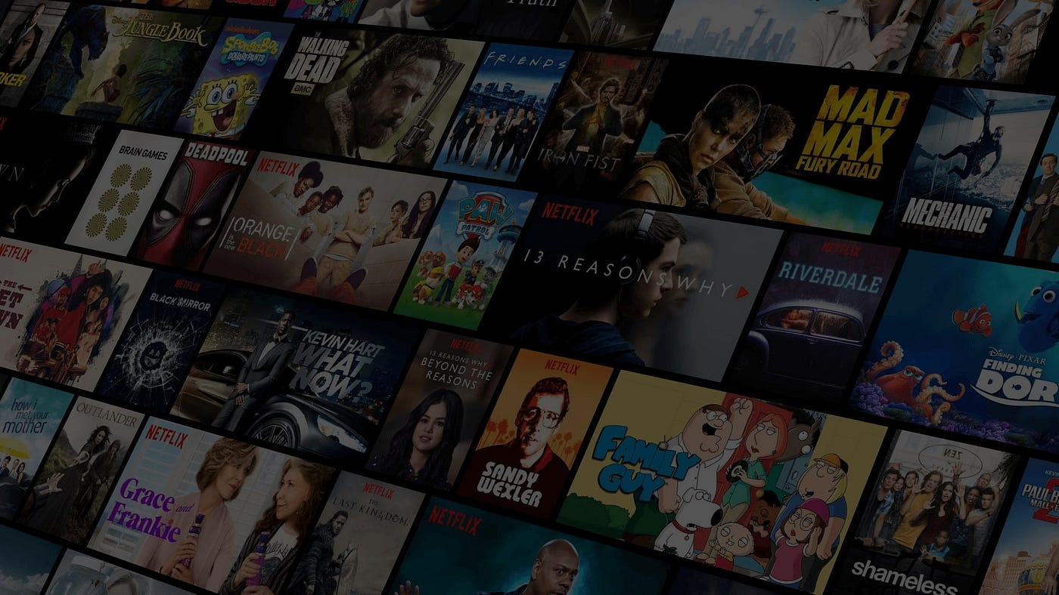
Cinematch
Movie Recommendation System
By: Pranava adithyaa
2430030089

Slide 2

Abstract / Idea
What is it? A web application that provides personalized movie recommendations.
How does it work? The user selects a movie they like, and the system recommends 5 other movies with similar content (like cast, crew, keywords, and plot).
Key Feature: This project uses Content-Based Filtering to understand why movies are similar, rather than relying on other users' ratings.
Core Technology: The system is built in Python, using scikit-learn for the similarity model and Streamlit to create the interactive user interface.

Slide 3

The Problem / Motivation
The "Paradox of Choice": We have access to thousands of movies on platforms like Netflix and Amazon Prime, but it's overwhelming to find something new to watch.
The Solution: Recommender systems solve this by filtering the noise and suggesting items most relevant to the user's tastes.
Project Goal: To build a practical, working recommender system from scratch to solve this common problem and understand the end-to-end process.

Slide 4

Project Objectives
01. Data Processing: To load, clean, and merge two large movie datasets (the TMDB 5000 movie and credits files).
02. Feature Engineering: To create a unified "tags" feature by combining a movie's overview, genres, keywords, cast, and crew.
03. Model Building: To transform the text "tags" into a numerical vector space (using CountVectorizer) and calculate the similarity between all movies (using cosine_similarity).
04. Application: To build an interactive web app (using Streamlit) that uses the saved model to provide real-time recommendations.

Slide 5
System Architecture
1. Input: Load movies.csv and credits.csv into Pandas DataFrames.
2. Preprocessing: Merge the two datasets. Drop missing values. Extract key names from JSON columns (cast, crew, genres).
3. Feature Engineering: Create the single tags column by combining all text features (overview, genres, keywords, cast, crew).
4. Vectorization: Feed the tags into CountVectorizer to create a large matrix of word counts (5000 max features).
5. Modeling: Calculate the cosine similarity score for every movie against every other movie, creating a similarity matrix.
6. Output: Save the final movie list and the similarity matrix as .pkl files using pickle.

Slide 6
Development Environment (H/W & S/W)
Hardware (H/W):
Machine: Windows 11 Laptop
CPU: Intel Core i5/i7 (or equivalent)
RAM: 8GB+
Software (S/W):
Core: Python 3.10
Environment: venv (Python Virtual Environment)
IDE: Visual Studio Code, Jupyter Notebook
Key Libraries:
  pandas & numpy (For data manipulation)
  scikit-learn (For ML model)
  streamlit (For the web application)
  pickle (For saving/loading the model)
  requests (For fetching API data)

Slide 7
Methodology & Algorithms
Methodology: Content-Based Filtering
This method recommends items based on their properties. It does not rely on other users' ratings.
(e.g., "If you liked The Avengers because it's a superhero movie with action, you'll like Iron Man").
Algorithm 1: CountVectorizer (Text Vectorization)
This converts our text tags (like "superhero action comedy") into a numerical vector based on word counts. This allows the computer to perform mathematical comparisons.
Algorithm 2: cosine_similarity (Similarity Metric)
This algorithm calculates the "angle" between two vectors. It's used to find how similar two movies are based on their word-count vectors. A score of 1 is identical, while 0 is completely different

Slide 8
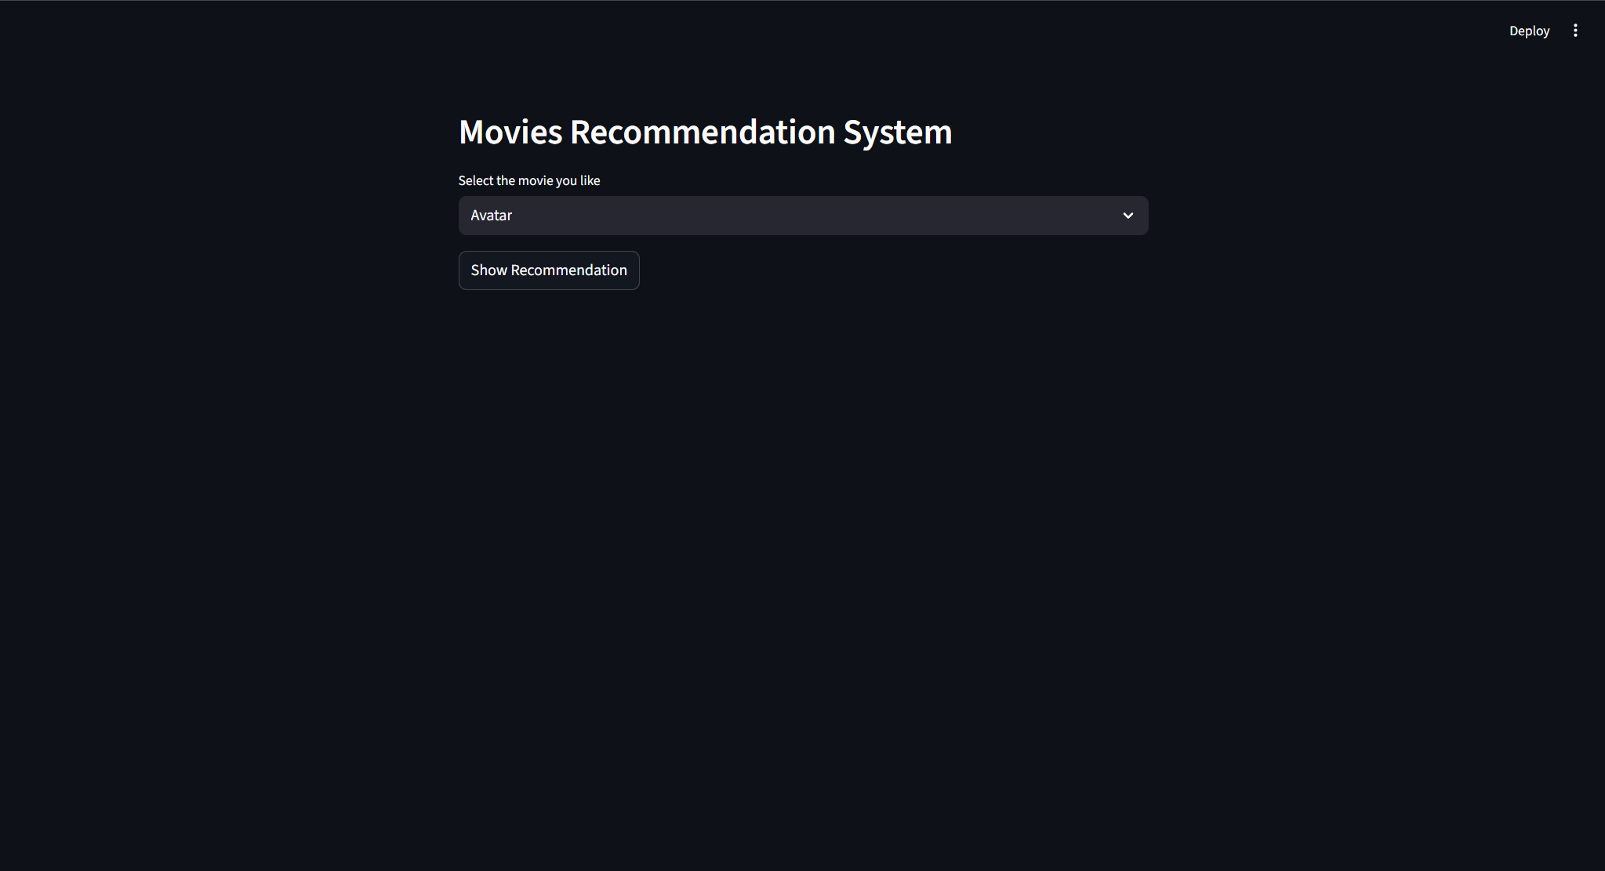
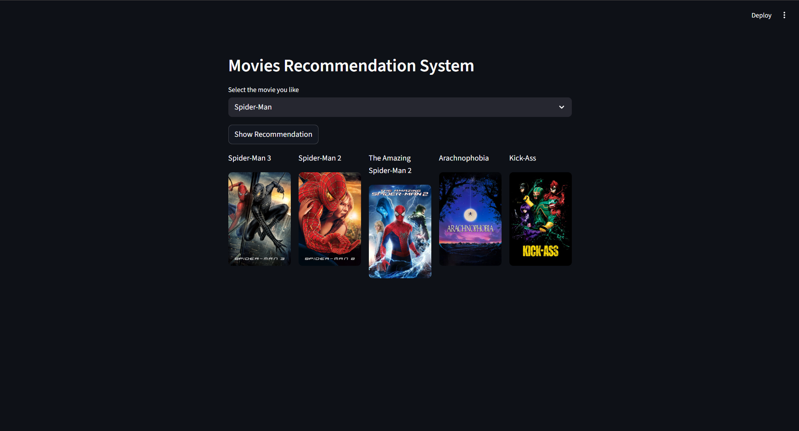
Application Screenshots

Slide 9

Conclusion
Outcome: Successfully built a complete, end-to-end machine learning project, from raw data to a working web application.
Result: The final product is a functional, local prototype that provides accurate movie recommendations based on content similarity.
Learning: Mastered the fundamentals of content-based filtering, text vectorization (Bag-of-Words), and building ML web apps with Streamlit.

Slide 10
THANK YOU

