Slide 1
Cryptography using Hill Cipher Method

Slide 2
Introduction
In the world of information security, cryptography plays a pivotal role in safeguarding sensitive data from unauthorized access. Among the various cryptographic techniques, the Hill cipher stands out as a polyalphabetic substitution cipher that utilizes matrix operations to enhance the secrecy of encrypted messages. This method delves into the intricacies of the Hill cipher, exploring its mathematical underpinnings, security considerations, and practical applications. By delving into the theoretical framework of the Hill cipher, we gain a deeper understanding of its strengths and limitations, enabling us to employ it effectively in secure communication scenarios.

Slide 3
Problem Statement
The main focus of this study is to investigate the contemporary relevance and challenges associated with the Hill Cipher method, a classical cryptographic approach rooted in matrix-based encryption. The Hill Cipher offers a unique perspective that relies on the elegance of linear algebra. This method aims to go into the issues of key management, operational efficiency, scalability, vulnerability to cryptanalysis, and practical implementation in real-world scenarios. The focus is to uncover the means by which the Hill Cipher can be strengthened and adapted for use in the modern data encryption landscape, ensuring the confidentiality and integrity of digital information.

Slide 4
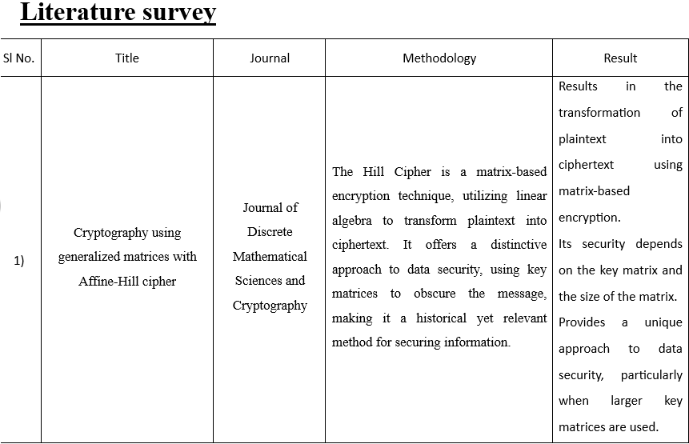
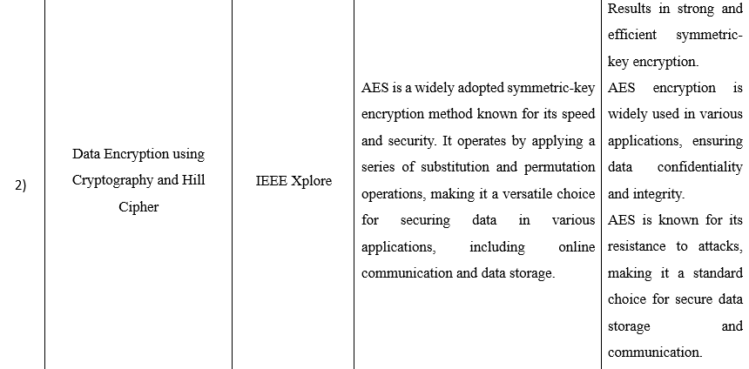

Slide 5
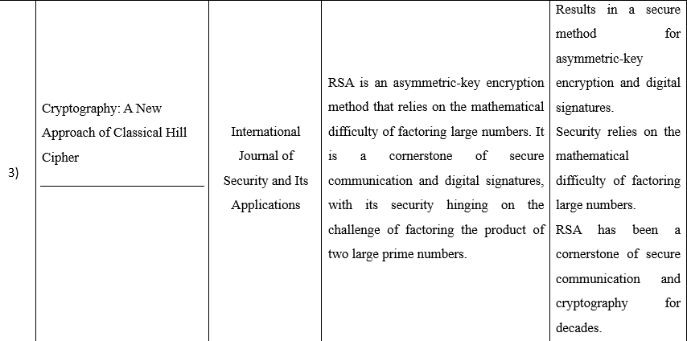
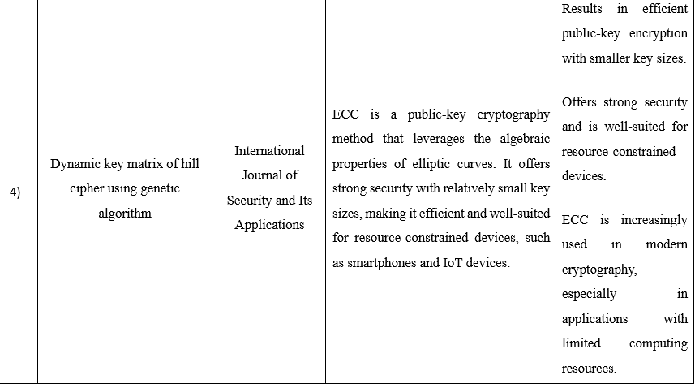

Slide 6
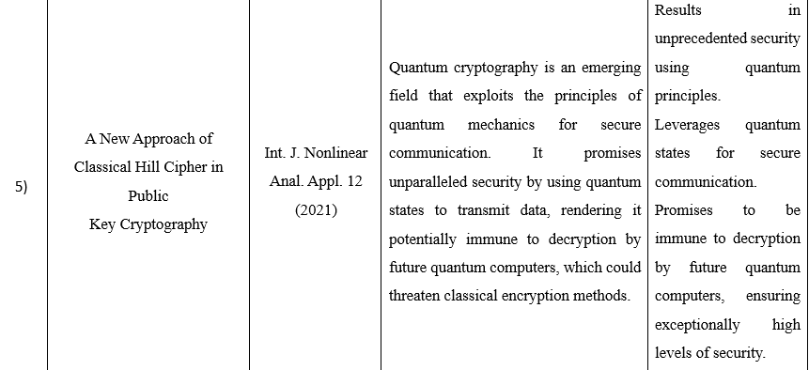

Slide 7
OBJECTIVE
This method aims to provide a comprehensive technique of the Hill cipher, a polyalphabetic substitution cipher employed in secure communication. Through in-depth exploration, the method delves into the mathematical underpinnings of the cipher, including matrix operations and modular arithmetic, laying a solid foundation for comprehending the encryption and decryption processes.
The method unravels the encryption and decryption algorithms, elucidating how the Hill cipher transforms plaintext into ciphertext and vice versa, enabling readers to grasp the cipher's practical implementation. Furthermore, the method critically evaluates the security strengths and weaknesses of the Hill cipher, examining its susceptibility to cryptanalysis techniques, providing insights into its limitations and potential areas for improvement.

Slide 8

METHODOLOGY – Phase 1
Let the message be Home
The matrix form is $\left[33 14 12 4\right]$
Let the cipher be HILL
Cipher = $\left(33 34 37 37\right)$
Matrix in (2*2) form : $\left[\begin{matrix}33 & 34 \\ 37 & 37\end{matrix}\right]$
Now taking two messages at a time
Message 1 = $\left[\begin{matrix}33 & 34 \\ 37 & 37\end{matrix}\right]\left[\begin{aligned}H \\ o\end{aligned}\right]= \left[\begin{aligned}1565 \\ 1739\end{aligned}\right]$
$\left[\begin{aligned}1565 \\ 1739\end{aligned}\right] \% 95= \left[\begin{aligned}45 \\ 29\end{aligned}\right]$ = $\left[\begin{aligned}T \\ D\end{aligned}\right]$
$\left[\begin{matrix}33 & 34 \\ 37 & 37\end{matrix}\right]\left[\begin{aligned}m \\ e\end{aligned}\right]= \left[\begin{aligned}57 \\ 22\end{aligned}\right]$
$\left[\begin{aligned}45 \\ 29\end{aligned}\right]$ % 95 = $\left[\begin{aligned}5 \\ w\end{aligned}\right]$
Hence the encoded message is TD5w

Slide 9
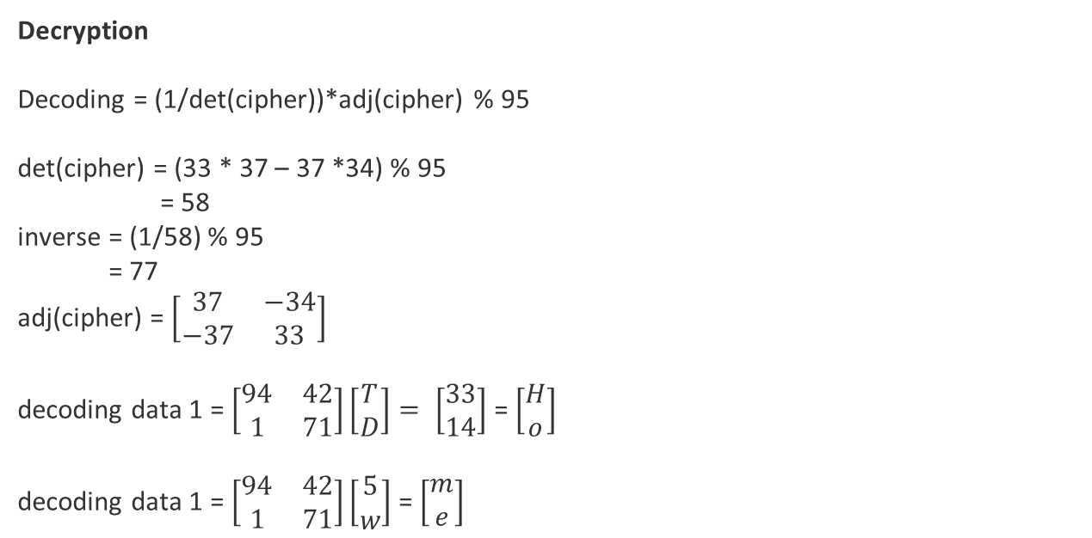
Decryption Decoding = (1/det(cipher))*adj(cipher) % 95 det(cipher) = (33 * 37 – 37 *34) % 95 = 58 inverse = (1/58) % 95 = 77 adj(cipher) = $\left[\begin{matrix}37 & −34 \\ −37 & 33\end{matrix}\right]$ decoding data 1 = $\left[\begin{matrix}94 & 42 \\ 1 & 71\end{matrix}\right]\left[\begin{aligned}T \\ D\end{aligned}\right]= \left[\begin{aligned}33 \\ 14\end{aligned}\right]$ = $\left[\begin{aligned}H \\ o\end{aligned}\right]$ decoding data 1 = $\left[\begin{matrix}94 & 42 \\ 1 & 71\end{matrix}\right]\left[\begin{aligned}5 \\ w\end{aligned}\right]$ = $\left[\begin{aligned}m \\ e\end{aligned}\right]$

Slide 10
Phase 2
Convert the message into numbers and assign numbers to each alphabets , constants, special symbols and blank spaces.
Calculate choice (0, 3) using function a python called rand int.
Using choice select one of the four functions.
0 – 1st function , 1 – 2nd function , 2 – 3rd function , 3 – 4th function
For each symbol of message calculate choice.
Input the number of symbols into particular function by choice.
Repeat process from step 2) for all symbols. The new value forms encrypted message.
We add the new value of symbol followed by the choice for that symbol.
Input a number N from 0 – 94 to add garbage values.
The code then will append 2*N garbage values.
At the end of encrypted message add number N.
For each number pf encrypted message convert to string.
Then this encrypted data is encrypted using hill cipher method.
Decode accordingly.

Slide 11
Expected Output
EXPECTED OUTPUT : Home
OBTAINED OUTPUT : Home

Slide 12
Novelty
Initially we ha one stage of encryption. Now we have added another stage of encryption to increase the security. We are using Caesar cipher method as an addition to our implementation to make the message more secure. This involves the shifting of digits to the right or left most side by a few times such that the hacker has minimum chances in decoding the message. Also, we are using the means of internet to send the message directly by running the code, that is, when the code is executed we get directly connected to the internet and the message is sent to receiver through any means. This helps us to send the message easily and quickly.

Slide 13
CONCLUSION
This method delved into the realm of data encryption, specifically exploring the application of the Hill Cipher method. Through our investigation, we have highlighted the strengths and weaknesses of the Hill Cipher, shedding light on its potential as a secure encryption technique. The mathematical foundation of the Hill Cipher, relying on matrix operations, provides a unique and robust approach to encryption, ensuring confidentiality and thwarting common cryptographic attacks. In conclusion, the main aim is to make the data secure and easily send the message to the receiver.

