Slide 1

AI-Powered Traffic Enforcement
Intelligent Traffic Violation Analysis
and Evidence Generation System
A computer-vision pipeline that detects vehicles and road users, identifies seven classes of traffic violations, reads license plates, and generates court-ready evidence — automatically, at scale.
Automated Photo Identification and Classification for Traffic Violations Using Computer Vision

Slide 2

The Problem
Manual review of traffic camera footage cannot keep pace with modern surveillance volume.
1000s
Slow
Inconsistent
of camera feeds generating images every minute, every day
manual inspection cannot scale with camera deployment growth
human review produces variable, error-prone judgments
Result: enforcement gaps, delayed penalties, and road-safety risks that compound as cities deploy more cameras without proportionally more reviewers.
Intelligent Traffic Violation Analysis & Evidence Generation System
2

Slide 3



Our Objective
Build an end-to-end computer-vision system that automatically processes traffic images, detects vehicles and road users, identifies violations, classifies their type, and generates annotated, audit-ready evidence — robust to real-world conditions and scalable across a city-wide camera network.
System at a Glance
15
pipeline stages
9
object classes detected
Detect
Vehicles, riders & pedestrians
7
violation types covered
Classify
7 violation types, confidently
3
evaluation domains tracked
Scale
Real-time, multi-camera ready
Intelligent Traffic Violation Analysis & Evidence Generation System
3

Slide 4













End-to-End Pipeline
Fifteen stages, from raw camera feed to enforcement-ready record.
1
2
3
4
5
Image Acquisition
Adaptive Preprocessing
Vehicle & Road-User Detection
Road Infrastructure Detection
Multi-Object Tracking
6
7
8
9
10
Vehicle–Rider Association
Violation Detection (7 types)
Reasoning Engine (Scene Graph)
License Plate Recognition
Vehicle Info Retrieval
11
12-13
14
15
Duplicate Suppression
Evidence + Metadata
Analytics Dashboard
Performance Evaluation
Intelligent Traffic Violation Analysis & Evidence Generation System
4

Slide 5
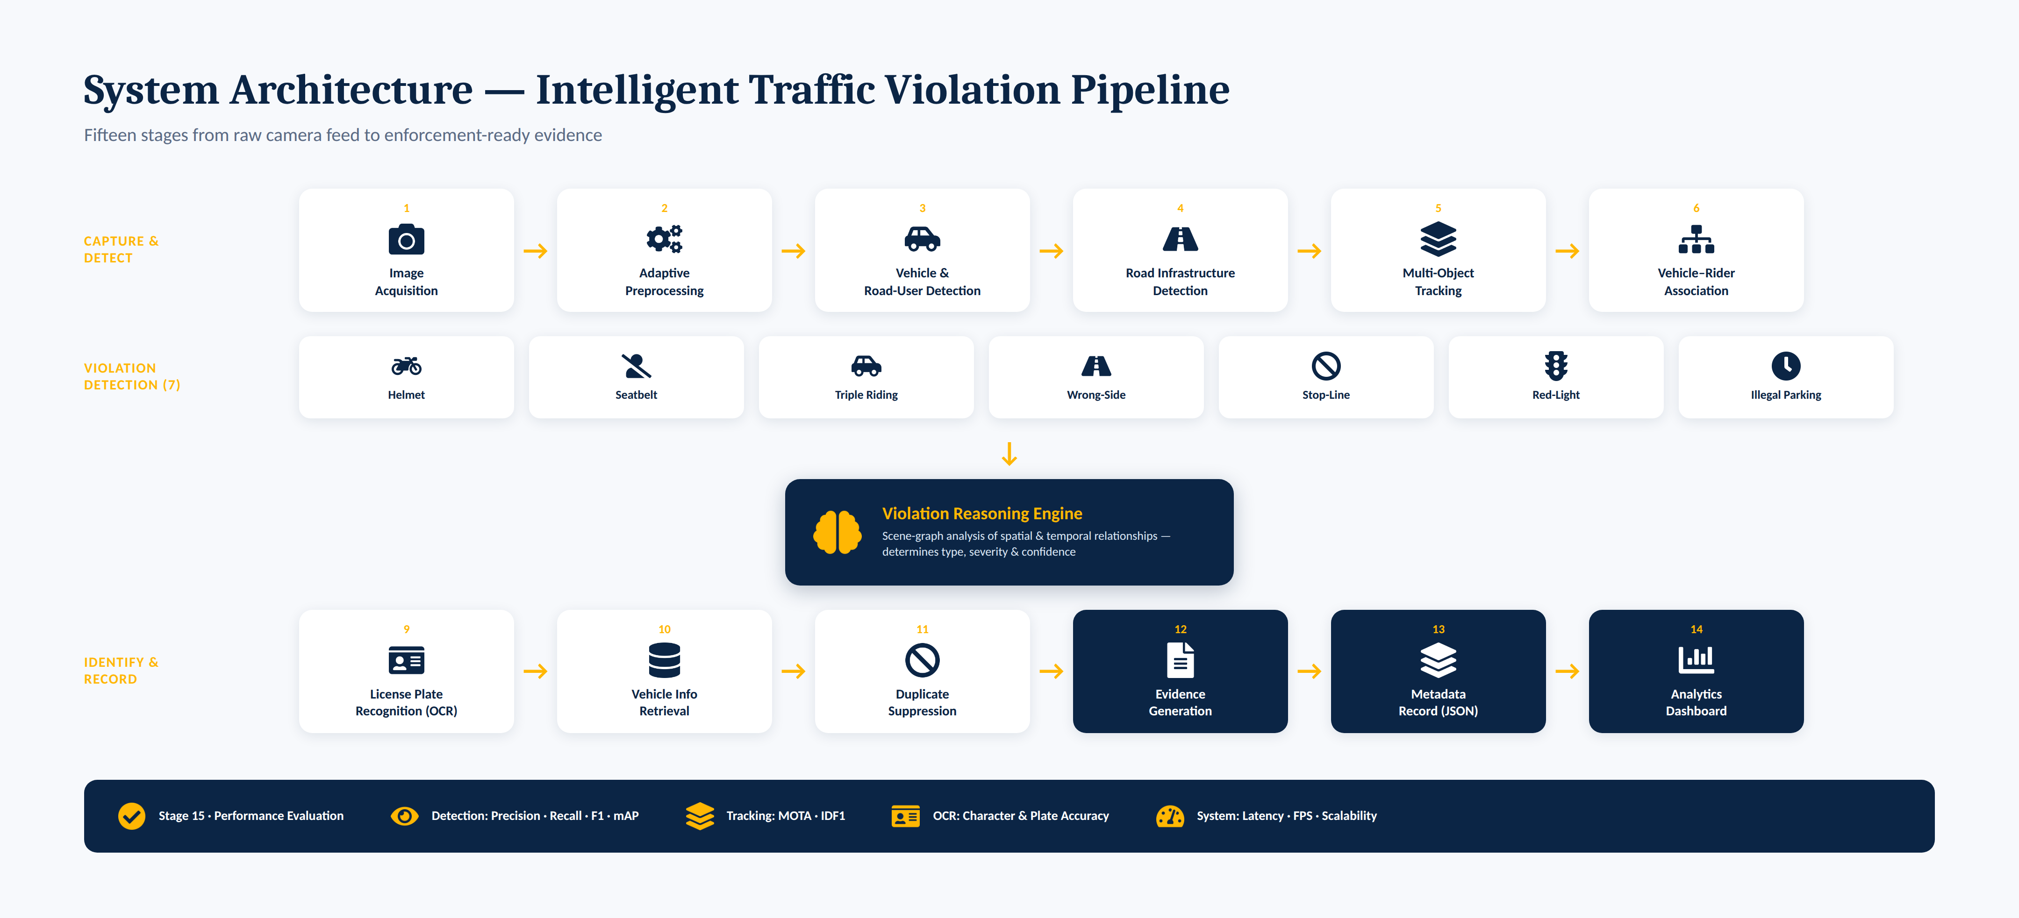
System Architecture — One-View Summary
The same 15-stage pipeline, shown end to end as a single connected flow.
Intelligent Traffic Violation Analysis & Evidence Generation System
5

Slide 6

Stage 1–2 · Adaptive Image Preprocessing
Every enhancement is applied only when the image actually needs it — protecting downstream detector accuracy.
Assess
Correct (conditionally)
Blur (Laplacian variance)
CLAHE — only if low contrast
Brightness level
Denoising — only if excessive noise
Noise estimation
Gamma correction — for low light
Contrast assessment
Resize, RGB convert, normalize
Why adaptive? Applying every enhancement to every frame indiscriminately can blur fine detail and degrade detector performance — selective correction preserves accuracy where image quality is already sufficient.
Intelligent Traffic Violation Analysis & Evidence Generation System
6

Slide 7




Stage 3–6 · Detection, Tracking & Association
Vehicle & Road-User Detection
Road Infrastructure Detection
YOLO detects 9 classes: car, bus, truck, motorcycle, bicycle, auto-rickshaw, person, traffic light, license plate — with bounding box + confidence.
Lane markings, stop lines, pedestrian crossings, parking/no-parking zones, and traffic signs.
Multi-Object Tracking
Vehicle–Rider Association
ByteTrack / DeepSORT assigns persistent IDs and maintains trajectories — enabling temporal reasoning across frames.
Beyond simple box overlap: combines IoU, center-point distance, motion consistency & tracking history into one association score.
Intelligent Traffic Violation Analysis & Evidence Generation System
7

Slide 8





Stage 7 · Seven Violation Types, Rule-Driven Logic
Helmet Violation
Seatbelt Violation
Triple Riding
Rider detected, no helmet present
Driver region has no seatbelt detected
Rider count on motorcycle > 2
Wrong-Side Driving
Stop-Line Violation
Red-Light Violation
Vehicle motion vector opposes lane direction
Bottom-center crosses stop line on red
Vehicle crosses line after signal turns red
Illegal Parking
Precision by design: stop-line and red-light logic track the bottom-center point, not full bounding-box overlap, specifically to avoid false positives.
Stationary in no-parking zone beyond threshold
Intelligent Traffic Violation Analysis & Evidence Generation System
8

Slide 9

KEY INNOVATION
Violation Reasoning Engine
Stage 8 — goes beyond simple rule-based detection by modeling relationships as a scene graph.
The graph reasons jointly over:
Violation Type
Violation Severity
Stop Line
Traffic Signal
Confidence Score
Lane
By analyzing spatial and temporal relationships between every entity in the scene — not isolated bounding boxes — the engine produces context-aware, defensible violation calls.
Parking Zone
Vehicle
Rider
Intelligent Traffic Violation Analysis & Evidence Generation System
9

Slide 10



Stage 9 · License Plate Recognition
Triggered only when a violation is detected — saving compute on the vast majority of compliant traffic.
1 · Detect
→
2 · Preprocess
→
3 · OCR
Locate plate region with YOLO
Crop, resize, grayscale, contrast enhance, denoise, threshold, perspective-correct, sharpen
PaddleOCR / EasyOCR extracts the registration number
Intelligent Traffic Violation Analysis & Evidence Generation System
10

Slide 11


Stage 10–13 · From Plate to Evidence Record
Vehicle Info Retrieval
Duplicate Suppression
Registration lookup returns vehicle type, registration details, and registered owner. Note: owner ≠ driver — that distinction cannot be resolved from a plate alone.
Same vehicle + same violation type + same location within a time window → suppressed. Different violation types still get recorded independently.
Evidence Generation
Metadata Record
Annotated image with vehicle box, rider/driver box, plate, violation type, confidence, timestamp, camera ID, and location.
Structured JSON: vehicle_number, owner_name, vehicle_type, violation_type, confidence_score, timestamp, camera_id, evidence_path.
Intelligent Traffic Violation Analysis & Evidence Generation System
11

Slide 12
Stage 14 · Analytics Dashboard
Turning enforcement events into actionable intelligence for traffic authorities.
Also Tracks
High-risk location ranking
Repeat-offender tracking
Searchable violation records
Automated summary reports
All evidence, metadata, and trend data are surfaced through one searchable, exportable interface for enforcement teams.
Intelligent Traffic Violation Analysis & Evidence Generation System
12

Slide 13

Stage 15 · Performance Evaluation
Every subsystem is measured against domain-appropriate metrics.
Detection
Tracking
OCR
System
Precision
MOTA
Character Accuracy
Latency
Recall
IDF1
Plate Accuracy
FPS
F1 Score
Memory Usage
mAP
Scalability
Intelligent Traffic Violation Analysis & Evidence Generation System
13

Slide 14

What Sets This Apart
Scene-graph reasoning, not flat rules
Adaptive, not blanket, preprocessing
Violations are inferred from spatial & temporal relationships across the whole scene, with severity and confidence — not single-rule triggers.
Enhancements apply only when image quality actually requires them, protecting detector accuracy instead of degrading it.
Robust vehicle–rider association
Built-in duplicate suppression
Combines IoU, distance, motion consistency and tracking history — far more reliable than bounding-box overlap alone.
Prevents repeated penalties for the same event, while still capturing genuinely distinct violations.
Intelligent Traffic Violation Analysis & Evidence Generation System
14

Slide 15
Expected Outcome
A scalable, AI-powered traffic monitoring system that automatically detects vehicles and road users, identifies seven classes of violations, recognizes license plates, generates legally sound evidence, suppresses duplicate penalties, and produces analytical reports for traffic law enforcement.
Less manual review
Consistent, auditable decisions
Evidence ready for enforcement
Thank You
Intelligent Traffic Violation Analysis & Evidence Generation System
15

