Slide 1
Project Iris (code name)
Software Architecture and Design Document
V1.0 (initial Draft)

Slide 2
Runtime Architecture & threading model → Pipeline
Camera read workers (RTSP grabber)
Detector workers (box + score)
Face tracker (per camera)
Crop extractor
Recognition worker pool (batching/process)
Liveness worker
Policy engine (OPA)
Camera
frames
frame queue
Tracked object
Recognition queue
candidate
track_id, bbox
match
Attendance Service

Slide 3
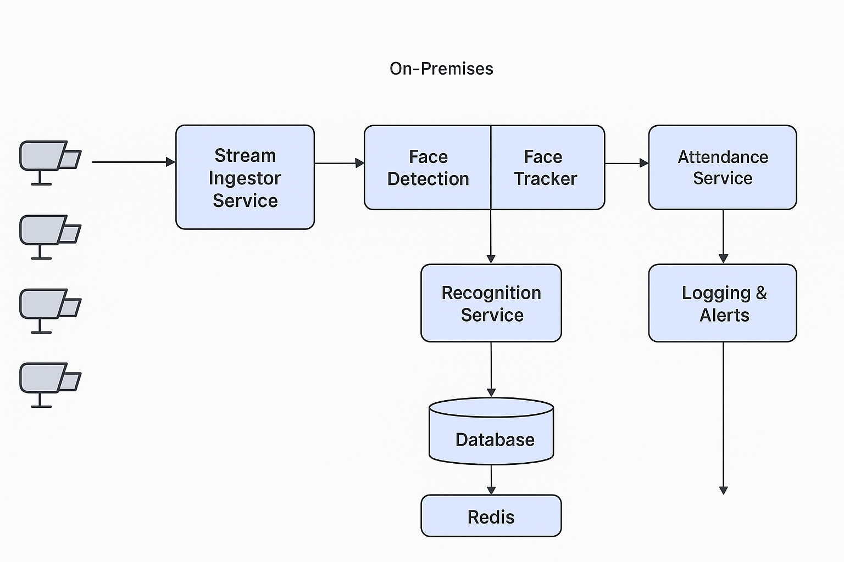

Slide 4
Process layout (processes)
Stream Ingestor Manager (process)
Spawns a lightweight RTSP grabber thread per channel.
Maintains per-channel frame queue (bounded).
Adjusts FPS throttle.
Detector Pool (process or threadpool)
Runs face detection model (CPU).
(Haar cascades, MTCNN, BlazeFace, or MobileNet-SSD variants)
Per-Camera Tracker (in-process, single-threaded per camera)
Runs ByteTrack/DeepSORT logic using detection boxes.
Produces stable track IDs.
Recognition Service (embedding extraction) (process)
ArcFace/FaceNet with ONNX Runtime (CPU EP) or OpenVINO..
process one crop at a time.
Throughput: depending on model, ~10–30 embeddings/sec per CPU core is typical.
Vector Index (FAISS) (shared in-memory or separate process)
Exposes match API to recognition service.
Liveness Service (process)
lightweight model on CPU (fast).
Called only for top candidates to conserve resources. - restrict liveness checks to only top-N matches instead of every crop.
OPA Policy Engine (sidecar / service)
Evaluate rules: deny/allow based on user status, time, blacklist, etc.
Attendance Service (API + DB)
Writes attendance events, triggers alerts/logs.
Logging & Alerting Engine
Stores audit logs (append-only) and routes alerts to UIs/SMTP/SMS.
Redis
Cache, short-term dedupe store, counters, feature flags, retry queues.

Slide 5
Concurrency model
RTSP Grabber: 1 goroutine/thread per RTSP channel — minimal work, only decoding + pushing frames into queue.
Detector workers: N CPU threads; size depends on CPU capacity. Non-blocking: We will use worker pools.
Tracker: 1 per camera, single-threaded to simplify state. It consumes detections and emits events.
Recognition: a bounded GPU worker pool (e.g., 1 worker per GPU) that supports batching. Use a small async queue and a timeout to trigger a batch.
Policy/Liveness: separate pools to avoid blocking recognition pipeline.
Resource scheduling
Each RTSP decode: ~small CPU usage; each 1080p (can go to 720p/480p) stream may require ~0.5–1 vCPU to decode (estimate varies).
Detector: on CPU might handle ~5–10 FPS per core with light detectors.
Recognition GPU: 1 GPU can serve tens to hundreds of crops/s depending on model and batching.
Note: Start and benchmark with the model performance.

Slide 6
Cache mechanism for fast ephemeral state, deduplication
Design Rationale:
Recent-seen / dedup window
avoid multiple attendance events for the same employee from repeated frames/tracks.
Implementation example: store recent_seen:{camera_id}:{user_id} with small TTL (e.g., 10–120s). Presence = skip.
Track -> user binding cache
while a track is active, cache track_user:{camera_id}:{track_id} = {user_id, last_seen_ts} TTL ~ track_timeout. Helps in reusing identity for same track.
User profile cache (fast read fallback)
read-through cache for user profile/employee metadata so attendance service can proceed if Postgres is momentarily down. Example Cached items (Actual need to design during pipeline formation): {user_id} -> {name, emp_code, dept, is_active, access_flags}.
Retry queue / pending events
Temporary storage for failed uploads/events that will be retried by background worker. Can be a Redis stream or list for reliability.
Alert dedupe / suppression
Keep alert_suppressed:{alert_key} with TTL to avoid flooding (e.g., repeated spoof alerts suppressed for N seconds).
Flow:
Dedup & track binding flow
Tracker outputs track_id for detection.
Recognition returns user_id with confidence.
Worker checks recent_seen:{camera}:{user} — if exists → ignore (log dedup).
Else write recent_seen:{camera}:{user} = now with TTL 60s and proceed to attendance logic.
Also set track_user:{camera}:{track} = {user_id, last_seen} TTL track_timeout.
Fallback when DB down
On recognition, fetch user_profile:{user_id} from Redis:
If present → proceed and write attendance event (mark source=cached).
If not present → record event to retry_queue and alert Deny Access User DB and log.
Alert suppression
On spoof detection for user_id on camera, check alert_suppressed:spoof:{camera}:{user}:
If exists → do not send alert; otherwise send alert and set suppression key TTL 300s.

Slide 7
Failure handling, retries and DB-down behavior
Failure modes & handling mechanism
FAISS / Vector DB unavailable
Recognition workers should fallback to a degraded mode: run embedding but mark no_index → push event to logging/alert and optionally store embedding to retry batch compare later.
Alert Deny Access Feature store or No match depending on logic.
Postgres user DB unavailable
Use cached user_profile:{user_id} in Redis to proceed. If not cached, do not block recognition — create a provisional attendance event with user_id and status=DB_LOOKUP_FAIL and push to retry_queue for post-processing. Alert Deny Access User DB.
Liveness model failures / model crashes
Fallback: mark liveness as unknown → policy decides (default deny). Log and alert Deny Access Spoof. Retry liveness for next frames for same track.
Network/IO issues
RTSP disconnects: reconnect with exponential backoff (store last N frames).
Write to DB fails: write to Redis retry queue and background worker will reattempt.
Retry policy
Immediate: 3 attempts with small jitter (0.5s → 1s → 2s).
Queued: push to Redis stream retry_queue with attempt_count. Background retry worker processes exponential backoff: attempt_count * base_delay up to max attempts (e.g., 5).
On final failure, record permanent audit log and raise high-severity alert.

Slide 8
Alert classification & mapping to actions
Alert Key | Trigger | Severity | Action
DenyAccess_NoFace | No face crop found at checkpoint / repeated | Medium | Deny access, log, notify guard UI
DenyAccess_FeatureStore | FAISS/index failure | High | Deny or fallback; alert Ops
Alert_Security_Repeated | Repeated failed matches or tampering | High | Notify security + create incident
DenyAccess_NoMatch | Face matched below confidence & policy denies | Medium | Deny access, show message, log
Alert_Security_Spoof | Liveness failed (spoof) | Critical | Immediate security alert, lock gate if integrated
DenyAccess_UserDB | User DB unreachable for matched ID and no cache | High | Deny/Quarantine, raise ops alert
DenyAccess_Timeout | Decision timeout (pipeline stalled) | Medium/High | Deny, log, notify Ops
Alerts sink:
Monitoring UI: show active alerts & status
Security Dashboard: show immediate security incidents
Audit logs: append-only event store for compliance

Slide 9
Policy evaluation flow (OPA integration)
Flow when a candidate is recognized:
Recognition returns {user_id, conf}.
Liveness result: pass/fail/unknown.
Query OPA with data: {user_profile, camera_meta, time, conf, liveness}.
OPA returns decision: {allow: true/false, reason, actions}.
Attendance service acts: create attendance event if allowed; otherwise deny and send alert according to reason.
Make decisions readable/auditable: keep the OPA input & output in the audit log for incident investigations.

Slide 10
CPU Sizing Evaluation
Workload Assumptions:
Video resolution: 720p (or 640p low priority)
Frame rate processed: ~5 fps (not full 30 fps)
Face density: 1–3 faces per frame (typical entrance scenarios). – Need to evaluate at actual
Detection: lightweight model (BlazeFace / RetinaFace-CPU)
Recognition: ArcFace/FaceNet CPU via ONNX Runtime/OpenVINO
Vector DB: FAISS (CPU, in-memory index)
Liveness: lightweight model (MediaPipe / small CNN)
Tracker: ByteTrack/DeepSORT (low CPU overhead)
Rough CPU Performance Metrics:
Decode RTSP (720p): ~0.3 vCPU per stream (vs 0.5 for 1080p).
Face detection (BlazeFace/RetinaFace-CPU): 1 vCPU can process ~15 fps (vs 10 at 1080p).
Recognition (ArcFace/FaceNet CPU): 1 vCPU → ~12–15 crops/sec (vs 8–12 at 1080p).
Liveness (light CNN/MediaPipe): 1 vCPU → ~12 crops/sec.
FAISS search: negligible (~<5 ms per query with 10–20k templates).
Deployment Sizing
Small (≤10 cameras @ 5 fps) → Saturday Demo with this
Cores: 6–8 vCPU
RAM: 16 GB
Medium (25–30 cameras)
Cores: 12–14 vCPU (instead of 16)
RAM: 24–32 GB

Slide 11
Development Task breakdown
Team- Video+ AI/ML
Epic 1 — Camera & Stream Handling
Story 1.1: Implement NVR integration (RTSP pull, config per camera with name/location). The camera configuration need to fetch from the database.
Story 1.2: Build Camera Handling Service (threaded workers for decoding).
Story 1.3: Add frame throttling (configurable fps per camera).
Story 1.4: Buffer frames (local queue) & retry mechanism.
Story 1.5: Health check API (camera online/offline status).
Epic 2 — Stream Ingestor (Detection + Tracking)
Story 2.1: Integrate face detection (BlazeFace/RetinaFace-CPU).
Story 2.2: Implement tracker (DeepSORT/ByteTrack).
Story 2.3: Deduplicate faces (per-camera time window).
Story 2.4: Extract cropped faces → send to Recognition service.
Story 2.5: Redis integration to buffer detection output.

Slide 12
Development Task breakdown
Team- Video+ AI/ML
Epic 3 — Recognition Service
Story 3.1: Implement embedding extraction (ArcFace/FaceNet, ONNX Runtime CPU).
Story 3.2: Store embeddings in FAISS (CPU index).
Story 3.3: Query FAISS for top-K matches, return confidence.
Story 3.4: Redis cache for recent embeddings (avoid recompute in short window).
Story 3.5: Handle low-confidence / no-match → send alert event.
Epic 4 — Liveness Detection
Story 4.1: Integrate lightweight liveness (MediaPipe/anti-spoof CNN or option to find something else which work on CPU).
Story 4.2: Run liveness only on recognized candidates (optimize CPU).
Story 4.3: Fail event → push “spoof alert” to Alerts Service.

Slide 13
Development Task breakdown
Team- Core Server logic
Epic 5 — Attendance Service
Story 5.1: Define attendance event schema (IN/OUT, timestamp, camera, employee_id).
Story 5.2: Implement deduplication (per employee within N-minute window).
Story 5.3: Apply business rules (shift mapping, IN/OUT detection).
Story 5.4: Integrate with OPA/Keycloak for access policy evaluation.
Story 5.5: Persist events to Postgres DB.
Epic 6 — Alerts & Logging
Story 6.1: Define alert categories (No face, No match, Spoof, Repeated attempts, DB down).
Story 6.2: Build Alert Service (publish/subscribe model).
Story 6.3: Store alerts in Audit Log DB.
Story 6.4: Integrate with monitoring (Prometheus/Grafana).
Story 6.5: Expose API for dashboard notifications.

Slide 14
Development Task breakdown
Team- Core Server logic
Epic 7 — Caching & Reliability
Story 7.1: Use Redis for:
recent embeddings (avoid recompute),
deduplication state (employee recently seen),
frame queue (temporary if recognition is slow).
Story 7.2: Implement retry queue for failed DB writes.
Story 7.3: Implement agent-to-server message buffering for outages.
Epic 8 — Admin & Config Management
Story 8.1: Camera configuration UI (add/edit/delete, assign location) – Implement onvif client to discover camera and auto add feature.
Story 8.2: Employee CRUD (add/edit, upload enrollment images).
Story 8.3: Sync embeddings into FAISS index after enrollment.
Story 8.4: Shift & policy management UI.
Team- Frontend

Slide 15
Development Task breakdown
Team- DevOps/Combine
Epic 9 — Deployment & Ops – Optional low priority
Story 9.1: Dockerize each service (camera handler, ingestor, recognition, attendance, alerts).
Story 9.2: Write docker-compose for single-server deployment.
Story 9.3: Monitoring stack (Prometheus + Grafana).
Story 9.4: Automated backups (Postgres, Redis, FAISS index).
Epic 10 — Camera Simulator Development
Story 10.1: Implement simple RTSP simulator using prerecorded video files (FFmpeg -stream_loop + RTSP server).
Story 10.2: Build simulator module to generate synthetic faces (random images, shuffle employees).
Story 10.3: Add configuration for multiple virtual cameras (each with camera_id, location).
Story 10.4: Implement "no face" scenario simulator (empty corridor/scene).
Story 10.5: Implement "spoof" scenario (printout/photo attack clips).
Story 10.6: Add time-based event playback (simulate shift change, crowd entry).
Story 10.7: Integrate simulator into CI/CD pipeline (auto-run test streams on each build). – Optional (Later)
Story 10.8: Web UI toggle: choose between live NVR camera vs simulated camera in config. – Optional (Later)
Team- Test/Combine

