Slide 1
WhalingGuard
Phishing Detection Using Machine Learning ADITHYAN M S
AMAL SOMAN
ASWANI N K
HARIKRISHNAN K B
KRISHNAPRIYA V J
Notes:
Good morning…V would like to present our project topic on <name>

Slide 2
Introduction
Phishing attack is a simplest way to obtain sensitive information from innocent users. Aim of the phishers is to acquire critical information like username, password and bank account details.
Cyber security persons are now looking for trustworthy and steady detection techniques for phishing websites .
Phishing detection is a crucial aspect of cybersecurity aimed at identifying and preventing phishing attacks.Phishing detection involves the use of sophisticated algorithms, machine learning models, and behavioral analysis to identify patterns and indicators that differentiate legitimate communications from phishing attempts.
The objective of this paper is to extract different features from a large dataset containing URLs and to analyse the accuracy levels for different machine learning algorithms and implementing the best among them. 15 different machine learning models are compared.
Notes:
1) Aim of the phishers is to acquire critical information like username, password and bank account details.
2) Phishing detection involves the use of sophisticated algorithms, machine learning models, and behavioral analysis to identify patterns and indicators that differentiate legitimate communications from phishing attempts.
3) 15 different machine learning models are compared.

Slide 3
Abstract
The development of the phishing detection model is essential to combat the increasing threat of phishing attacks, protect users from fraud and data breaches, and enhance overall cybersecurity in the digital landscape.
In this research paper, we have done preprocessing on 2 datasets containing URLs and they are merged to form a new output dataset. Feature extraction is done on this new dataset and have extracted 74 features.
After comparing 15 different machine learning models with the extracted features, we have found that Logistic Regression(LR) model provides the highest accuracy.
The trained LR model is then integrated into our Web Application for predicting whether the input URL from the user interface is phishing or non-phishing.
Notes:
So we used logistic regression

Slide 4
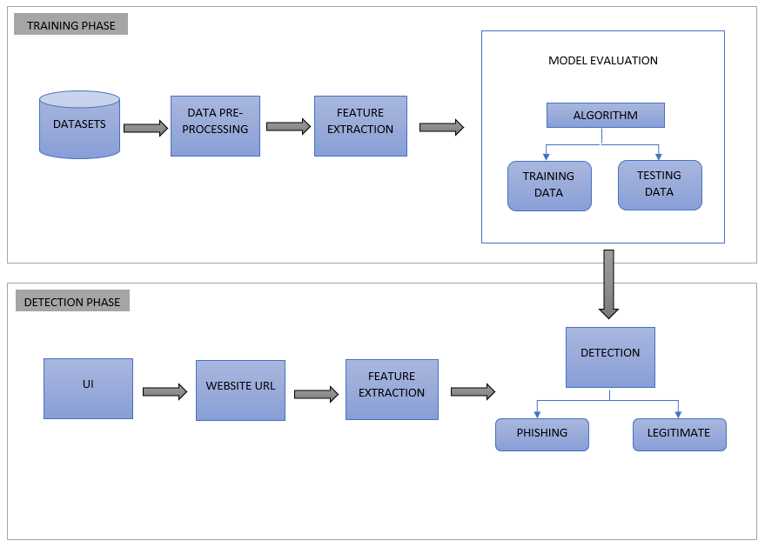
System Architecture
2 phases :
Training Phase
Detection Phase
Training Phase
Datasets:
Dataset-I : from phishtank.com, contains 96,020 data, columns- domain & label [this dataset contains 50% phishing URLs and 50% Legitimate website]
Dataset –II : from Kaggle.com, contains 450,176 data, columns – urls, label & result {this dataset is included to improve our model upon deployment}
Data pre-processing:{Data pre-processing is an essential step in preparing raw data for feature extraction}
Data Cleaning
Data Reduction
Data Integration
Notes:
Initial_urls.csv
An additional dataset is merged with the original to improve our model upon deployment.
Data pre-processing is an essential step in preparing raw data for feature extraction

Slide 5
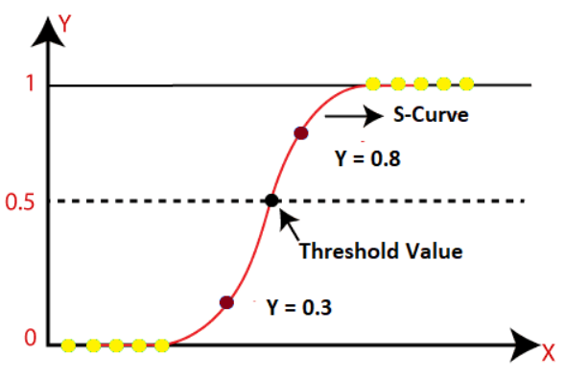
Feature Extraction:
Lexical features
Numeric features
Model Evaluation:
Logistic Regression Algorithm{it is a classification algorithm, It is based on the assumption that the relationship between the input variables and the log- odds of the binary outcome. And there is threshold value, so the goal is to predict the probability of an event or the likelihood of an outcome falling into one of two classes. }
Detection Phase
User Interface:
React Web Application
Nodejs API server
Website URL: Input URL from the user through the user interface
Detection:
Phishing :Type of URLs that are specifically designed to deceive users by impersonating legitimate websites or services.
Non-Phishing:Type of URLs that are the genuine URLs of legitimate websites or services
Notes:
Logistic Regression: Logistic regression is a statistical modeling technique used for binary classification problems, where the goal is to predict the probability of an event or the likelihood of an outcome falling into one of two classes. Despite its name, logistic regression is a classification algorithm rather than a regression algorithm. It is based on the assumption that the relationship between the input variables (also known as independent or predictor variables) and the log- odds of the binary outcome (dependent or response variable)
can be approximated by a linear relationship.

Slide 6
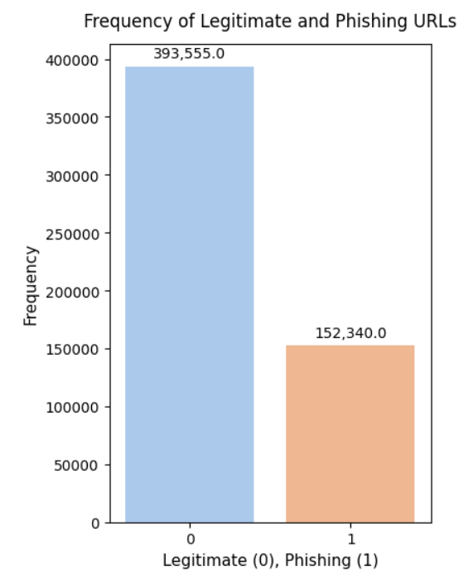
Implementation
System Implementation is divided into 5:
Data Pre-processing
Feature Extraction
Model Comparison
Model Evaluation
Model Implementation
Data Pre-processing
Inputs: Dataset I and Dataset II
Data Cleaning
Dropping Null Values
Data Reduction
Dropping Unwanted Columns
Data Integration
Changing Data Types
Merging the 2 Datasets
Removing Duplicates
Output: New Dataset after pre-processing
Notes:
Dropping Null Values—in the dataset we can see that there were 92 URLs without label i.e, having null values. We will simply drop these rows.
Dropping Columns– Dataset2 which is the additional_urls contains unwanted columns, We will be also dropping these columns.
Changing Dtypes--- Dtypes (Datatypes) are changed so the two datasets match , giving advantage on the merging process.
Merging DataFrames– as the final step we will concatenate both the datasets
Dropping Duplicates—After concatenation there are chances of duplicate URLs. There were 194
Duplicate URLs in our resultant dataset. And these were dropped.

Slide 7
Feature Extraction
Lexical Features
Numeric Features
Input: Dataset generated after pre-processing
Lexical Features
Involve analyzing the textual components and patterns within a URL. These features capture characteristics related to the structure, keywords, and other textual elements of a URL.
Measuring the entropy of URL strings : getEntropy
Check if the URL contains specific keyword ”login,” : hasLogin
Check for the presence of redirection in URL string : Redirection
Check if the length of the URL is greater than or equal 54
characters : lenClassify
Checks for the presence of ’@’ symbol in the URL : haveAtSign
Calculate the number of subpages in the given URL : getDepth
Check if the URL is URL shortened : tinyURL
Check if there is IP address instead of hostname : isDomainIp
Check the presence of ’-’ in the domain of URL : prefixSufix
Notes:
getEntropy-In the context of strings, entropy is often used as a measure of the amount of information or complexity in the string.
hasLogin---we can capture the fact that certain ‘red flag’ keywords appear in a URL string. These keywords may relate to keywords attackers use when trying to spoof a legitimate page or keywords that relate to popular nomenclature of security settings on a website that a hacker will try to manipulate. Eg:login
Redirection—:- Phishing attackers often employ redirection techniques to hide the true destination of a malicious URL.
The existence of “//” within the URL path means that the user will be redirected to another website.
lenClassify-- Phishers can use long URL to hide the doubtful part in the address bar.
haveAtSign--Using “@” symbol in the URL leads the browser to ignore everything preceding the “@” symbol and the real address often follows the “@” symbol. used to mimic or spoof well-known websites or services.
getDepth--- This feature calculates the number of sub pages in the given url based on the '/'. It represents how nested a specific resource is within a website’s directory structure.
tinyURL---URL shortening is a method in which a URL are shortened and still lead to the required webpage. And this is accomplished by almost all the phishing websites.
isDomainIp---Some Phishing URLs represents the domain name by IP address instead of hostname.
prefixSuffix-- Phishers tend to add prefixes or suffixes separated by (-) to the domain name so that users feel that they are dealing with a legitimate webpage. The dash symbol is rarely used in legitimate URLs

Slide 8
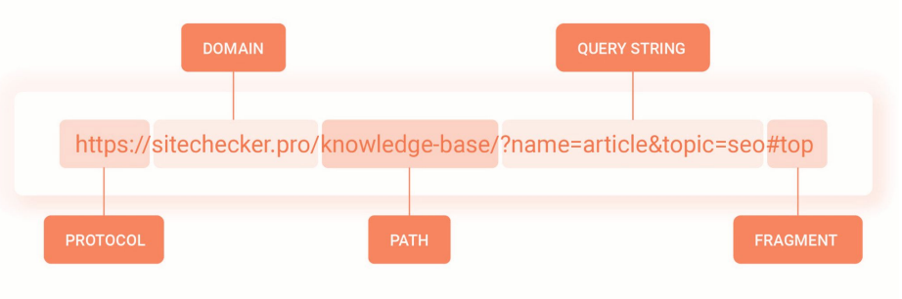
Numeric Features
Features that represent quantitative or continuous values. These features can take on a wide range of numeric values
URL text features are basically classified into - protocol, domain, path, query, fragment.
The length of this each feature (excluding protocol) and the count of the different special characters in that specific feature are extracted
The special characters like ‘.’ ‘-’ ‘/’ ‘?’ ‘=’ ‘@’ ‘&’ ‘!’ ‘ ’ ‘˜’ ‘,’ ‘+’ ‘*’ ‘#’ ‘$’ ‘%’ .
Finally, a total of 74 features are extracted.
Output: New Dataset with extracted Features
Notes:
So basically we will be extracting the length of the basic features (i,.e, URL,Domain,Path,Query and Fragment) and also the count of special characters in that features
Thus at first will extract these features using urlparse from the urllib liberay of python.
This new csv file passed for the next phase which is the model evaluation.
And there these extracted features are trained and then tested.

Slide 9
Model Comparison
Pycaret
PyCaret, machine learning library in Python is used to compare 15 different machine learning models
compare_models() function of pycaret intiates the comparison and returns a table of model performance metrics sorted by a specified evaluation metric.
Result: Logistic Regression shows highest Accuracy
Model Evaluation
Evaluating the LR model includes the following steps:
Splitting the dataset into training and testing sets
Fitting the logistic regression model to the training data
Use the trained model to predict test dataset.
Calculating evaluation metrics(accuracy, precision, recall, F1-score, AUC-ROC, and confusion matrix)
Notes:
PyCaret is an open-source, low-code machine learning library in Python that provides a wide range of tools for building and deploying machine learning models quickly and easily.

Slide 10
Model Implementation
This include the following processes:
Saving the trained model in a serialized format
Integrating the model into the target Web Application
Loading the serialized model into the implementation environment
Get the input URL from the user
Extract the 74 different features from the input URL
Utilize the loaded model to generate predictions on the extracted features.
Output Delivery : The prediction result is then passed to the API
Notes:
Exporting the Model: Saving the trained model in a serialized format that can be easily loaded and used for predictions.
Model Integration: Integrating the model into the target application which is the WhalingGuard Web Application where it will be used for predictions by API call.
Model Loading: Loading the serialized model into the implementation environment, making it ready for use
Input Data Feeding: Providing the new data, which is the URL to the model for prediction.
Feature Extraction: Extract the 74 different features from the input URL that where extracted during training phase.
Prediction Generation: Utilize the loaded model to generate predictions on the extracted features.
Output Delivery: The prediction result is then passed to the API and the API then sends the results as a response to the frontend.

Slide 11
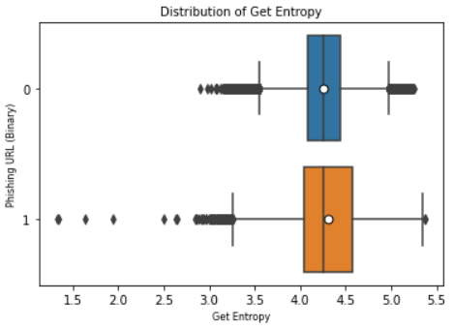
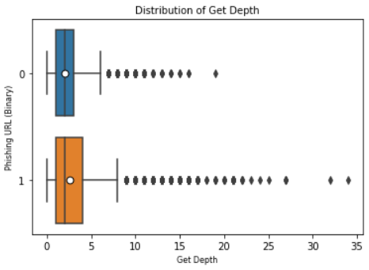
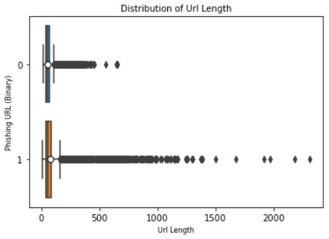
Results and Discussion
Feature Analysis
Boxplot Graph: It is employed to explore and understand the distribution of feature values during the analysis of the dataset and provides insights including measures of central tendency, dispersion, mean and identification of outliers. Visualization of some features are shown below:
Notes:
The boxplot graph is a useful visualization for displaying the distribution of a numerical feature or variable.
Visually, we see that legitimate URLs have higher entropy and are generally longer than phishing URLs. Similarly, we can capture the fact that ‘red flag’ keywords appear in a URL string which is the keyword ‘login’, is more seen in the phishing URLs. The depth of the URL i.e., number of hierarchical levels or directories in the URL’s path for phishing URLs is seen greater than the legitimate ones. It is also seen that the phishing URLs have higher URL length than the legitimate URLs.

Slide 12
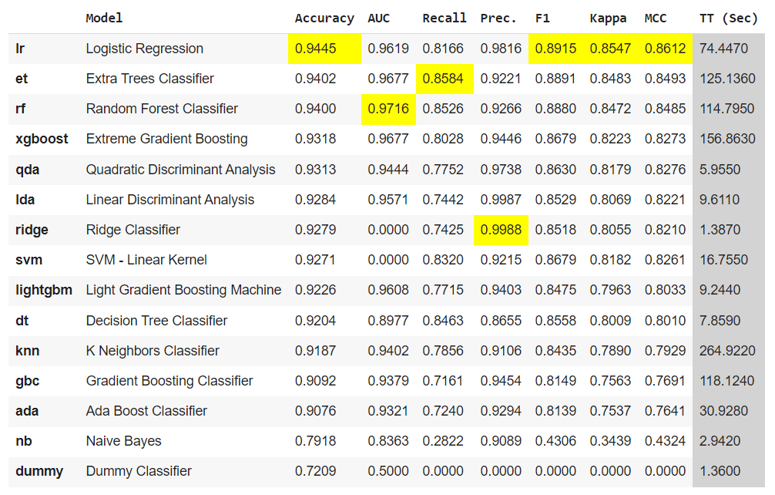
Pycaret Analysis
Comparison results obtained using PyCaret guide in selecting the most suitable machine learning model(s) for this project, taking into account performance metrics, statistical significance, feature importance, and other relevant factors.Below Fig shows the comparison result.
Notes:
Here we can see that logistic regression gives the hightest accuracy

Slide 13
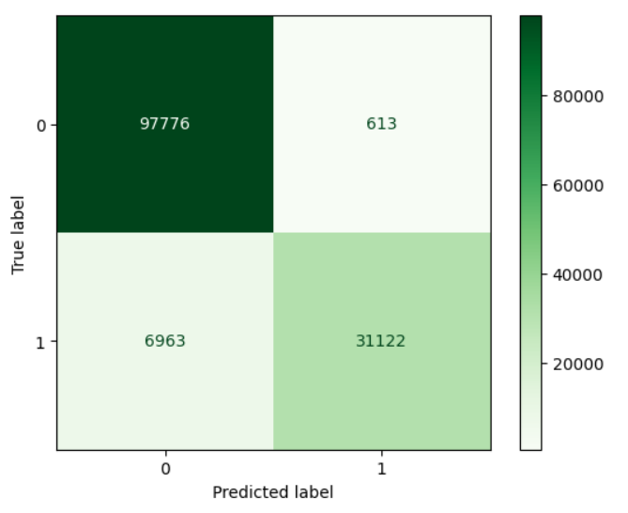
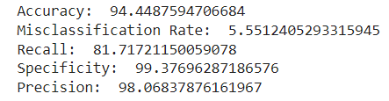
Model Analysis
The confusion matrix provides a more detailed understanding of the model’s performance beyond simple accuracy.
Evaluation Metrics:
Notes:
A confusion matrix is a table that is used to evaluate the performance of a classification model.

Slide 14
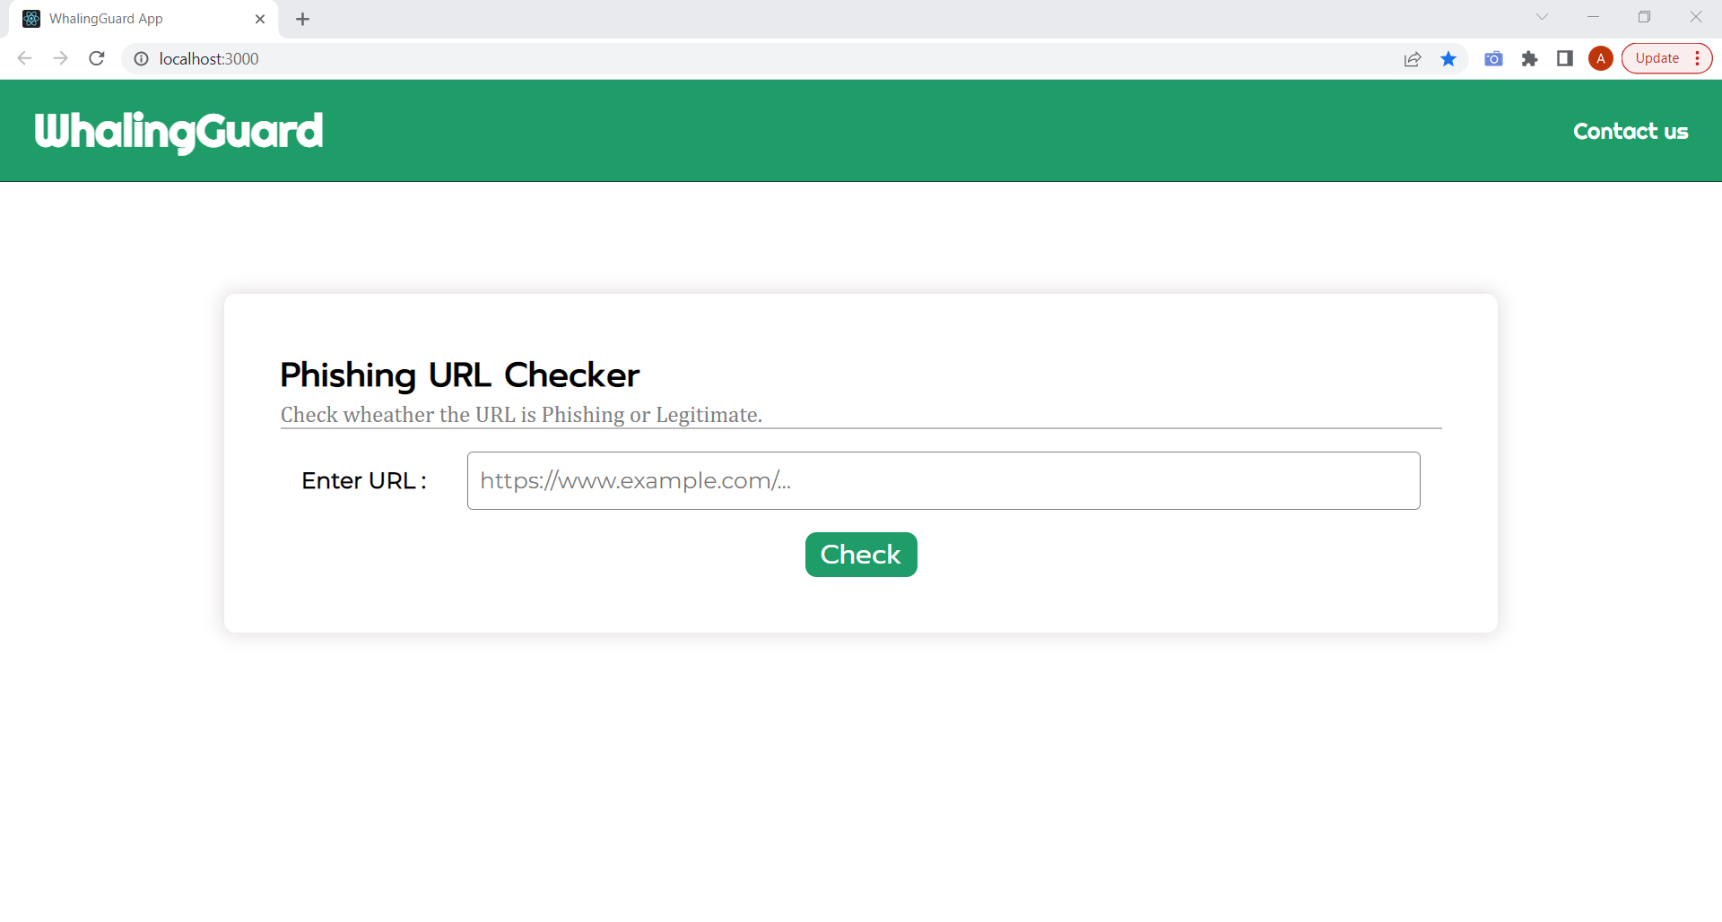
Web Application
We have developed a web application where the users can input URLs to check if it is phishing or non-phishing. UI of the application is developed using Reactjs and the API setup for the application is implemented using Nodejs.
Notes:
Below shows the User Interface of the WhalingGuard web application.

Slide 15
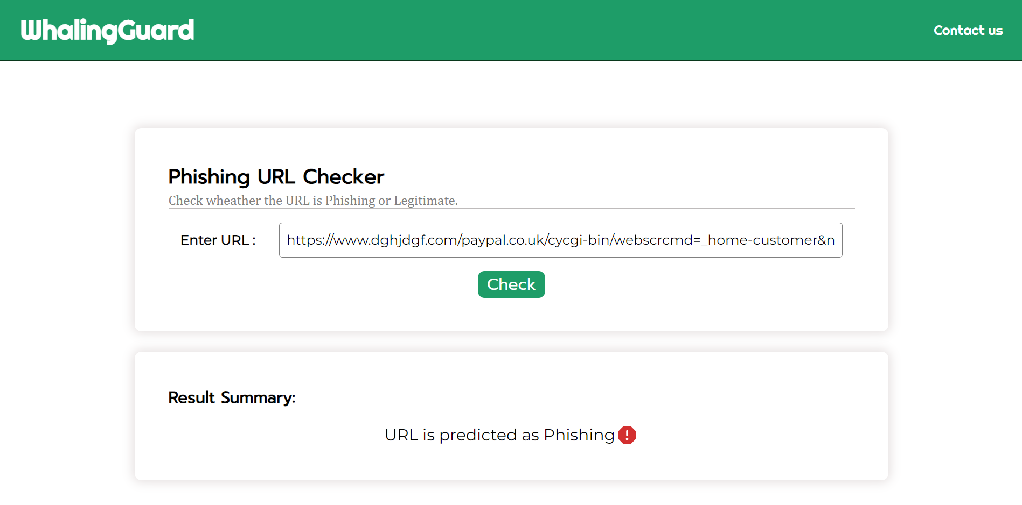
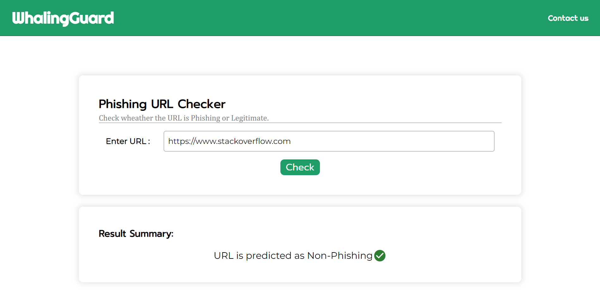
The URL entered by the user is received by the server and it is predicted by the evaluated LR model. Based, on the prediction, the summary of the result is shown as output in the user-interface. The following figures shows the 2 different output produced

Slide 16
Conclusion
In particular, phishing has become more common and has begun to raise significant issues. There needs to design phishing detection method to affectively detect if the website is phishing or non-phishing. Considering the significance of phishing detection, in this study, we extracted 74 different features from the website URL. After comparing different machine learning algorithms, we found that Logistic Regression gives higher accuracy. So, we used Logistic Regression model for phishing prediction. In future we are planning to design a framework for identifying and preventing phishing attacks that are delivered through email messages.

Slide 17
Thank You
Notes:
Thank you

