Slide 1
A PROJECT
ON Phishing Detection Using Machine Learning BACHELOR OF TECHNOLOGY IN COMPUTER SCIENCE AND ENGINEERING BY ADITHYAN M S
AMAL SOMAN
ASWANI N K
HARIKRISHNAN K B
Under the Guidance of
Ms. KRISHNA PRIYA V J
ACADEMIC BATCH: 2019-2023
Notes:
Good morning…V would like to present our project topic on <name>

Slide 2
Contents
Introduction
Abstract
Problem Definition
Objectives
Scope
Literature Survey
System Architecture
Module-wise Description
System Implementation
Software Requirements

Slide 3
Introduction
Phishing attack is a simplest way to obtain sensitive information from innocent users.
Cyber security persons are now looking for trustworthy and steady detection techniques for phishing websites detection.
Notes:
Aim of the phishers is to acquire critical information like username, password and bank account details.
Various machine algorithms are used to detect phishing websites.

Slide 4
Abstract
In our project the datasets are first collected and cleaned and from this datasets features are extracted.
The URL’s received by the user will be given input to the machine learning model then the algorithm will process the input and display the output whether it is phishing or legitimate.
There are various ML algorithms like SVM, Neural Networks, Random Forest, Decision Tree, XG boost etc. that can be used to classify these URLs.
Notes:
Aim of the paper is to detect phishing URLs by using best machine learning algorithm by comparing accuracy rate, false positive and false negative rate of each algorithm

Slide 5
Problem Definition
Phishing has a list of negative effects on a Business, including loss of money, loss of intellectual property, damage to reputation, and disruption of operational activities. An attack is disguised as a message from a legitimate company. Phishing is facilitated by communicating a sense of urgency in the message, which could threaten account suspension, money loss or loss of the targeted users job.
Therefore, we suggest a phishing detection model based on machine learning that compares the features of the target websites mainly the URLs.
Notes:
According to the FBI, phishing incidents nearly doubled in frequency, from 114,702 [1 lakh 14 thousand] incidents in 2019, to 241,324 [2 lakh forty thousand ] incidents in 2020.

Slide 6
Objectives
Automatically Storing URLs of different available websites in our Country which are detected as phishing URLs
To analyse the accuracy level for different machine learning algorithms and implementing the best among them
To design and Implement a software to search and detect whether it is phishing or not.

Slide 7
Scope
Algorithm will analyze various blacklisted and legitimate URLs and their features to accurately detect the phishing websites including zero-hour phishing websites.
Notes:
Zero-hour – a cyberattack taking place the same day a hacker finds a vulnerability in a software, hardware or firmware.

Slide 8
Literature Survey

Slide 9
Year | Title | Author | Methodology | Conclusion/Results
2020 | PhishHaven—An Efficient Real-Time AI Phishing URLs Detection System | Maria Sameen; Kyunghyun Han; Seong Oun Hwang | Design a PhishHaven which detects and classifies a URL using three subcomponents. First subcomponent, URL Hit The second subcomponent is Features Extractor. The third subcomponent is Modelics, | In this new paradigm executes ensemble-based machine learning models in parallel using multi-threading technique, and results in real-time detection by significant speed-up in the classification process.
2021 | Phishing Happens Beyond Technology: The Effects of Human Behaviors and Demographics on Each Step of a Phishing Process | Hossein Abroshan; Jan Devos; Geert Poels; Eric Laermans | Participants play a risk-taking game and answer questions related to two psychological scales to measure their behaviours, and then conducted a simulated phishing campaign to assess their phishability throughout the three phishing steps selected. | Analysed the effect of some personal behaviours and demographic factors in each of the three phishing steps described.
2022 | A Systematic Literature Review on Phishing Email Detection Using Natural Language Processing Techniques | Said Salloum; Tarek Gaber; Sunil Vadera; Khaled Shaalan | The use of Natural Language Processing (NLP) techniques for detection of phishing except one that shed light on the use of NLP techniques for classification and training purposes, while exploring a few alternatives. | In this research, journal, conference, and workshop papers were carefully analysed, published between 2006 and 2022, with different techniques to investigate the trend of phishing email detection.

Slide 10
Year | Title | Author | Methodology | Conclusion/Results
2020 | AI Meta-Learners and Extra-Trees Algorithm for the Detection of Phishing Websites | Yazan Ahmad Alsariera; Victor Elijah Adeyemo; Abdullateef Oluwagbemiga Balogun | Data Source and Preparation Algorithm Implementation Model Development Model Evaluation | This paper implemented and presented four different AI-based meta-learner models using Extra-tree algorithm base learner for detecting phishing websites.
2021 | Sufficiency of Ensemble Machine Learning Methods for Phishing Websites Detection | Yi Wei; Yuji Sekiya | Phishing instances are usually derived from PhishTank Other legitimate instances are from Alexa, DMOZ, and Common Crawl. Features used in phishing detection are usually extracted from URLs (protocol, domain, path, parameters) | This feature selection framework achieves a remarkable 87.6% reduction in feature quantity with suffering from only a 0.1% deterioration in detecting accuracy, making it possible for up-date training and real-time detecting in a production environment.
2022 | PDGAN: Phishing Detection With Generative Adversarial Networks | Saad Al-Ahmadi; Afrah Alotaibi; Omar Alsaleh | The proposed PDGAN model consists of a generator and a discriminator trained in adversarial processes. The generator is an LSTM model which generates synthetic phishing URLs, and the discriminator is a CNN model which decides whether a URL is phishing or legitimate. | PDGAN achieved 97.58% accuracy and 98.02% precision without depending on third-party services and greater accuracy than other compared models.

Slide 11
Year | Title | Author | Methodology | Conclusion/Results
2019 | A Comprehensive Survey for Intelligent Spam Email Detection | Asif Karim; Sami Azam; Bharanidharan Shanmugam; Krishnan Kannoorpatti; Mamoun Alazab | Looked into several papers selected based on the listed index terms and thoroughly analyzed the presented method, whether it has effectively used machine learning principles; how robust and impactful the proposed solution really | High adoption of supervised approaches is quite obvious SVM and Naïve Bayes are in high demand. Single-algorithm anti-spam systems are quite common
2021 | Eth-PSD: A Machine Learning-Based Phishing Scam Detection Approach in Ethereum | Arkan Hammoodi Hasan Kabla; Mohammed Anbar; Selvakumar Manickam; Shankar Karupayah | Detect phishing scam-related transactions using a novel machine learning-based approach. Eth-PSD tackles some of the limitations in the existing works, such as the use of imbalanced datasets, complex feature engineering, and lower detection accuracy. | Proposed Eth-PSD to detect the phishing scam in Ethereum. Started with derived requirements based on the limitations of related works and other effective IDSs from previous related works.
2019 | Phishing Website Detection Based on Multidimensional Features Driven by Deep Learning | Peng Yang; Guangzhen Zhao; Peng Zeng | Character sequence features of the given URL are extracted and used for quick classification by deep learning,we combine URL statistical features, webpage code features, webpage text features, and the quick classification result of deep learning into multidimensional features | found that the MFPD approach is effective with high accuracy, low false positive rate and high detection speed.

Slide 12
Year | Title | Author | Methodology | Conclusion/Results
2019 | OFS-NN: An Effective Phishing Websites Detection Model Based on Optimal Feature Selection and Neural Network | Erzhou Zhu; Yuyang Chen; Chengcheng Ye; Xuejun Li; Feng Liu | In the proposed OFS-NN, a new index, feature validity value (FVV), is first introduced to evaluate the impact of sensitive features on the phishing websites detection. Then, based on the new FVV index, an algorithm is designed to select the optimal features from the phishing websites. | This algorithm could properly deal with problems of big number of phishing sensitive features and the continuous changes of features. Consequently, it can mitigate the over-fitting problem of the neural network classifier.

Slide 13
Year | Title | Author | Methodology | Conclusion/Result
2006 | Detecting Phishing Web Pages with Visual Similarity Assessment Based on EMD | Anthony Y, Liu Wenyin | Convert the involved Web pages into low resolution images Use EMD to calculate the signature distances of the images Train an EMD threshold vector for classifying a Web page as a phishing or a normal | 10,281 suspected Web pages are carried out to show high classification precision, phishing recall, and applicable time performance for online enterprise solution.
2009 | Counteracting Phishing Page Polymorphism:An Image Layout Analysis Approach | Leng fat lam, Wei cheng Xiao,Kuana ta chen | Analyze the layout of webpages rather than the HTML codes, colors, or content. Speciflcally, compute the similarity degree of a suspect page and an authentic page through image processing techniques. | This mechanism is more robust than the HTML-based approachbecause it is more adaptable to phishing page polymorphism.
2015 | A Computer Vision Technique to Detect Phishing Attacks | Routhu Srinivasa Rao ,Syed Taqi Ali | The proposed approach is a combination of white list and visual similarity based techniques. Use computer vision technique called SURF detector to extract discriminative key point features from both suspicious and targeted websites. | This proposed solution is efficient, covers a wide range of websites phishing attacks and results in less false positive rate.

Slide 14
Year | Title | Author | Methodology | Conclusion/Result
2009 | Fighting Phishing with Discriminative Keypoint Features | Kuan-Ta Chen; Jau-Yuan Chen; Chun-Rong Huang | An effective image-based antiphishing scheme based on discriminative keypoint features in Web pages. Their invariant content descriptor, the Contrast Context Histogram (CCH), computes the similarity degree between suspicious and authentic pages. | The results show that the proposed scheme achieves high accuracy and low error rates.
2018 | Defending against Phishing Attacks: Taxonomy of Methods, Current Issues and Future Directions | B. B. Gupta, Nalin Asanka Gamagedara Arachchilage, Konstantinos E. Psannis | Discuss the history of phishing attacks and the attackers motivation in details Provide taxonomy of various solutions proposed in literature to protect users from phishing based on the attacks identified in our taxonomy. | Conclude paper discussing various issues and challenges that still exist in the literature, which are important to fight against with phishing threats.
2007 | A Layout-Similarity-Based Approach for Detection | Angelo P.E Rosiello | In this paper, an extension of our system (called DOMAntiPhish) that mitigates the shortcomings of previous system. In particular, novel approach leverages layout similarity information to distinguish between malicious and benign web pages. | This makes it possible to reduce the involvement of the user and significantly reduces the false alarm rate, experimental evaluation demonstrates that our solution is feasible in practice.

Slide 15
Year | Title | Author | Methodology | Conclusion/Result
2009 | School of phish: a real-world evaluation of anti-phishing training | P. Kumaraguru,Justin Cranshaw | Teaches users to avoid falling for phishing attacks by delivering a training message when the user clicks on the URL in a simulated phishing email. | Adding a second training message to reinforce the original training Training does not decrease users willingness to click on links in legitimate messages
2007 | Phishing for user security awareness | Curtis Carver | Taken the concept of using an exercise and modified it in application to evaluate a users propensity to respond to email phishing attacks in an unannounced test. | This paper describes the considerations in establishing and the process used to create and implement an evaluation of one aspect of our user information assurance education program.
2021 | Research on Phishing Email Detection Based on URL Parameters Using Machine Learning Algorithms | Mylda Tubyte | This paper addresses the URL Boolean classification problem using various machine learning methods such as Support Vector Machine, Random Forest, Decision Tree, Linear Discriminant Analysis, and Logistic Regression. | This paper provides a comparative study on these algorithms applied for two different URL classification datasets.

Slide 16
Year | Title | Author | Methodology | Conclusion/Result
2020 | Comparison of Classification Algorithms for Detection of Phishing Websites | Paulius Vaitkevicius | Compare classic supervised machine learning algorithms on all publicly available phishing datasets with predefined features and to distinguish the best performing algorithm for solving the problem of phishing websites detection, regardless of a specific dataset design. | The comparison results are presented in this paper, showing ensembles and neural networks outperforming other classical algorithms.

Slide 17
Year | Title | Author | Methodology | Conclusion/Result
2021 | HinPhish: An Effective Phishing Detection Approach Based on Heterogeneous Information Networks | Bingyang Guos | HinPhish extracts various link relationships from webpages and uses domains and resource objects to construct a heterogeneous information network. HinPhish applies a modified algorithm to leverage the characteristics of different link types. | HinPhish not only improves the accuracy of detection, but also can increase the phishing cost for attackers. Extensive experimental results demonstrate that HinPhish can achieve an accuracy of 0.9856 and F1-score of 0.9858.
2019 | A Methodical Overview on Phishing Detection along with an Organized Way to Construct an Anti-Phishing Framework | Srushti Patil, Sudhir Dhage | This paper presents a focused literature survey of methods available to detect phishing websites. A comparative study of the in-use anti-phishing tools was accomplished and their limitations were acknowledged. | Analyzed the URL-based features used in the past to improve their definitions as per the current scenario which is our major contribution
2020 | Phishing Detection using Random Forest, SVM and Neural Network with Backpropagation | Sindhu, Sunil Parameshwar Patil,Arya Sreevalsan, Faiz Rahman | The paper explains the improved Random Forest classification method, SVM classification algorithm and Neural Network with backpropagation classification methods which have been implemented with accuracies of 97.369%, 97.451% and 97.259% respectively. | This paper explains the existing machine learning methods that are used to detect phishing websites.

Slide 18
Year | Title | Author | Methodology | Conclusion/Result
2019 | A Machine Learning Approach for URL Based Web Phishing Using Fuzzy Logic as Classifier | Happy Chapla, Riddhi Kotak,Mittal Joiser | Users are not aware of this type of attack and later they will also become a part of the phishing attacks. It may be the losses of financial found, personal information, reputation of brand name or trust of brand. | So the detection of phishing site is necessary. In this paper we design a framework of phishing detection using URL
2014 | Intelligent rule-based phishing websites classification | Rami M. Mohammad,Fadi Thabtah,Lee McLusky | The authors shed light on the important features that distinguish phishing websites from legitimate ones and assess how good rule-based data mining classification techniques are in predicting phishing websites and which classification technique is proven to be more reliable. | These features extracted automatically without any intervention from the users using computerised developed tools.
2016 | Phishing sites detection based on Url Correlation | Ying Xue, Yang Li,Yuangang Yao, Xianghui Zhao, Jianyi Liu,Ru Zhang | proposed Vulnerable Sites List and a new feature which is named URL Correlation. URL Correlation is based on the similarity of URLs with the List above that we created. | a large improvement of accuracy is observed by comparing methods which use our new feature with the others which use the normal one.

Slide 19
Year | Title | Author | Methodology | Conclusion/Result
2010 | Large-Scale Automatic Classification of Phishing Pages | Collin Whittaker,Brian Ryner,Maria Nasif | We describe the design and performance characteristics of a scalable machine learning classifier we developed to detect phishing websites. We use this classifier to maintain Googles phishing blacklist automatically. | Despite the noise in the training data, our classifier learns a robust model for identifying phishing pages which correctly classifies more than 90% of phishing pages several weeks after training concludes.
2021 | Phishing Happens Beyond Technology: The Effects of Human Behaviors and Demographics on Each Step of a Phishing Process | Hossein Abroshan; Jan Devos; Geert Poels; Eric Laermans | asked participants to play a risk-taking game and to answer questions related to two psychological scales to measure their behaviours, and then conducted a simulated phishing campaign to assess their phishability throughout the three phishing steps selected. | The results of this study and the model developed can be used to build a comprehensive framework to prevent the success of phishing attempts, starting from their root causes.
2021 | A Methodical Overview on Detection, Identification and Proactive Prevention of Phishing Websites | M. D. Bhagwat;P. H. Patil;T. S. Vishawanath | This approach is based on smooth logic and machine learning algorithms that define various factors on the phishing website. | A total of 30 characteristics or features and phishing website attributes can be used for phishing detection with high accuracy.

Slide 20
Year | Title | Author | Methodology | Conclusion/Result
2018 | Tools for Investigating the Phishing Attacks Dynamics | Vyacheslav Lyashenko, Oleg Kobylin, Mykyta Minenko | The use of analysis tools makes it possible to investigate the peculiarities of the phishing attacks occurrence, as well as methods for their identification effectiveness. | This allows you to expand the scope of the analysis of phishing attacks. For analysis, we use real data about phishing attacks.
2017 | A Secured Methodology for Anti-Phishing | Churi, T., Sawardekar, P., Pardeshi, A., & Vartak, P. | phished pages commonly asks for getting into and submitting the credentials but is not able to retrieved any user acknowledged facts, right here we suggest a preventive anti-phishing technique keep away from to be victims of phishing attacks. | The technique used to perform on-line robbery/stealing of person credentials is called a phishing in cyber international.

Slide 21
Year | Title | Author | Methodology | Conclusion/Result
2022 | Characteristics of Understanding URLs and Domain Names Features: The Detection of Phishing Websites With Machine Learning Methods | Ilker Kara; Murathan Ok; Ahmet Ozaday | The proposed method simplifies the process of feature extraction, and reduces processing overhead while going beyond analyzing on HTML, DOM, and URL based features by considering URLs, and domain names. | A minimum loss in data conversion, selecting the appropriate machine learning technique, and consistency of definitions in the data set.
2018 | Detecting phishing websites using machine learning technique | Ashit Kumar Dutta, Zhihan Lv | The proposed framework employs RNN—LSTM to identify the properties Pm and Pl in an order to declare an URL as malicious or legitimate. | The proposed method (LURL) is developed in Python 3.0 with the support of Sci—Kit Learn and NUMPY packages. Also, the existing URL detectors are constructed for evaluating the performance of LURL. LURL has produced an average of 97.4% and 96.8% for Phishtank and Crawler datasets respectively.
2022 | Web Phishing Detection Using Machine Learning | N Kumaran, Purandhar Sri Sai, Lokesh Manikanta | Data Collection Data Pre-Processing Feature Extraction Evaluation Model | Machine learning methods were imported using the Scikit-learn library. Each classification is performed using a training set, and the performance of the classifiers is evaluated using a testing set. The accuracy score of classifiers was calculated to assess their performance.

Slide 22
Year | Title | Author | Methodology | Conclusion/Results
2021 | Detection of Phishing Websites using Machine Learning | Atharva Deshpande, Omkar Pedamkar, Nachiket Chaudhary | Collect unstructured data of URLs from Phishtank website, Kaggle website and Alexa website, etc. Train the three unique classifiers and analyse their presentation based on exactness two classifiers utilized are Decision Tree and Random Forest algorithm. | Scikit-learn tool has been used to import Machine learning algorithms. Each classifier is trained using training set and testing set is used to evaluate performance of classifiers. Performance of classifiers has been evaluated by calculating classifiers accuracy score. improve the accuracy of our models with better feature extraction.
2017 | Systemization of Knowledge (SoK) : A Systematic Review of Software-Based Web Phishing | Issa Khalil, Mohsen Guizani, Abdallah Khreishah | URL based methods; Support Vector Machine Naive Bayes Logistic Regression | This paper present a systematic review of the automatic phishing detection schemes.
2013 | Favicon-a clue to phishing sites detection | Xiao-Dong Lee, Wei wang, Shian-Syong | Favicon Images Recognition Algorithm | In the paper that analyzes the favicons in phishing Web sites and detects phishes with favicon recognition. One significant advantage of the proposed method is language independent, even for picture-in-picture phishing, as long as the site contains a fake favicon.

Slide 23
Year | Title | Author | Methodology | Conclusion/Result
2018 | A New Method for Detection of Phishing Websites: URL Detection | Shraddha Parekh, Dhwanil Parikh , Srushti Kotak , Prof. Smita Sankhe | Random forest algorithm is implemented using Rstudio. The parsed dataset undergoes heuristic classification where the dataset is spilt into 70% and 30%. The 70% data is considered for training and 30% for testing. | In this paper, a different methodology has been proposed to detect phishing websites by using random forests as the classification algorithm with the help of Rstudio.
2018 | Detection of URL based Phishing attacks Using Machine Learning | Ms. Sophiya Shikalgar , Dr. S. D. Sawarkar , Mrs. Swati Narwane | Hybrid Algorithm Approach is a mixture of different classifiers working together which gives good prediction rate and improves the accuracy of the system. | This system provides us with 85.5 % of accuracy for XG Boost Classifier, 86.3% accuracy for SVM Classifier, 80.2 % accuracy for NaÃ¯ve Bayes Classifier and finally 85.6 percentage of accuracy when using Stacking Classifier.
2011 | PhishZoo : Detecting Phishing Website by Looking at Them | Sadia Afroz, Rachel Greenstadt | Detect phishing sites using content similarity between real sites and malicious sites. Malicious sites tend to use sensitives sites appearance to provoke false belief in users. PhishZoo makes profiles of sensitive sites and compares all loaded sites against these stored profiles. | This paper presents the first step in a new approach of web-phishing detection using vision techniques. This presents results that defeat the vast majority of current attacks,

Slide 24
Year | Title | Author | Methodology | Conclusion/Result
2020 | Phishing Website Detection Using Machine Learning Classifiers Optimized by Feature Selection | Dzelila Mehanivic,Jasmin Kevrić | In this paper applied K-Nearest Neighbor (KNN), Decision Tree and Random Forest classifiers. | Results obtained by the feature selection and machine learning methods described in the previous section. Several feature selection methods were applied, and their results were compared to find the attributes with highest impact to the result. Furthermore, classification algorithms, such as KNN, Decision Tree and Random Forest were applied to initial and reduced dataset.

Slide 25
System Requirements
Software Requirements
Programming Languages: Python, JavaScript
Integrated Development Environment (IDE): VisualStudioCode, Google Colab
Libraries: numpy, panda, scikit-learn, Matplotlib/Seaborn, pycaret, pickle, React
Frameworks: Anaconda, Express.js
Web Browsers: Google Chrome, Mozilla Firefox, Microsoft Edge
Package Managers: pip, npm
Version Control: Git, Github
Hardware Requirements
Processor: Intel i5 and above
RAM: 8gb and above
Notes:
Requirements satisfied

Slide 26
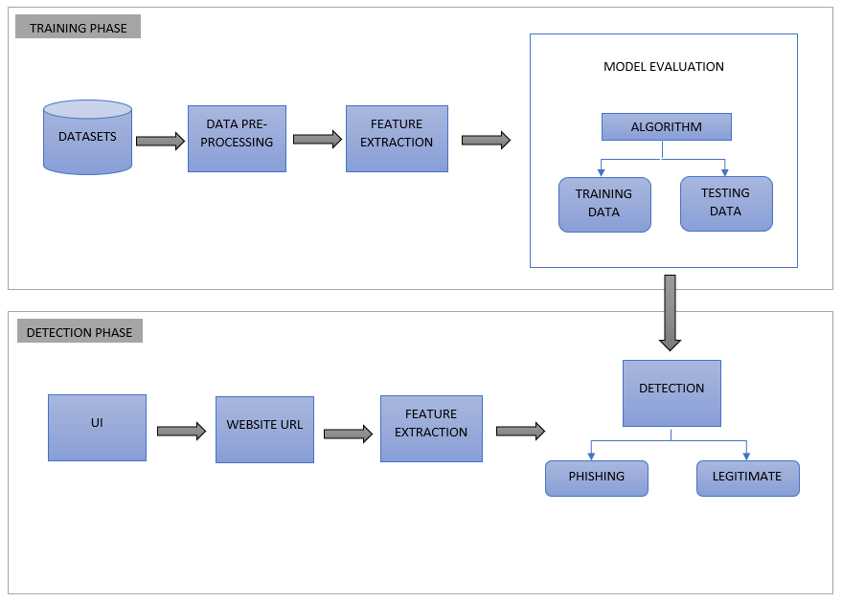
System Architecture
Notes:
First of all.. We have a dataset contains both phishing and legitimate websites…Then we’ll extract features from the dataset, then we use a accurate algorithm for training and testing the features…
Then, We will be having a user interface where the urls from users are collected …Which is considered as the website data… and predict whether it is phishing or legitimate using the algorithm…

Slide 27
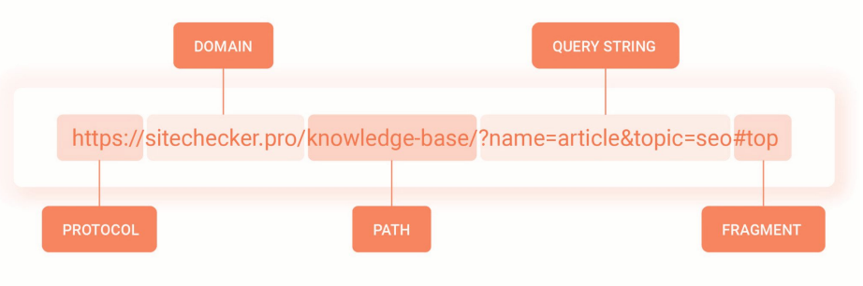
Module-wise Description
User Interface
Gets the URLs from the user and then displaying if the website if phishing or not
Also providing information about the website
Website Data
It includes the URLs given by the user
Feature Extraction
Extracting the different features from the website
The Basic Features are:

Slide 28
These basic features along with other multiple features are extracted from each URLs of the dataset. And respective feature columns are created for the dataframes
Datasets
Contains a collection of both phishing and legitimate website URLs. Datasets are represented as a 2-dimensional data structure with columns of potentially different types called DataFrames. The Feature Extraction is applied on this datasets.
Algorithms
Training Data: The extracted URL features are trained using different Machine learning algorithms
Testing Data : We check for the working of the proposed system by testing and comparing the results of the algorithm and the actual result. It is basically validating the system. The testing is done for each algorithm with a legitimate and phishing URLs and results
Detection
Classifying the input URL using ML algorithms into Phishing and Legitimate

Slide 29
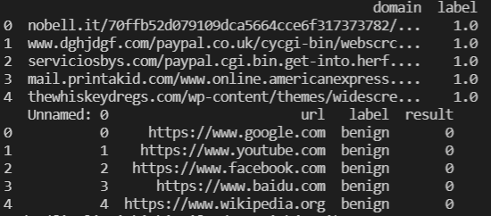
System Implementation
Datasets
Initial_urls.csv
Additional_urls.csv
Initial_urls.csv
From phishtank.com
Total Data – 96020
Columns - domain, label
Additional_urls.csv
From Kaggle.com
Total Data – 450176
Columns - url, label, result
Notes:
Initial_urls.csv contains 50% phishing URLs and 50% Legitimate website.
An additional dataset is merged with the original to improve our model upon deployment.
- A data structure called dataFrames of the pandas library in python is used for working with this datasets.

Slide 30
Phases of Implementation :
Data Preprocessing
Feature Extraction
Model Comparison
Model Evaluation
Model Implementation
Data Preprocessing
Aim: Collecting & Cleaning both datasets and merging them
Import Datasets
Initial Cleaning
Dropping Null Values
Dropping Columns
Changing Data types
Notes:
Dropping Null Values—in the dataset we can see that there were 92 URLs without label i.e, having null values. We will simply drop these rows.
Dropping Columns– Dataset2 which is the additional_urls contains unwanted columns, We will be also dropping these columns.
Changing Dtypes--- Dtypes (Datatypes) are changed so the two datasets match , giving advantage on the merging process.

Slide 31
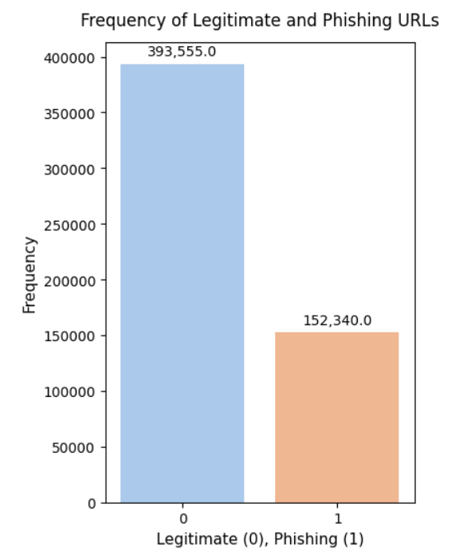
Final Changes
Merging Data Frames
Dropping Duplicates
Output: Cleaned New Dataset– final_urls.csv
Bar-Graph Classification of Phishing and Legitimate data:
Notes:
Merging DataFrames– as the final step we will concatenate both the datasets
Dropping Duplicates—After concatenation there are chances of duplicate URLs. There were 194
Duplicate URLs in our resultant dataset. And these were dropped.

Slide 32
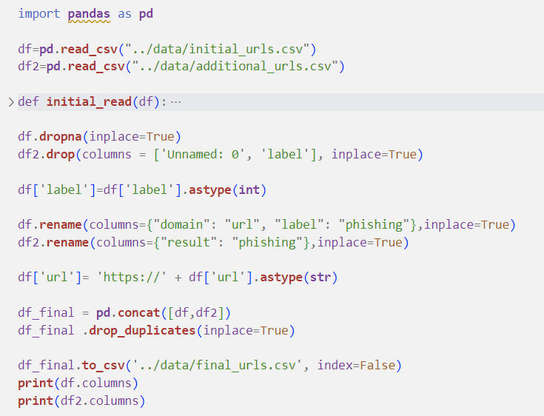
Notes:
dropna() : function used to drop null values

Slide 33
Feature Extraction
Lexical Features:
getEntropy
Phishing URLs often have longer and more complex URLs, and therefore a higher entropy.
hasLogin
If the URL string contains “login” keyword, the value assigned to this feature is 1 (phishing) or else 0 (legitimate).
Redirection
If the "//" is anywhere in the URL apart from after the protocol , thee value assigned to this feature is 1 (phishing) or else 0 (legitimate).
lenClassify
If the length of URL >= 54 , the value assigned to this feature is 1 (phishing) or else 0 (legitimate).
Notes:
getEntropy-In the context of strings, entropy is often used as a measure of the amount of information or complexity in the string.
hasLogin---we can capture the fact that certain ‘red flag’ keywords appear in a URL string. These keywords may relate to keywords attackers use when trying to spoof a legitimate page or keywords that relate to popular nomenclature of security settings on a website that a hacker will try to manipulate. Eg:login
Redirection--The existence of “//” within the URL path means that the user will be redirected to another website.
lenClassify-- Phishers can use long URL to hide the doubtful part in the address bar.

Slide 34
haveAtSign
If the URL has '@' symbol, the value assigned to this feature is 1 (phishing) or else 0 (legitimate).
getDepth
The value of feature is a numerical based on the URL.
tinyURL
If the URL is using Shortening Services, the value assigned to this feature is 1 (phishing) or else 0 (legitimate).
isDomainIp
If the domain name is Ip address, the value assigned to this feature is 1 (phishing) or else 0 (legitimate).
prefixSuffix
If the URL has '-' symbol in the domain part of the URL, the value assigned to this feature is 1 (phishing) or else 0 (legitimate).
>
Notes:
haveAtSign--Using “@” symbol in the URL leads the browser to ignore everything preceding the “@” symbol and the real address often follows the “@” symbol.
getDepth--- This feature calculates the number of sub pages in the given url based on the '/'.
tinyURL---URL shortening is a method in which a URL are shortened and still lead to the required webpage. And this is accomplished by almost all the phishing websites.
isDomainIp---Some Phishing URLs represents the domain name by IP address instead of hostname.
prefixSuffix-- Phishers tend to add prefixes or suffixes separated by (-) to the domain name so that users feel that they are dealing with a legitimate webpage.

Slide 35
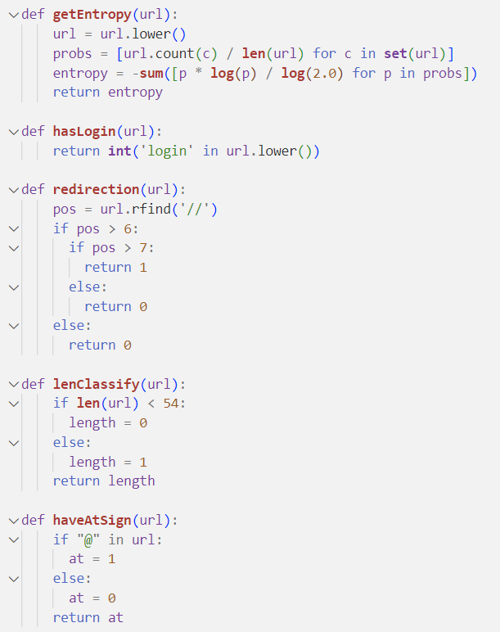
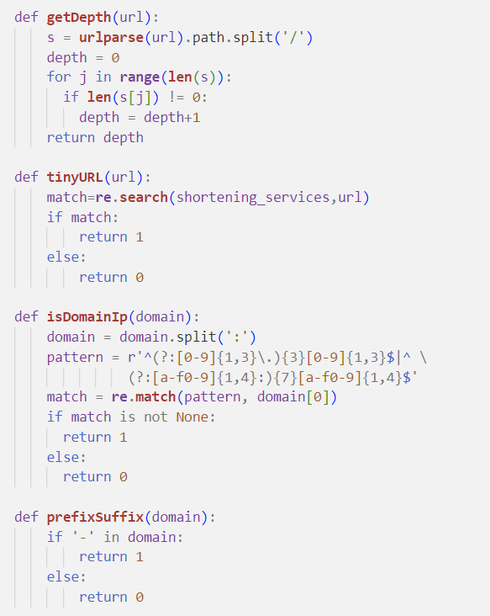
Notes:
rightClick---Phishers use JavaScript to disable the right-click function, so that users cannot view and save the webpage source code.. Nonetheless, for this feature, we will search for event “event.button==2” in the webpage source code and check if the right click is disabled.
mouseover---Phishers may use JavaScript to show a fake URL in the status bar to users. To extract this feature, we must dig-out the webpage source code, particularly the “onMouseOver” event, and check if it makes any changes on the status bar
Forwarding---The fine line that distinguishes phishing websites from legitimate ones is how many times a website has been redirected. In our dataset, we find that legitimate websites have been redirected one time max. On the other hand, phishing websites containing this feature have been redirected at least 2 times.

Slide 36
Numerical Features
URL Based includes:
url_length
Occurance of special characters in URL ( ‘.’ ‘-’ ‘/’ ‘?’ ‘=’ ‘@’ ‘&’ ‘!’ ‘ ’ ‘~’ ‘,’ ‘+’ ‘*’ ‘#’ ‘$’ ‘%’ )
Domain Based includes:
domain_length
Occurance of special characters in Domain ( ‘.’ ‘-’ )
Path Based incudes:
path_length
Occurance of special characters in Path( ‘.’ ‘-’ ‘/’ ‘=’ ‘@’ ‘&’ ‘!’ ‘ ’ ‘~’ ‘,’ ‘+’ ‘*’ ‘$’ ‘%’ )
Query Based includes:
query_length
Occurance of special characters in Query ( ‘.’ ‘-’ ‘/’ ‘?’ ‘=’ ‘@’ ‘&’ ‘!’ ‘ ’ ‘~’ ‘,’ ‘+’ ‘*’ ‘$’ ‘%’ )
Fragment Based includes:
frag_length
Occurance of special characters in Fragment ( ‘.’ ‘-’ ‘/’ ‘?’ ‘=’ ‘@’ ‘&’ ‘!’ ‘ ’ ‘~’ ‘,’ ‘+’ ‘*’ ‘$’ ‘%’ )
Notes:
So basically we will be extracting the length of the basic features (i,.e, URL,Domain,Path,Query and Fragment) and also the count of special characters in that features
Thus at first will extract these features using urlparse from the urllib liberay of python.

Slide 37
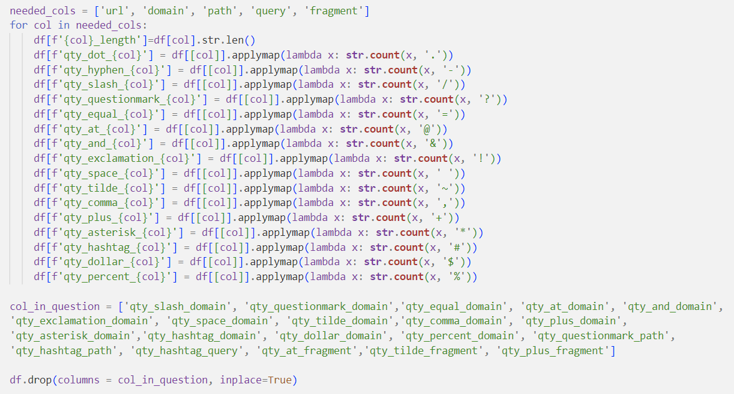
Calling each functions for feature extraction
Output : Extracted Features saved to new csv file –> url_features.csv
Notes:
This new csv file passed for the next phase which is the model evaluation.
And there these extracted features are trained and then tested.

Slide 38
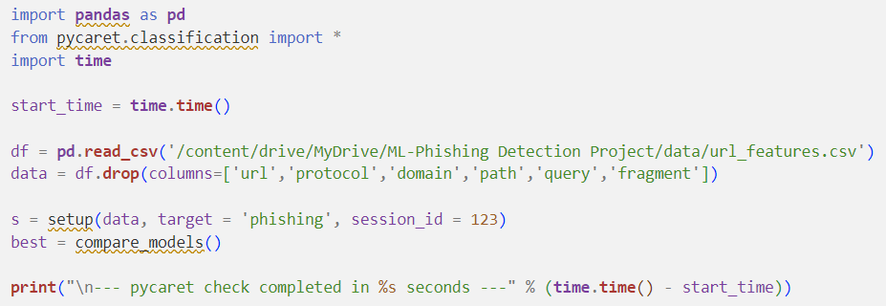
Model Comparison PyCaret is an open-source, low-code machine learning library in Python that provides a wide range of tools for building and deploying machine learning models quickly and easily. compare_models() is a PyCaret function that trains and evaluates multiple machine learning models on a given dataset and returns a table of model performance metrics sorted by a specified evaluation metric.

Slide 39
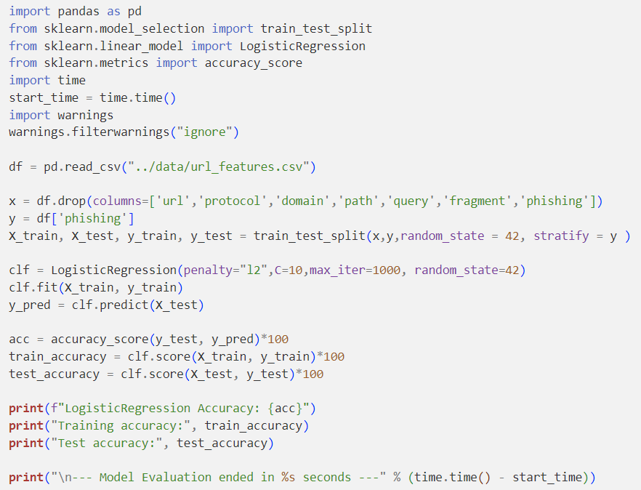
4. Model Evaluation Evaluating the LR model includes
the following steps:
Splitting the dataset
Training the LR model
Make predictions
Make predictions
Notes:
Splitting the dataset: Dividing dataset into training and testing sets, ensuring that both sets have a representative distribution of the target variable.
Training the LR model: Fitting the logistic regression model to the training data using a suitable library such as scikit-learn.
Make predictions: Use the trained model to predict the target variable for the test dataset.
Calculating evaluation metrics: Comparing the predicted values with the actual values from the test dataset and calculating the evaluation metrics such as accuracy, precision, recall, F1-score, AUC-ROC, and confusion matrix. Libraries like scikit-learn provide functions to calculate these metrics

Slide 40
4. Model Evaluation This include the following processes:
Exporting the Model
Model Integration
Model Loading
Input Data Feeding
Feature Extraction
Prediction Generation
Output Delivery
Notes:
Exporting the Model: Saving the trained model in a serialized format that can be easily loaded and used for predictions.
Model Integration: Integrating the model into the target application which is the WhalingGuard Web Application where it will be used for predictions by API call.
Model Loading: Loading the serialized model into the implementation environment, making it ready for useInput Data Feeding: Providing the new data, which is the URL to the model for prediction.
Feature Extraction: Extract the 74 different features from the input URL that where extracted during training phase.
Prediction Generation: Utilize the loaded model to generate predictions on the extracted features.
Output Delivery: The prediction result is then passed to the API and the API then sends the results as a response to the frontend.

Slide 41
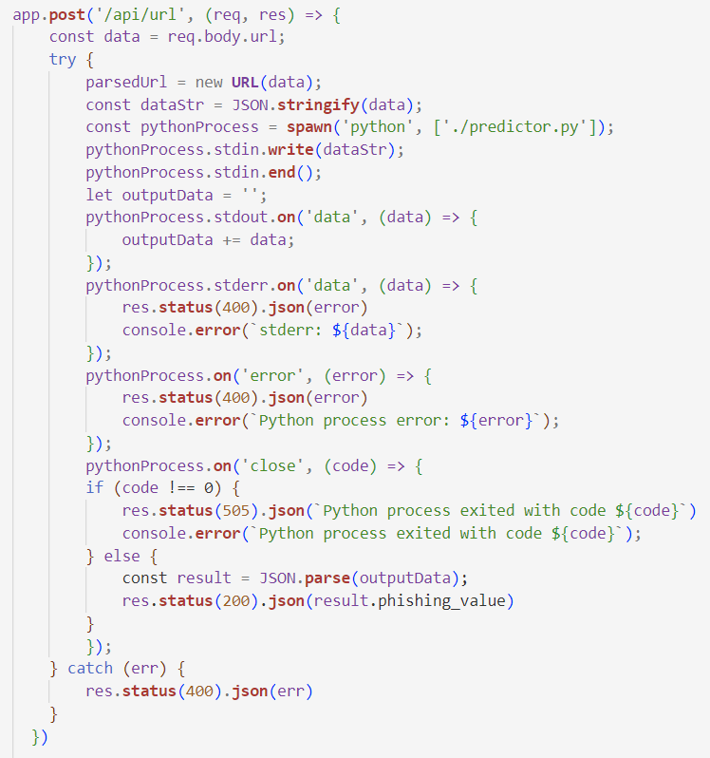
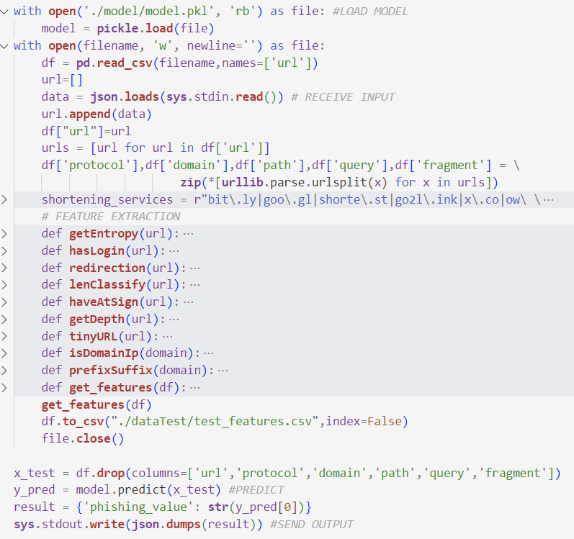

Slide 42
Conclusion
In particular, phishing has become more common and has begun to raise significant issues. There needs to design phishing detection method to affectively detect if the website is phishing or non-phishing. Considering the significance of phishing detection, in this study, we extracted 74 different features from the website URL. After comparing different ma- chine learning algorithms, we found that Logistic Regression gives higher accuracy. So, we used Logistic Regression model for phishing prediction. In future we are planning to design a framework for identifying and preventing phishing attacks that are delivered through email messages.

Slide 43
Thank You
Notes:
Thank you

