Slide 1

A STUDY ON SOCIAL PRESSURE IN DECISION MAKING
1
ST.THOMAS COLLEGE (AUTONOMOUS), THRISSUR
DEPARTMENT OF DATA SCIENCE
FOURTH SEMESTER B.VOC DATA SCIENCE
SDC4CS15(PR) : INDUSTRIAL VISIT AND MINI PROJECT
ADITHYAN JOHNSON THAWBOA031

Slide 2
Introduction
2
Have you ever felt like the decisions you make are not entirely your own? That's the influence of social pressure at work. Social pressure is like a silent whisper in our ears, nudging us to conform to what society expects or what our friends think is cool. It's the reason why we often consider what others will say or think before making a choice.
By studying this, we hope to learn more about why we make the choices we do and how we can make better decisions, even when there's pressure from others. This research isn't just for academics — it's about giving everyone a better understanding of how social pressure shapes our lives, so we can make choices that are right for us.

Slide 3
Statement of the Problem
3
This study aims to understand the impact of social pressure on decision-making and also other factor that affect our decision making. We want to dig deeper into how this pressure affects the way we decide things, and what it means for the quality and satisfaction we get from our choices
This study seeks to provide valuable insights into the influence of social pressure on decision-making we aim to equip individuals with the knowledge and awareness necessary to navigate these influences more effectively, leading to more authentic and fulfilling decision-making processes.

Slide 4
General Objectives
4
The general objectives for the study are to understand how social pressure affects individual decision-making in different situations and how other factors affect our decision making , figure out how social pressure works, and explore how individual and situational factors influence the connection between social pressure and decision-making.
Like age ,income,education,family,gender etc

Slide 5
Variables
5
Independent Variable
Social Pressure
Dependent Variables
Decision-Making:

Slide 6
Hypothesis
6
H0:Social pressure has an impact on how individuals make decisions. This suggests that the influence of external factors significantly affects the choices people make in different situations.
H1:Social pressure has no impact on how individuals make decisions. This suggests that the influence of external factors significantly not affects the choices people make in different situations.

Slide 7
Population and Sample
7
Population : Individuals in different age groups(15 to 64)in Thrissur
Sample : A randomly selected 30 participants in different age groups(15 to 64) representing various sectors of society, including students, professionals, and individuals from diverse cultural backgrounds.

Slide 8
Questionnaire
8
A Study on Social Pressure in Decision making
1. Social pressure significantly impacts my decision-making process.
a)Strongly Disagree
b)Disagree
c)Neutral
d)Agree
e)Strongly Agree

Slide 9
2 . I am confident in my decision-making when faced with social pressure.
a)Strongly Disagree
b)Disagree
c)Neutral
d)Agree
e)Strongly Agree
9
3. The quality of my decisions is compromised when influenced by social pressure.
a)Strongly Disagree
b)Disagree
c)Neutral
d)Agree
e)Strongly Agree

Slide 10
4. I can resist making choices against my preferences even when facing social pressure.
a)Strongly Disagree
b)Disagree
c)Neutral
d)Agree
e)Strongly Agree
10
5. How satisfied are you with the decisions you make under social pressure?
Not at all satisfied
Somewhat satisfied
Moderately satisfied
Very satisfied
Extremely satisfied

Slide 11
6. I can resist making choices against my preferences even when facing social pressure.
a)Strongly Disagree
b)Disagree
c)Neutral
d)Agree
e)Strongly Agree
11
7. Do you feel pressured to conform to the choices of your peers?.
a)Strongly Disagree
b)Disagree
c)Neutral
d)Agree
e)Strongly Agree

Slide 12
8. To what extent do you believe social pressure influences your decision-making process?
a)Strongly Disagree
b)Disagree
c)Neutral
d)Agree
e)Strongly Agree
12
9. When making decisions under social pressure, do you feel your choices align with your personal needs and values?
a)Strongly Disagree
b)Disagree
c)Neutral
d)Agree
e)Strongly Agree

Slide 13
10 .How much do you feel your age influences the degree to which you are swayed by the opinions or actions of your peers when making decisions?
a)Strongly Disagree
b)Disagree
c)Neutral
d)Agree
e)Strongly Agree
13
11. In your experience, how has your age influenced your confidence in decision-making when faced with social pressure?
a)Strongly Disagree
b)Disagree
c)Neutral
d)Agree
e)Strongly Agree

Slide 14
12. To what extent do you think age plays a role in your ability to resist making choices against your preferences when under social pressure?
a)Strongly Disagree
b)Disagree
c)Neutral
d)Agree
e)Strongly Agree
14
13. How do you perceive the influence of your age on the speed at which you adopt new trends under social pressure?
a)Strongly Disagree
b)Disagree
c)Neutral
d)Agree
e)Strongly Agree

Slide 15
14. Does your age impact the likelihood of experiencing regret in decisions made under social pressure?
a)Strongly Disagree
b)Disagree
c)Neutral
d)Agree
e)Strongly Agree
15
15. To what extent do you believe individuals with higher education are less influenced by social pressure in decision-making?
a)Strongly Disagree
b)Disagree
c)Neutral
d)Agree
e)Strongly Agree

Slide 16
16. I feel more confident in my decision-making when faced with social pressure due to my educational background.
a)Strongly Disagree
b)Disagree
c)Neutral
d)Agree
e)Strongly Agree
16
17. My educational background helps me resist making choices against my preferences when under social pressure.
a)Strongly Disagree
b)Disagree
c)Neutral
d)Agree
e)Strongly Agree

Slide 17
18. I believe individuals with higher education are less influenced by social pressure in decision-making.
a)Strongly Disagree
b)Disagree
c)Neutral
d)Agree
e)Strongly Agree
17
19. Support from my family significantly influences my ability to deal with social pressure.
a)Strongly Disagree
b)Disagree
c)Neutral
d)Agree
e)Strongly Agree

Slide 18
20. My family's opinions significantly affect my decision-making process under social pressure.
a)Strongly Disagree
b)Disagree
c)Neutral
d)Agree
e)Strongly Agree
18
21. Family expectations often lead me to make decisions against my preferences.
a)Strongly Disagree
b)Disagree
c)Neutral
d)Agree
e)Strongly Agree

Slide 19
22. I feel more confident in my choices when I have the support of my family during social pressure.
a)Strongly Disagree
b)Disagree
c)Neutral
d)Agree
e)Strongly Agree
19
23. I can resist social pressure more effectively when my family supports my decisions.
a)Strongly Disagree
b)Disagree
c)Neutral
d)Agree
e)Strongly Agree

Slide 20
24. Social pressure significantly influences my decision to adopt new trends.
a)Strongly Disagree
b)Disagree
c)Neutral
d)Agree
e)Strongly Agree
20
25. The fear of social judgment influences my decision to adopt new trends.
a)Strongly Disagree
b)Disagree
c)Neutral
d)Agree
e)Strongly Agree

Slide 21
26. I adopt new trends to align with societal expectations even if they go against my preferences.
a)Strongly Disagree
b)Disagree
c)Neutral
d)Agree
e)Strongly Agree
21
27. The level of social pressure influences how quickly I adopt new trends.
a)Strongly Disagree
b)Disagree
c)Neutral
d)Agree
e)Strongly Agree

Slide 22
28. I feel more satisfied with my choices when adopting new trends under minimal social pressure.
a)Strongly Disagree
b)Disagree
c)Neutral
d)Agree
e)Strongly Agree
22

Slide 23
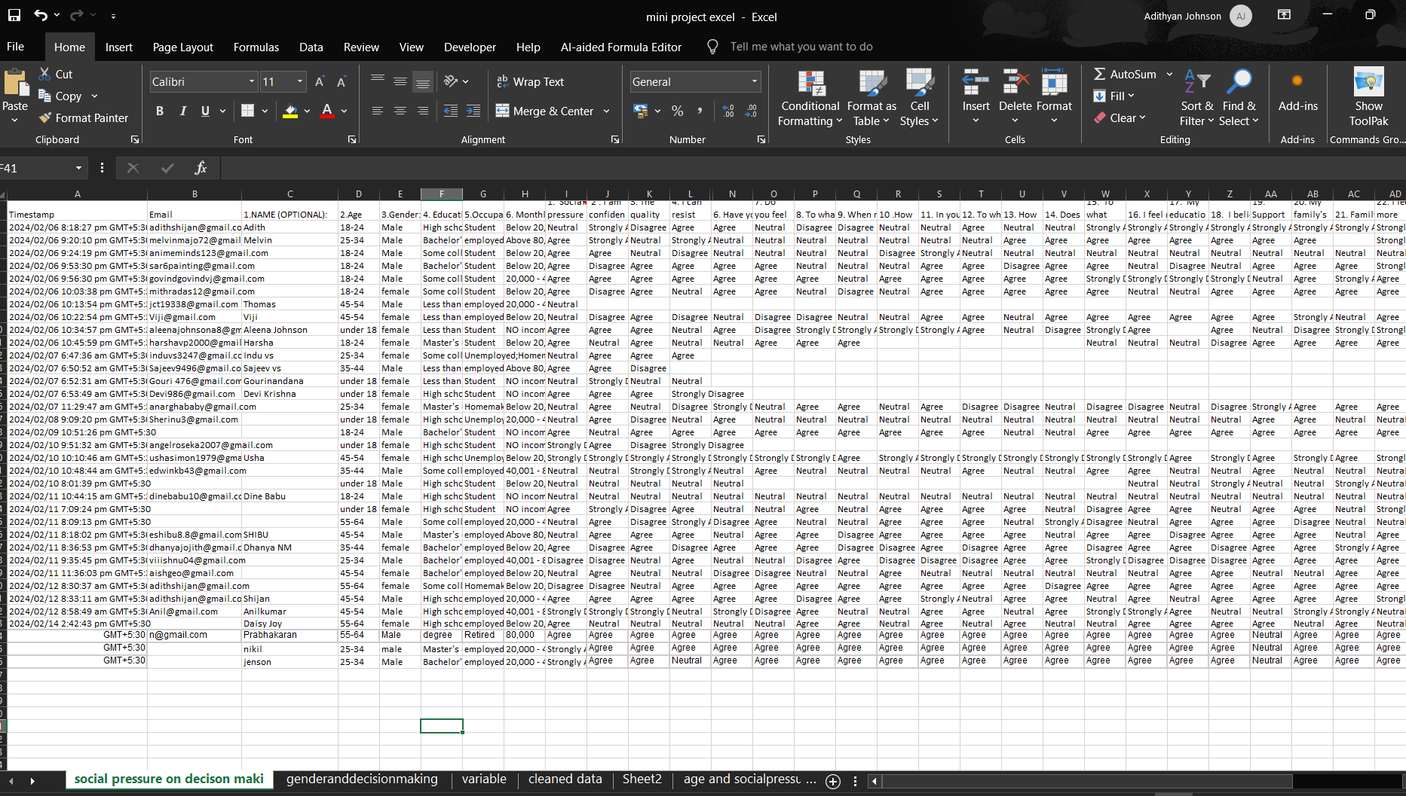

Slide 24
Analysis and Data Visualization
23

Slide 25
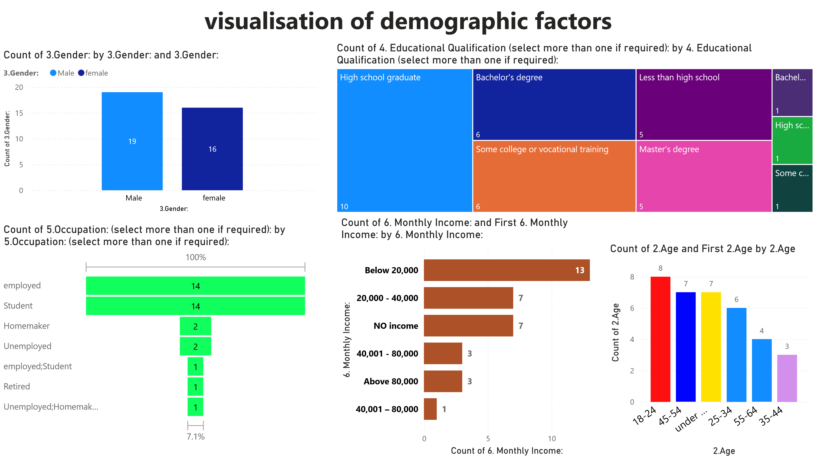
24
Here we can see the visualization of various demographic factors including age,income,education qualification ,gender,occupation etc here we can see their count used for the analysis this is for understanding our survey

Slide 26
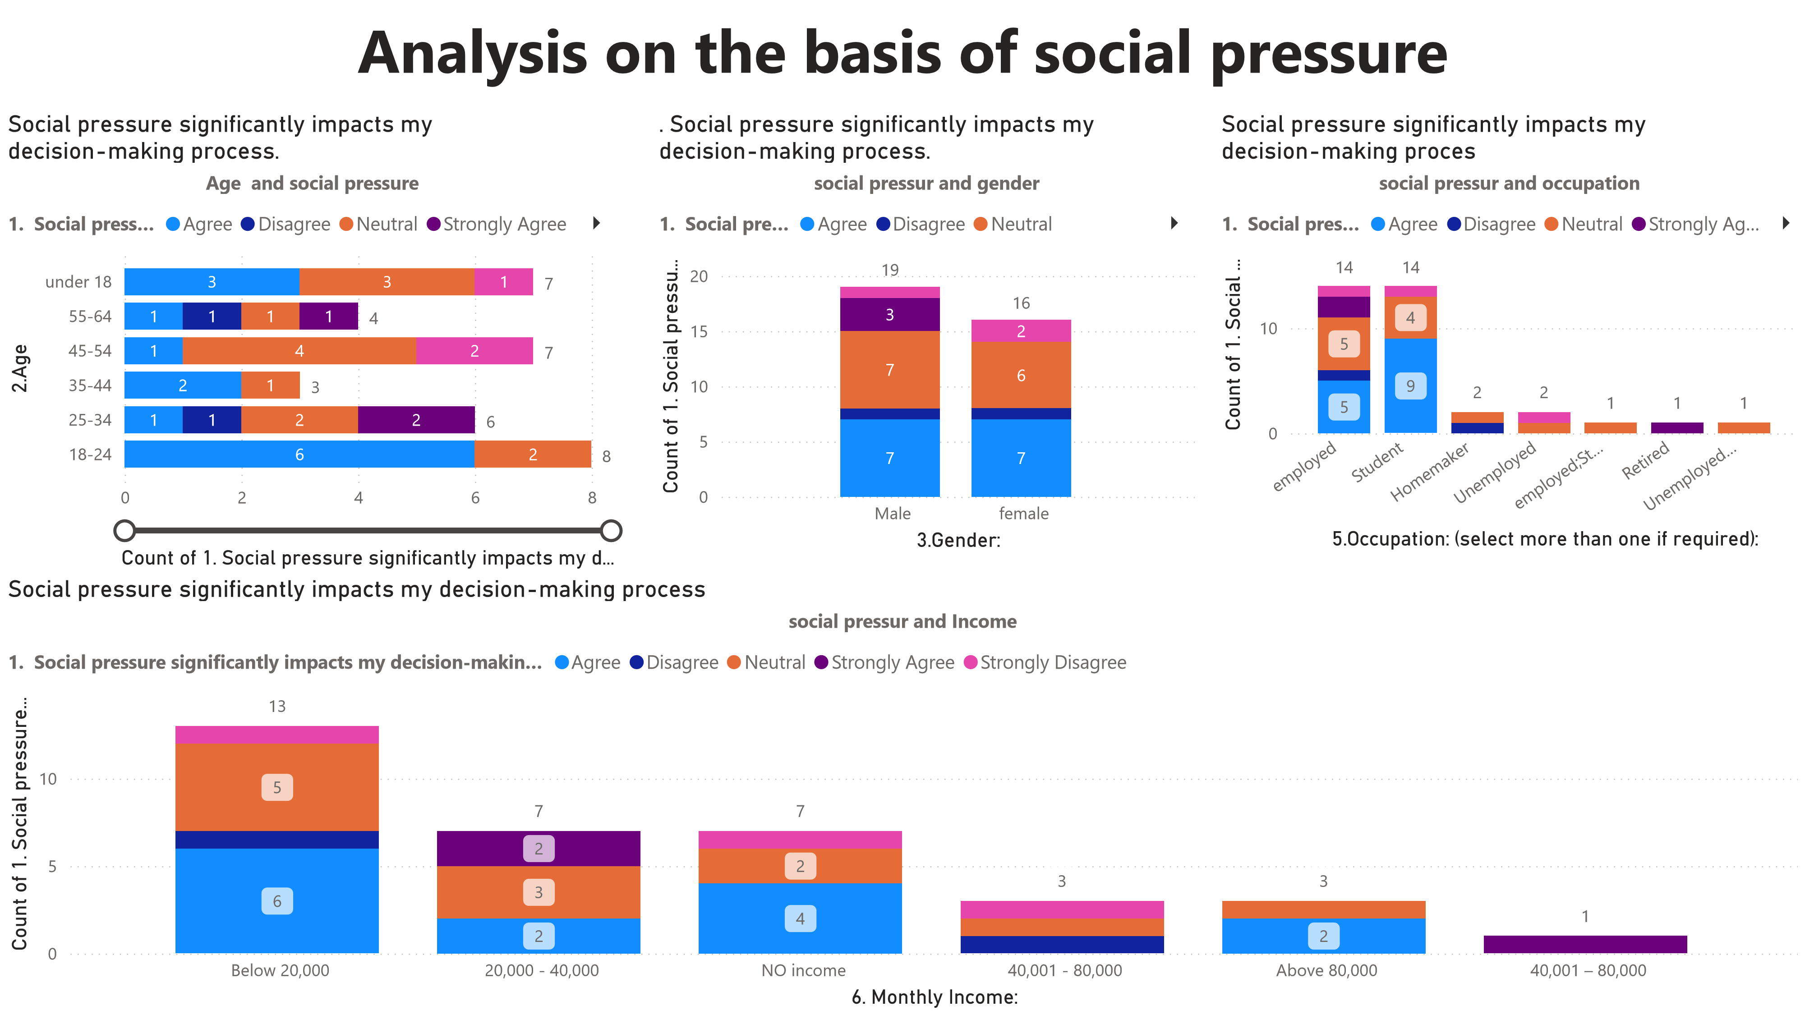

Slide 27
24
Social pressure impacts decision-making differently across various demographic factors. Younger individuals (under 18 and 18-24) and students tend to agree more that social pressure impacts their decision-making.
Gender differences are minimal, with both males and females showing similar patterns of agreement and disagreement.
Occupation shows more variation, with students and homemakers feeling more impacted by social pressure compared to employed and retired individuals. Income levels also show differences, with those earning below 20,000 and those with no income feeling more impacted by social pressure compared to higher income groups.
This analysis highlights the nuanced ways in which social pressure can shape our decisions, depending on our demographic background.

Slide 28
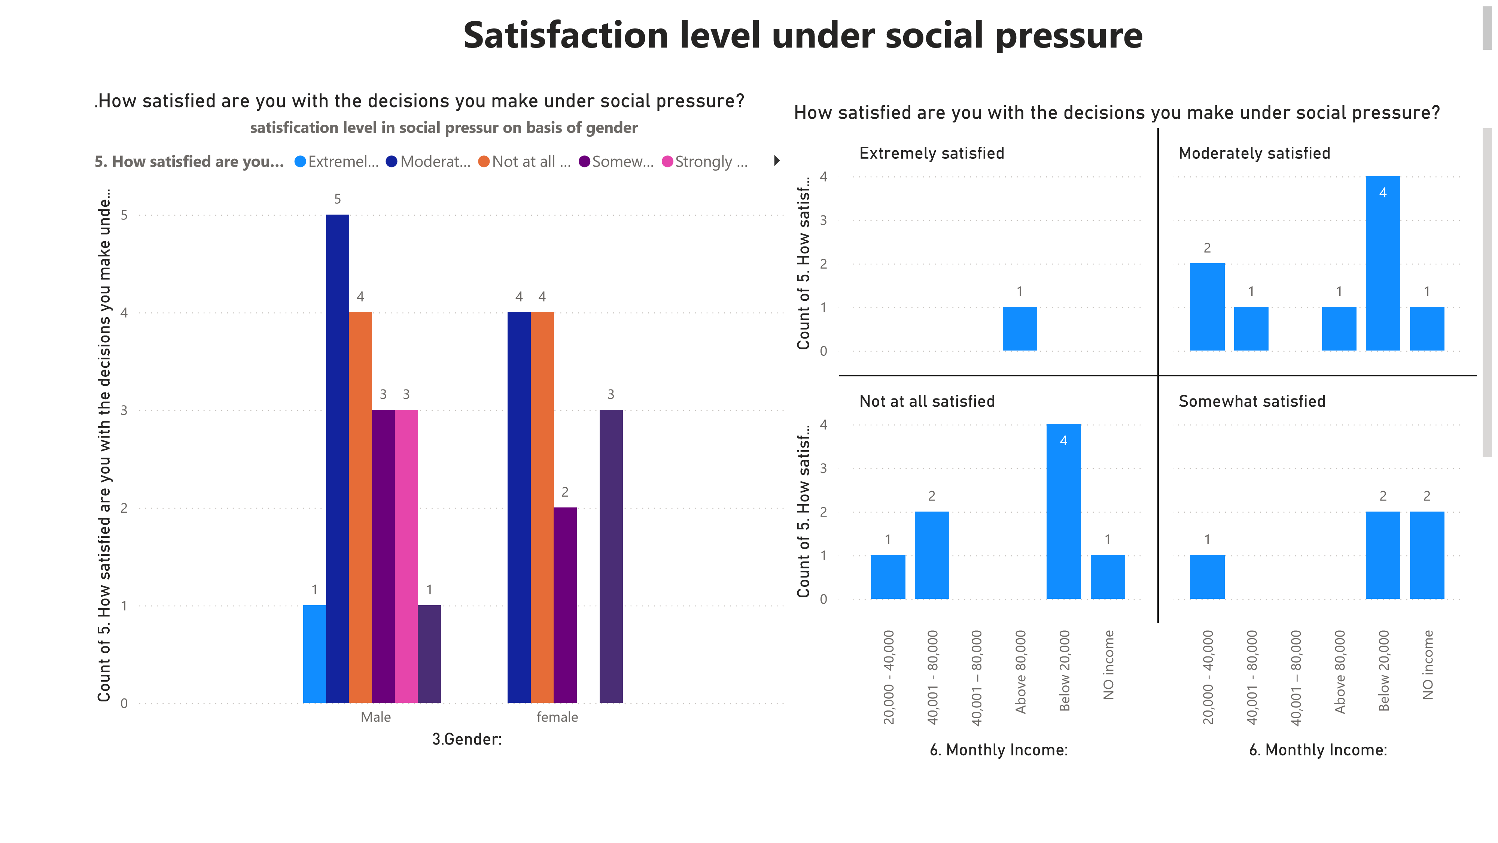
Both males and females generally report high satisfaction with their decisions under social pressure, with the majority indicating either extreme or moderate satisfaction. So there is no such relation between social pressure and gender
But coming to income only 1 person is extremely satisfied he is person above income of 80000 so income and social pressur are related

Slide 29
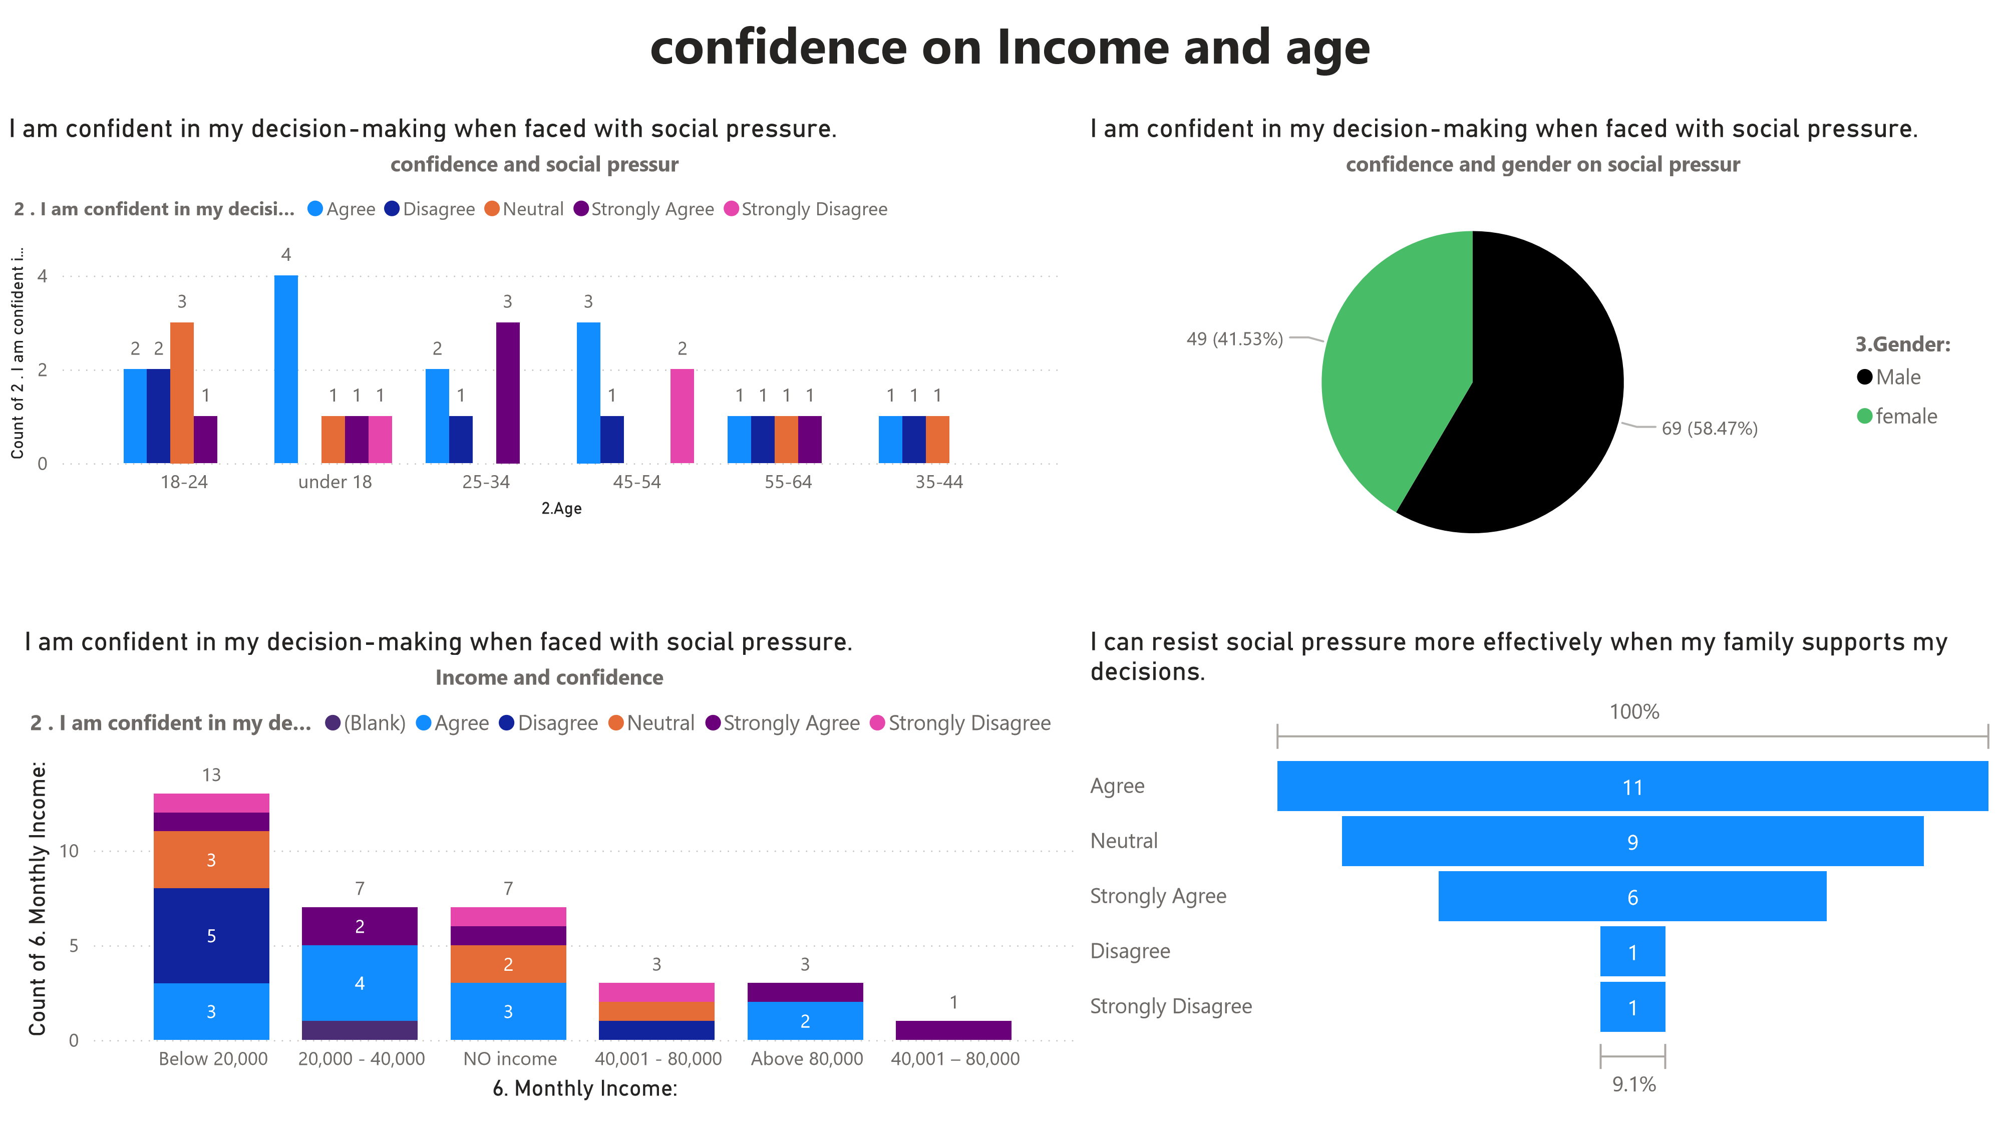

Slide 30
25
In every age group we can see more count agree to confidence in social pressur for decision making so our hypothesis was wrong confidence is not a factor that influence our decision making
In gender we can see male gender is 10% more confident in decision making in social pressur
Family support is a big factor in decision making more people agree to this
When it comes to income below 20000 earning people are more confident in social pressur so as income increases our pressur to take a decision also increases

Slide 31
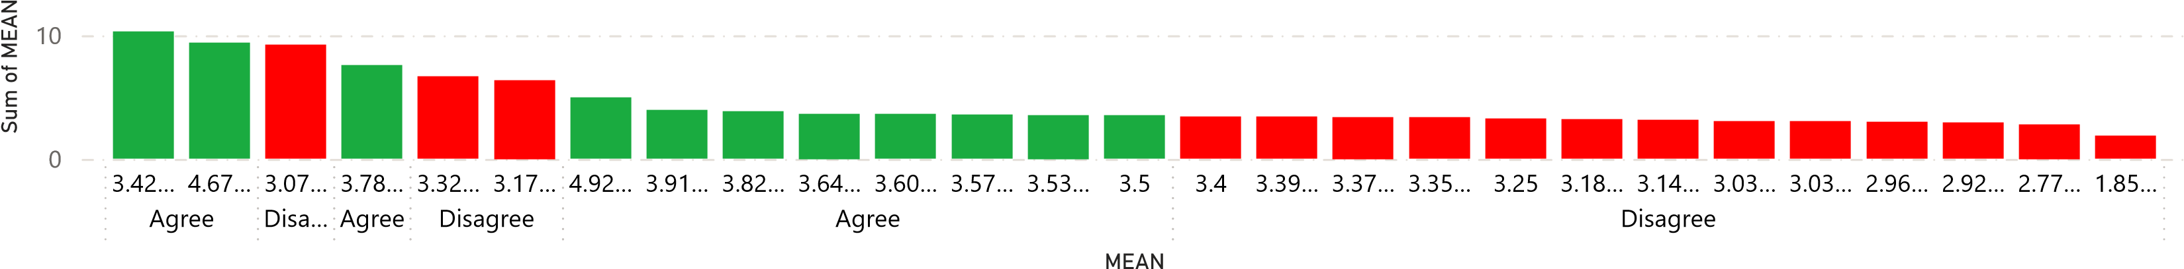
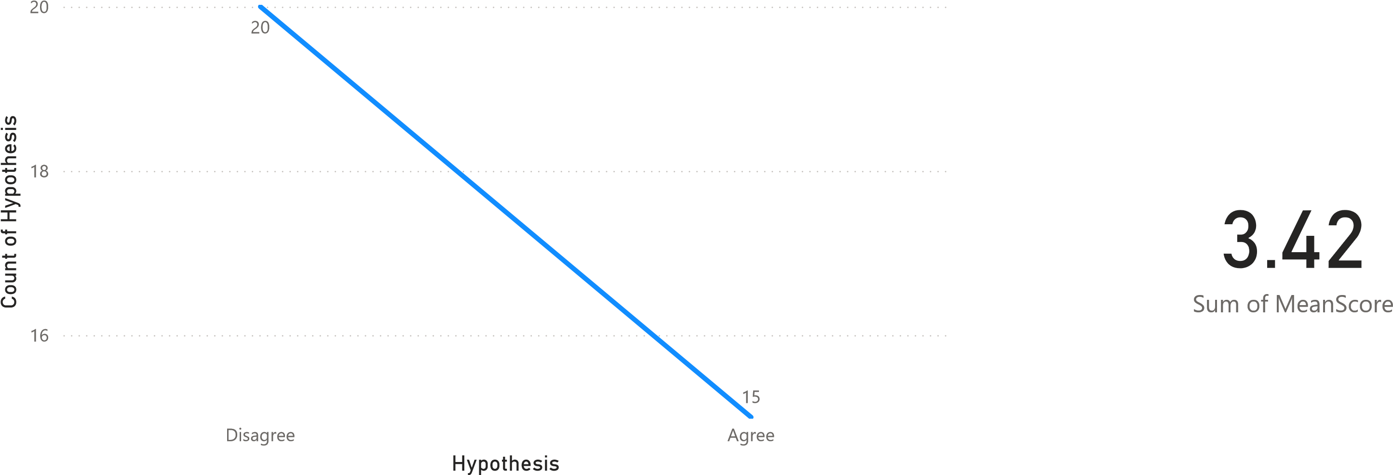
Analysis of hypothesis

Slide 32
Conclusion
30
The study reveals the role of social pressure in decision-making processes across diverse demographic groups. In conclution of our analysis social pressur influence our decision making more people disagree to our hypothsis that social pressur influence their decision making when compare with mean so we accept our alternative hypothesis but taking individual factors our assumptions become true in case of family ,family support influence our decision making,income also affect our decision making as income increases our decisions get affected by social pressur,there is no relation between gender and social pressur,when comes to age group the social pressur is more in age group of (18-24),in occupation the social pressur is more for students and employess

Slide 33
Thank you
31

