Slide 1
Wednesday, October 5, 2016
CS 106B
Lecture 5: Stacks and Queues
Programming Abstractions
Fall 2016
Stanford University
Computer Science Department
Lecturer: Chris Gregg
reading:
Programming Abstractions in C++, Chapter 5.2-5.3

Slide 2
Today's Topics
Logistics:
Sections start today!
Fauxtoshop due Friday, Noon
Chris G's office hours moved on this Thursday: 3-4pm instead of 4:00-5:00pm
(next week they will be during the regular time)
Vector Review
Memory layout
Efficiency of element manipulation
Stacks
Queues

Slide 3
Vector ("dynamic array") Review
So far, we have learned about the Vector, but let's look into the details of a Vector, in preparation for some other "Abstract Data Types" that we will talk about next.
Under the covers, a Vector is what we call a "dynamic array," which means that it is an array that can grow and shrink as necessary.
But, arrays are simply chunks of memory where one value follows directly after the other. Each "box" in an array is simply a memory address that can hold a single value.
Address 0 | Address 1 | Address 2 | Address 3
value 0 | value 1 | value 2 | value 3
As Chris P. discussed on Monday:
When we .add() a value to the array, the array grows by one, and the new value gets put on the right end.
When we .insert() a value inside the array, all elements to the right are shifted (this takes time!)
When we .remove() a value somewhere in the array, all the values to the right of that value must be moved, and that, too, takes time.

Slide 4
Vector ("dynamic array") Review
Pop quiz: what gives better speed, inserting and removing at the beginning or at the end of a Vector?
Answer: At the end (no moving of elements necessary)
Pop quiz: If a Vector has n elements, and we are going to insert somewhere into the Vector, what is the maximum number of elements that must be moved?
Answer: n
Pop quiz: If a Vector has n elements, and we are going to insert somewhere into the Vector, what is the minimum number of elements that must be moved?
Answer: 0

Slide 5

Vector: Actually an Abstract Data Type
So we just talked about how a Vector is implemented under the covers. And that may be important to the user -- the user should know about the speed of the operations so that he or she can make good choices about using the Vector.
But -- is it necessary to implement a Vector with an array? We are going to switch gears a bit and talk about Abstract Data Types (ADT), and the Vector actually counts as an ADT.
An abstract data type is a model that describes how data is manipulated from the point of view of the user. In other words, the user should get a set of functions and behaviors that are identical regardless of how the model is implemented.

Slide 6

Vector: Does the user care how it is implemented?
Consider the following program that uses a Vector:
From the perspective of the user, the Vector class needs to have certain behaviors, but the user isn't really concerned with how those behaviors are implemented under the covers.
This is the idea behind an ADT -- the Vector needs to have add(), insert(), and remove() functions, but the fact that it is an array under the covers is not relevant if you just want certain behaviors.
So...
int main() {
Vector<string> states;
// manually add in alphabetic order
states.add("California");
states.insert(0,"Alaska");
states.add("Texas");
states.insert(3,"Utah");
states.insert(2,"Nebraska");
cout << "Originals: "
<< states.toString() << endl; // for testing
// revolution happens
states.remove(3); // Texas
cout << "After removing Texas: "
<< states.toString() << endl;
return 0;
}

Slide 7

Vector: Implemented with Moon Monkeys®
We could imagine implementing the Stanford Library Vector using Moon Monkeys®, who keep all of our data on the Moon, and simply pass back the results of our functions as we need them.
Vector<string> states;
states.add("California");
For these statements, we call up the Moon Monkeys, and say "we want a Vector that holds strings," and then we radio up to them, 'Please add "California" to the Vector.'
Is this efficient? No. Does it meet the requirements of our Vector ADT? Yes.
That is the principle idea behind ADTs: the functional behavior is what matters, not the implementation.

Slide 8
A “stack” is another example of an abstract data type. A stack has the following behaviors / functions:
push(value) (or add(value)) - place an entity onto the top of the stack
pop() (or remove()) - remove an entity from the top of the stack and return it
top() (or peek()) - look at the entity at the top of the stack, but don’t remove it
isEmpty() - a boolean value, true if the stack is empty, false if it has at least one element. (note: a runtime error occurs if a pop() or top() operation is attempted on an empty stack.)
Why do we call it a "stack?" Because we model it using a stack of things:
Stacks
Push
4
2
5
7
3
Pop
Top

Slide 9
The push, pop, and top operations are the only operations allowed by the stack ADT, and as such, only the top element is accessible. Therefore, a stack is a “Last-In-First-Out” (LIFO) structure: the last item in is the first one out of a stack.
Stacks
Push
4
2
5
7
3
Pop
Top

Slide 10

Despite the stack’s limitations (and indeed, because of them), the stack is a very frequently used ADT. In fact, most computer architectures implement a stack at the very core of their instruction sets — both push and pop are assembly code instructions.
Stack operations are so useful that there is a stack built in to every program running on your PC — the stack is a memory block that gets used to store the state of memory when a function is called, and to restore it when a function returns.
Stacks
Why are stacks used to when functions are called?
Let’s say we had a program like this:
What happens to the state of the system as this program runs?
main() {
function1();
return;
}
function1() {
function2();
return;
}
function2() {
function3();
return;
}

Slide 11
Stacks
main() {
function1();
return;
}
function1() {
function2();
return;
}
function2() {
function3();
return;
}
main calls function1, which calls function2, which calls function3.
Then, function3 returns, then function2 returns, then function1 returns, then main returns.
This is a LIFO pattern!
main
function1
main
function2
function1
main
function3
function2
function1
main
function2
function1
main
function1
main
main

Slide 12
What are some downsides to using a stack?
Stacks
No random access. You get the top, or nothing.
No walking through the stack at all — you can only reach an element by popping all the elements higher up off first
No searching through a stack.
What are some benefits to using a stack?
Useful for lots of problems -- many real-world problems can be solved with a Last-In-First-Out model (we'll see one in a minute)
Very easy to build one from an array such that access is guaranteed to be fast.
Where would you have the top of the stack if you built one using a Vector? Why would that be fast?

Slide 13
The following is a simple example of a program that uses a Stack. It simply creates a stack, pushes words onto the stack, then pops off the words and prints them.
Simple Stack Example
// Simple Stack Example
#include <iostream>
#include "console.h"
#include "stack.h"
using namespace std;
const char SPACE = ' ';
int main() {
string sentence = "hope is what defines humanity";
string word;
Stack<string> wordStack;
cout << "Original sentence: " << sentence << endl;
for (char c : sentence) {
if (c == SPACE and word != "") {
wordStack.push(word);
word = ""; // reset
}
else {
word += c;
}
}
if (word != "") {
wordStack.push(word);
}
cout << " New sentence: ";
while (!wordStack.isEmpty()) {
string word = wordStack.pop();
cout << word << SPACE;
}
cout << endl;
return 0;
}
Output:
Original sentence: hope is what defines humanity
New sentence: humanity defines what is hope

Slide 14
When you were first learning algebraic expressions, your teacher probably gave you a problem like this, and said, "What is the result?"
More Advanced Stack Example
5 * 4 - 8 / 2 + 9
The class got all sorts of different answers, because no one knew the order of operations yet (the correct answer is 25, by the way). Parenthesis become necessary as well (e.g., 10 / (8-3)).
This is a somewhat annoying problem — it would be nice if there were a better way to do arithmetic so we didn't have to worry about order of operations and parenthesis.
As it turns out, there is a "better" way! We can use a system of arithmetic called "postfix" notation — the expression above would become the following:
5 4 * 8 2 / - 9 +
Wat?

Slide 15
Postfix notation* works like this: Operands (the numbers) come first, followed by an operator (+, -, *, /, etc.). When an operator is read in, it uses the previous operands to perform the calculation, depending on how many are needed (most of the time it is two).
So, to multiply 5 and 4 in postfix, the postfix is 5 4 * To divide 8 by 2, it is 8 2 /
There is a simple and clever method using a stack to perform arithmetic on a postfix expression: (talk to your neighbor about how you might do this!)
Postfix Example
5 4 * 8 2 / - 9 +
Read the input and push numbers onto a stack until you reach an operator.
When you see an operator, apply the operator to the two numbers that are popped from the stack.
Push the resulting value back onto the stack.
When the input is complete, the value left on the stack is the result.
*Postfix notation is also called "Reverse Polish Notation" (RPN) because in the 1920s a Polish logician named Jan Łukasiewicz invented "prefix" notation, and postfix is the opposite of postfix, and therefore so-called "Reverse Polish Notation"

Slide 16
// Postfix arithmetic, implementing +, -, *, /
#include <iostream>
#include "console.h"
#include "simpio.h"
#include "stack.h"
using namespace std;
const string OPERATORS = "+-*x/";
const string SEPARATOR = " ";
// function prototypes
double parsePostfix(string expression);
string getNextToken(string &expression);
void performCalculation(Stack<double> &s, char op);
Postfix Example Code
Top of program:

Slide 17
// Postfix arithmetic, implementing +, -, *, /
#include <iostream>
#include "console.h"
#include "simpio.h"
#include "stack.h"
using namespace std;
const string OPERATORS = "+-*x/";
const string SEPARATOR = " ";
// function prototypes
double parsePostfix(string expression);
string getNextToken(string &expression);
void performCalculation(Stack<double> &s, char op);
Postfix Example Code
Top of program:
Uses a stack
Allows * or x for multiplication
Three functions

Slide 18
int main() {
string expression;
double answer;
do {
expression = getLine("Please enter a postfix expression (blank to quit): ");
answer = parsePostfix(expression);
cout << "The answer is: " << answer << endl << endl;
} while (expression != "");
return 0;
}
Postfix Example Code
main():

Slide 19
int main() {
string expression;
double answer;
do {
expression = getLine("Please enter a postfix expression (blank to quit): ");
answer = parsePostfix(expression);
cout << "The answer is: " << answer << endl << endl;
} while (expression != "");
return 0;
}
Postfix Example Code
main():
do / while to continue until user quits

Slide 20
string getNextToken(string &expression) {
// pull out the substring up to the first space
// and return the token, removing it from the expression
string token;
int sepLoc = expression.find(SEPARATOR);
if (sepLoc != (int) string::npos) {
token = expression.substr(0,sepLoc);
expression = expression.substr(sepLoc+1,expression.size()-sepLoc);
return token;
}
else {
token = expression;
expression = "";
return token;
}
}
Postfix Example Code
getNextToken():

Slide 21
string getNextToken(string &expression) {
// pull out the substring up to the first space
// and return the token, removing it from the expression
string token;
int sepLoc = expression.find(SEPARATOR);
if (sepLoc != (int) string::npos) {
token = expression.substr(0,sepLoc);
expression = expression.substr(sepLoc+1,expression.size()-sepLoc);
return token;
}
else {
token = expression;
expression = "";
return token;
}
}
Postfix Example Code
getNextToken():
string functions!

Slide 22
double parsePostfix(string expression) {
Stack<double> s;
string nextToken;
while (expression != "") {
// gets the next token and removes it from expression
nextToken = getNextToken(expression);
if (OPERATORS.find(nextToken) == string::npos) {
// we have a number
double operand = stringToDouble(nextToken);
s.push(operand);
}
else {
// we have an operator
char op = stringToChar(nextToken);
performCalculation(s,op);
}
}
return s.pop();
}
Postfix Example Code
parsePostfix():

Slide 23
double parsePostfix(string expression) {
Stack<double> s;
string nextToken;
while (expression != "") {
// gets the next token and removes it from expression
nextToken = getNextToken(expression);
if (OPERATORS.find(nextToken) == string::npos) {
// we have a number
double operand = stringToDouble(nextToken);
s.push(operand);
}
else {
// we have an operator
char op = stringToChar(nextToken);
performCalculation(s,op);
}
}
return s.pop();
}
Postfix Example Code
parsePostfix():
push when you get a number
calculate when you get an operator

Slide 24
void performCalculation(Stack<double> &s, char op) {
double result;
double operand2 = s.pop(); // LIFO!
double operand1 = s.pop();
switch(op) {
case '+': result = operand1 + operand2;
break;
case '-': result = operand1 - operand2;
break;
// allow "*" or "x" for times
case '*':
case 'x': result = operand1 * operand2;
break;
case '/': result = operand1 / operand2;
break;
}
s.push(result);
}
Postfix Example Code
performCalculation():

Slide 25
void performCalculation(Stack<double> &s, char op) {
double result;
double operand2 = s.pop(); // LIFO!
double operand1 = s.pop();
switch(op) {
case '+': result = operand1 + operand2;
break;
case '-': result = operand1 - operand2;
break;
// allow "*" or "x" for times
case '*':
case 'x': result = operand1 * operand2;
break;
case '/': result = operand1 / operand2;
break;
}
s.push(result);
}
Postfix Example Code
performCalculation():
remember LIFO behavior (subtraction and division are not commutative)
the result simply gets pushed back on the stack

Slide 26
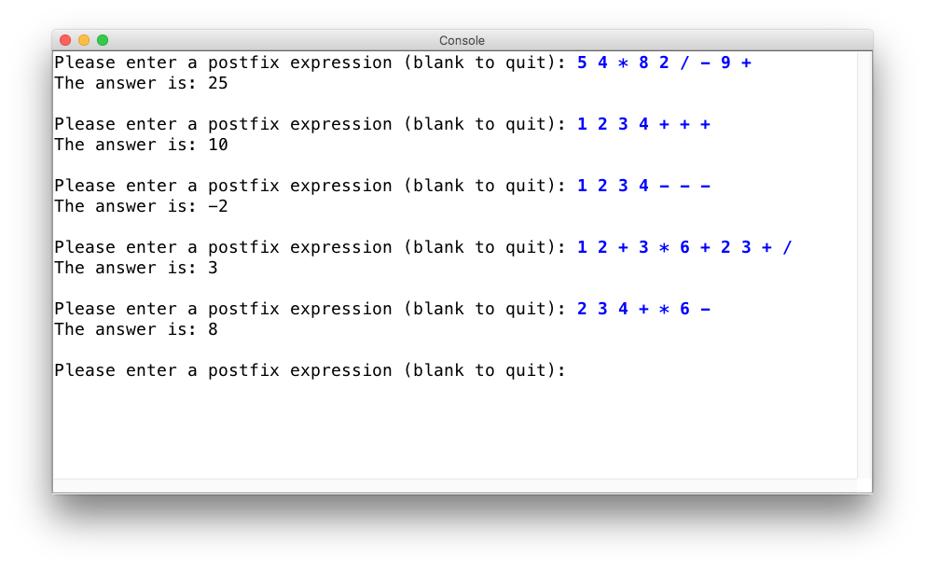
Postfix Example Output

Slide 27
World's First Programmable Desktop Computer
The HP 9100A Desktop Calculator: the world’s first programmable scientific desktop computer — really, the first desktop computer
(Wired, Dec. 2000)
RPN (postfix)
Special algorithm for trigonometric and logarithmic functions
Cost $5000 in 1968 ($35,000 today)

Slide 28
Next...

Slide 29
Queues
The next ADT we are going to talk about is a "queue." A queue is similar to a stack, except that (much like a real queue/line), it follows a "First-In-First-Out" (FIFO) model:
The first person in line
is the first person served
The last person in line
is the last person served
Insertion into a queue "enqueue()" is done at the back of the queue, and removal from a queue "dequeue()" is done at the front of the queue.

Slide 30
Like the stack, the queue Abstract Data Type can be implemented in many ways (we will talk about some later!). A queue must implement at least the following functions:
enqueue(value) (or add(value)) - place an entity onto the back of the queue
dequeue() (or remove()) - remove an entity from the front of the queue
front() (or peek()) - look at the entity at the front of the queue, but don’t remove it
isEmpty() - a boolean value, true if the queue is empty, false if it has at least one element. (note: a runtime error occurs if a dequeue() or front() operation is attempted on an empty queue.)
Please look at the Stanford Library Queue reference for other functions (e.g., there is a back() function that is analogous to front() for the back of the queue -- but no removing the value!)
Queues
Queue<int> q; // {}, empty queue
q.enqueue(42); // {42}
q.enqueue(-3); // {42, -3}
q.enqueue(17); // {42, -3, 17}
cout << q.dequeue() << endl; // 42 (q is {-3, 17})
cout << q.front() << endl; // -3 (q is {-3, 17})
cout << q.dequeue() << endl; // -3 (q is {17})

Slide 31
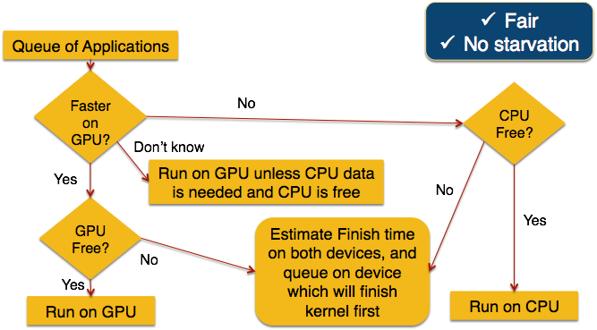
There are many real world problems that are modeled well with a queue:
Jobs submitted to a printer go into a queue (although they can be deleted, so it breaks the model a bit)
Ticket counters, supermarkets, etc.
File server - files are doled out on a first-come-first served basis
Call centers (“your call will be handled by the next available agent”)
The LaIR is a queue!
Chris G’s research! Scheduling work between a CPU and a GPU is queue based.
Queue Examples
The Scheduling Algorithm
Applications are moved from a main queue into a device sub-queue based on a set of rules (assuming one CPU and one GPU):
Actual slide from Chris’s
Dissertation Defense

Slide 32

Both the Stanford Stack and Queue classes have a size() function that returns the number of elements in the object.
What is the output of the following code?
Queue<int> queue;
// produce: {1, 2, 3, 4, 5, 6}
for (int i = 1; i <= 6; i++) {
queue.enqueue(i);
}
for (int i = 0; i < queue.size(); i++) {
cout << queue.dequeue() << " ";
}
cout << queue.toString() << " size " << queue.size() << endl;
Queue Mystery
A. 1 2 3 4 5 6 {} size 0
B. 1 2 3 {4,5,6} size 3
C. 1 2 3 4 5 6 {1,2,3,4,5,6} size 6
D. none of the above

Slide 33
Both the Stanford Stack and Queue classes have a size() function that returns the number of elements in the object. But, you must be careful using it!
What is the output of the following code?
Queue<int> queue;
// produce: {1, 2, 3, 4, 5, 6}
for (int i = 1; i <= 6; i++) {
queue.enqueue(i);
}
for (int i = 0; i < queue.size(); i++) {
cout << queue.dequeue() << " ";
}
cout << queue.toString() << " size " << queue.size() << endl;
Queue Mystery
Changes during the loop! Be careful!!
A. 1 2 3 4 5 6 {} size 0
B. 1 2 3 {4,5,6} size 3
C. 1 2 3 4 5 6 {1,2,3,4,5,6} size 6
D. none of the above

Slide 34
If you are going to empty a stack or queue, a very good programming idiom is the following:
Queue<int> queue;
// produce: {1, 2, 3, 4, 5, 6}
for (int i = 1; i <= 6; i++) {
queue.enqueue(i);
}
while (!queue.isEmpty()) {
cout << queue.dequeue() << " ";
}
cout << queue.toString() << " size " << queue.size() << endl;
Queue Idiom 1
A. 1 2 3 4 5 6 {} size 0
B. 1 2 3 {4,5,6} size 3
C. 1 2 3 4 5 6 {1,2,3,4,5,6} size 6
D. none of the above

Slide 35

If you are going to go through a stack or queue once for the original values, a very good programming idiom is the following:
int origQSize = queue.size();
for (int i=0; i < origQSize; i++) {
int value = queue.dequeue();
cout << value << " ";
// re-enqueue even values
if (value % 2 == 0) {
queue.enqueue(value);
}
}
Queue Idiom 2
Output:
1 2 3 4 5 6 {2, 4, 6} size 3

Slide 36
If you are going to go through a stack or queue once for the original values, a very good programming idiom is the following:
int origQSize = queue.size();
for (int i=0; i < origQSize; i++) {
int value = queue.dequeue();
cout << value << " ";
// re-enqueue even values
if (value % 2 == 0) {
queue.enqueue(value);
}
}
Queue Idiom 2
Fix value of origQSize at the beginning
Output:
1 2 3 4 5 6 {2, 4, 6} size 3

Slide 37
Recap
Vectors Review:
Stored as arrays under the covers -- you should be cognizant of the ramifications of inserting or removing from the middle of the Vector.
But, the Vector ADT does not require an array! We could have Moon Monkeys.
Abstract Data Types:
An ADT is a set of behaviors that the underlying code must produce, but how the underlying code is written does not affect the ADT behavior (but it might affect the speed!)
Stacks:
Stacks are Last-In-First-Out (LIFO) and will have push(value), pop(), top(), and isEmpty().
Queues:
Queues are First-In-First-Out (FIFO) and will have enqueue(value), dequeue(), front(), and isEmpty().

Slide 38
References and Advanced Reading
References:
Stanford Stack reference: http://stanford.edu/~stepp/cppdoc/Stack-class.html
Stanford Queue reference: stanford.edu/~stepp/cppdoc/Queue-class.html
Advanced Reading:
Hewlett-Packard 9100A: http://en.wikipedia.org/wiki/Hewlett-Packard_9100A
Reverse Polish Notation: http://en.wikipedia.org/wiki/Reverse_Polish_notation
Standard stack library (not Stanford) reference: http://www.cplusplus.com/reference/stack/stack/
Standard queue library (not Stanford) reference: www.cplusplus.com/reference/queue/queue
Chris G's dissertation (you will be one of few people to actually read it!)
All about memory caching: http://www.hardwaresecrets.com/how-the-cache-memory-works/

Slide 39
Extra Slides

Slide 40

What is wrong with the following code?
Stack Example
1516
17
18
19
20
21
int main() {
for (int i=0; i < 10; i++) {
if (i % 2 == 0) {
cout << i << endl;
}
return 0;
}
In Qt Creator, this is what happens when you compile:
How does Qt Creator know that there are un-matched curly braces? A stack!

Slide 41
A Stack example algorithm: determine if a program has properly matched bracket symbols — parentheses, square brackets, and curly brackets: ( ) [ ] { }
Stacks Example: Properly matched brackets
Algorithm: Think about it for a few minutes -- talk to your neighbor!
Make an empty stack.
Start reading characters.
If the character is an opening symbol, push it onto the stack.
If it is a closing symbol, then if the stack is empty, report an error. Otherwise, pop the stack.
If the symbol popped is not the corresponding opening symbol, then report an error.
At the end of the input, if the stack is not empty, report an error.
See code from lecture for full program.

