Slide 1


Title: Simulation and LCA of amine scrubber for CO2 capture with heat pump and electrode boilers
Adithya Harisha Supervisor: Ankur Gaikwad

Slide 2
Contents
Goal of the thesis
Simulation and LCA
Results
Conclusion

Slide 3


Goal of the thesis
Simulate and evaluate 7 configurations for CO2 capture.
Conduct LCA, compare environmental impact with the goal of determining the most sustainable approach for amine-based CO2 capture.
Technology: Post combustion capture
Software
Aspen Plus v12.1
GaBi (8.7), EDU-Database
Excel

Slide 4
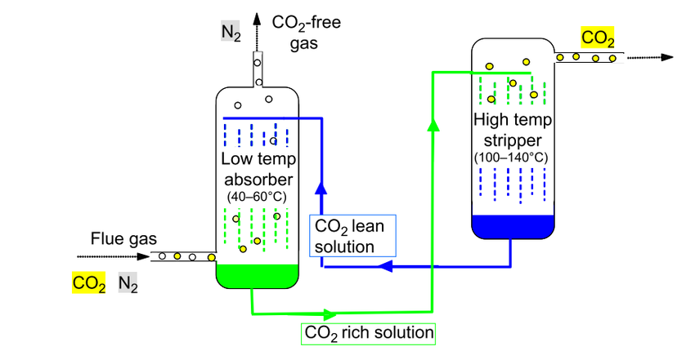
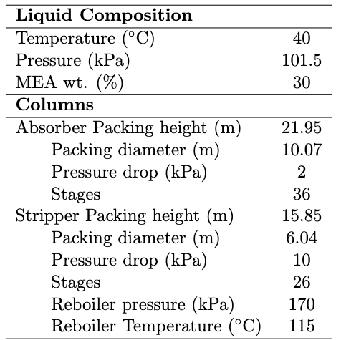
Simulation and LCA
Amine-based Post combustion capture (PCC) plant¹
Simulation data²

Slide 5
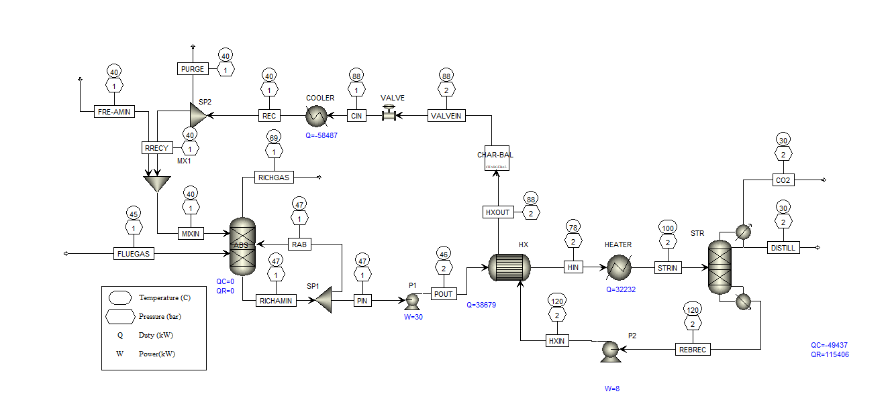
Configuration 1: Conventional

Slide 6
IC—Innovative configuration
NG-Natural gas

Slide 7
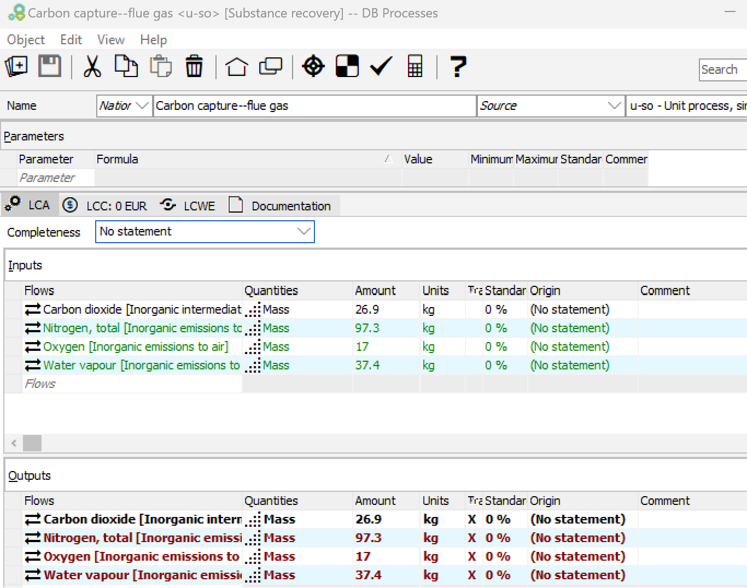
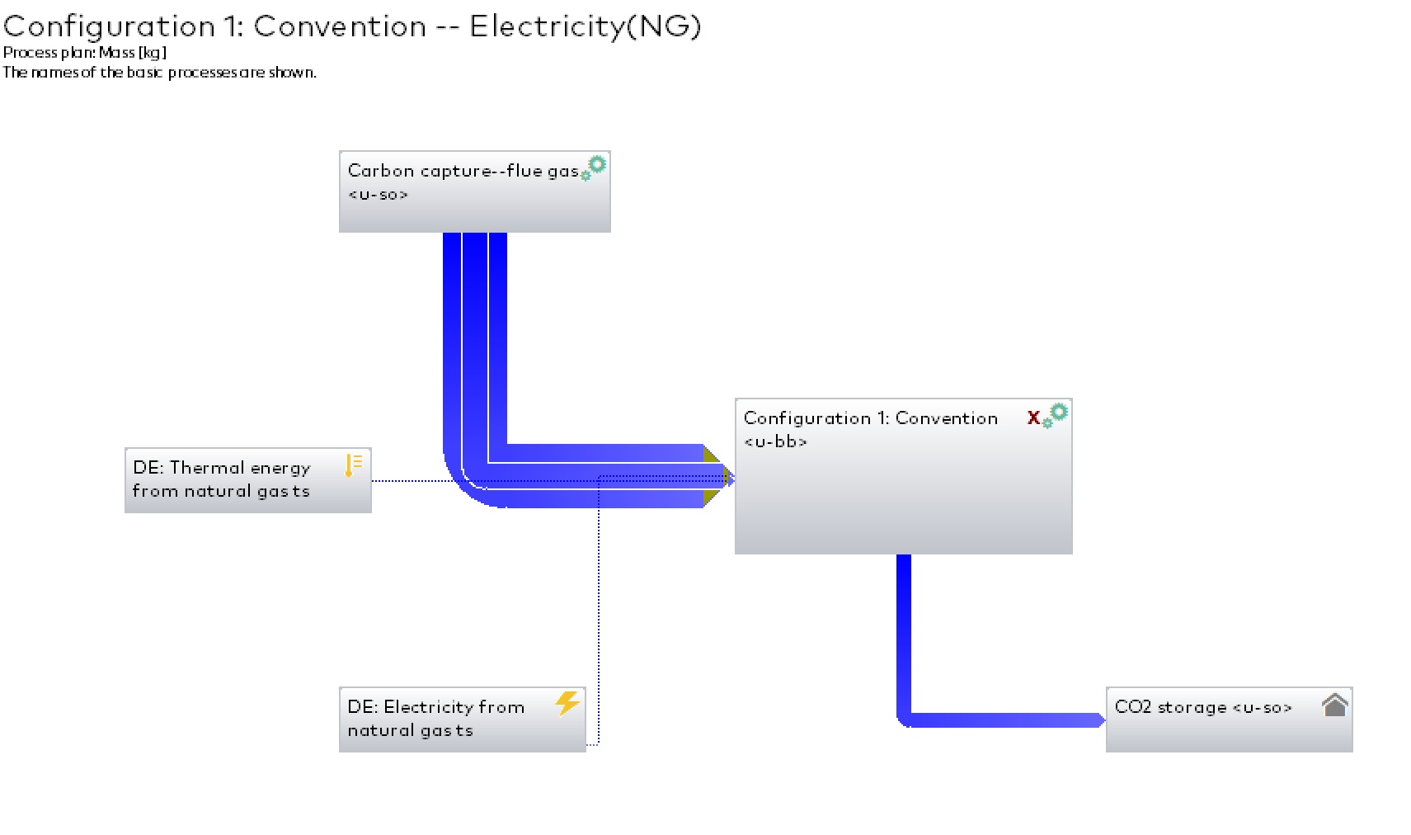
GaBi Plan
Flue gas composition

Slide 8
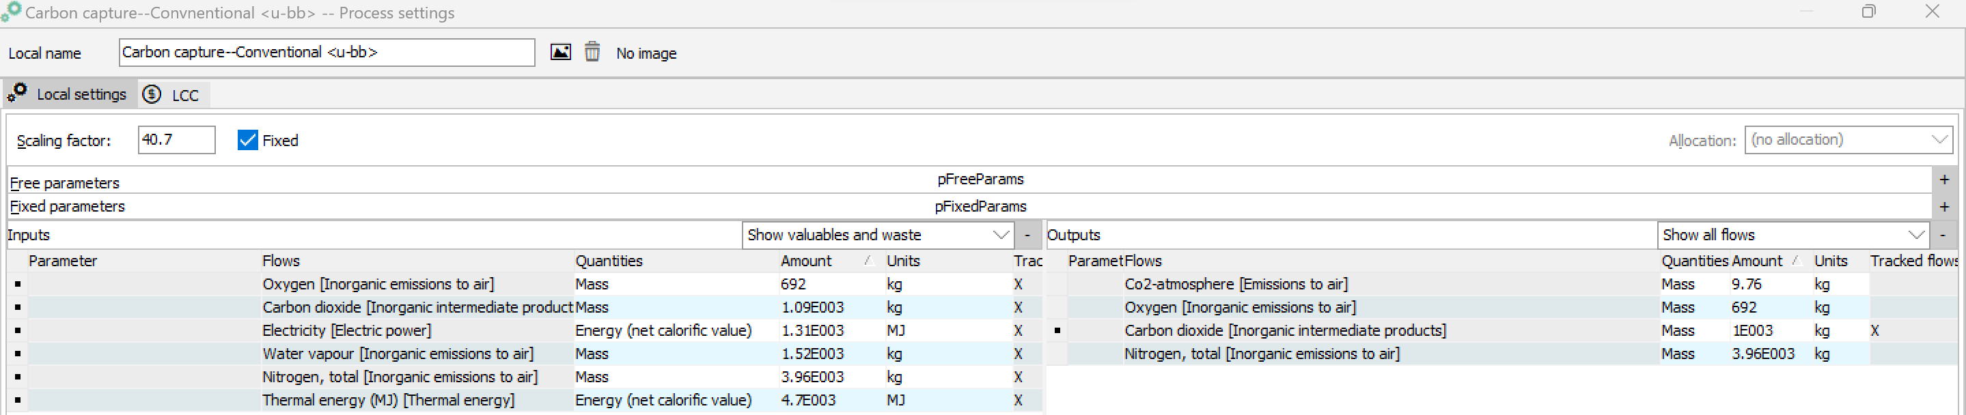
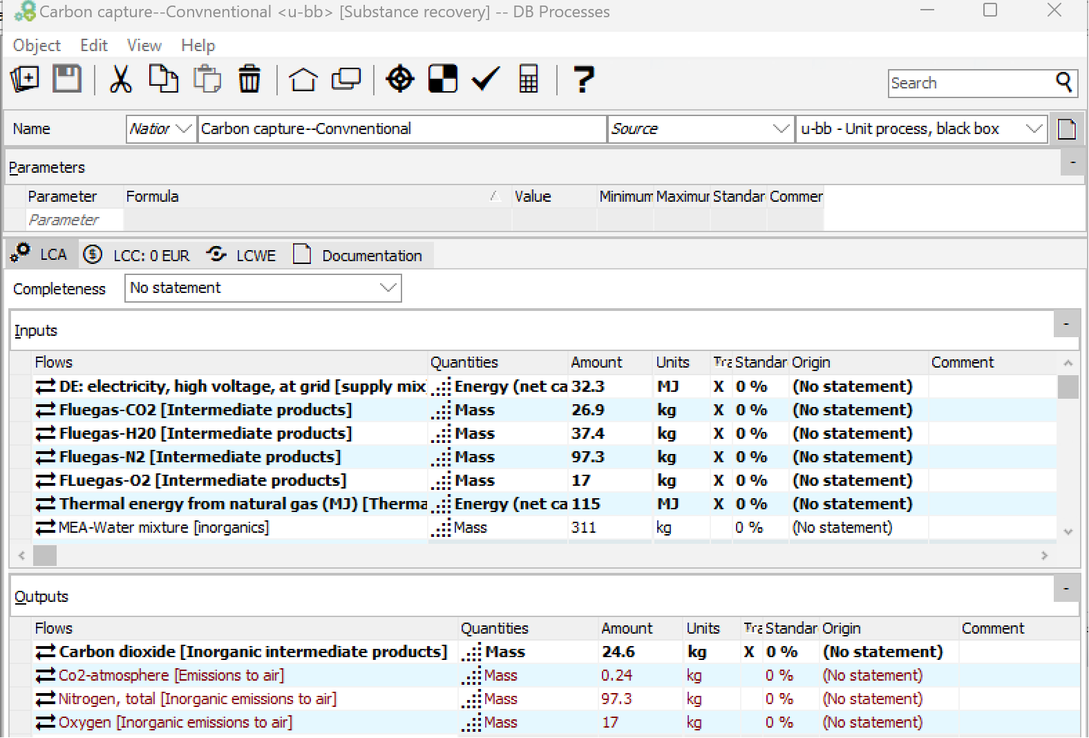
GaBi : Scaling
GaBi : Process inputs and outputs

Slide 9
Results
Comparison: Net CO2 equivalent footprint

Slide 10
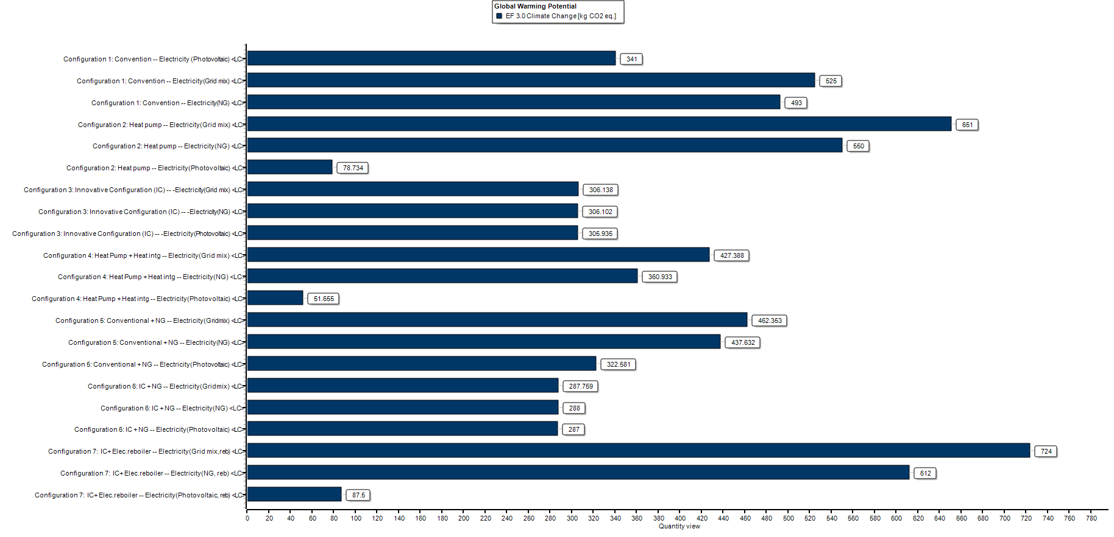
Comparison: kg CO2 equivalent footprint of the process

Slide 11
Comparison: Contribution analysis of climate change(Electrical and thermal share)

Slide 12
Comparison: Contribution analysis of Resource use (Electrical and thermal share)

Slide 13
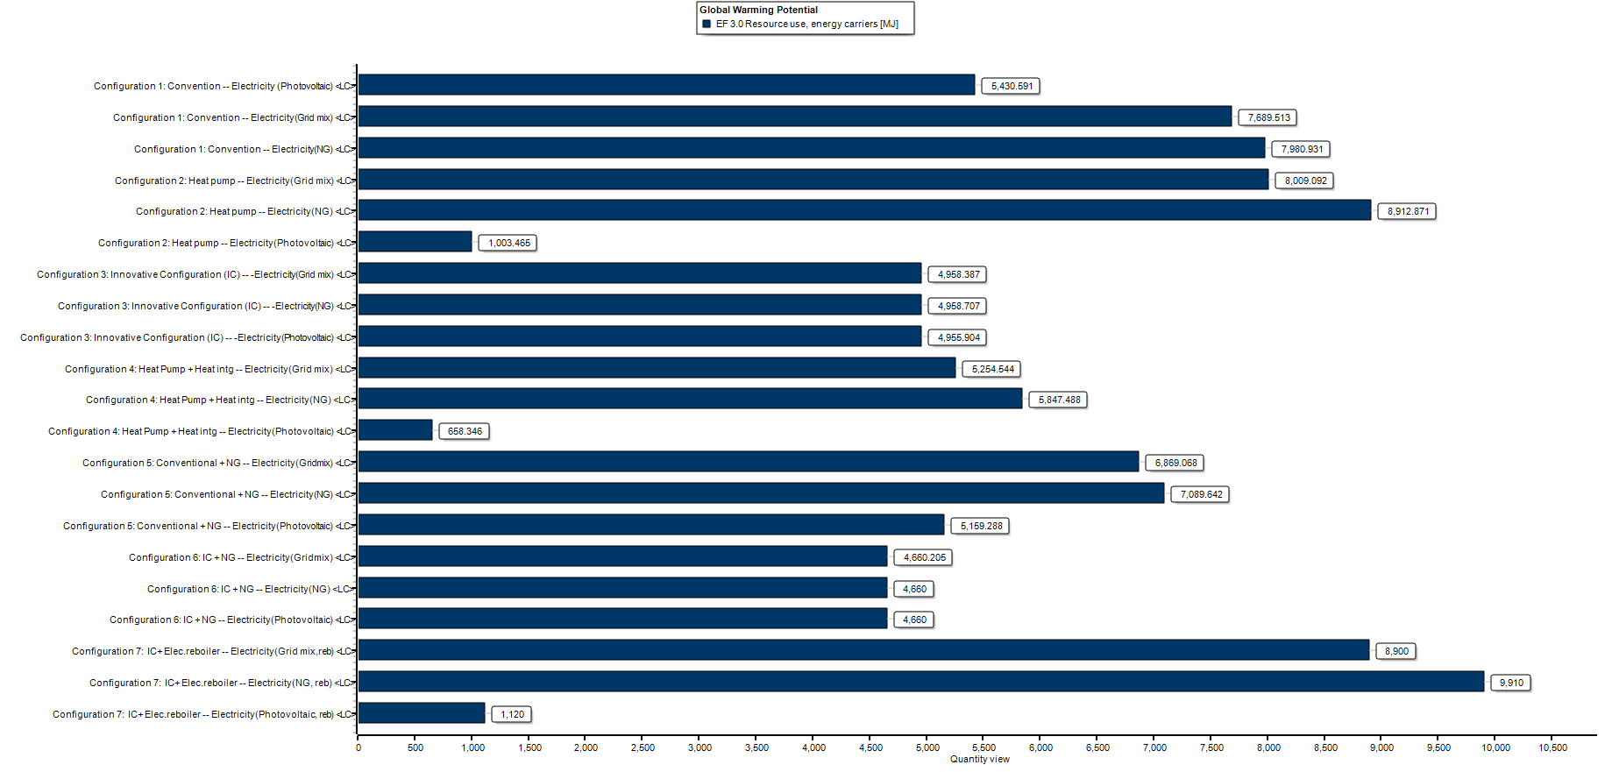
Comparison: Resource use

Slide 14

Summary
Configuration 2 (heat pump) and Configuration 7(electrode reboilers), shows more emissions compared to all other configurations because of carbon intensity in gridmix and natural gas.
Configurations 3-6 have less emissions compared to Configuration 1 because of heat integration or high share of thermal energy.
Configuration 2 shows less emissions compared to all other configurations when source of energy is from renewables.
Contribution analysis of climate change and resource use are interlinked.

Slide 15

Conclusion
Configuration 2 (heat pump) and Configuration 7 (electrode reboilers) are viable choices when the energy source comes from renewables.
Configuration 4, which includes a heat pump and heat integration, presents a feasible alternative that shows lower emissions when compared to other configurations.
Configuration 3 is also a wise choice when heat integration strategy is applied.

Slide 16

Thanks

Slide 17
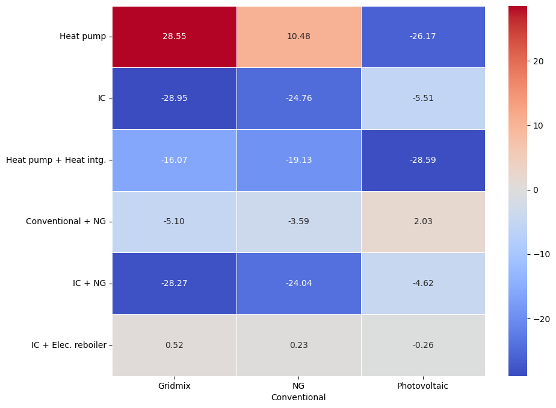

Slide 18
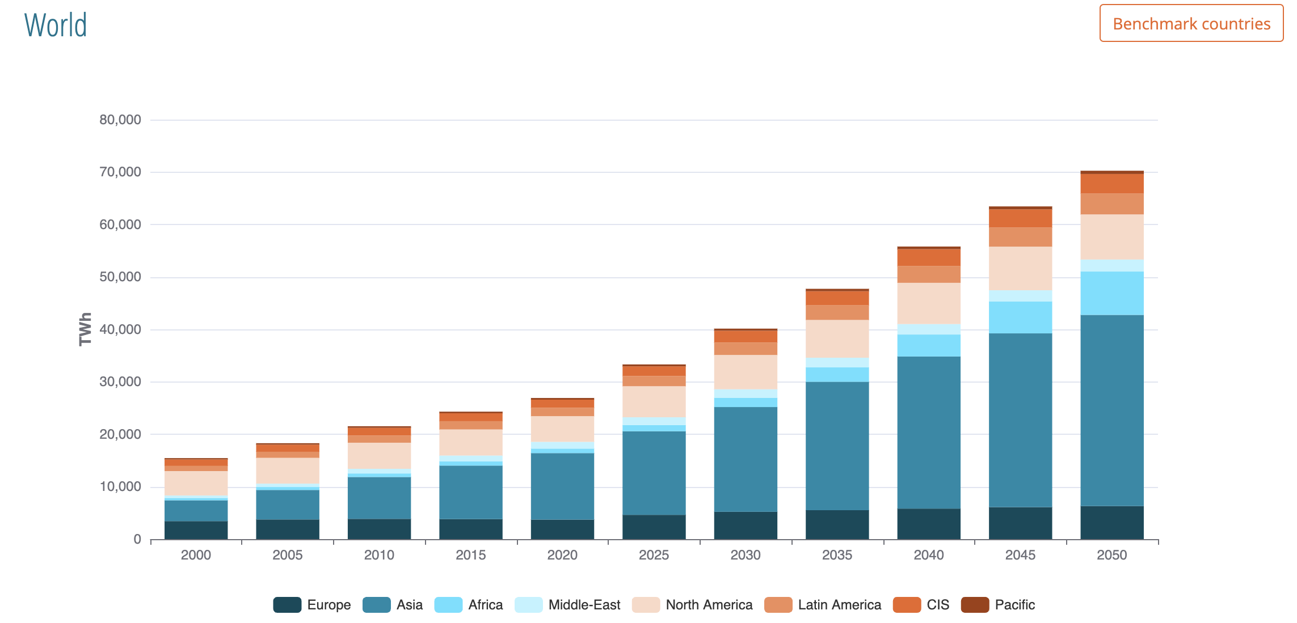
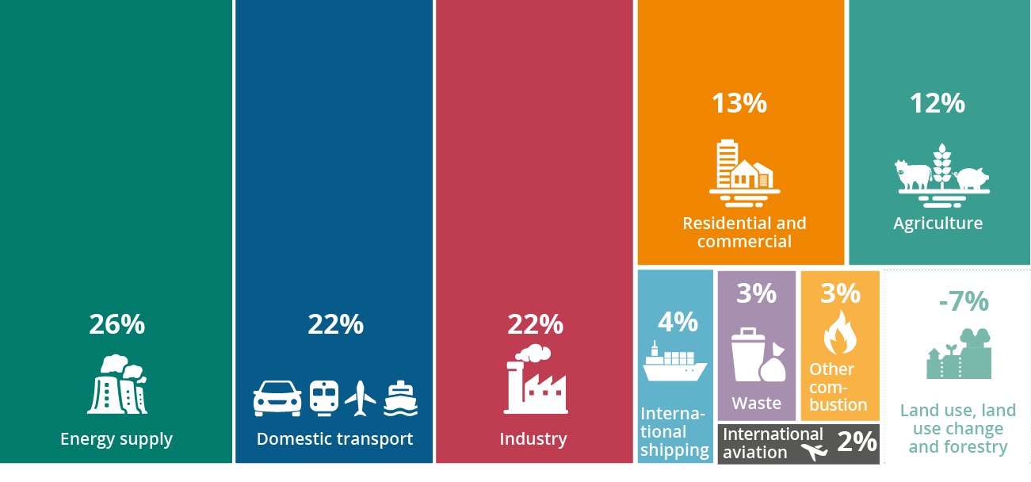
Forecast of global electricity demand over 2000 - 2050¹
Greenhouse gas emissions in the EU²
Global electricity demand increase 3% every year.
CO2 utilization in combination with renewable
technologies, contributes directly to 9/17 UN SDG.
IPCC-138% more costly, on average to
achieve climate objectives.
Quarter share—Energy supply
Follows domestic transport and industry
¹https://eneroutlook.enerdata.net/total-electricity-generation-projections.html
²https://www.eea.europa.eu/signals-archived/signals-2022/infographics/what-are-the-sources-of/view

Slide 19
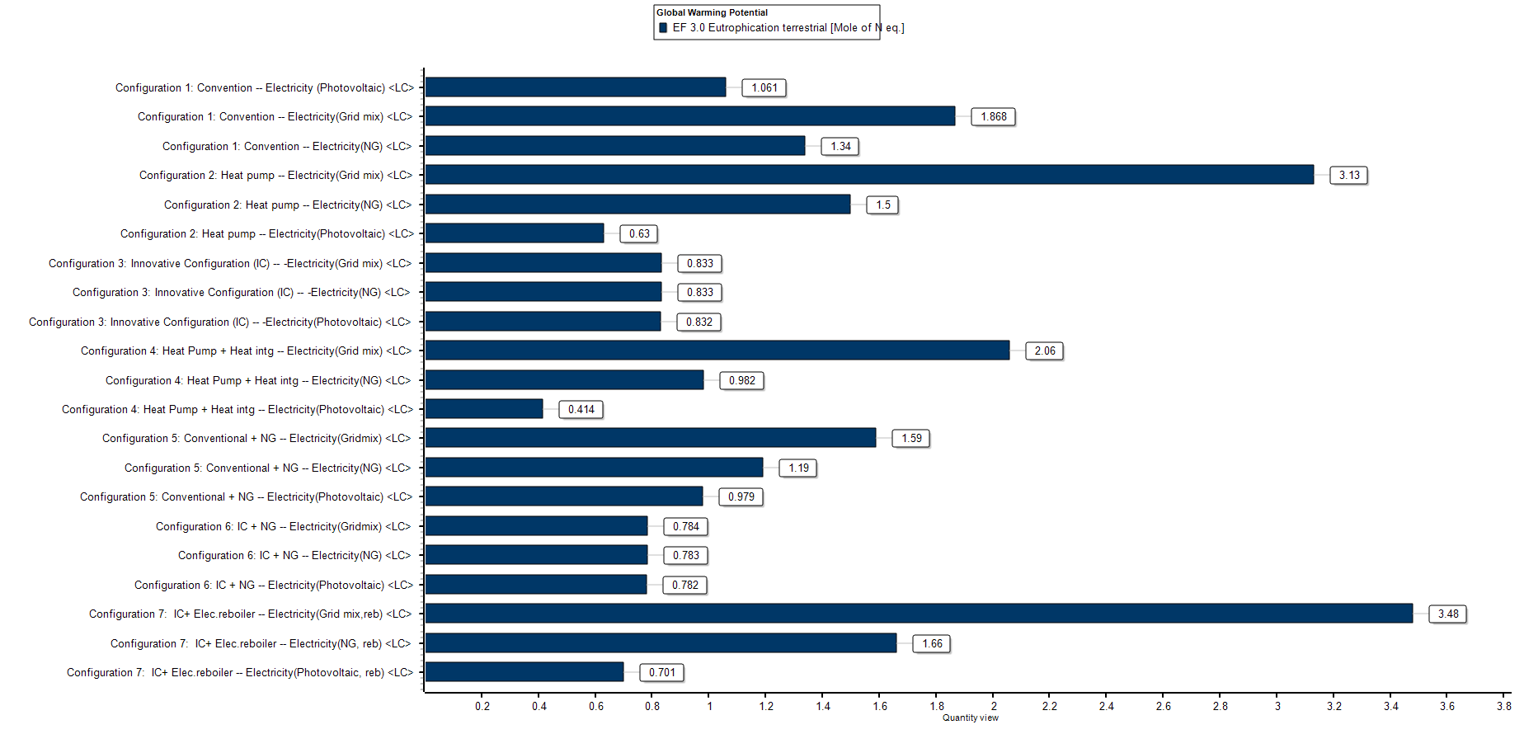

Slide 20
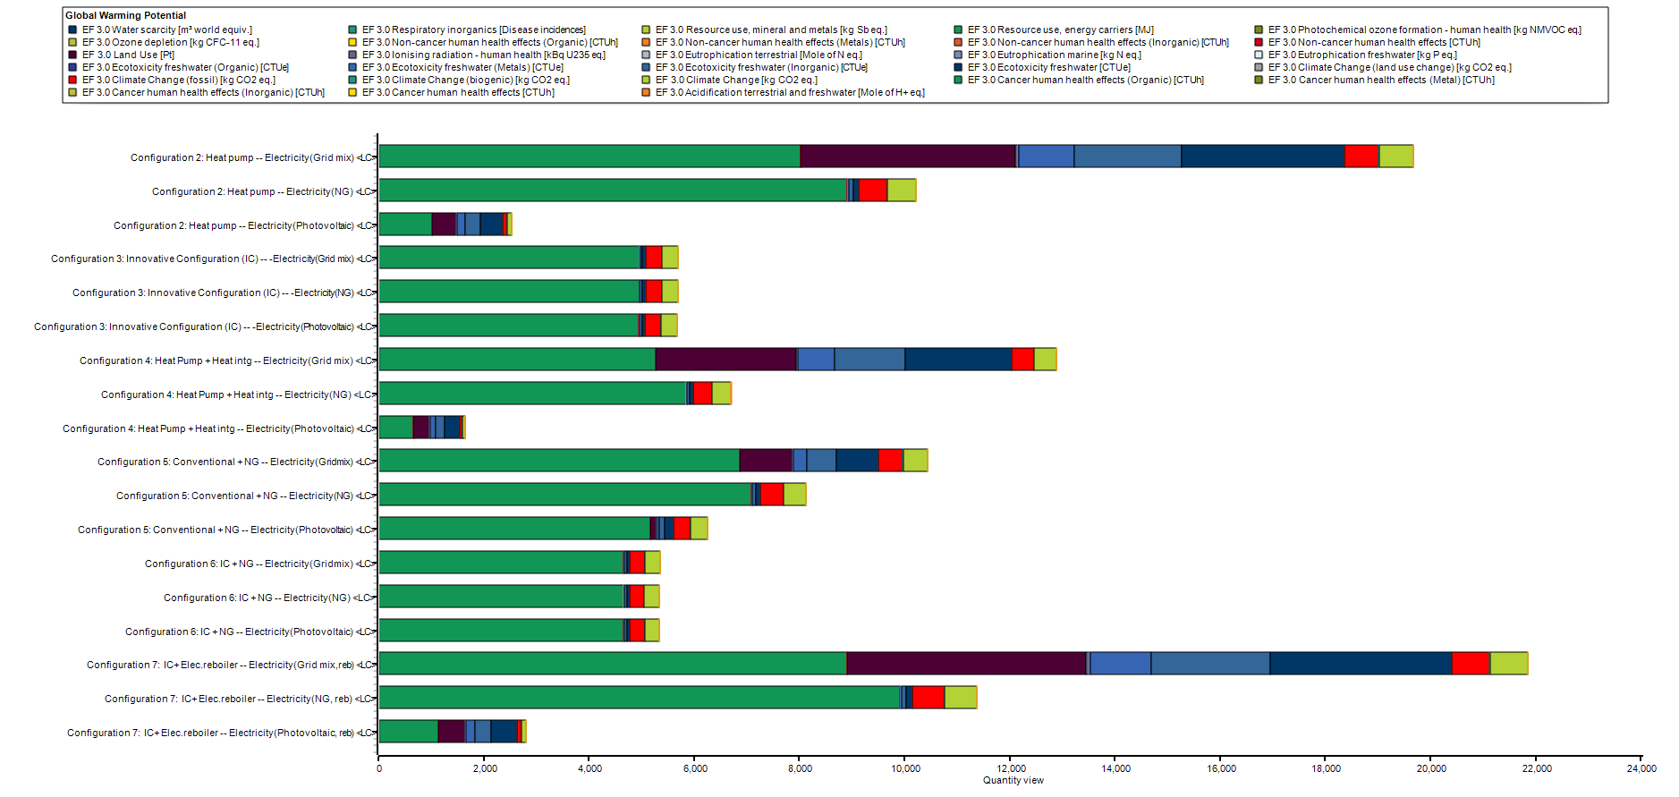
Comparison: Global warming potential indicators

