Slide 1



Financial Marketing Dashboard in Power BI
- Adithya Singh

Slide 2

Learning Objectives
Learn how to create interactive Power BI dashboards.
Gain insights into sales and finance.
Use Power BI visuals like bar charts, pie charts, and line graphs, etc.
GOAL
Source :
www.freepik.com/

Slide 3
Tools and Technology used
Power BI
Microsoft Excel / CSV

Slide 4
Methodology
Data Collection
Data Cleaning
Data Transformation
Visualization
Dashboard Design

Slide 5
Problem Statement:
Total Units sold by each product
Total Gross sales by each country
Total profit by each month – line chart
Avg Manufacturing price of each product
Total profit by each Segment using pie chart
Crad charts : Avg sales price , avg manufacturing price , total COGS , Total profit
Create 5 more visuals based on your understanding

Slide 6
Solution:
Created all the possible dashboard through the knowledge gained from attending all the sessions.
It includes Bar chart, Pie chart, Tree, Cards, Table,etc.

Slide 7
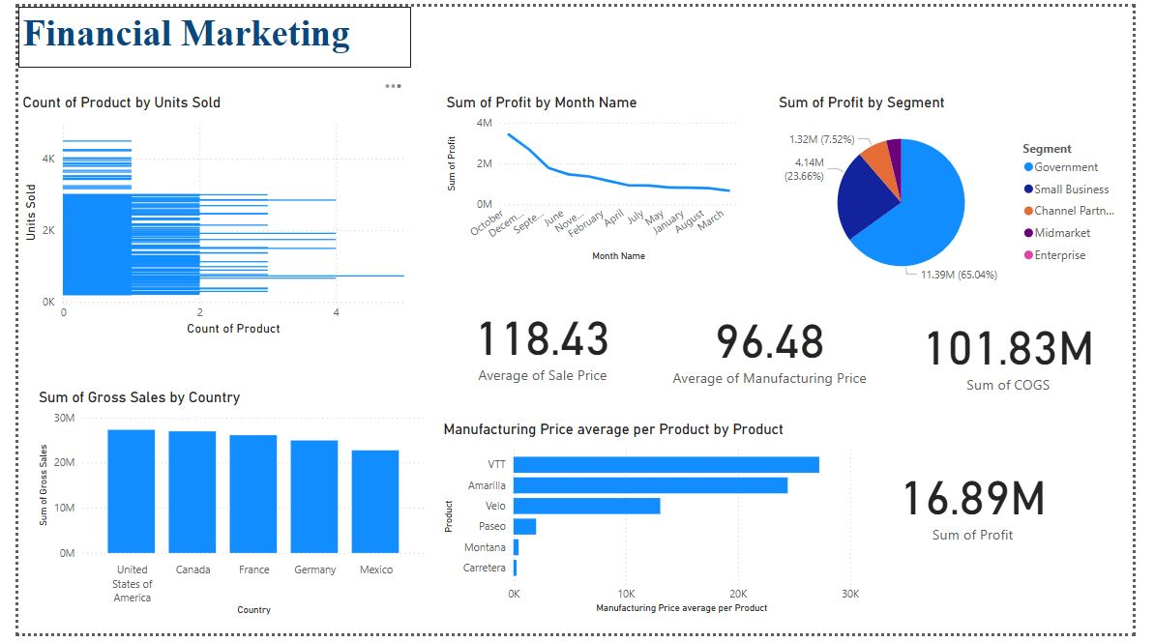
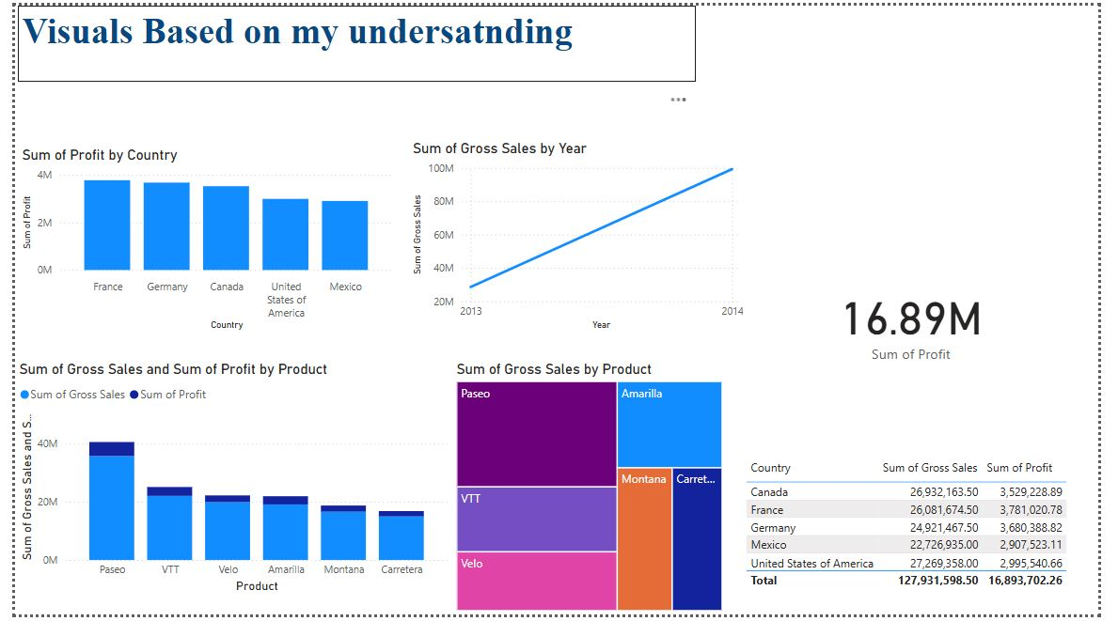
Screenshot of Output:

Slide 8
Conclusion:
Key Learnings:
Created a data-driven marketing dashboard.
Used Power BI visualizations to analyze financial performance.
Gained insights into top products, sales trends, and profitability.
Improved decision-making using interactive analytics.

