Slide 1
Web Scraping Car Details from Cars24
A Data Extraction Project
By ADITHYA SINGH

Slide 2
Objective
Extract detailed information about used cars listed on Cars24.
Gather data including: Car names Prices Fuel types Kilometers driven Transmission types Ownership details Location
Organize data into a structured CSV format for further analysis.

Slide 3
Technologies Used
Tools and Libraries
Python: Core programming language for scripting.
Selenium: For web scraping and browser automation.
Pandas: For data manipulation and CSV export.
Google Colab: Cloud-based environment for running the script.

Slide 4
Methodology
Setup Selenium in Google Colab -Installed dependencies (chromium-chromedriver,selenium). -Configured Chrome options for headless browsing.
Listed Target URLs -Selected 10 used car listings from Cars24 (Hyderabad).
Scraped Data Used Selenium to extract: Car Name, Price (in ₹ lakhs), Fuel Type, Kilometers Driven, Transmission, Ownership, Location Handled dynamic web elements with XPath. Added delays (time.sleep()) for page loading.
Data Processing Cleaned data (removed symbols, standardized units). Stored in a Pandas DataFrame. Exported to cars24_selected_cars.csv.

Slide 5
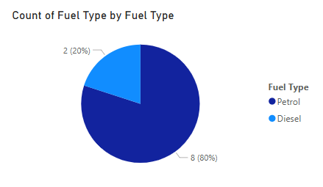
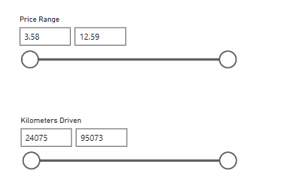
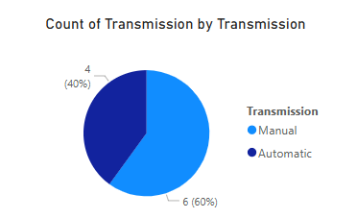
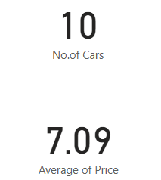
Analysis
Total Cars : 10
Average Price : ₹7.09 lakhs
Fuel Type : 8 Petrol, 2 Diesel
Transmission : 6 Manual, 4 Automatic
Price Range : ₹3.58-12.59 lakhs
KM Driven Range : 24,075-95,073 km

Slide 6
Conclusion
Demonstrated effective use of web scrapping for real-time data collection from Cars24.
Produced a clean, structured dataset ready for analysis.
Can be useful to • Track used car pricing trends over time. • Analyze demand patterns in that particular region. • Develop recommendation systems for buyers.

Slide 7
Thank You

