Slide 1


NAAN MUDHALVAN
𝐂𝐲𝐛𝐞𝐫 𝐒𝐞𝐜𝐮𝐫𝐢𝐭𝐲
Keylogger In Security
𝐏𝐫𝐞𝐬𝐧𝐭𝐞𝐝 𝐛𝐲
𝐀𝐝𝐢𝐭𝐡𝐲𝐚 𝐌 ,𝐈𝐈𝐈-𝐂𝐒𝐄

Slide 2

𝐈𝐧𝐭𝐫𝐨𝐝𝐮𝐜𝐭𝐢𝐨𝐧
A keylogger is a type of software or hardware device that records every keystroke made by a user on a computer or mobile device.
Its primary purpose is to covertly monitor and capture the user's activities, including passwords, messages, emails, and other sensitive informati Keyloggers can be used for legitimate purposes, such as parental control or employee monitoring, but they can also be employed maliciously by hackers to steal personal information or login credentials.

Slide 3
Problem staement (should not include solution)
Proposed System/Solution
System Developed Approach (technoloy Used)
Algorithm & Deployment Result (Output Image) Conclusion
Future Scope Reference

Slide 4
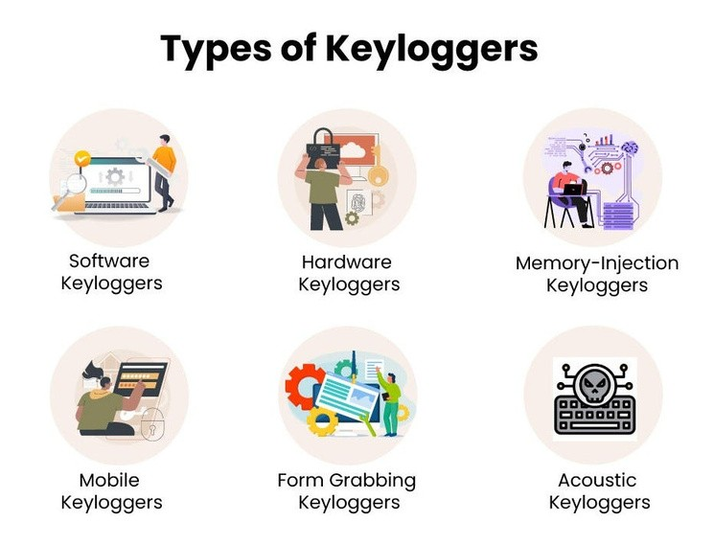
𝐏𝐫𝐨𝐛𝐥𝐞𝐦
𝐒𝐭𝐚𝐭𝐞𝐦𝐞𝐧𝐭
A keylogger problem statement might look something like this:
"Keyloggers pose a significant threat to computer security by covertly recording keystrokes, potentially compromising sensitive information such as passwords, credit card numbers, and personal messages. Detecting and preventing the installation and operation of keyloggers is critical to safeguarding user privacy and protecting against unauthorized access to data."

Slide 5

𝐏𝐫𝐨𝐩𝐨𝐬𝐞𝐝 𝐒𝐨𝐥𝐮𝐭𝐢𝐨𝐧
Advanced Anti-Keylogger Software
Encryption and Secure Input Handing
System wide Monitoring and Alerting
User Education and Awarness Training
Multi Factor Authentication (MFA)
Continueous Updates and Patch Management
Regular Security Audits Penetration Testing

Slide 6




𝐀𝐥𝐠𝐨𝐫𝐢𝐭𝐡𝐦 & 𝐃𝐞𝐩𝐥𝐨𝐲𝐦𝐞𝐧𝐭
𝐀𝐥𝐠𝐨𝐫𝐢𝐭𝐡𝐦:
𝖪𝖾𝗒𝗌𝗍𝗋𝗈𝗄𝖾 𝖢𝖺𝗉𝗍𝗎𝗋𝖾
𝖣𝖺𝗍𝖺 𝖫𝗈𝗀𝗀𝗂𝗇𝗀
𝖲𝗍𝖾𝖺l𝗍𝗁 M𝗈𝖽𝖾
𝖤𝗇𝖼𝗋𝗒𝗉𝗍𝗂𝗈𝗇 (𝖮𝗉𝗍𝗎𝗈𝗇𝖺l)
𝐃𝐞𝐩𝐥𝐨𝐲𝐦𝐞𝐧𝐭:
𝖣𝗂𝗂𝖻𝗂
𝖨𝖺ll𝖺𝗂
𝖯𝖾𝗂𝖾𝖼𝖾
𝖱𝖾𝖾 𝖠𝖼𝖼𝖾
𝖤𝖺𝗂 𝖳𝖾𝖼𝗁𝗂𝖾
𝖴𝖽𝖺𝖾 𝖺𝖽 M𝖺𝗂𝖾𝖺𝖼𝖾

Slide 7


𝐑𝐞𝐬𝐮𝐥𝐭
The presence of a keylogger in a security context typically results in severe consequences and compromises to the affected system and user privacy. Here are some potential outcomes:
Data Breach
Privacy Voilation
Compromised System
Cost of Remediation
Back to Agenda Page

Slide 8

𝐂𝐨𝐧𝐜𝐥𝐮𝐬𝐢𝐨𝐧
Prevention and vigilance are crucial in safeguarding against keyloggers. By prioritizing security best practices, organizations and individuals can mitigate the risks posed by keyloggers and protect their sensitive information from unauthorized access and exploitation.

Slide 9
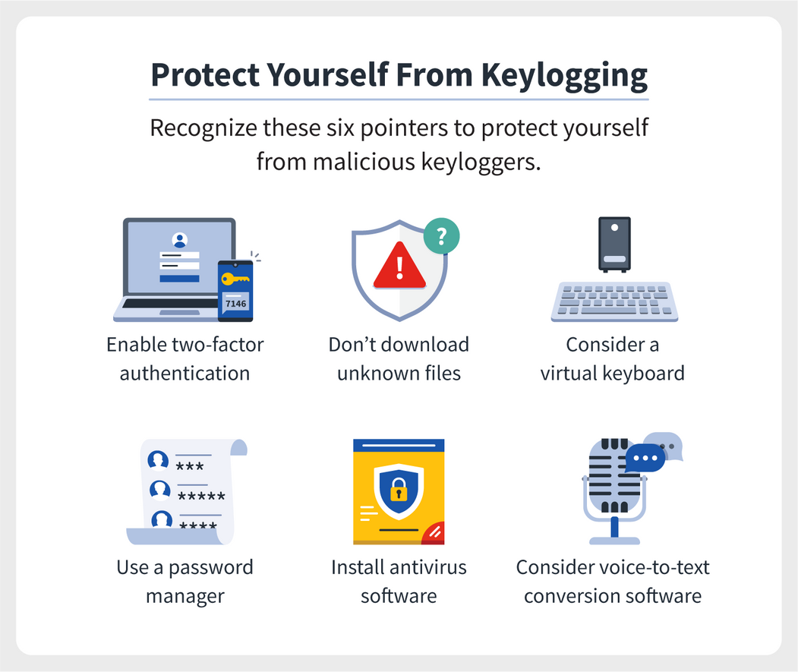
𝐅𝐮𝐭𝐮𝐫𝐞 𝐒𝐜𝐨𝐩𝐞
In summary, the future scope of keyloggers will involve a continuous arms race between attackers and defenders, with both sides leveraging technological advancements to gain an advantage. By staying informed about emerging threats, investing in advanced security solutions, and fostering collaboration within the cybersecurity community, organizations can effectively mitigate the risks posed by keyloggers and safeguard their digital assets.

Slide 10

𝐑𝐞𝐟𝐞𝐫𝐞𝐧𝐜𝐞
Blyth, A. J., & Kovacich, G. L. (2006). The Dark Side of Computing: A Forensic Computing Handbook. Pearson Education.This book provides insights into various cyber threats, including keyloggers, and offers guidance on forensic investigation techniques.
These references provide valuable insights into keyloggers, their detection, and their impact on cybersecurity, offering guidance for practitioners, researchers, and cybersecurity professionals.

Slide 11
𝐓𝐇𝐀𝐍𝐊 𝐘𝐎𝐔

