Slide 1
Big-O
Figure out what the input is and what n represents.
Express the maximum number of operations, the algorithm performs in terms of n.
Eliminate all excluding the highest order terms.
Remove all the constant factors.
Refer Algorithm folder
Order of time taken
O(1) < O(log n) < O(n) < O(n^2) < O(n^3) < O(2^n)

Slide 2
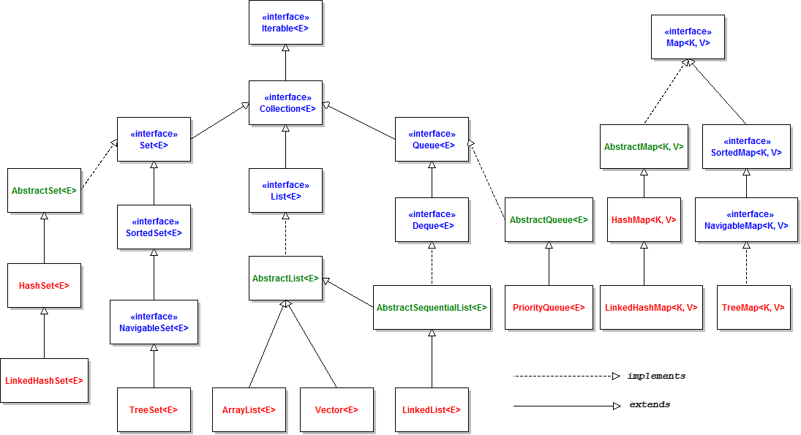
Introduction to basic data structures

Slide 3
List
ArrayList or LinkedList
How do they work internally
Maintain the ordered collection.
Index-based methods to
insert,
update,
delete and
search the elements.
Can have the duplicate elements.
We can also store the null elements in the list.

Slide 4
Hash table
In an hash table, data is stored in an arrays.
Data is stored in Buckets identified by unique hash.
Each value in the array are Key value pairs.
Access of data becomes very fast.
Access of data is O(1) complex
while access of data in array is O(n) complex
Insertion is also O(1) complex.
Hash Table uses an array as a storage medium
Uses hash technique to generate the index where element is inserted.
For e.g. if there are 50 buckets.
index = hash of the key % 50.
This way each element would fall into some bucket.

Slide 5
Set
Unique Collection of elements (Or objects)
Contains no duplicate elements.
An interface that extends Collection interface.
Unlike List,
Java Set is NOT an ordered collection,
it’s elements does NOT have a particular order.
For ordering and sorted we can use SortedSet.
TreeSet implements SortedSet.
does NOT provide a control over the position where you can insert an element.
You cannot
access elements by their index and also search elements in the list.
cannot convert a Java Set into an array directly
NOT implemented using an Array.

Slide 6
DBMS
Database management system: software used to manage the database.
For e.g.:MySQL, Oracle
DBMS provides
Interface to perform various operations like
database creation,
storing data in it,
updating data,
creating a table in the database etc.
Provides protection and security to the database.
Maintains data consistency across users.
DBMS allows users to do DDL and DML

Slide 7
Tutorials
Refer below url for assignment
https://github.com/vilasvarghese/mysql-tutorial
https://gist.github.com/amelieykw/c1650cbc4ccbdd49894990a679e334cf
Advanced tutorials of Mysql
https://www.mysqltutorial.org/
https://www.mysqltutorial.org/advanced-mysql/

Slide 8
Problem Solving
An algorithmic problem is specified by
describing the complete set of instances it must work on
what properties the output must have as a result of running on one of these instances.
The following steps are involved in solving computational problems.
Problem definition
Read the problem (multiple) times.
Define the input and output of the problem
Define constraints if any

