Slide 1

DMDW Lab using PYTHON
5th Semester
Department of Computer Science and Engineering
GIET University, Gunupur

Slide 2
Assignment-6
Association rule mining.
Frequent pattern mining Using Apriori Algorithm.
Frequent pattern mining Using Frequent Pattern
growth algorithm.

Slide 3
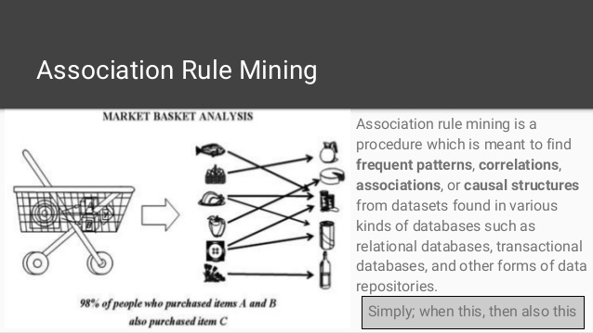
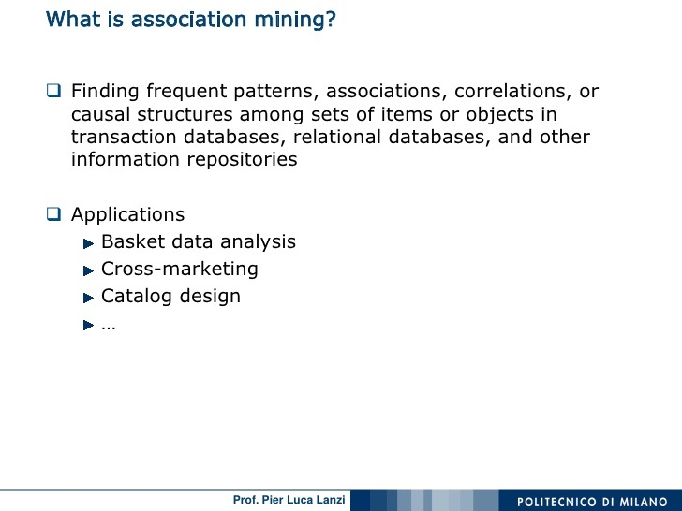

Slide 4
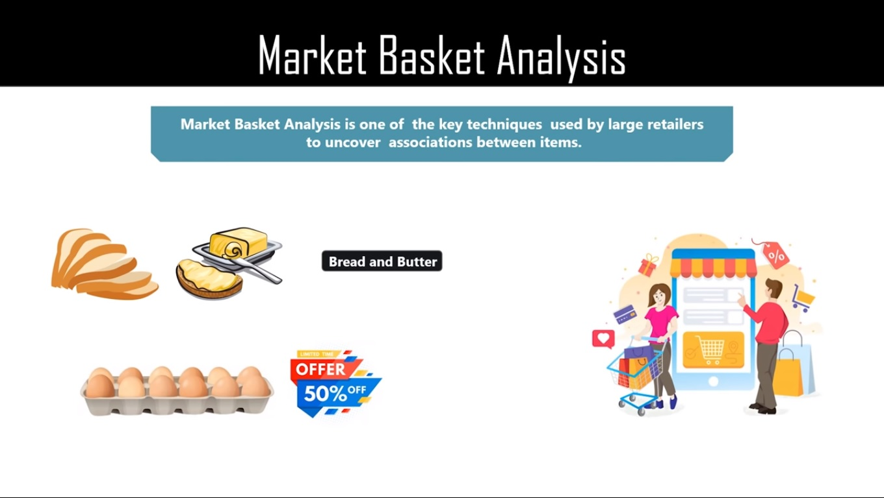

Slide 5
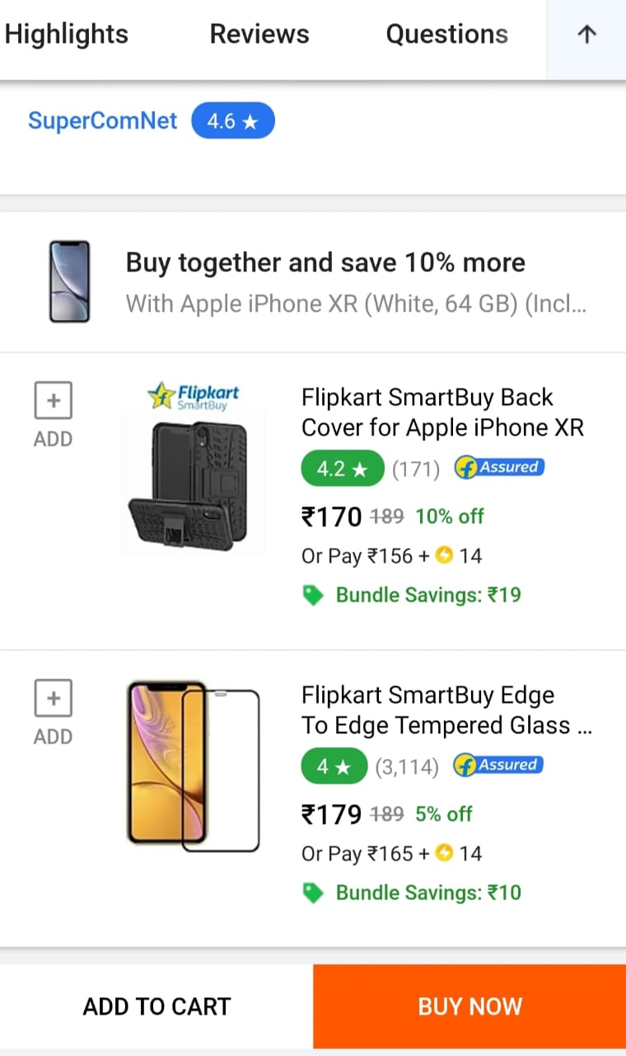

Slide 6
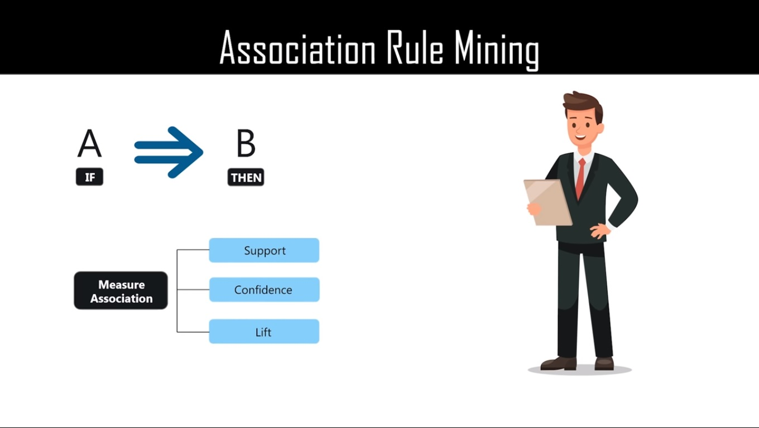
The Percentage of transactions that contain all Of the items in an item set.
The Probability that a transaction that contains the items
The probability of all of the items in a rule occurring together divided by the product of the probability of the items

Slide 7
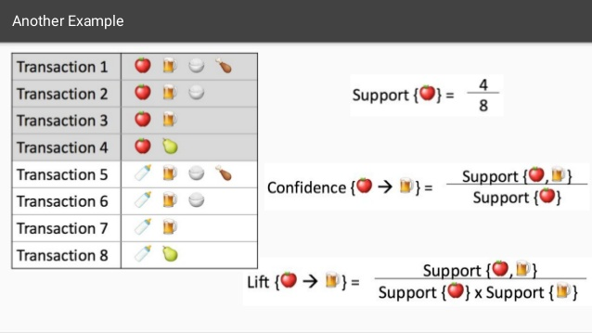

Slide 8
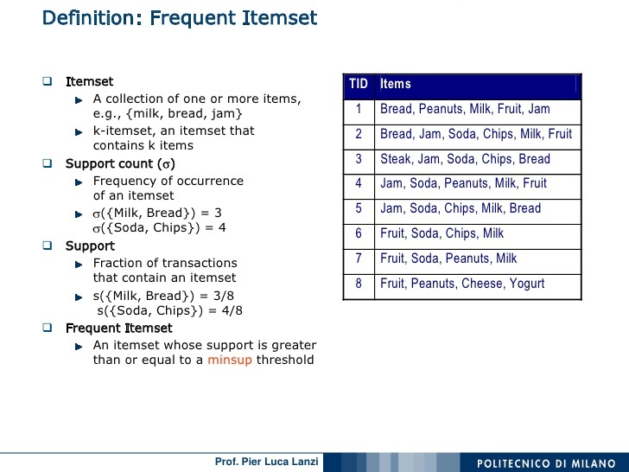

Slide 9
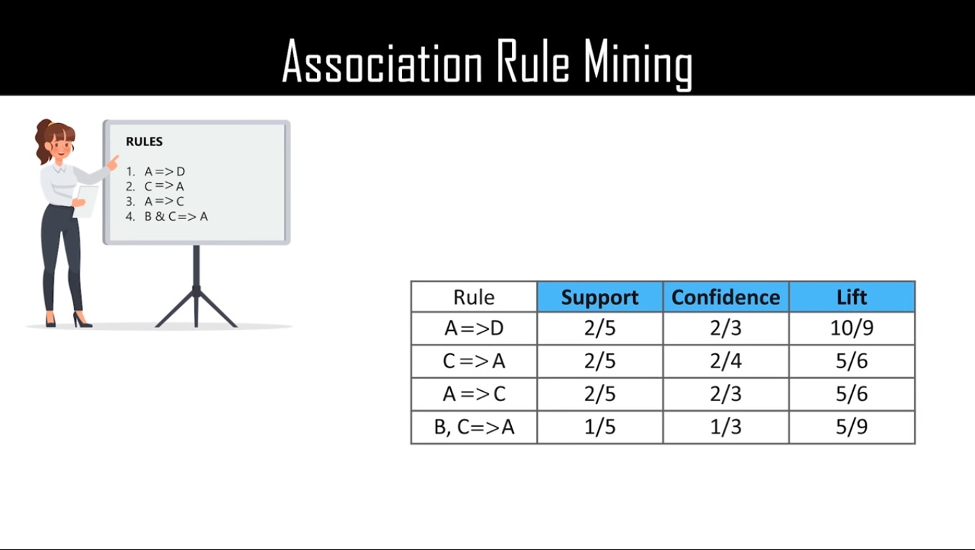

Slide 10
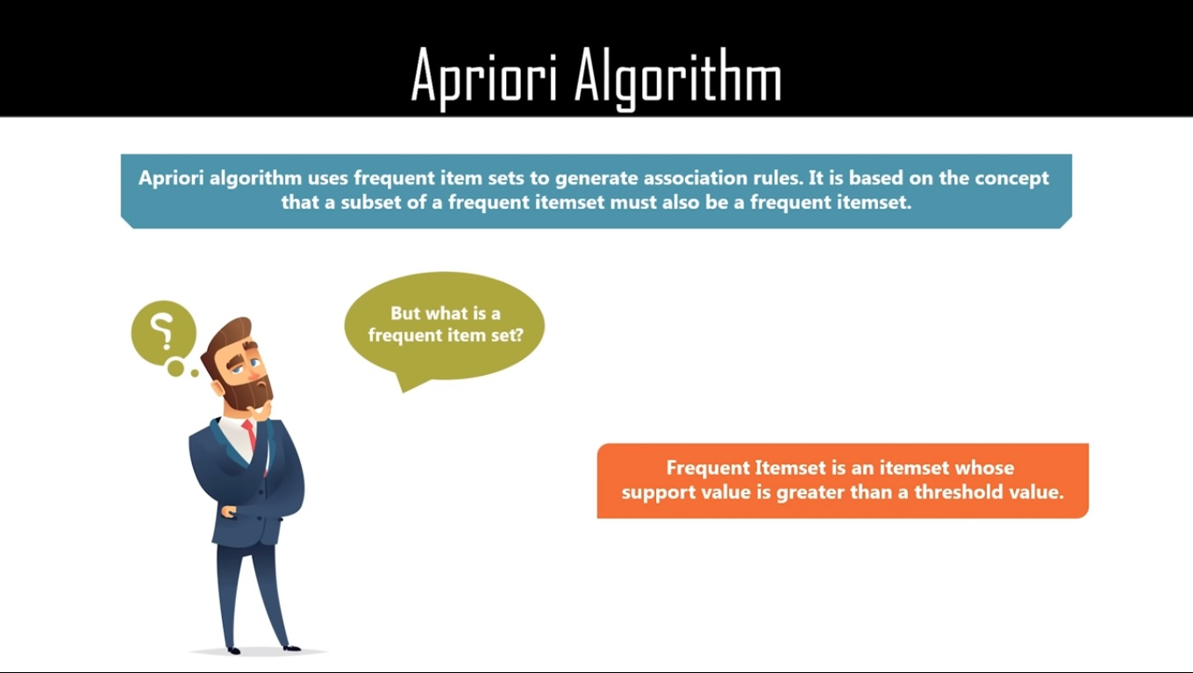

Slide 11
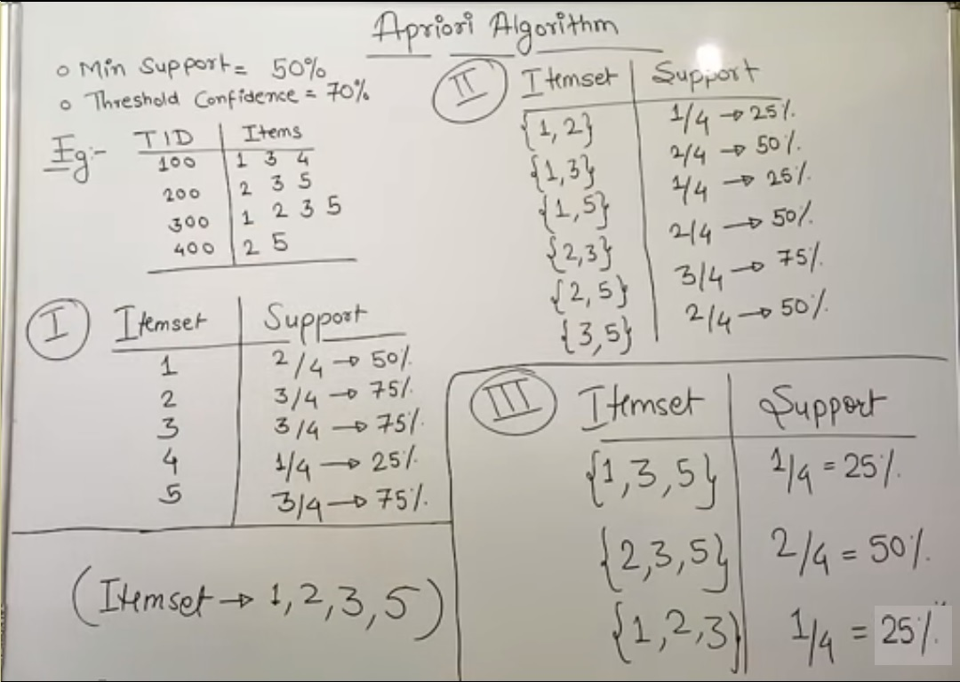

Slide 12
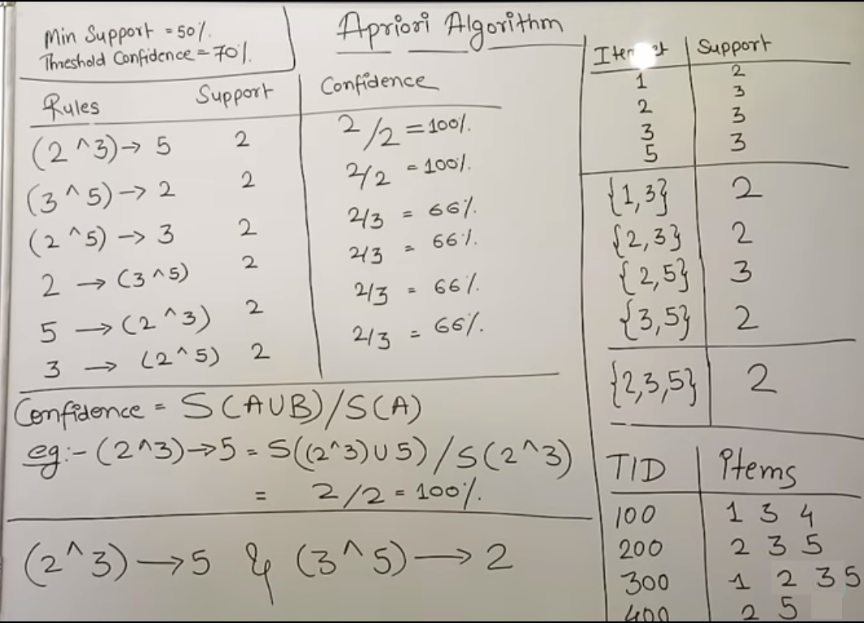

Slide 13
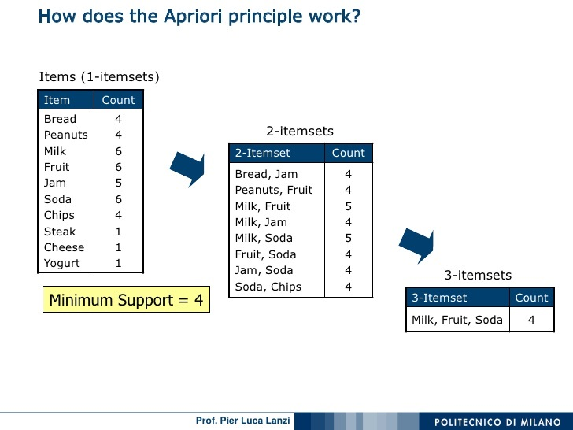

Slide 14
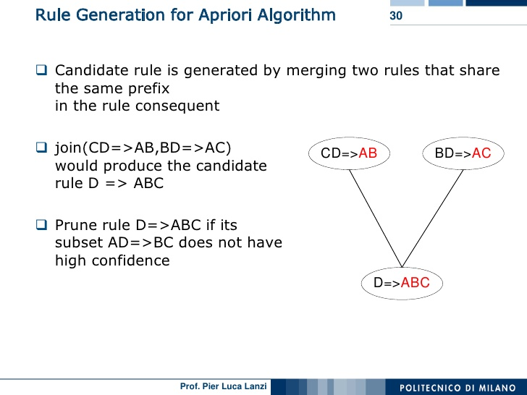

Slide 15
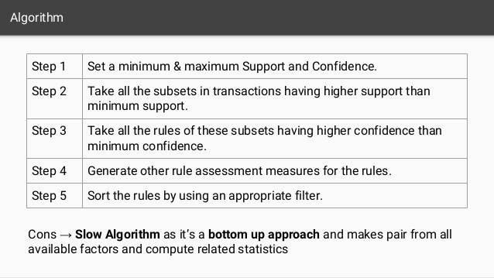

Slide 16
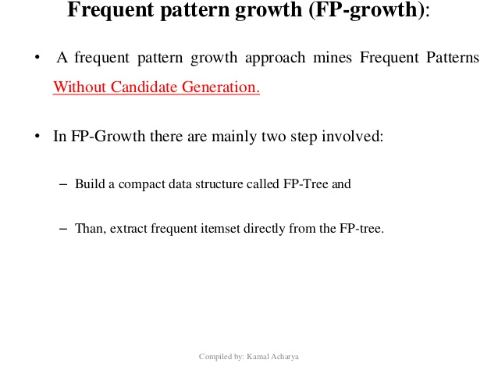

Slide 17
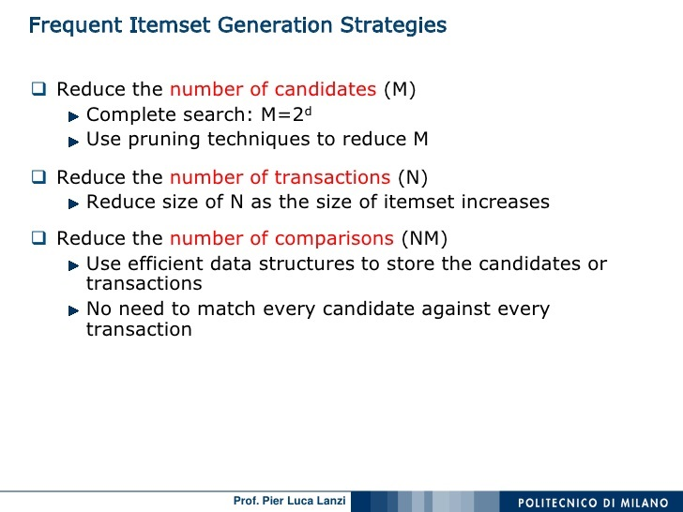

Slide 18
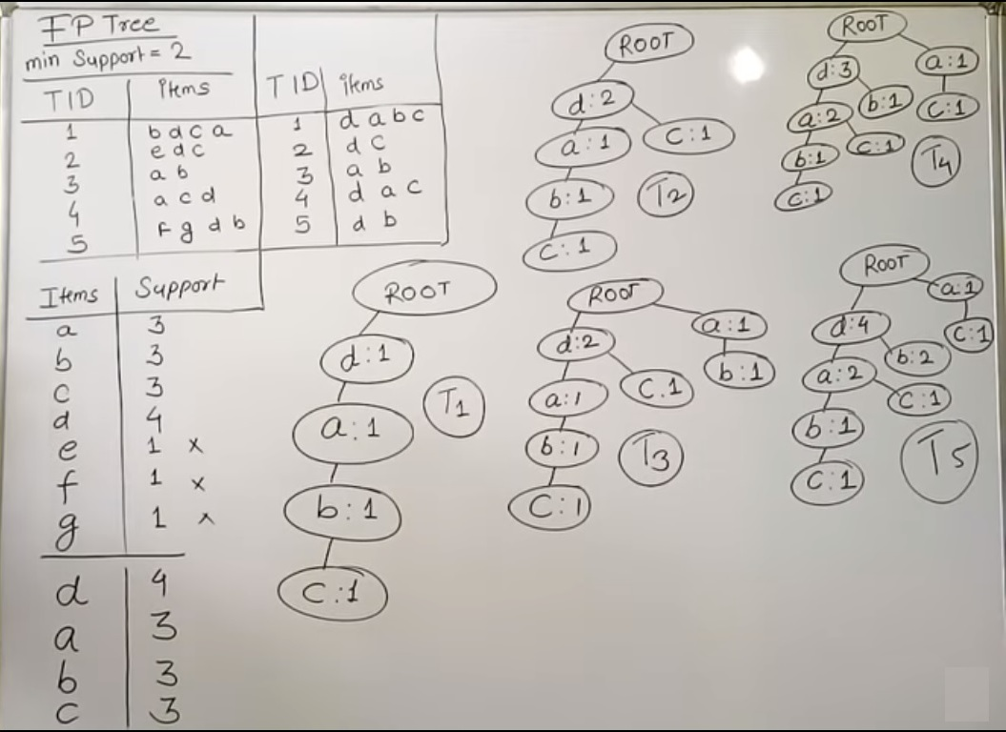

Slide 19
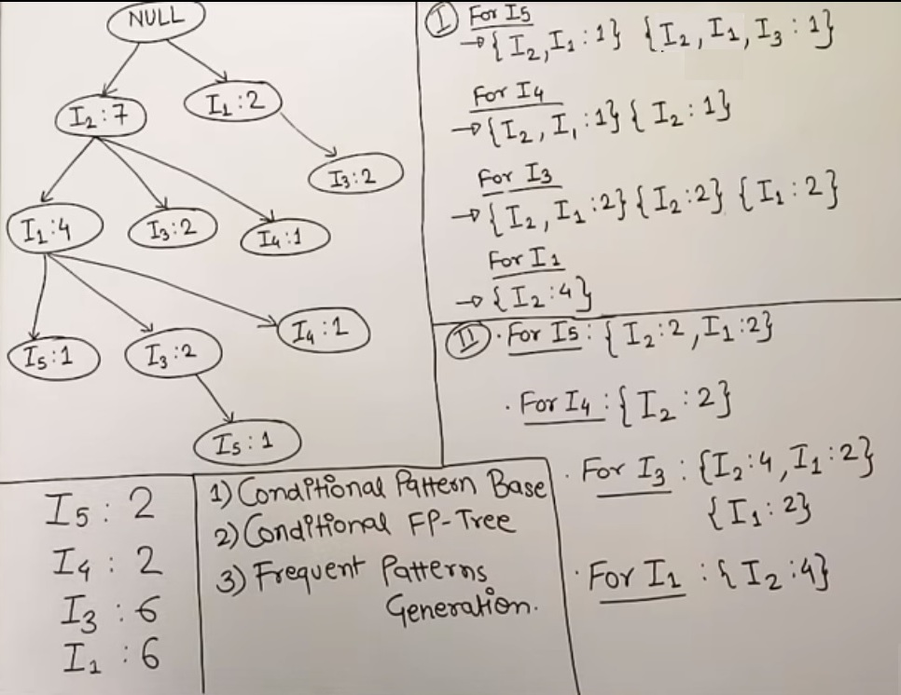

Slide 20
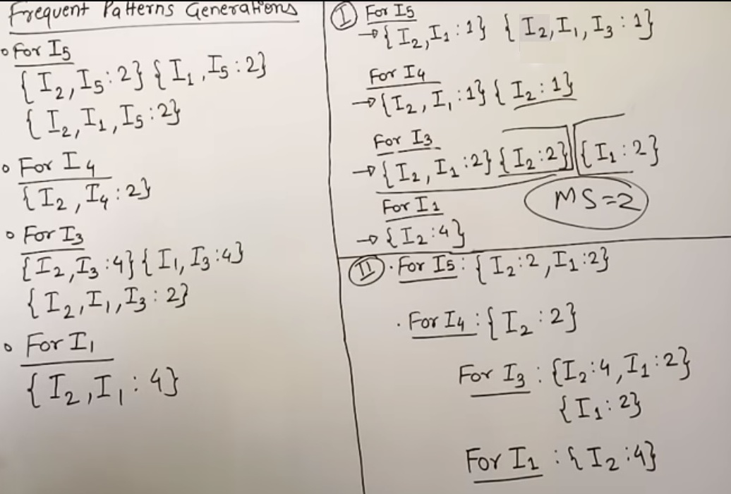

Slide 21
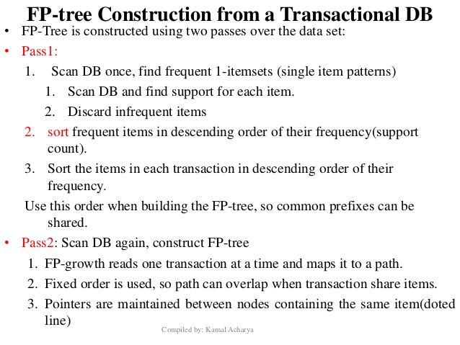

Slide 22
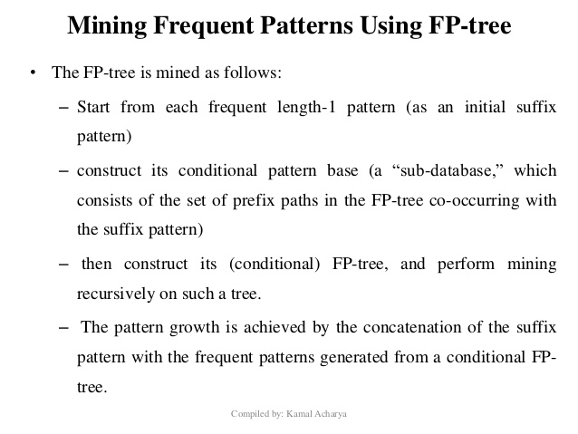

Slide 23
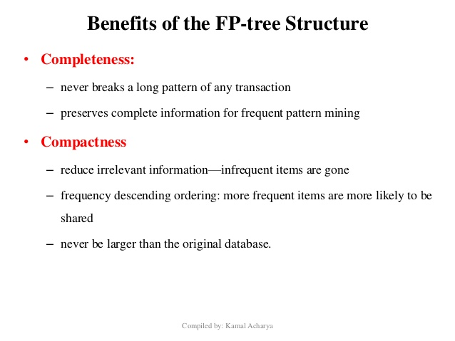

Slide 24
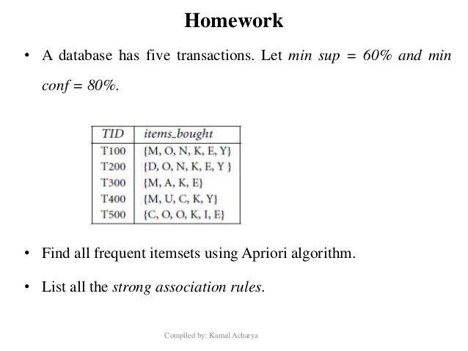

Slide 25
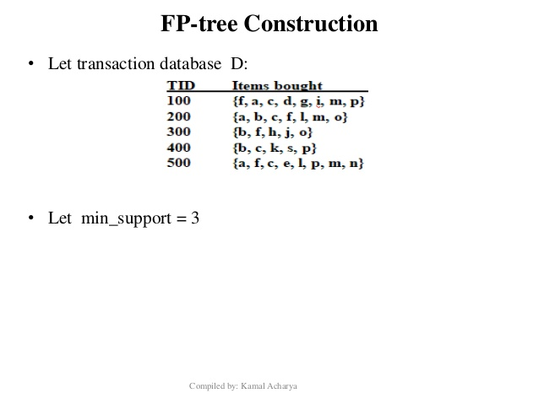

Slide 26
Our Next Assignment-7
Introduction to sklearn library.
Classification using decision tree induction.

