Slide 1

DMDW Lab using PYTHON
5th Semester
Department of Computer Science and Engineering
GIET University, Gunupur

Slide 2
Assignment-5
Correlation co-efficient relation and co- variance analysis.
Normalization (Min-Max, Z-score, Decimal Scaling) techniques.

Slide 3
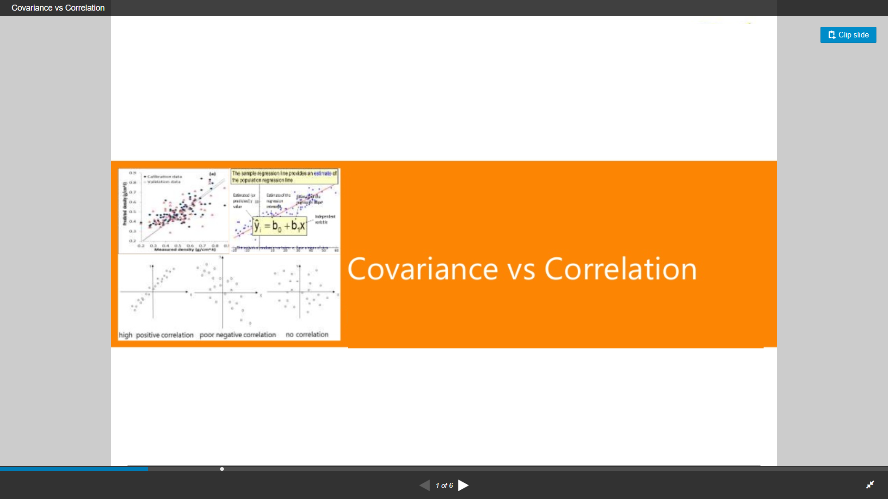

Slide 4
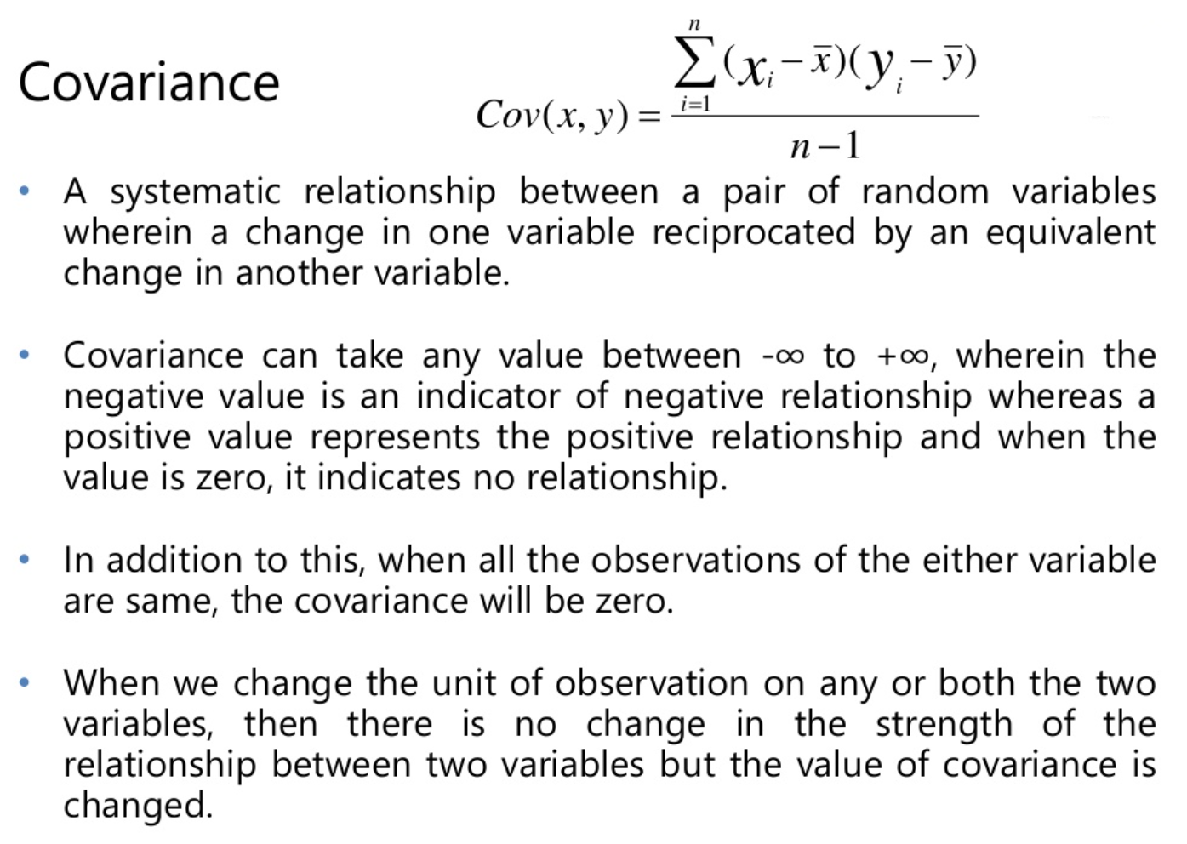

Slide 5
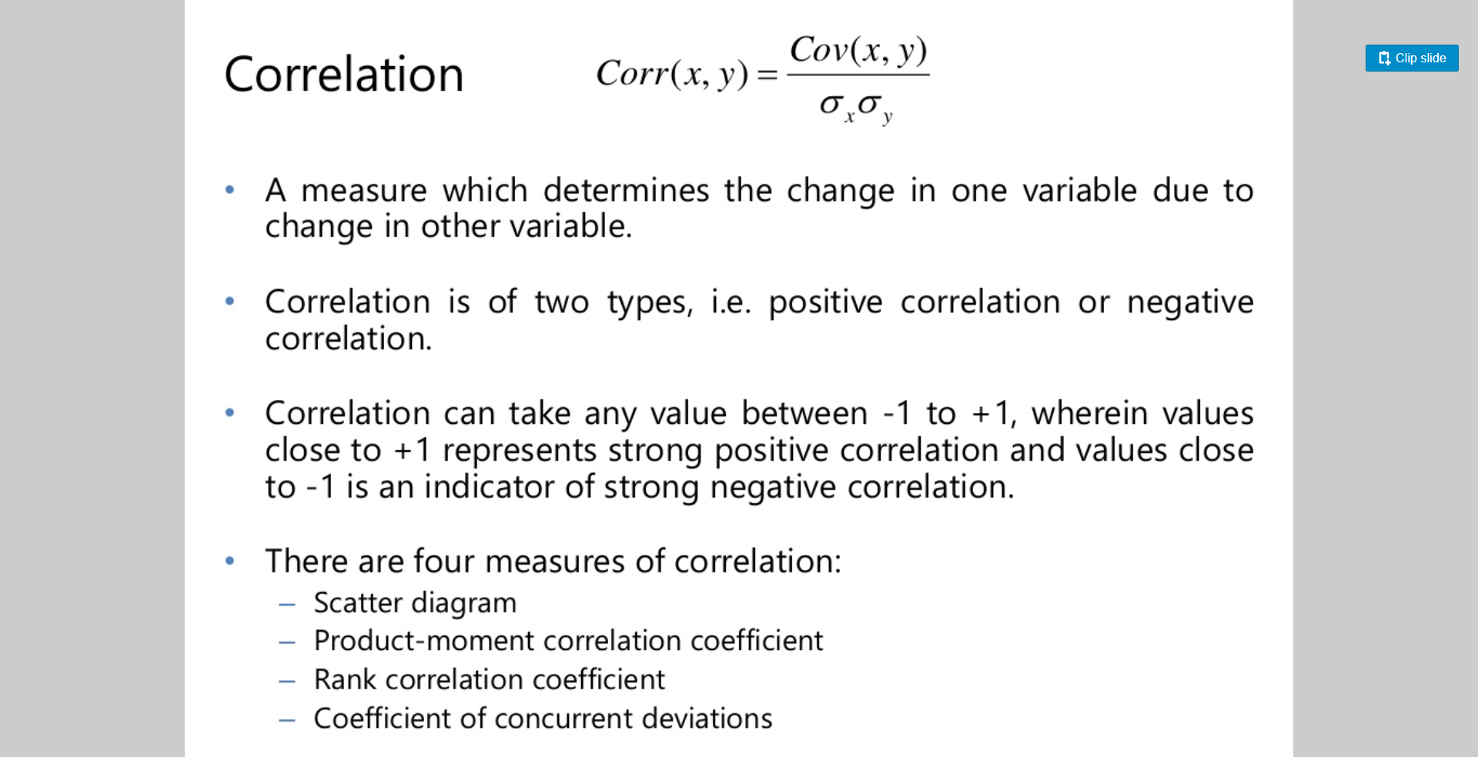

Slide 6
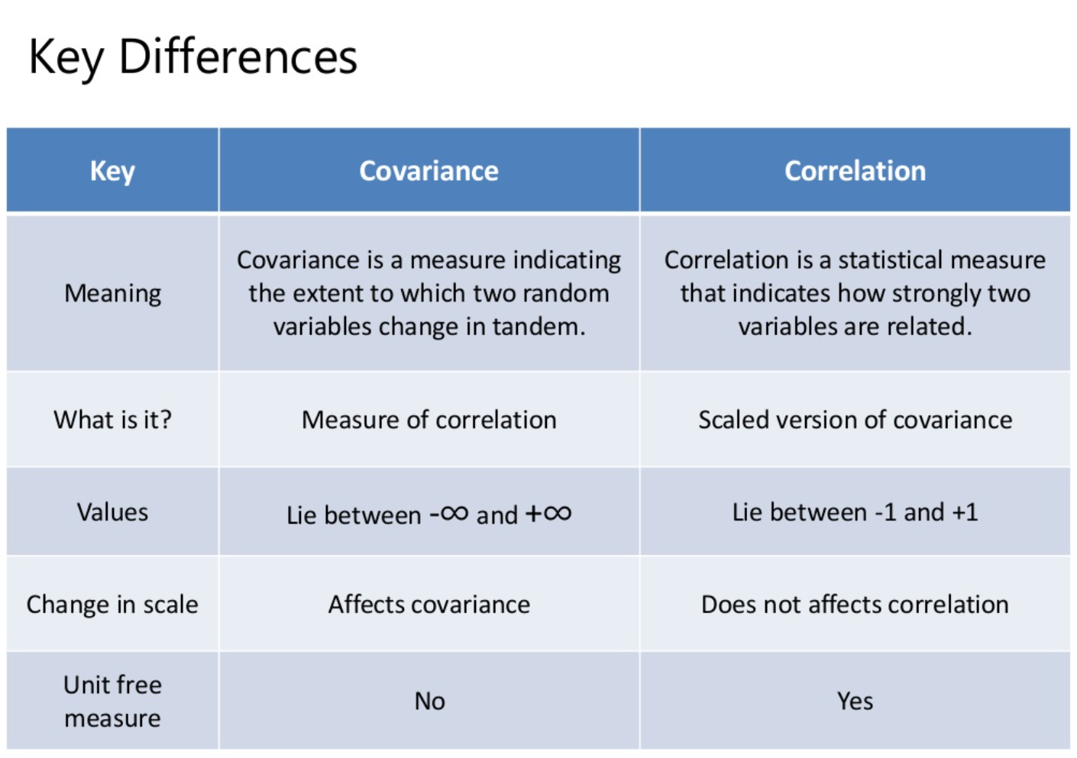

Slide 7
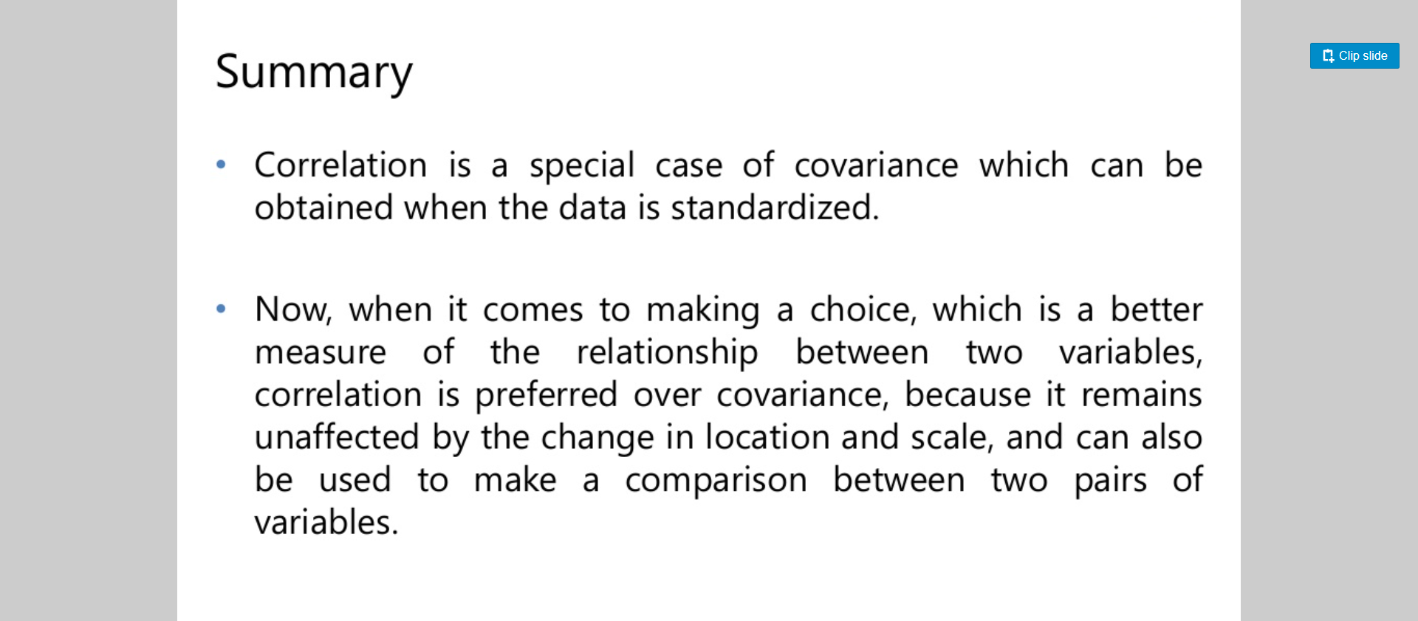

Slide 8
Normalization
(Min-Max, Z-score, Decimal Scaling)

Slide 9
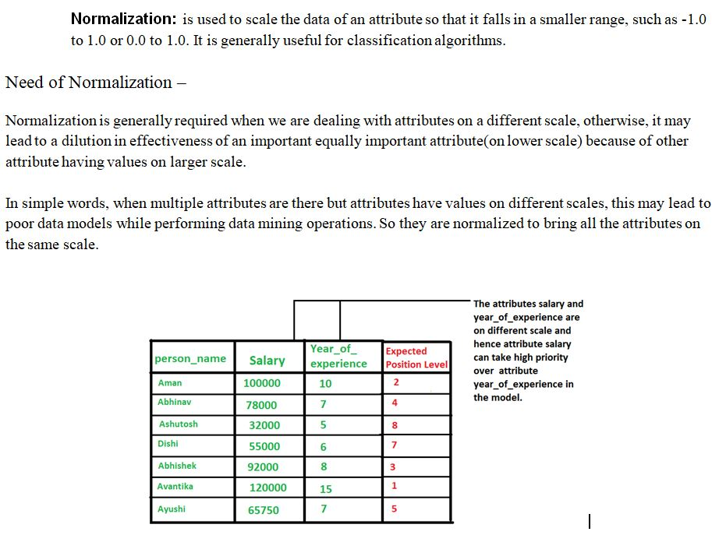

Slide 10
Normalization
Min-max normalization: to [new_min_{A}, new_max_{A}]
Ex. Let income range $12,000 to $98,000 normalized to [0.0, 1.0]. Then $73,600 is mapped to
Z-score normalization (μ: mean, σ: standard deviation):
Ex. Let μ = 54,000, σ = 16,000. Then
Normalization by decimal scaling
Where j is the smallest integer such that Max(|ν’|) < 1

Slide 11
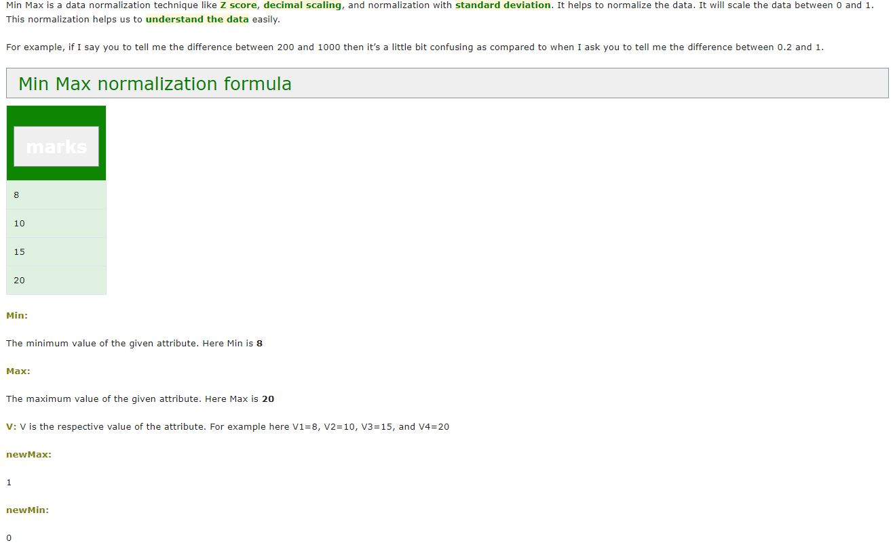

Slide 12
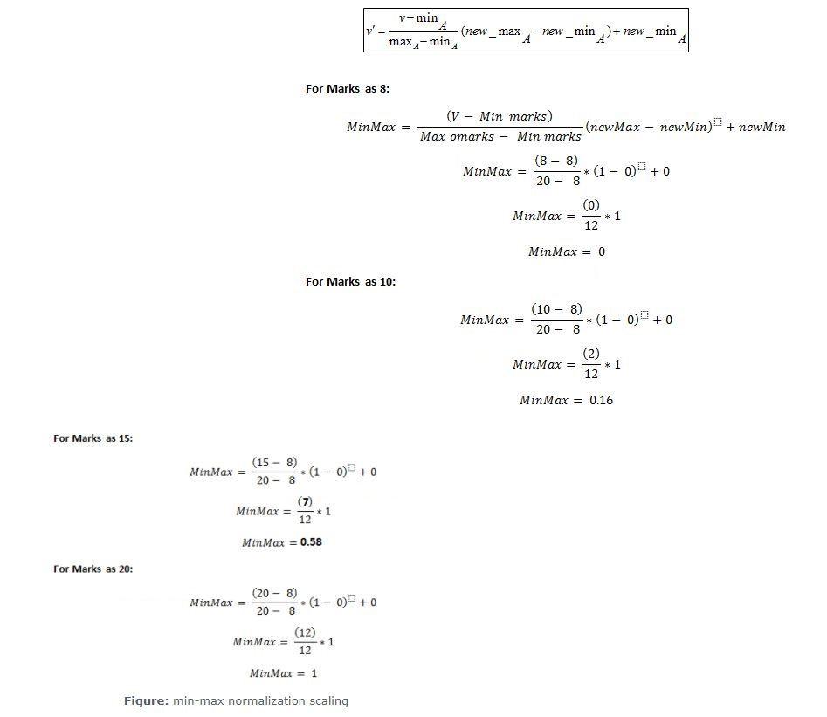

Slide 13
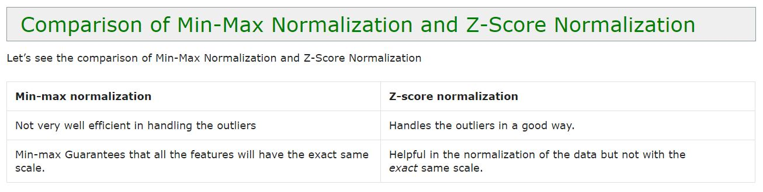

Slide 14
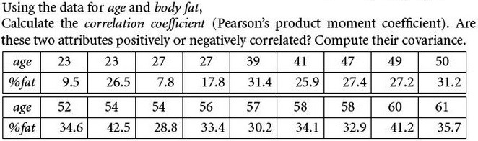
Exercise

Slide 15
Exercise
What are the value ranges of the following normalization methods?
min-max normalization
z-score normalization
normalization by decimal scaling

Slide 16
Exercise
For the following group of data: 200, 300, 400, 600, 1000, use the following methods to normalize the values.
min-max normalization
z-score normalization
normalization by decimal scaling

Slide 17
Our Next Assignment- 6
Frequent pattern mining Using Apriori Algorithm.
Frequent pattern mining Frequent Pattern growth algorithm, and
Association rule mining.

