Slide 1

DMDW Lab using PYTHON
5th Semester
Department of Computer Science and Engineering
GIET University, Gunupur

Slide 2
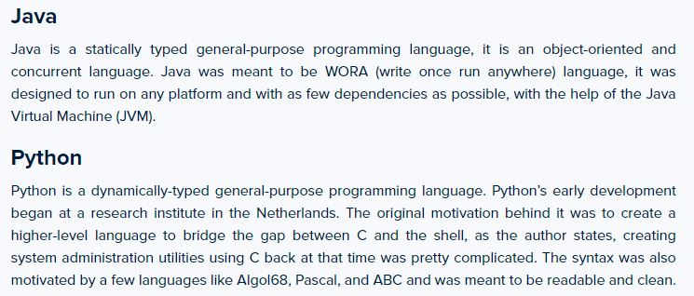
Java-vs-Python

Slide 3
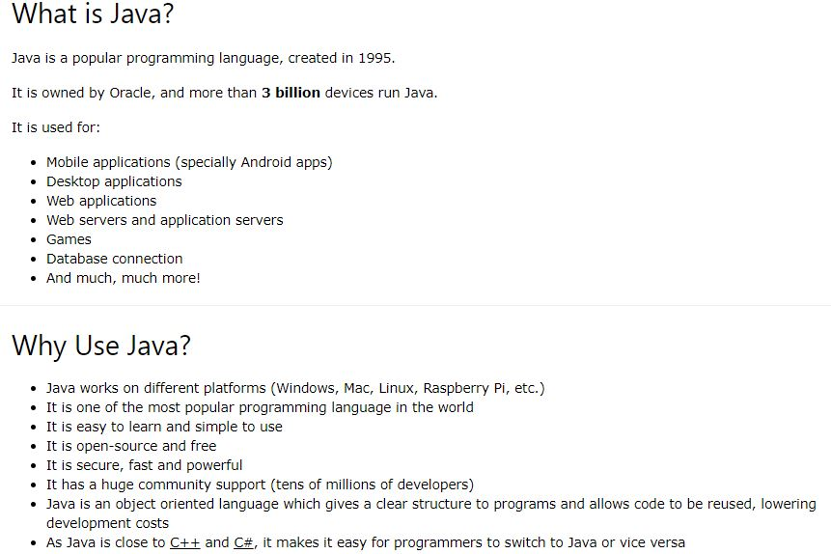

Slide 4
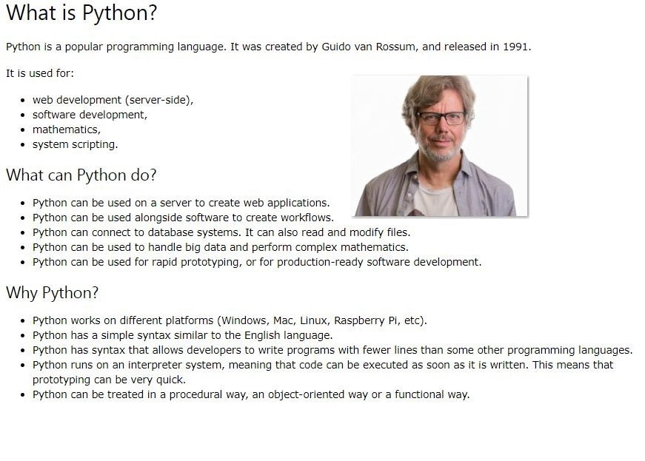

Slide 5
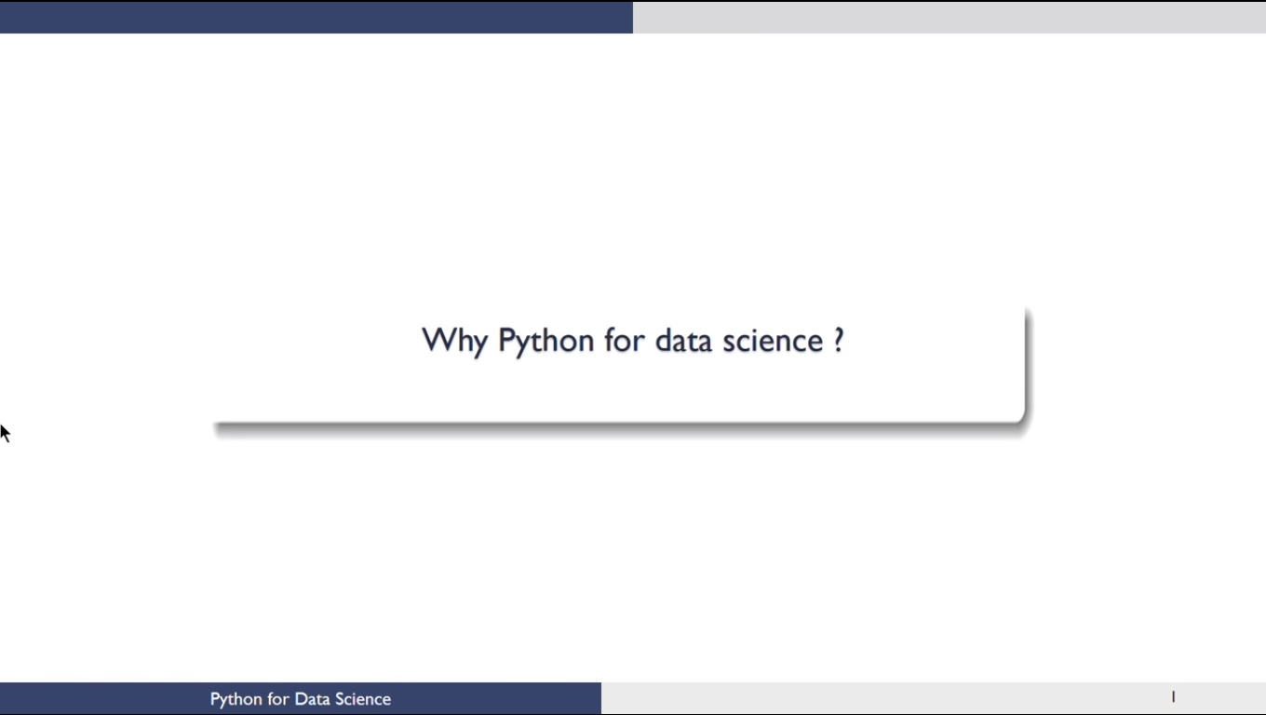

Slide 6
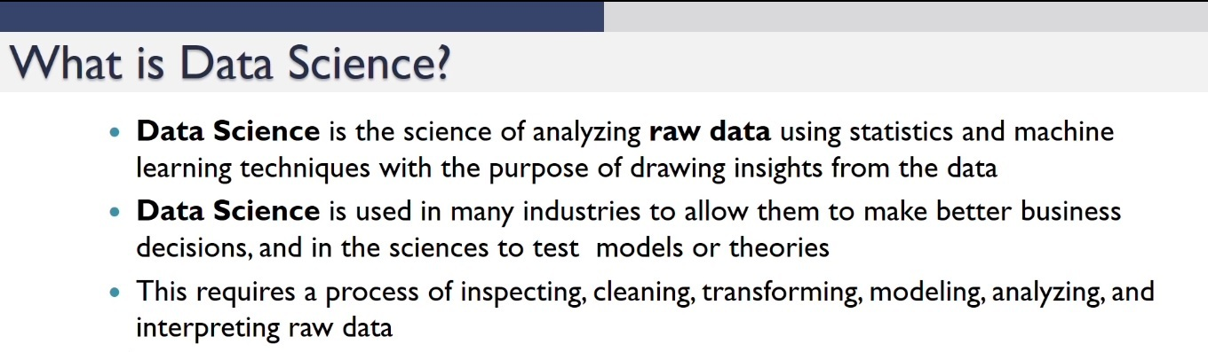

Slide 7
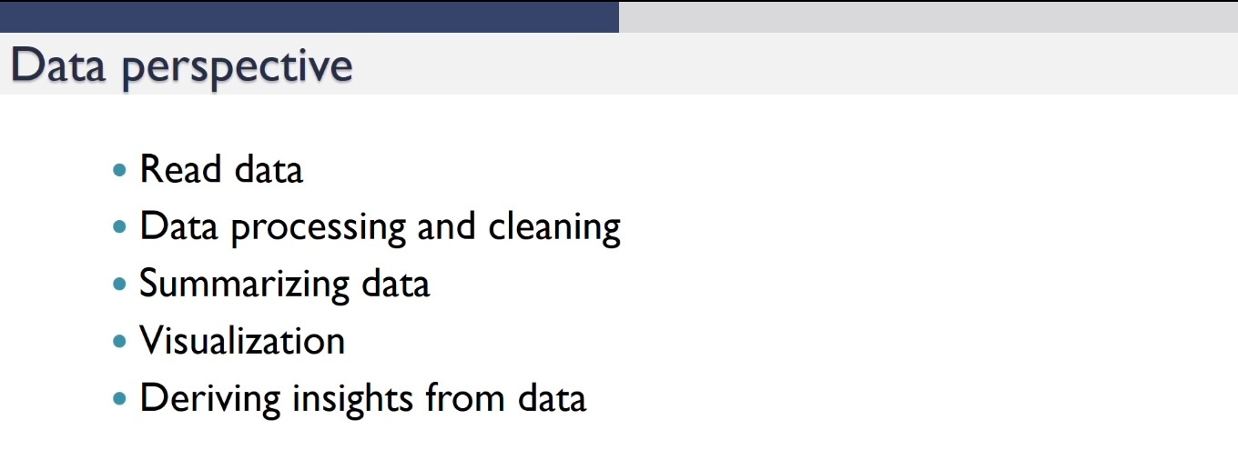

Slide 8
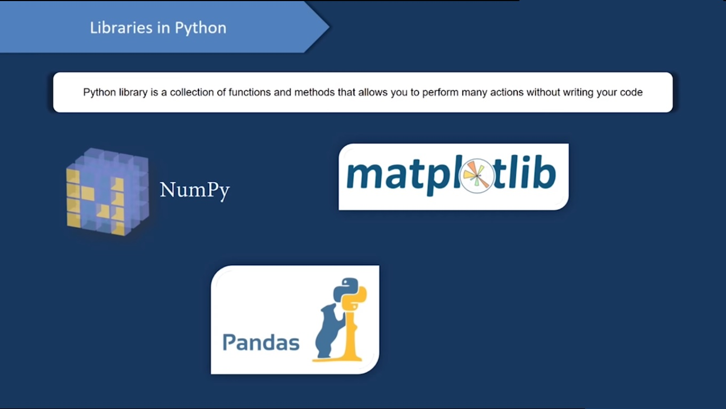

Slide 9
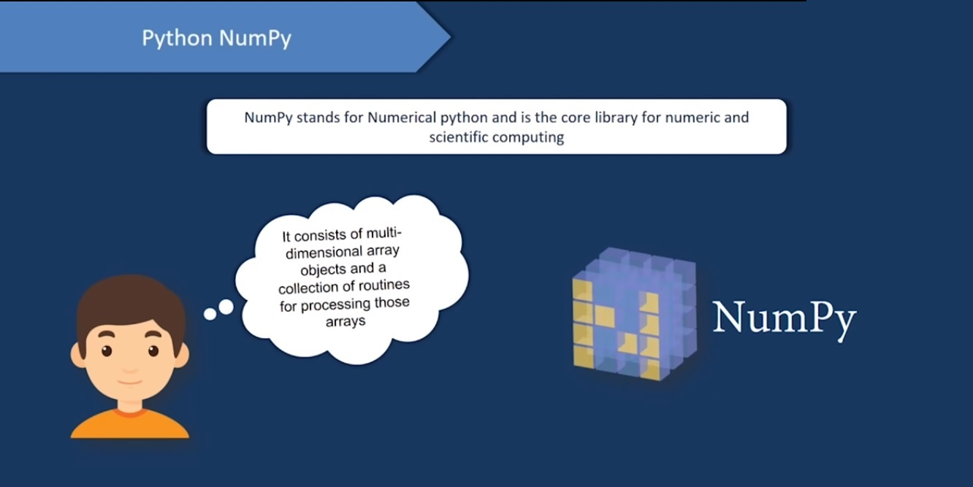

Slide 10
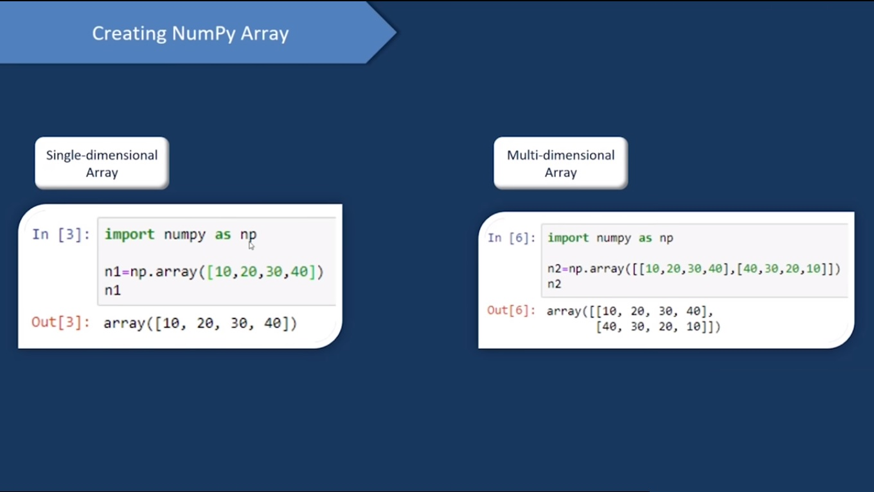

Slide 11
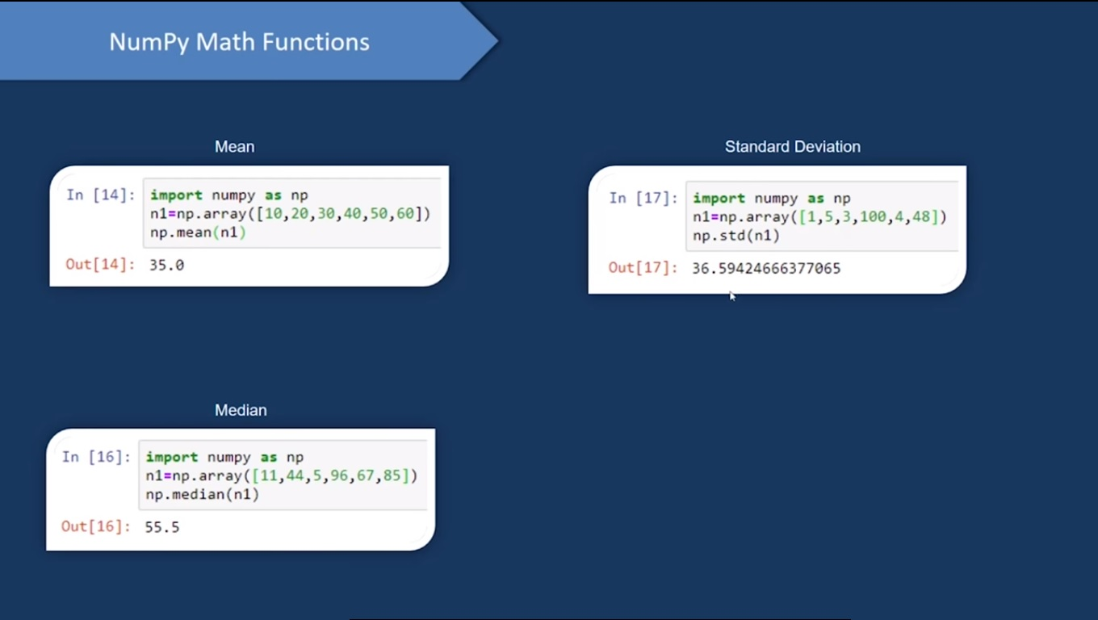

Slide 12
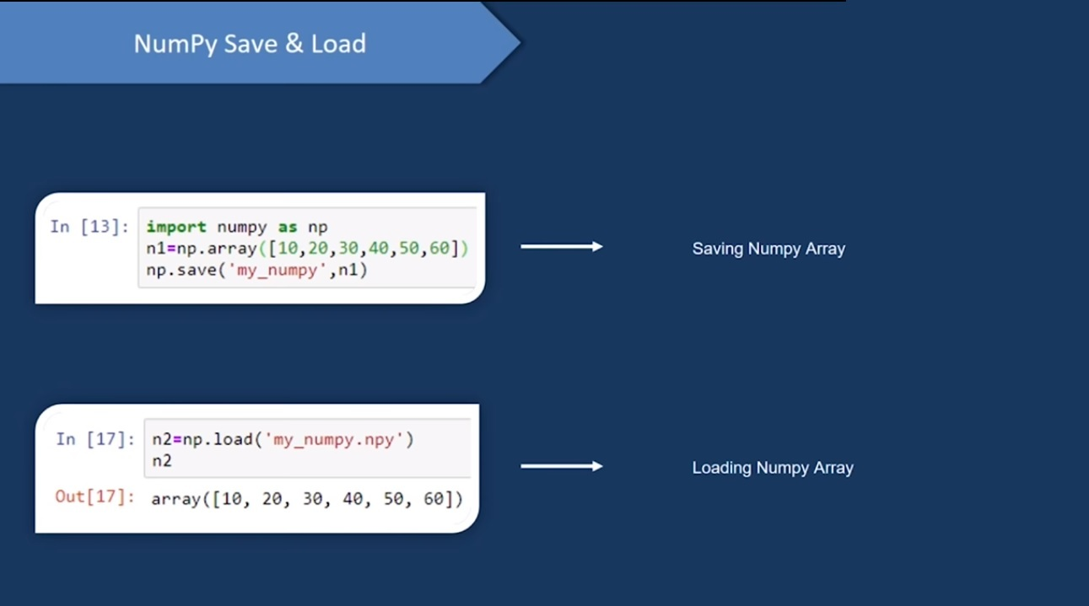

Slide 13
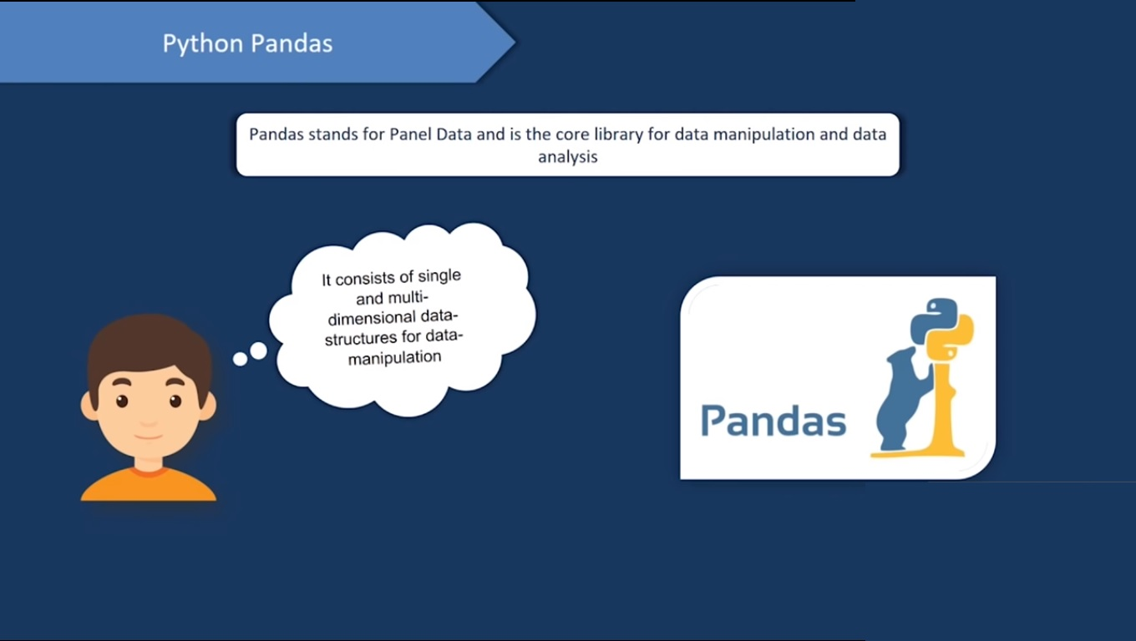

Slide 14
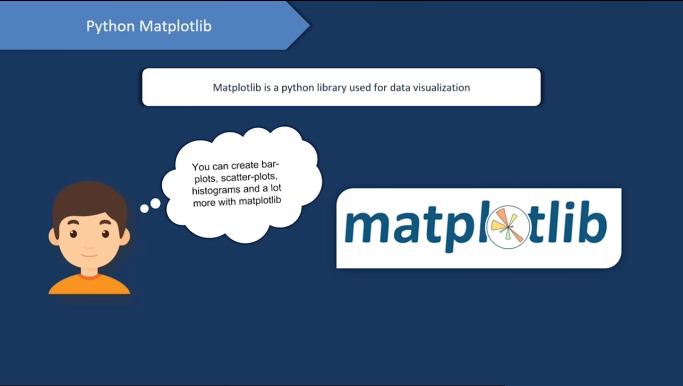

Slide 15
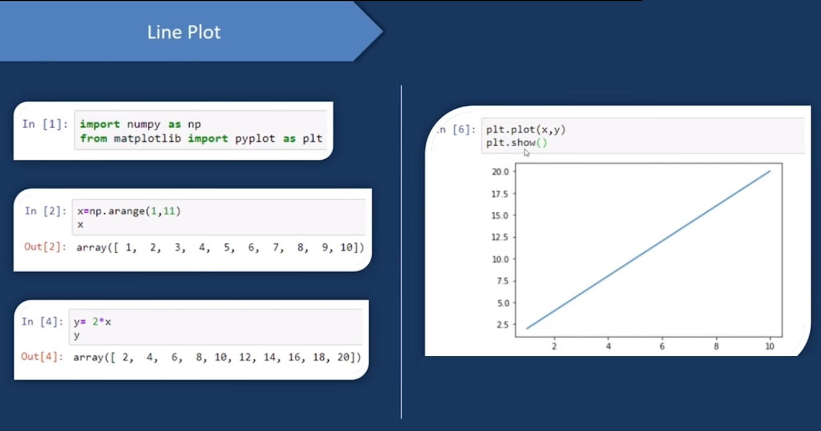

Slide 17
Measures of Central Tendency
A measure of central tendency is a single value that attempts to describe a set of data by identifying the central position within that set of data.
The mean, median and mode are all valid measures of central tendency, but under different conditions, some measures of central tendency become more appropriate to use than others.

Slide 18
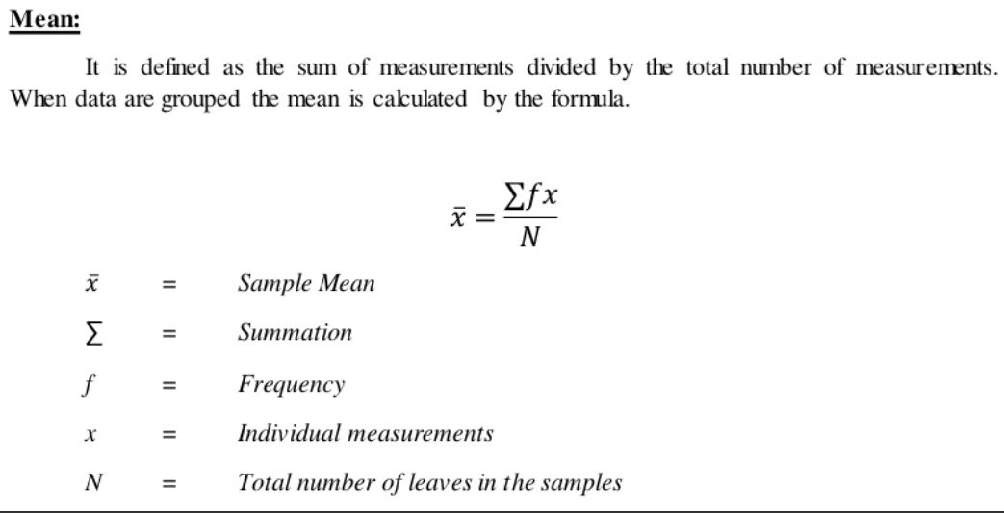
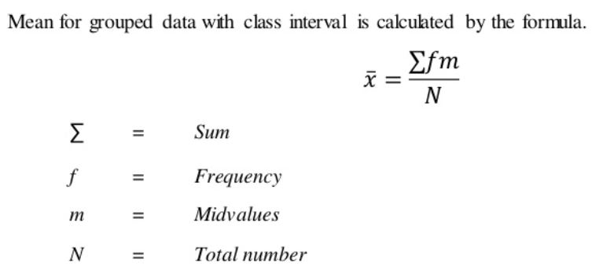

Slide 19
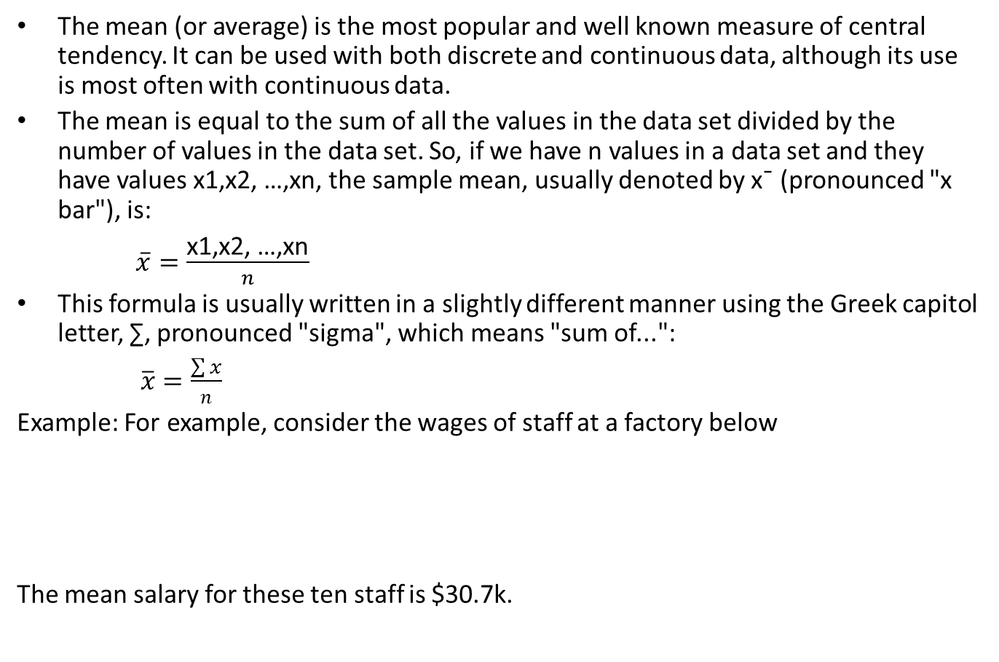
Mean
The mean (or average) is the most popular and well known measure of central tendency. It can be used with both discrete and continuous data, although its use is most often with continuous data.
The mean is equal to the sum of all the values in the data set divided by the number of values in the data set. So, if we have n values in a data set and they have values x1,x2, …,xn, the sample mean, usually denoted by x¯ (pronounced "x bar"), is:
$\overline{x}=\frac{\text{x}\text{1,}\text{x}\text{2, …,}\text{xn}}{n}$
This formula is usually written in a slightly different manner using the Greek capitol letter, ∑, pronounced "sigma", which means "sum of...":
$\overline{x}=\frac{\sum{x}}{n}$
Example: For example, consider the wages of staff at a factory below
The mean salary for these ten staff is $30.7k.
Staff | 1 | 2 | 3 | 4 | 5 | 6 | 7 | 8 | 9 | 10
Salary | 15k | 18k | 16k | 14k | 15k | 15k | 12k | 17k | 90k | 95k

Slide 20
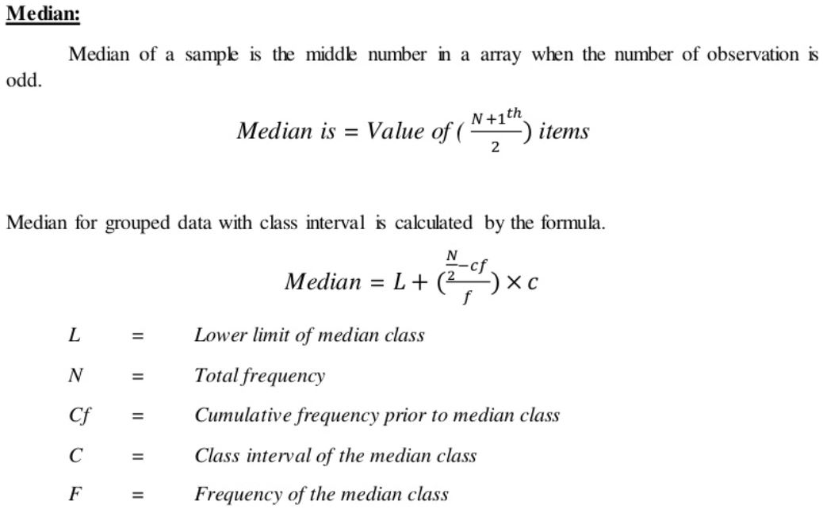

Slide 21
Median
The median is the middle score for a set of data that has been arranged in order of magnitude.
The median is less affected by outliers and skewed data. In order to calculate the median, suppose we have the data below:
65 55 89 56 35 14 56 55 87 45 92
Our median mark is the middle mark - in this case, 56
Example-2:
We first need to rearrange that data into order of magnitude (smallest first):
14 | 35 | 45 | 55 | 55 | 56 | 56 | 65 | 87 | 89 | 92
65 | 55 | 89 | 56 | 35 | 14 | 56 | 55 | 87 | 45
We again rearrange that data into order of magnitude (smallest first):
Only now we have to take the 5th and 6th score in our data set and
average them to get a median of 55.5.
14 | 35 | 45 | 55 | 55 | 56 | 56 | 65 | 87 | 89

Slide 22
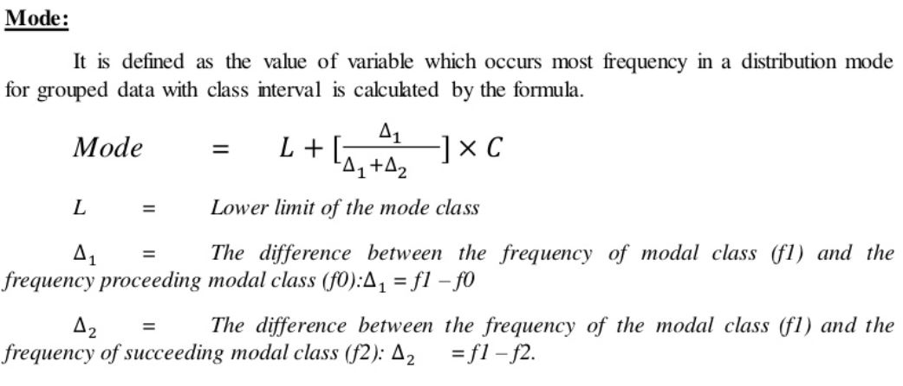
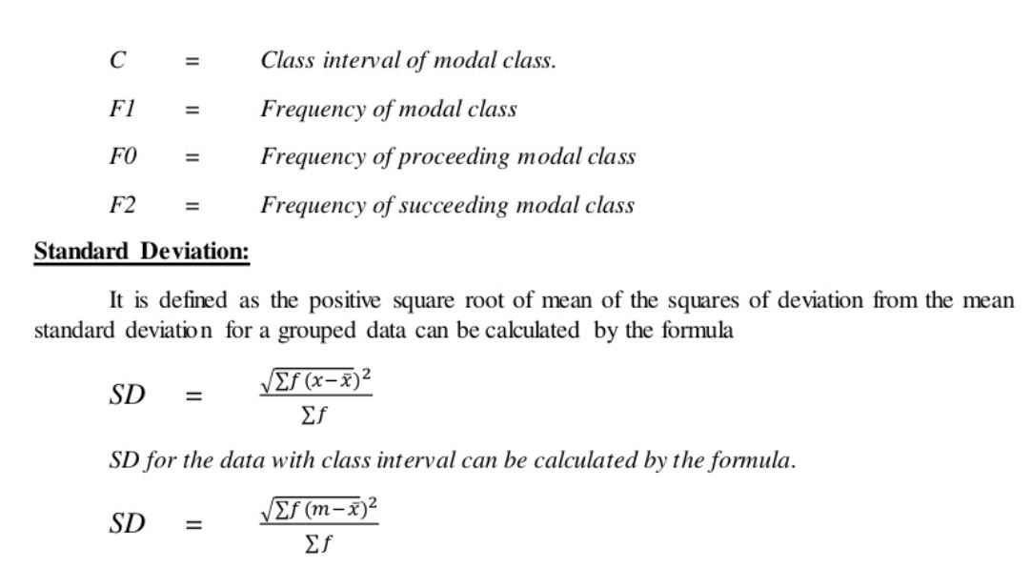

Slide 23
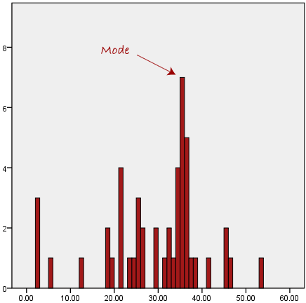
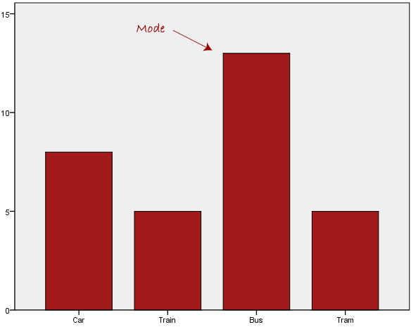
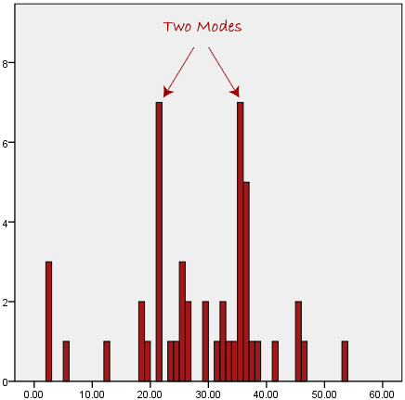
Mode
The mode is the most frequent score in our data set. On a histogram it represents the highest bar in a bar chart or histogram in fig-1.
Fig-1
Fig-2
Fig-3
Normally, the mode is used for categorical data where we wish to know which is the most common category, as illustrated in fig-2.
However, one of the problems with the mode is that it is not unique, so it leaves us with problems when we have two or more values that share the highest frequency, such as fig-3.

Slide 24
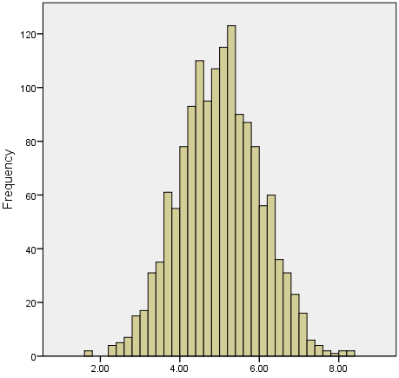
Skewed Distributions and the Mean and Median
We often test whether our data is normally distributed because this is a common assumption underlying many statistical tests. An example of a normally distributed set of data is presented below.
In any symmetrical distribution the mean, median and mode are equal.
However, the mean is widely preferred as the best measure of central tendency because it is the measure that includes all the values in the data set for its calculation, and any change in any of the scores will affect the value of the mean.

Slide 25
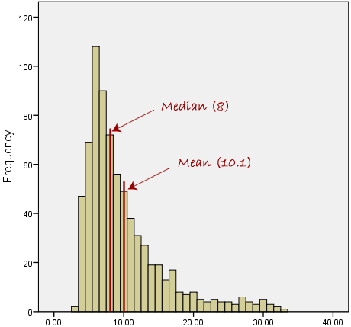
Contd.
However, when our data is skewed, for example, as with the right-skewed data set below:
The median is generally considered to be the best representative of the central location of the data.
The more skewed the distribution, the greater the difference between the median and mean, and the greater emphasis should be placed on using the median as opposed to the mean.
A classic example of the above right-skewed distribution is income (salary), where higher-earners provide a false representation of the typical income if expressed as a mean and not a median.

Slide 26
Summary of when to use the mean, median and mode
Please use the following summary table to know what the best measure of central tendency is with respect to the different types of variable.
Type of Variable | Best measure of central tendency
Nominal | Mode
Ordinal | Median
Interval/Ratio (not skewed) | Mean
Interval/Ratio (skewed) | Median

Slide 27
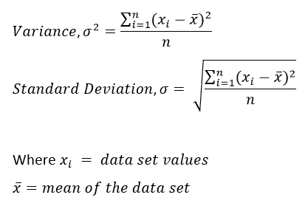
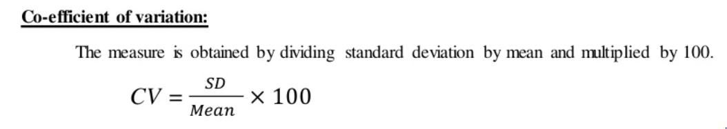

Slide 28
Example
The ages of you and your friends are 25, 26, 27, 30, and 32.
First, we must find the mean age: (25 + 26 + 27 + 30 + 32) / 5 = 28.
Then, we need to calculate the differences from the mean for each of the 5 friends.
25 – 28 = -3 26 – 28 = -2 27 – 28 = -1 30 – 28 = 2 32 – 28 = 4
Next, to calculate the variance, we take each difference from the mean, square it, then average the result.
Variance = ( (-3)² + (-2)² + (-1)² + 2² + 4²)/ 5
= (9 + 4 + 1 + 4 + 16 ) / 5 = 6.8
So, the variance is 6.8. And the standard deviation is the square root of the variance, which is 2.61.

Slide 29
PRACTICE-1
Write the python code for following statistical operations with and without library function:
Mean
Median
Mode
Standard Deviation and
Variance

Slide 30
Python code mean(), mode(), median()
import numpy speed = [99,86,87,88,111,86,103,87,94,78,77,85,86] x = numpy.mean(speed) x = numpy.median(speed)
x = numpy.mode(speed)
x = numpy.std(speed) x = numpy.var(speed) print(x)

Slide 31
# Python program to print mean of elements
# list of elements to calculate mean
n_num = [1, 2, 3, 4, 5]
n = len(n_num)
get_sum = sum(n_num)
mean = get_sum / n
print("Mean / Average is: " + str(mean))

Slide 32
# Python program to print median of elements
# list of elements to calculate median
n_num = [1, 2, 3, 4, 5]
n = len(n_num)
n_num.sort()
if n % 2 == 0:
median1 = n_num[n//2]
median2 = n_num[n//2 - 1]
median = (median1 + median2)/2
else:
median = n_num[n//2]
print("Median is: " + str(median))

Slide 33
# Python program to print mode of elements
from collections import Counter
# list of elements to calculate mode
n_num = [1, 2, 3, 4, 5, 5]
n = len(n_num)
data = Counter(n_num)
get_mode = dict(data)
mode = [k for k, v in get_mode.items() if v == max(list(data.values()))]
if len(mode) == n:
get_mode = "No mode found"
else:
get_mode = "Mode is / are: " + ', '.join(map(str, mode))
print(get_mode)

Slide 34
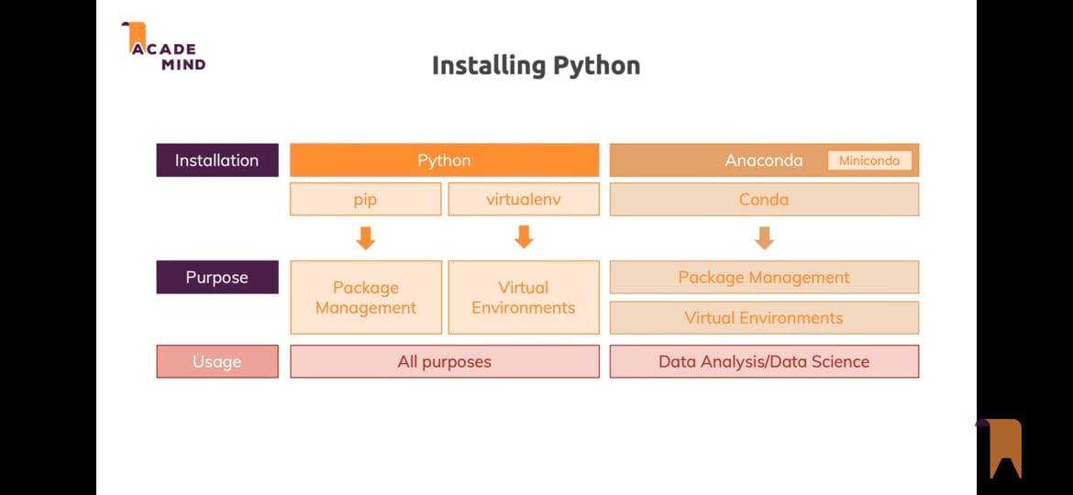
2. INSTALATION PROCESS

Slide 35
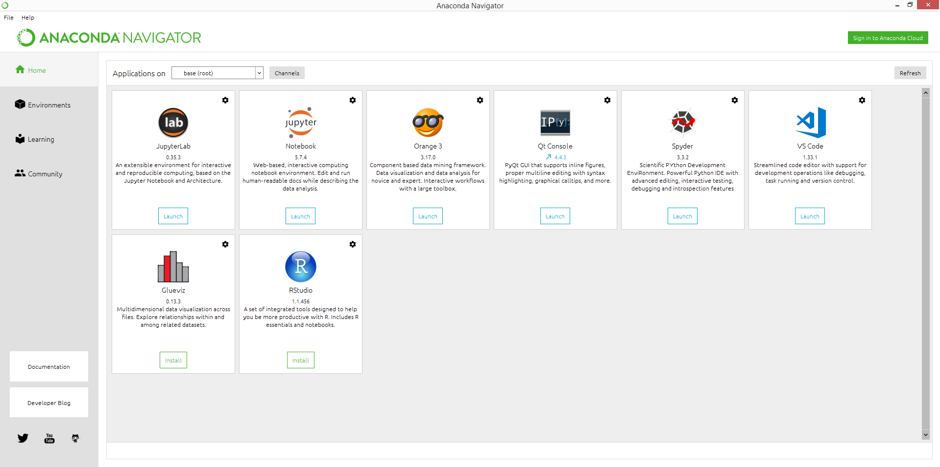
Anaconda Platform
Anaconda Individual Edition is the world's most popular Python distribution platform with over 20 million users worldwide.
Anaconda Navigator is a desktop graphical user interface (GUI) included in Anaconda distribution that allows users to launch applications and manage conda packages, environments and channels without using command-line commands.
Navigator can search for packages on Anaconda Cloud or in a local Anaconda Repository, install them in an environment, run the packages and update them. It is available for Windows, macOS and Linux.

Slide 36
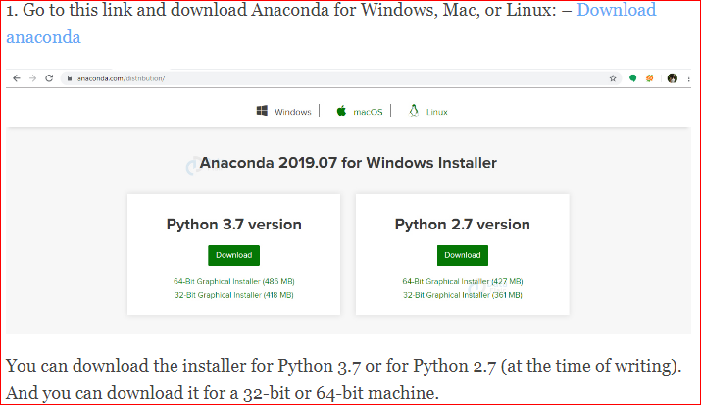
Anaconda Installation Steps

Slide 37
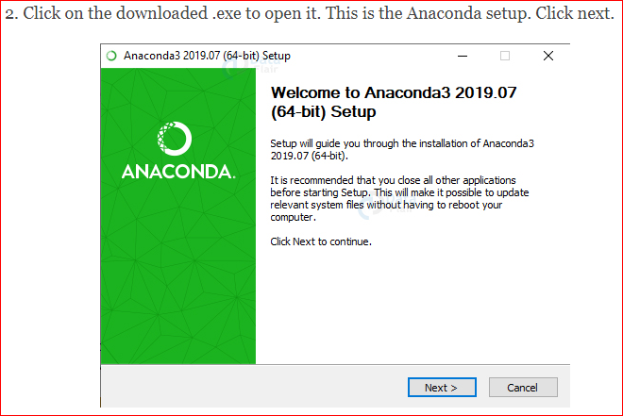

Slide 38
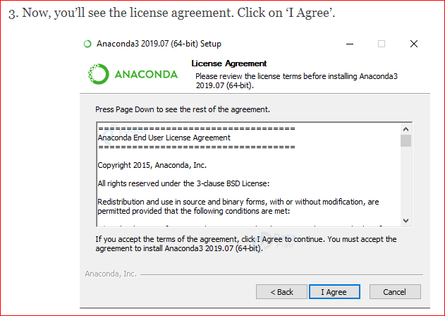

Slide 39
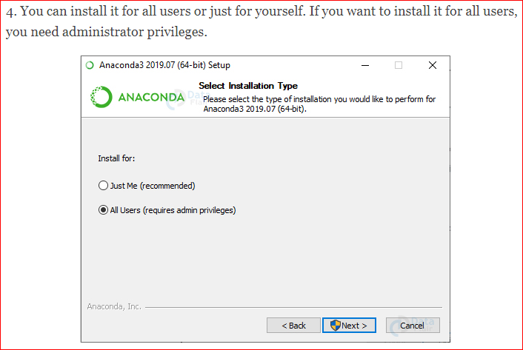

Slide 40
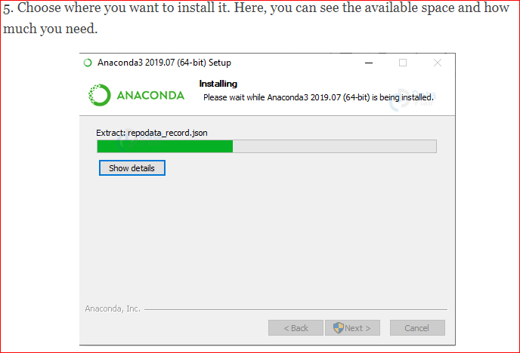

Slide 41
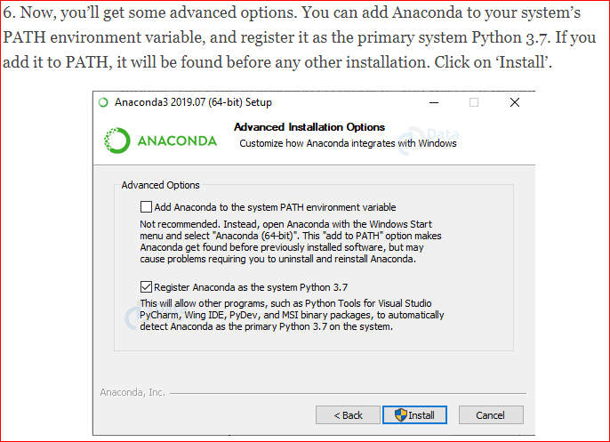

Slide 42
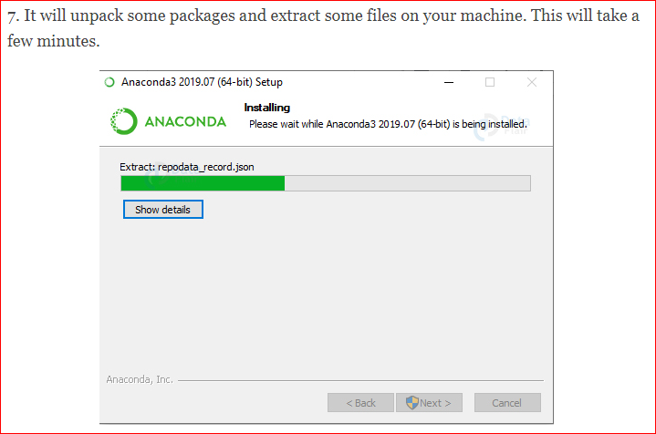

Slide 43
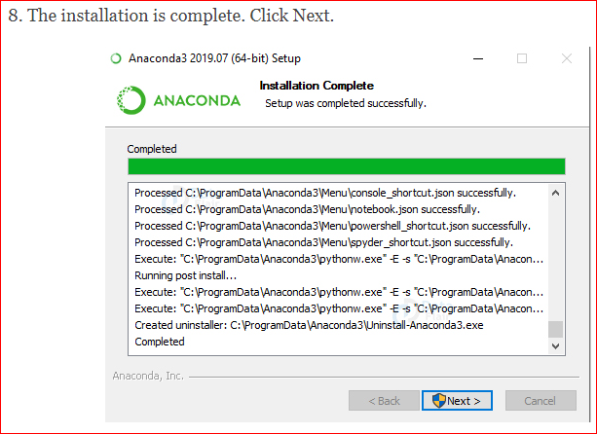

Slide 44


Slide 45
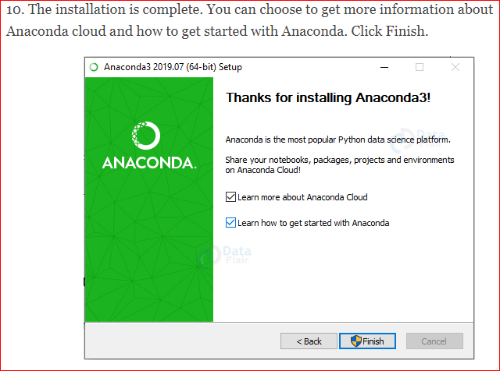

Slide 46
Benefits of Using Python Anaconda
Why should you use Anaconda for your project? Well, it does have the following benefits:
It is free and open-source
It has more than 1500 Python/R data science packages
Anaconda simplifies package management and deployment
It has tools to easily collect data from sources using machine learning and AI
It creates an environment that is easily manageable for deploying any project
Anaconda is the industry standard for developing, testing and training on a single machine
It has good community support- you can ask your questions there.
What you get
Download more than 1500 Python/R data science packages
Manage libraries, dependencies, and environments with conda
Build and train ML and deep learning models with scikit-learn, TensorFlow and Theano
Use Dask, NumPy, Pandas and Numba to analyze data scalably and fast
Perform visualization with Matplotlib, Bokeh, Datashader, and Holoviews

Slide 47
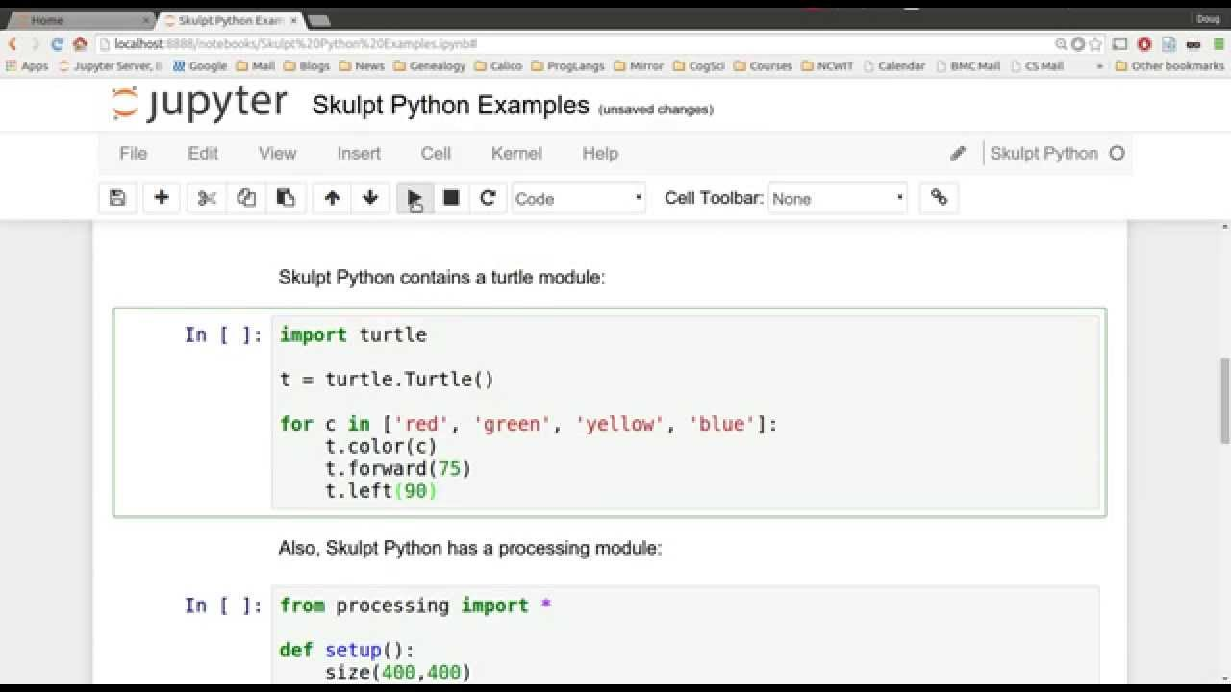
The Jupyter Notebook
The Jupyter Notebook is an open-source web application that allows you to create and share documents that contain live code, equations, visualizations and narrative text.
Uses include: data cleaning and transformation, numerical simulation, statistical modeling, data visualization, machine learning, and much more.

Slide 48
Introduction to Google-colab
Colaboratory, or 'Colab' for short, allows you to write and execute Python in your browser, with
Zero configuration required
Free access to GPUs
Easy sharing
Advantages
It performs all the tasks and code that Jupyter Notebook executes, using Python 2 and 3.
It is THE Google Documents of Code. The notebook can be shared and edited in real-time by different team members, add comments, see the edition history and go back to previous versions, like in google docs.
No more Anaconda. It is all cloud-based and it doesn't require any main settings or installations. If the library that you want to use is not on Colab, just pip it as usual. Being installed in the virtual environment.
Select your hardware accelerator. Run your notebook based on your necessities on a GPU or TPU.
Code snippets integrated: A pre-charged library of code to try several specific solutions. (like camera activation, visualizations, integrations, etc.).This is especially good when learning Machine Learning.
No more crazy scrolling. Table of contents visible all the time.
Personalization. Add your own shortcuts, night/light/adaptive - mode, and fonts.
Playground mode. With 2 clicks you can enter open a new notebook that won’t be saved, and try different code options without affecting your original code.

Slide 49
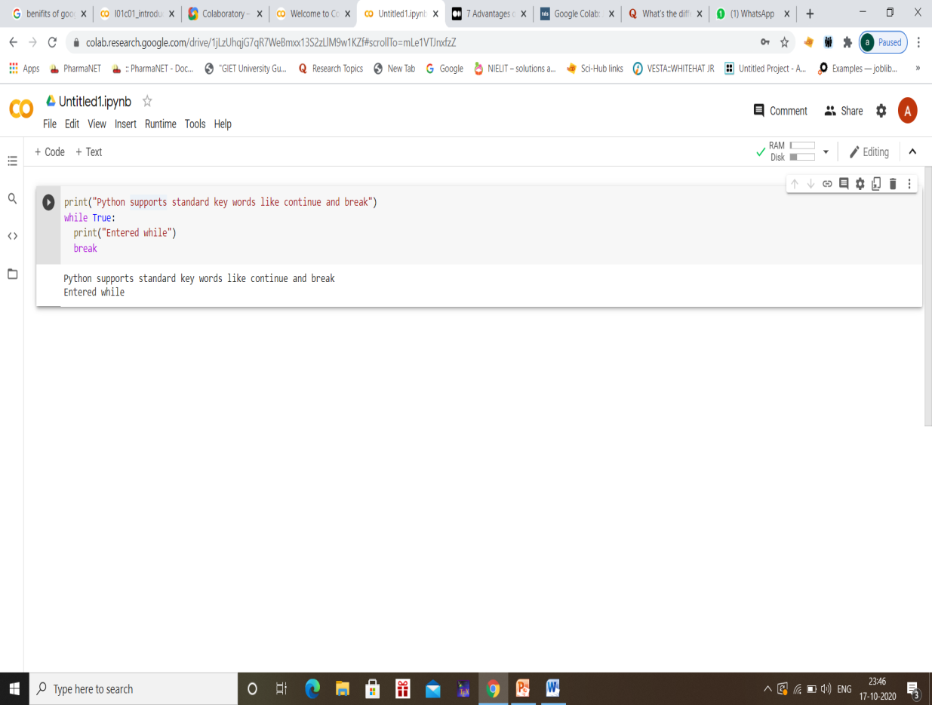
Reference Links:
https://research.google.com/colaboratory/faq.html
https://colab.research.google.com/notebooks/intro.ipynb
https://medium.com/python-in-plain-english/7-advantages-of-using-google-colab-for-python-82ac5166fd4b
https://www.quora.com/Whats-the-difference-between-Google-Colaboratory-and-Jupyter-notebooks

