Slide 1

DMDW Lab using PYTHON
5th Semester
Department of Computer Science and Engineering
GIET University, Gunupur

Slide 2
Assignment-2
Introduction of Dataset.
Dataset Upload.
Numpy & Pandas library methods.
Data Preprocessing.

Slide 3
What is Dataset
A dataset is a collection of data.
In the case of tabular data, a data set corresponds to
one or more database tables where every column of a
table represents a particular variable.
Each row corresponds to a given record of the data set
in question.
Each value is known as a datum/ a piece of information.

Slide 4
Import of dataset
Datasets are generally imported as a raw data files.
Datasets are generally in the form of CSV, JSON or XML data format.
For the purpose of this class, CSV is used in the accompanying examples.

Slide 5
Importing the Dataset - Python
import pandas as pd
# use pandas library for data frames
dataset = pd.read_csv( ‘data.csv’ ) # read CSV file into a data frame
CSV data converted to data frame.
pathname to raw data file
Function to read a CSV file
Data Frame adds these indices
Example Data (CSV File):
Generated Data Frame:
Age, Gender, Income, Spending 22,M,18000,6000
25,F,30000,8000
31,F,35000,12000
35,M,40000,18000
 | Age | Gender | Income | Spending
0 | 22 | M | 18000 | 6000
1 | 25 | F | 30000 | 8000
2 | 31 | F | 35000 | 12000
3 | 35 | M | 40000 | 18000

Slide 6
Categorical Variables
Independent Variables (Features)
Dependent Variables (Label)
Age | Gender | Income
25 | Male | 25000
26 | Female | 22000
30 | Male | 45000
24 | Female | 26000
Real Values
Value to Predict
Categorical Values

Slide 7
What is google colab
Colab (short for Colaboratory) is a free platform from Google that allows users to code in Python.
Colab is essentially the Google Suite version of a Jupyter Notebook.
Some of the advantages of Colab over Jupyter include an easier installation of packages and sharing of documents.
When loading files like CSV files, it requires some extra coding.
I will show you three ways to load a CSV file into Colab and insert it into a Pandas dataframe..

Slide 8
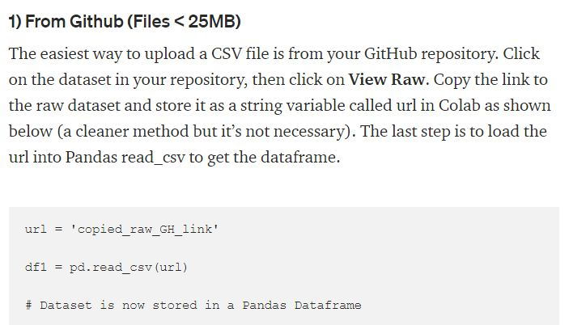
Way to upload dataset in colab

Slide 9
from local drive
2. From a local drive to upload from your local drive, start with the following code:
from google.colab import files uploaded = files.upload()
It will prompt you to select a file. Click on “Choose Files” then select and upload the file. Wait for the file to be 100% uploaded. You should see the name of the file once Colab has uploaded it.
3. Finally, type in the following code to import it into a dataframe
import io
df1 = pd.read_csv(io.BytesIO(uploaded['Filename.csv']))

Slide 10
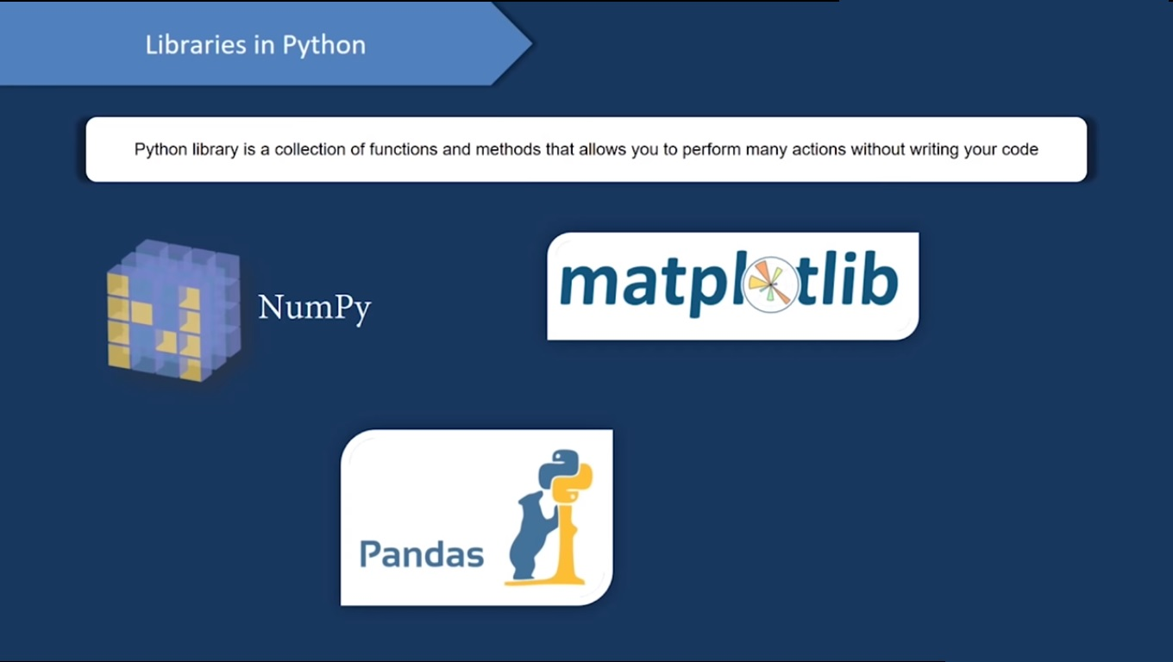

Slide 11
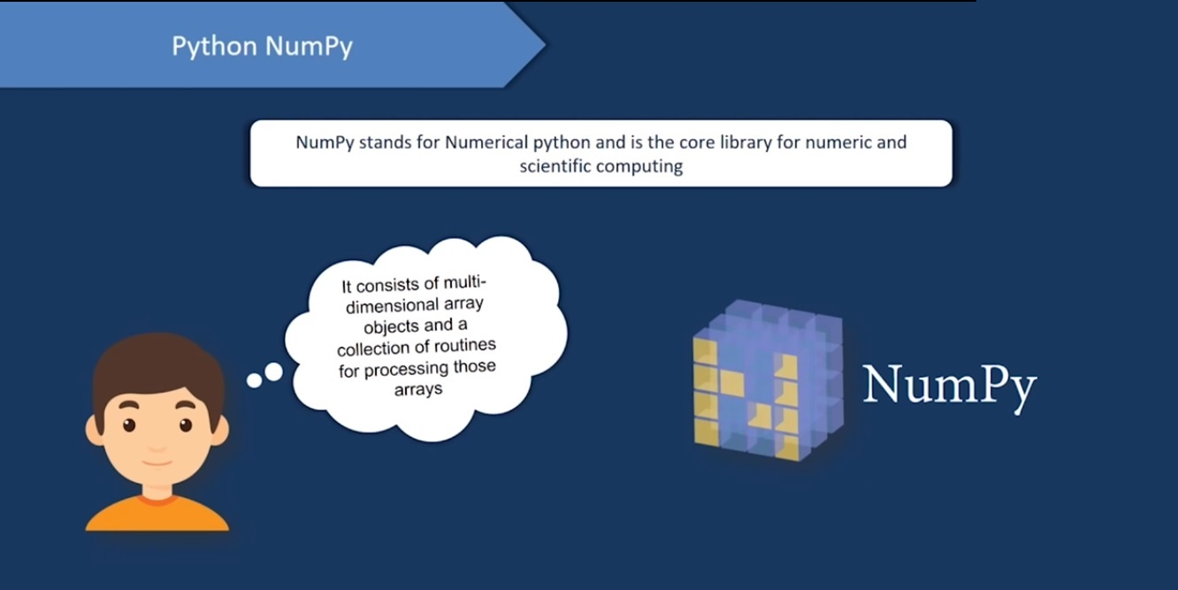

Slide 12
Numpy library
NumPy is a python library used for working with arrays.
NumPy stands for Numerical Python.
It also has functions for working in domain of linear algebra, fourier transform, and matrices.
NumPy was created in 2005 by Travis Oliphant. It is an open source project and you can use it freely.

Slide 13
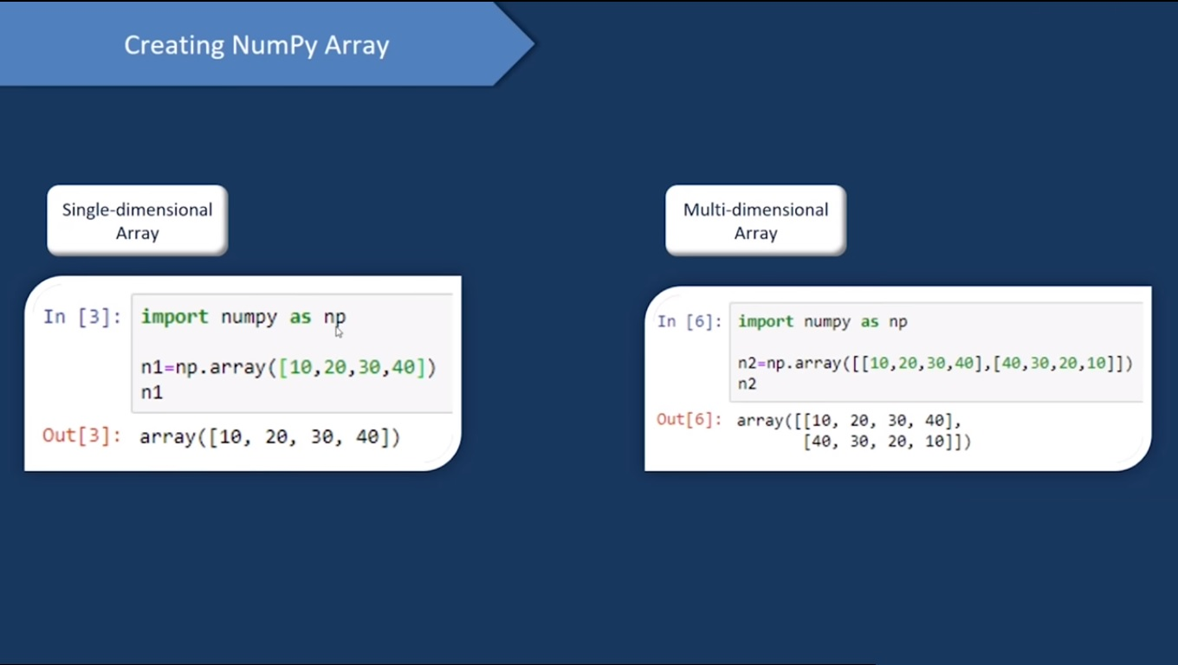

Slide 14
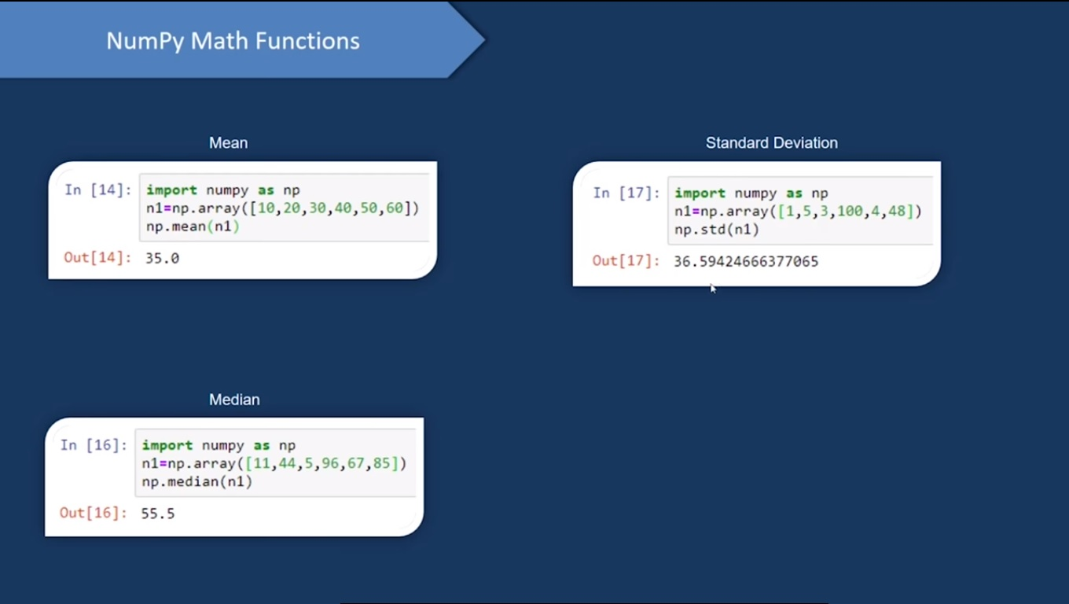

Slide 15
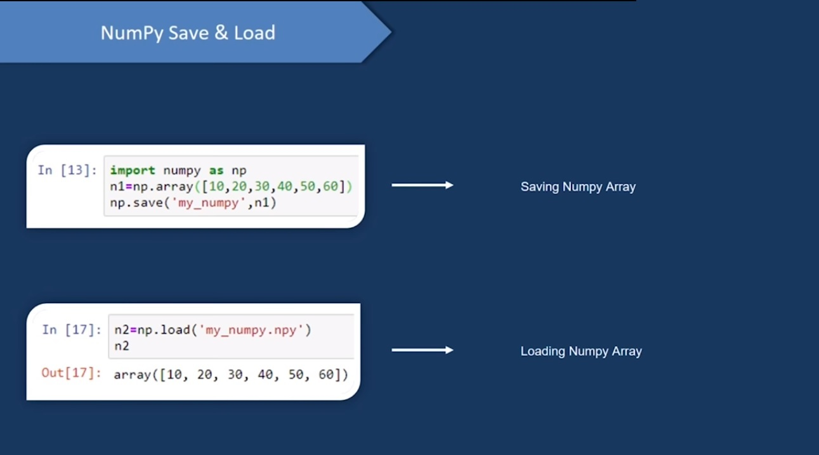

Slide 16
Installation of Numpy library
Syntax:- pip install numpy
Use of numpy in program :- import numpy as np

Slide 17
example Numpy library
import numpy arr = numpy.array([1, 2, 3, 4, 5]) print(arr)
import numpy as np arr = np.array([1, 2, 3, 4, 5]) print(arr)
import numpy as np print(‘np.__version__’)
import numpy as np arr = np.array([1, 2, 3, 4, 5]) print(arr) print(type(arr))

Slide 18
example Numpy library
5. # Create 2 new lists height and weight
height = [1.87, 1.87, 1.82, 1.91, 1.90, 1.85]
weight = [81.65, 97.52, 95.25, 92.98, 86.18, 88.45] # Import the numpy package as np
import numpy as np
# Create 2 numpy arrays from height and weight
np_height = np.array(height)
np_weight = np.array(weight)

Slide 19
example Numpy library
7.import numpy as np
a = np.array(42)
b = np.array([1, 2, 3, 4, 5])
c = np.array([[1, 2, 3], [4, 5, 6]])
d = np.array([[[1, 2, 3], [4, 5, 6]], [[1, 2, 3], [4, 5, 6]]])
print(a.ndim)
print(b.ndim)
print(c.ndim)
print(d.ndim)

Slide 20
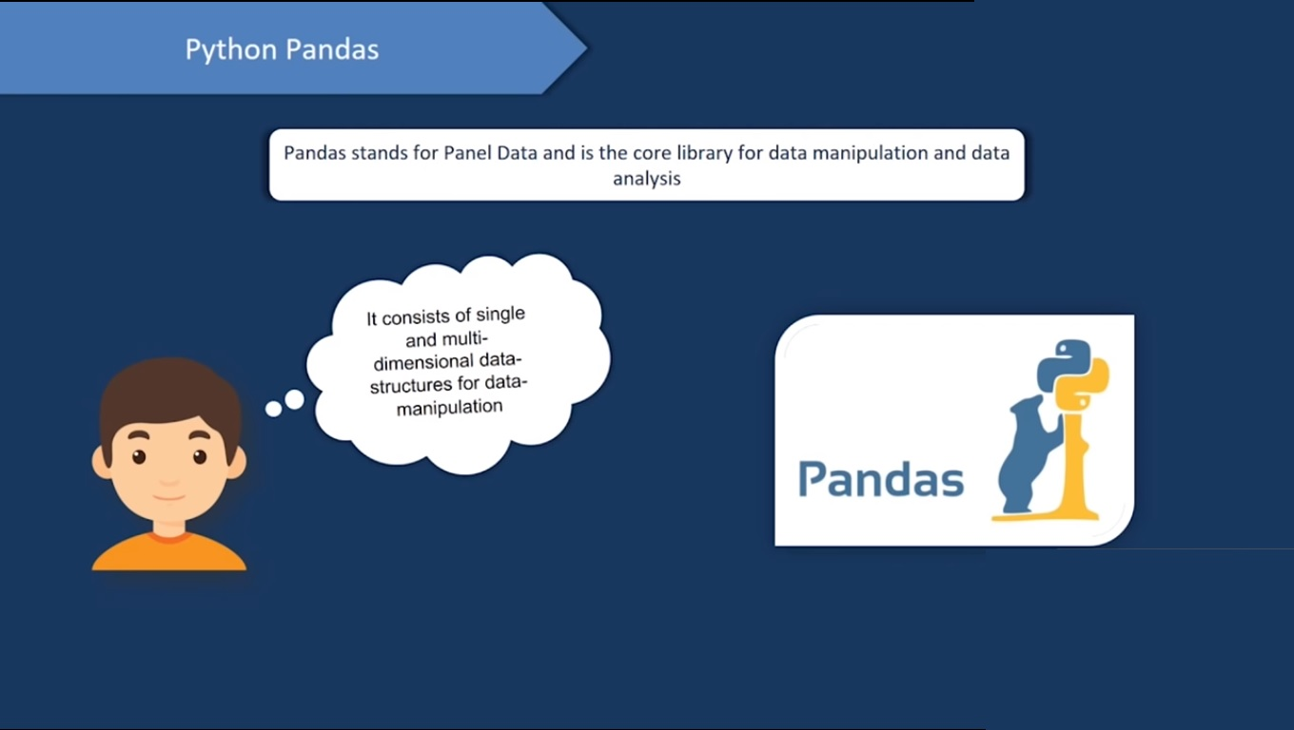

Slide 21
Pandas library
pandas is an open source, BSD-licensed library providing high-performance, easy-to-use data structures and data analysis tools for the Python programming language.
pandas' data analysis and modeling features enable users to carry out their entire data analysis workflow in Python.

Slide 22
Installation of pandas library
Syntax:- pip install pandas
Use of numpy in program :- import pandas as pd

Slide 23
Example of pandas library
Ex-1)
import pandas as pd
data = [1,2,3,4,5]
df = pd.DataFrame(data)
print(df)

Slide 24
Example of pandas library
Ex-2)
import pandas as pd
data = [['Alex',10],['Bob',12],['Clarke',13]]
df = pd.DataFrame(data,columns=['Name','Age'])
print(df)

Slide 25
Example of pandas library
Ex-3)
import pandas as pd
d = {'one' : pd.Series([1, 2, 3], index=['a', 'b', 'c']),
'two' : pd.Series([1, 2, 3, 4], index=['a', 'b', 'c', 'd'])}
df = pd.DataFrame(d)
print ("Adding a new column by passing as Series:")
df['three']=pd.Series([10,20,30],index=['a','b','c'])
print(df)
print ("Adding a new column using the existing columns in Data")
df['four']=df['one']+df['three']
print(df)

Slide 26
Example of pandas library
Ex-4)
import pandas as pd
data = [['Alex',10],['Bob',12],['Clarke',13]]
df = pd.DataFrame(data,columns=['Name','Age'],dtype=float)
print(df)

Slide 27
Example of pandas library
Ex-5)
import pandas as pd
data = {'Name':['Tom', 'Jack', 'Steve', 'Ricky'],'Age':[28,34,29,42]}
df = pd.DataFrame(data)
print(df)

Slide 28
Data Preprocessing

Slide 29
What is Data Preprocessing
In a real-world, data preprocessing is one of the most important things, and it is one of the common factors of success of a model.
if there is correct data preprocessing and feature engineering, then that model is more likely to produce noticeably better results as compared to a model for which data is not well preprocessed.

Slide 30
Steps involved in data preprocessing :
Importing the required Libraries
Importing the data set
Handling the Missing Data.
Encoding Categorical Data.
Splitting the data set into test set and training set.
Feature Scaling.

Slide 31
Importing the required Libraries
we will require to import Numpy and Pandas.
Numpy is a Library which contains Mathematical functions and is used for scientific computing.
Pandas is used to import and manage the data sets.
import pandas as pd import numpy as np

Slide 32
Importing the Dataset
Data sets are available in .csv or excel or txt format.
A CSV file stores tabular data in plain text. Each line of the file is a data record. We use the read_csv method of the pandas library to read a local CSV file as a dataframe.
For Excel file
dataset = pd.read_csv('Data.csv')
dataset = pd.read_excel('Data.xls')

Slide 33
Contd…
After carefully inspecting our dataset, we are going to create a matrix of features in our dataset (X) and create a dependent vector (Y) with their respective observations.
To read the columns, we will use iloc of pandas (used to fix the indexes for selection) which takes two parameters — [row selection, column selection].
X = dataset.iloc[:, :-1].values y = dataset.iloc[:, 3].values

Slide 34
Handling the Missing Data
To do this we need to replace the missing data by the Mean or Median of the entire column.
For this we will be using the sklearn.preprocessing Library which contains a class called Imputer which will help us in taking care of our missing data.
Our object name is imputer. The Imputer class can take parameters like :
missing_values : It is the placeholder for the missing values. All occurrences of missing_values will be imputed. We can give it an integer or “NaN” for it to find missing values.
strategy : It is the imputation strategy — If “mean”, then replace missing values using the mean along the axis (Column). Other strategies include “median” and “most_frequent”.
axis : It can be assigned 0 or 1, 0 to impute along columns and 1 to impute along rows.
from sklearn.preprocessing import Imputer imputer = Imputer(missing_values = "NaN", strategy = "mean", axis = 0)

Slide 35
Contd…
Now we fit the imputer object to our data.
Now replacing the missing values with the mean of the column by using transform method.
imputer = imputer.fit(X[:, 1:3])
X[:, 1:3] = imputer.transform(X[:, 1:3])

Slide 36
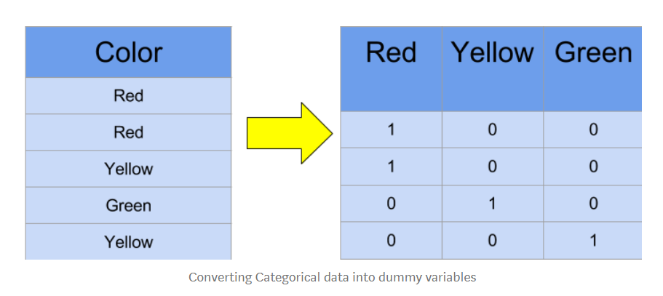
Encoding categorical data
To do this we import “LabelEncoder” class from “sklearn.preprocessing” library and create an object labelencoder_X of the LabelEncoder class.
After that we use the fit_transform method on the categorical features.
After Encoding it is necessary to distinguish between between the variables in the same column, for this we will use OneHotEncoder class from sklearn.preprocessing library.

Slide 37
One-Hot Encoding
One hot encoding transforms categorical features to a format that works better with classification and regression algorithms.
from sklearn.preprocessing import LabelEncoder, OneHotEncoder labelencoder_X = LabelEncoder() X[:, 0] = labelencoder_X.fit_transform(X[:, 0])
onehotencoder = OneHotEncoder(categorical_features = [0]) X = onehotencoder.fit_transform(X).toarray()
labelencoder_y = LabelEncoder() y = labelencoder_y.fit_transform(y)

Slide 38
Splitting the Data set into Training set and Test Set
we divide our data into two sets, one for training our model called the training set and the other for testing the performance of our model called the test set.
we will create 4 sets —
X_train (training part of the matrix of features),
X_test (test part of the matrix of features),
Y_train (training part of the dependent variables associated with the X train sets, and therefore also the same indices) ,
Y_test (test part of the dependent variables associated with the X test sets, and therefore also the same indices).
from sklearn.model_selection import train_test_split

Slide 39
Contd…
We will assign to them the test_train_split, which takes the parameters — arrays (X and Y), test_size (Specifies the ratio in which to split the data set).
X_train, X_test, Y_train, Y_test = train_test_split( X , Y , test_size = 0.2, random_state = 0)

Slide 40
Feature Scaling
To avoid this Feature standardization or Z-score normalization is used. This is done by using “StandardScaler” class of “sklearn.preprocessing”.
Further we will transform our X_test set while we will need to fit as well as transform our X_train set.
The transform function will transform all the data to a same standardized scale.
from sklearn.preprocessing import StandardScaler sc_X = StandardScaler()
X_train = sc_X.fit_transform(X_train) X_test = sc_X.transform(X_test)

Slide 41
Next Assignment-3
Introduction to Matplotlib and Seaborn library.
Data visualization.
Different plotting techniques and their importance.

Slide 42
example Numpy library in matplotlib
import numpy as np
from matplotlib import pyplot as plt
x = np.arange(1,11)
y = 2 * x + 5
plt.title("Matplotlib demo")
plt.xlabel("x axis caption")
plt.ylabel("y axis caption")
plt.plot(x,y,"ob")
plt.show()

