Slide 1

DMDW Lab using PYTHON
5th Semester
Department of Computer Science and Engineering
GIET University, Gunupur

Slide 2
Assignment-3
Introduction of Data visualization.
Introduction to Matplotlib and Seaborn library.
Different plotting techniques and their importance.

Slide 3
Data Visualization
Data visualization is the process of converting raw data into easily understandable pictorial representation, which enables fast and effective decisions.
Data visualization is a strategy where we represent the quantitative information in a graphical form.
key points are –
Data visualization is the first step of analysis work.
It gives intuitive understanding of data.
Helps you to see data in certain meaningful patterns.
Visual representations enhance the human cognitive process.
Benefits of Data Visualization
Data visualization allows users to see several different perspectives of data.
Data visualization makes it possible to interpret vast amounts of data.
It offers ability to note expectations in data.
Exploring trends within a database through visualization by letting analysts navigate through data and visually orient themselves to the patterns in the data.

Slide 4
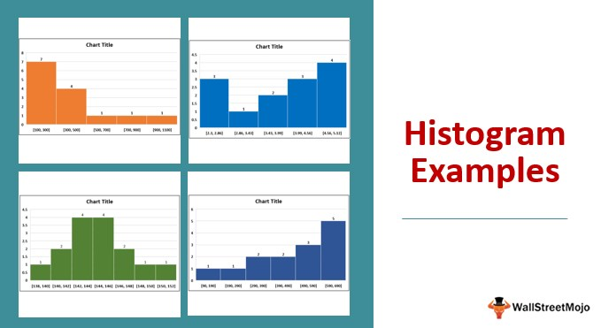
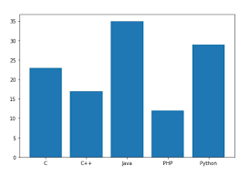
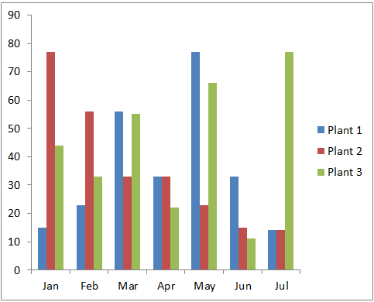
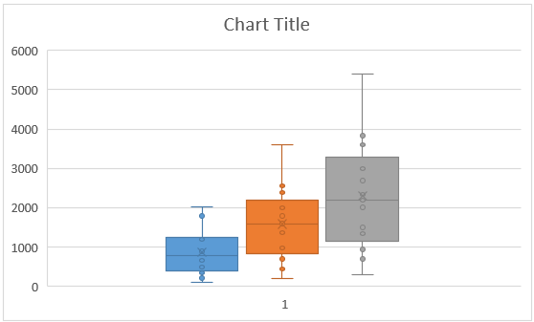
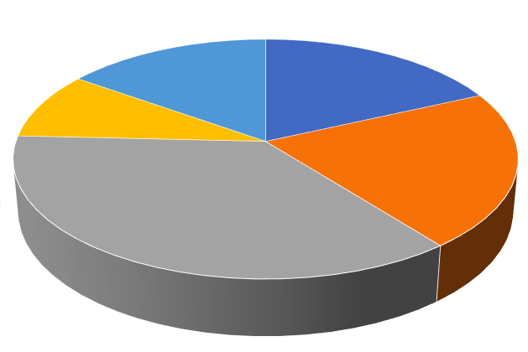
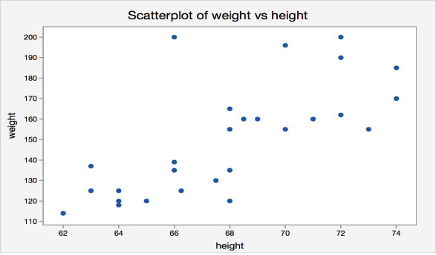
Data Visualization Techniques
Some of the popular techniques are:
Histogram Bar plot Column Chart
Box plot chart Pie chart Scatter plot

Slide 5
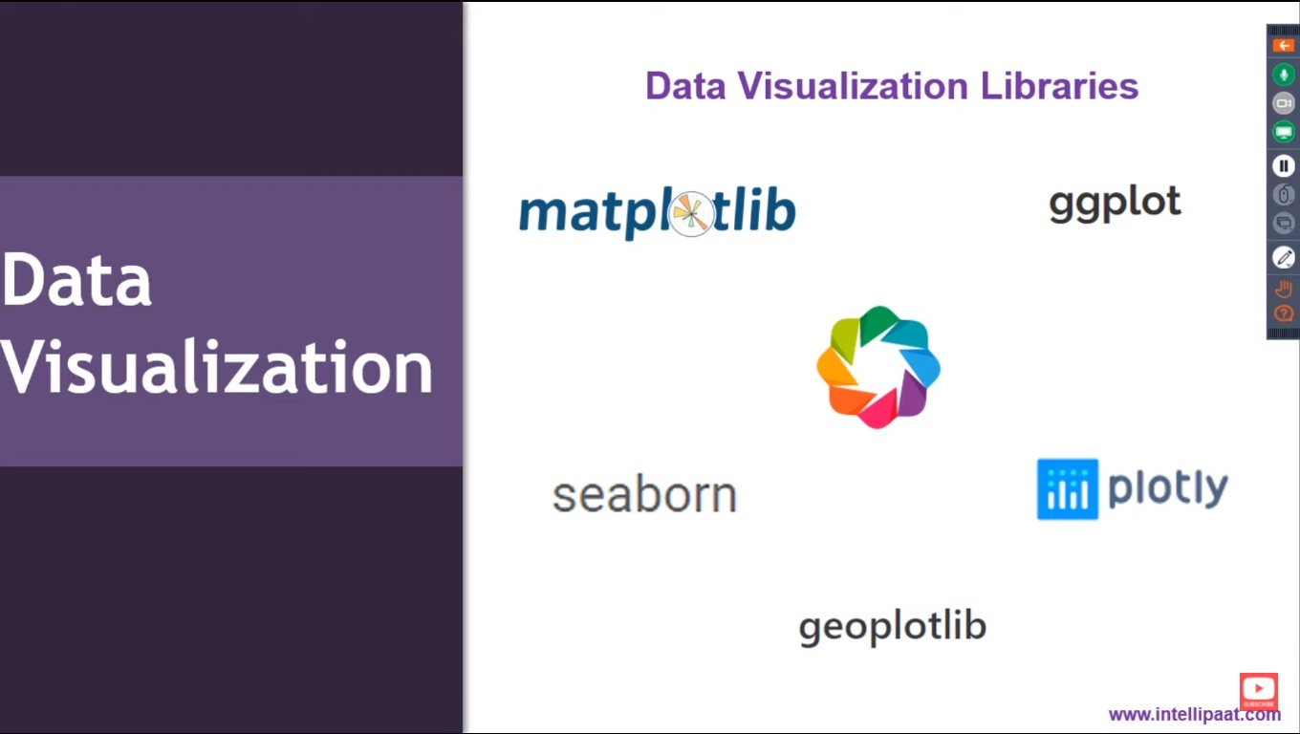

Slide 6
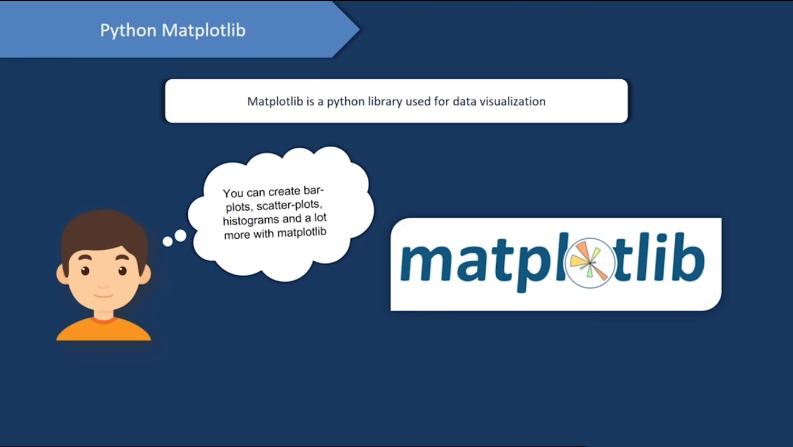

Slide 7
Matplotlib
Matplotlib library is a graph plotting library of python.
Using matplotlib we can plot different line graphs, scatter plots, bar graphs, pie chart and histograms .
Using these plots we can visualize our data.
It provides an object-oriented APIs for embedding plots into applications using general-purpose GUI toolkits like Tkinter, wxPython, Qt, or GTK+.

Slide 8
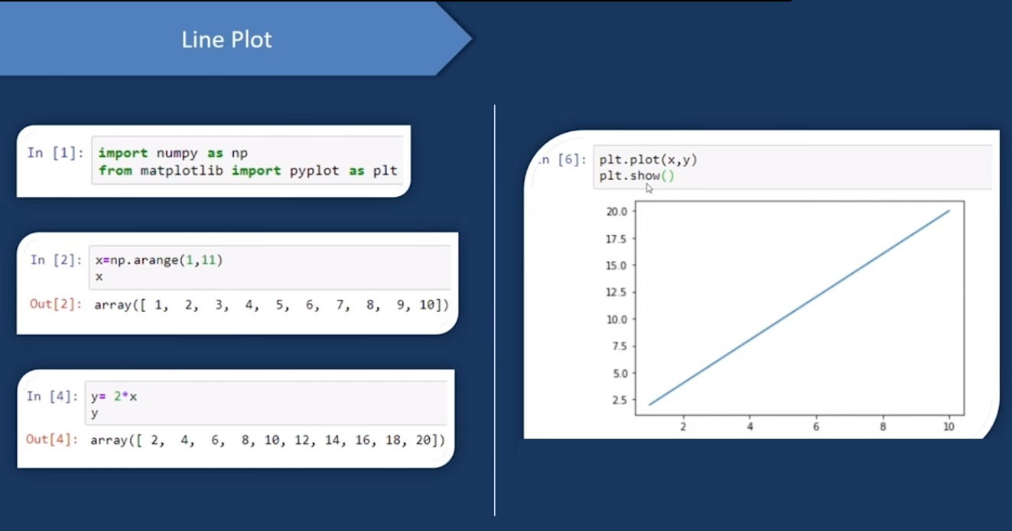

Slide 9
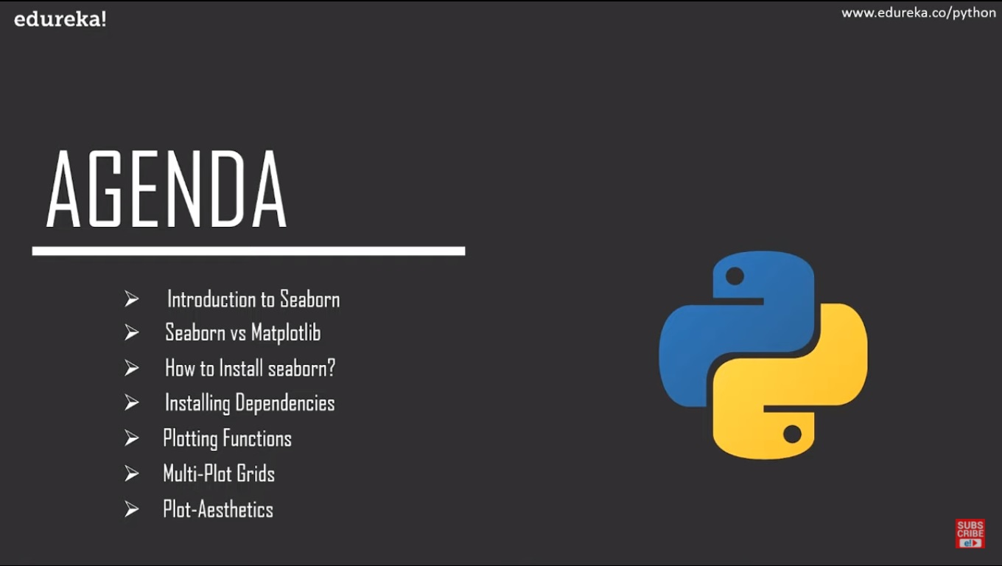


Slide 10
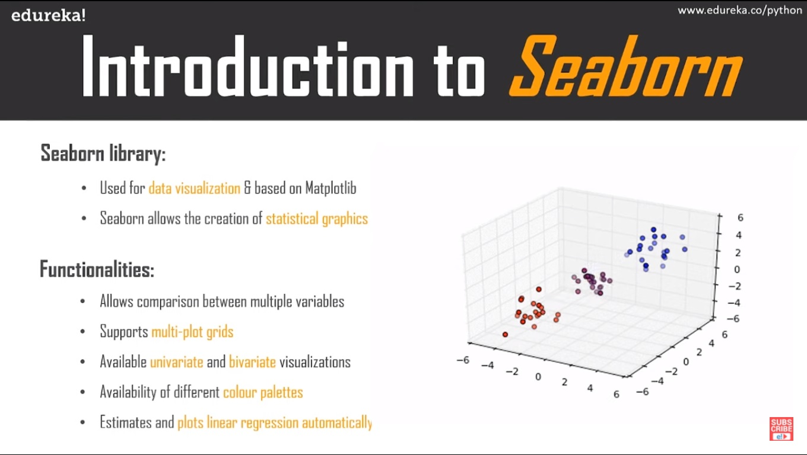

Slide 11
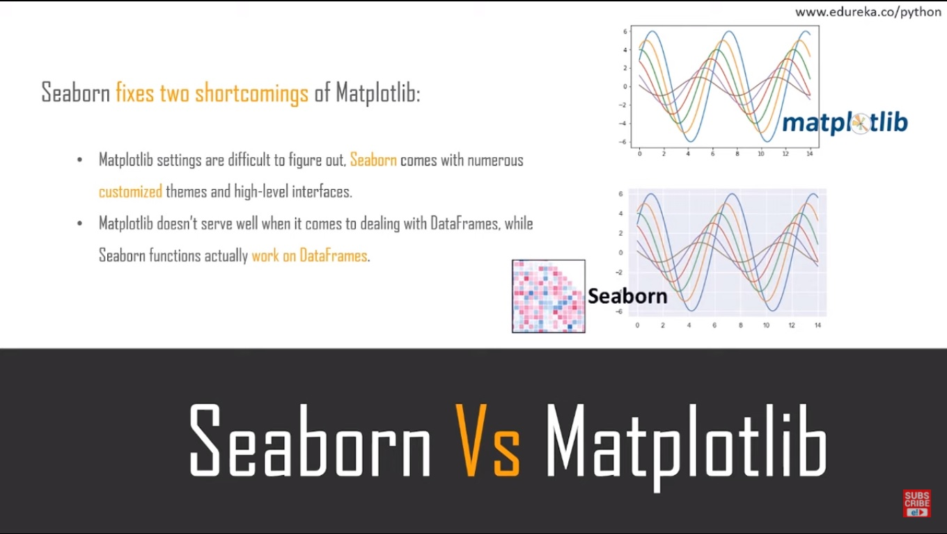

Slide 12
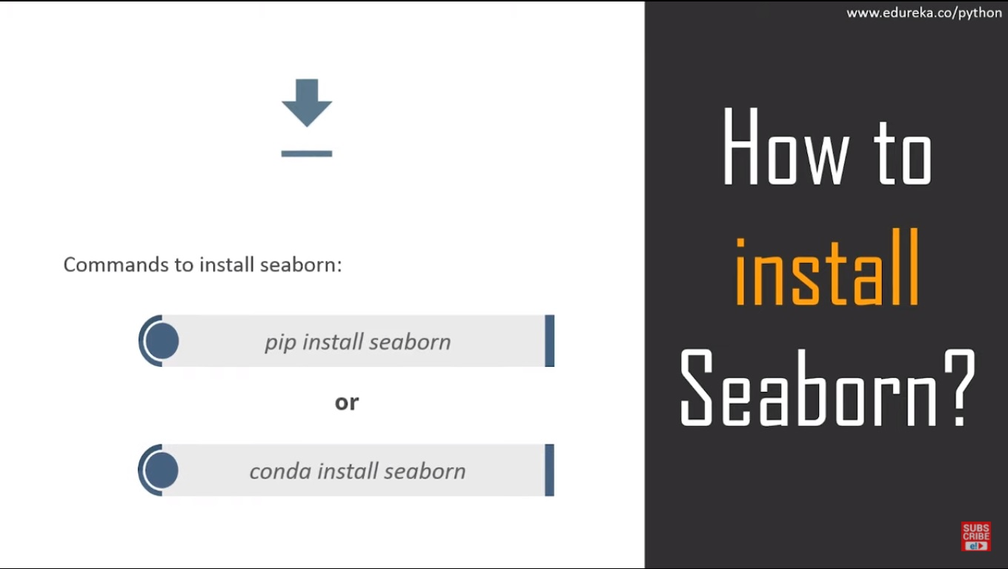

Slide 13
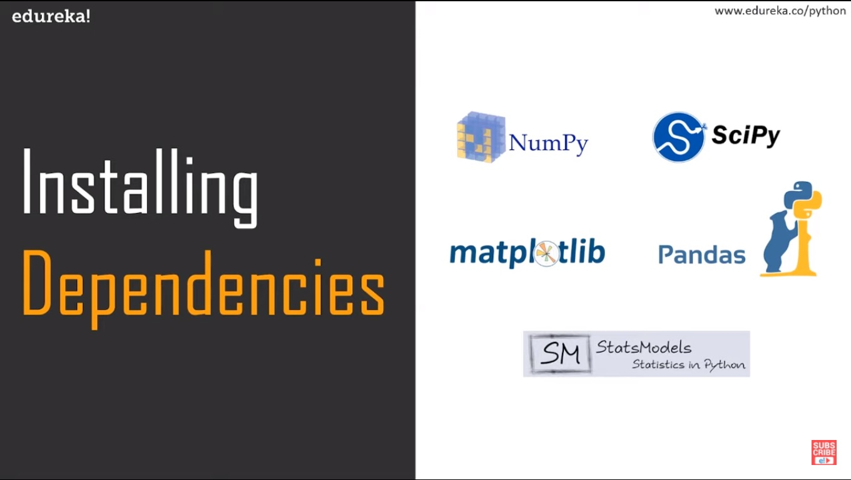

Slide 14
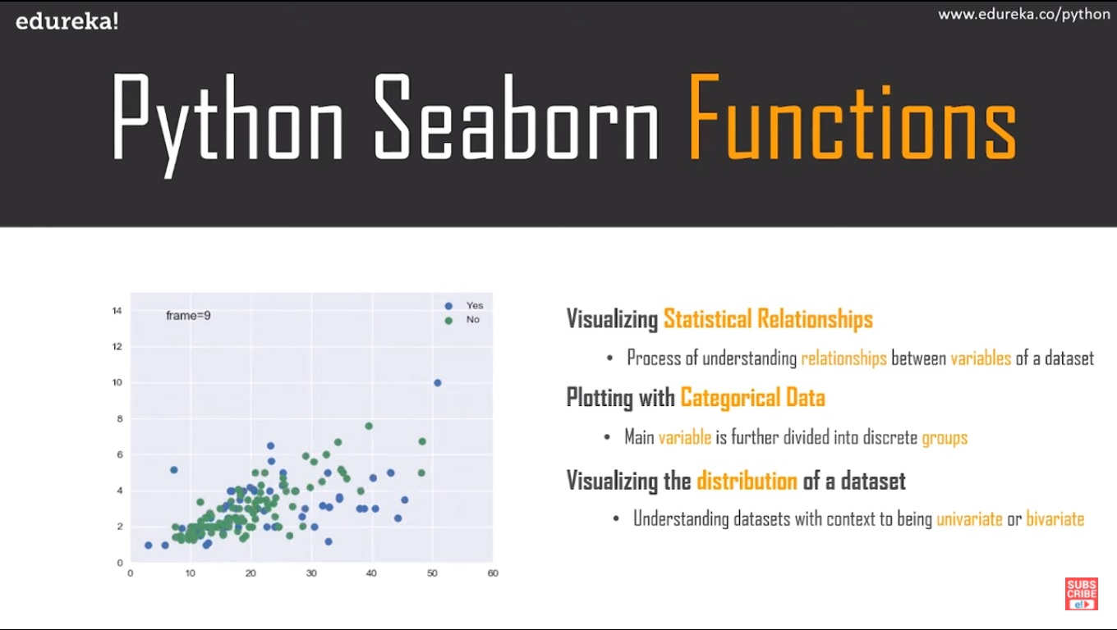

Slide 15
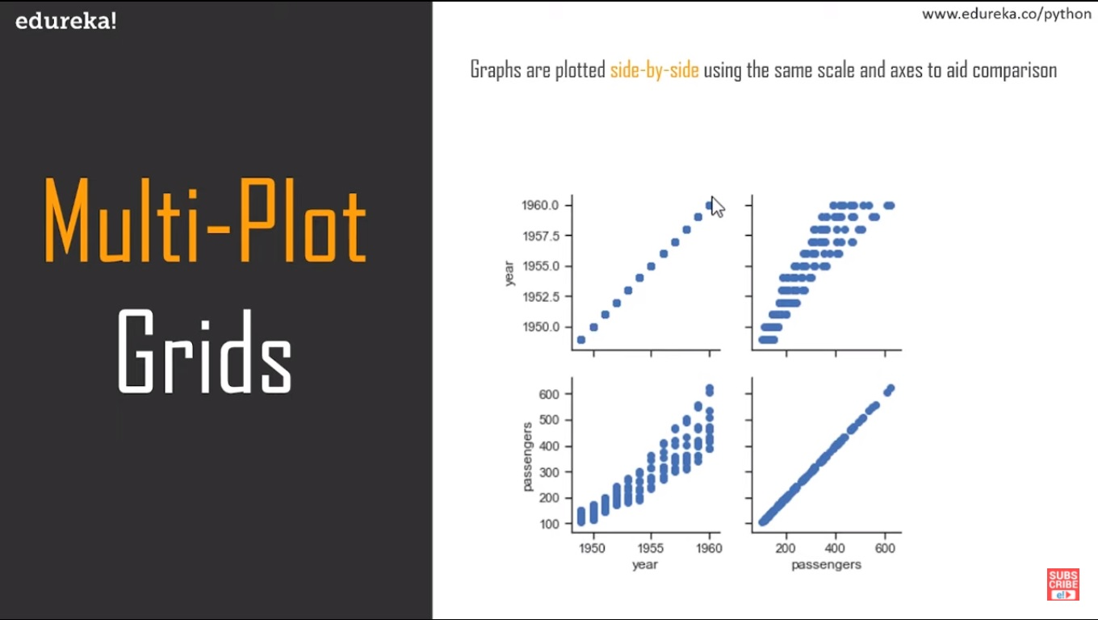

Slide 16
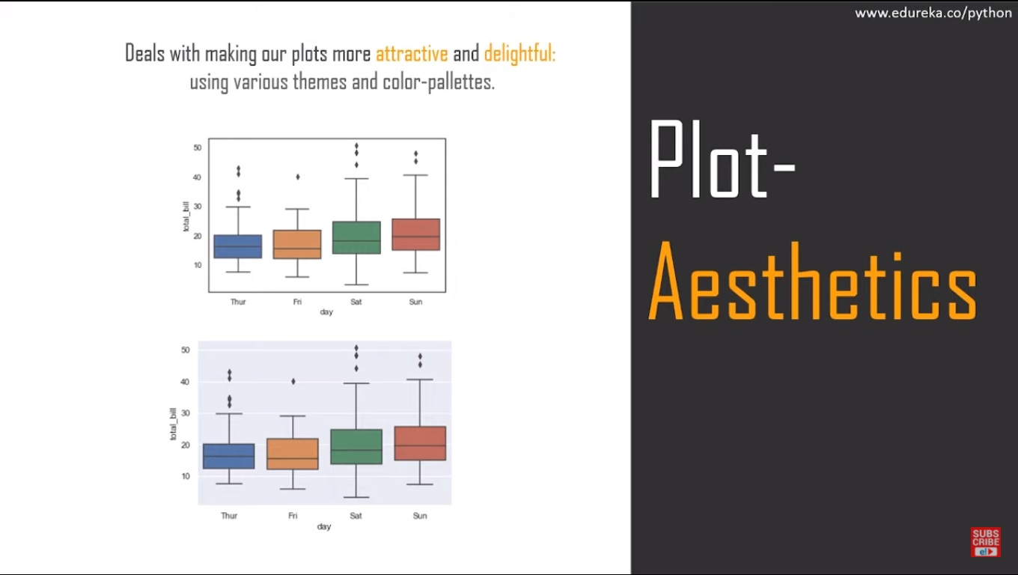

Slide 17
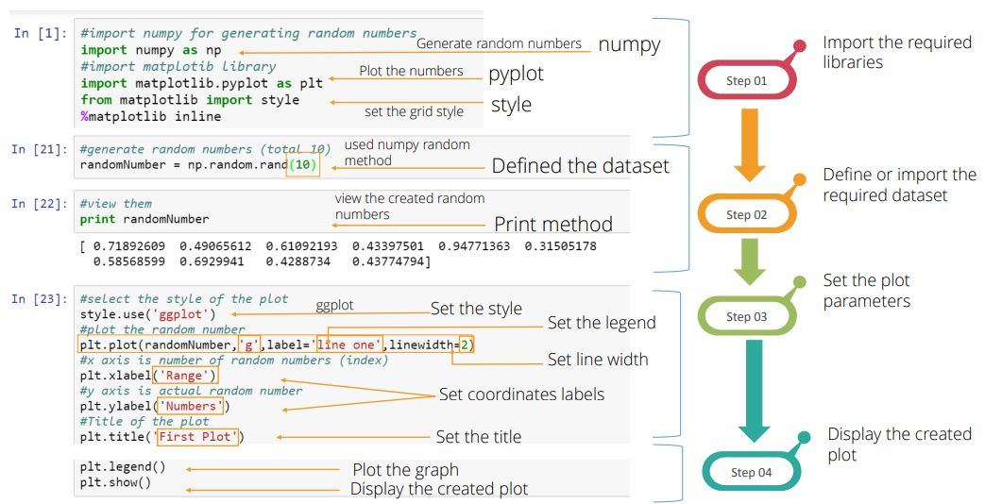

Slide 18
Referencs
https://medium.com/swlh/introduction-to-data-visualization-with-seaborn-6232b70e9b30
https://towardsdatascience.com/a-comprehensive-intro-to-data-visualization-with-seaborn-distribution-plots-888ff3436f36
https://towardsdatascience.com/complete-guide-to-data-visualization-with-python-2dd74df12b5e
https://www.simplifiedpython.net/data-visualization-python-tutorial/
https://www.analyticsvidhya.com/blog/2020/03/6-data-visualization-python-libraries/
https://www.simplilearn.com/data-visualization-in-python-using-matplotlib-tutorial

Slide 19
Our Next Assignment-4
Dissimilarity Matrix generation for
Binary,
Nominal, and
Ordinal attributes.

