Slide 1
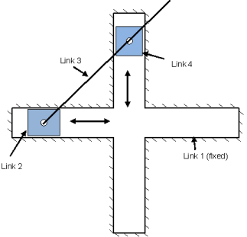
ME518 Assignment 3
Elliptical Trammel
2022MEB1289 | Aditi Garg

Slide 2
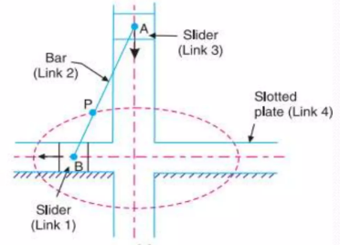
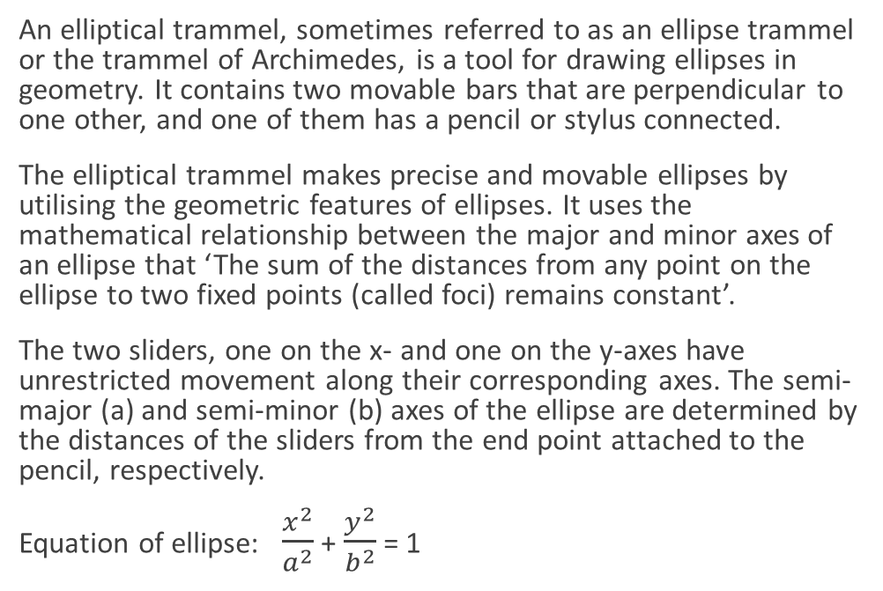
What is an Elliptical Trammel?
An elliptical trammel, sometimes referred to as an ellipse trammel or the trammel of Archimedes, is a tool for drawing ellipses in geometry. It contains two movable bars that are perpendicular to one other, and one of them has a pencil or stylus connected.
The elliptical trammel makes precise and movable ellipses by utilising the geometric features of ellipses. It uses the mathematical relationship between the major and minor axes of an ellipse that ‘The sum of the distances from any point on the ellipse to two fixed points (called foci) remains constant’.
The two sliders, one on the x- and one on the y-axes have unrestricted movement along their corresponding axes. The semi-major (a) and semi-minor (b) axes of the ellipse are determined by the distances of the sliders from the end point attached to the pencil, respectively.
Equation of ellipse: $\frac{x^{2}}{a^{2}}$ + $\frac{y^{2}}{b^{2}}$ = 1

Slide 3
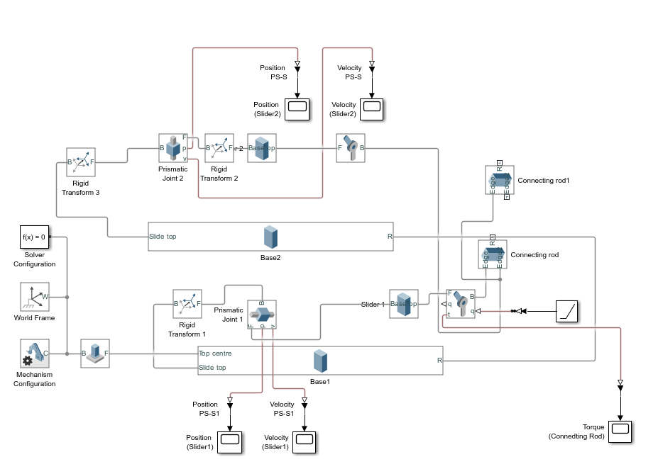
Simulink Simulation
Simulink allows us to simulate a multibody system using blocks that donate different bodies, joints, signals etc. It allows us to analyse the position, velocity, torque etc for different parts of the body using graphs.
The major parts in an Elliptical trammel are:
1. Sliders 2. Connecting Rod 3. Base
All these three elements were made using the ‘Solid Brick’ block in Simulink
The major joints in an Elliptical trammel are:
1. Prismatic Joints (Between the base and the sliders)
2. Revolute Joint (Between the sliders and connecting rod)
3. Welded Joint (To attach the base to the ground)

Slide 4
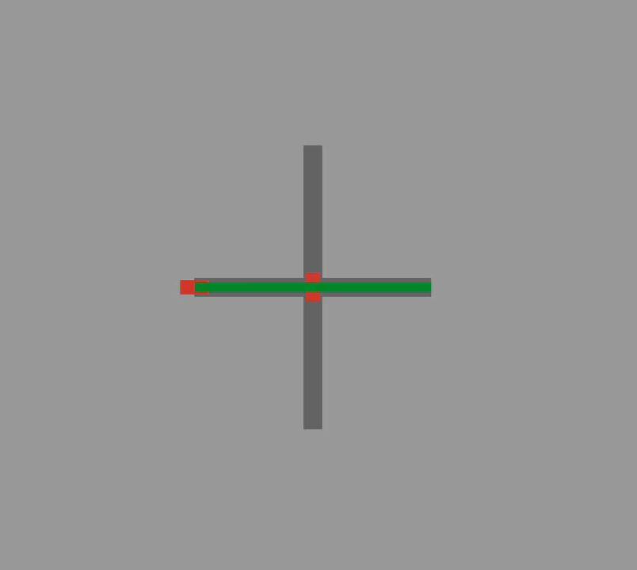
Simulink Simulation
Since, the system of Elliptical Trammel has only one Degree of Freedom (DOF), giving input to any one of the joints is enough to set the mechanism into motion.
I have provided a Ramp input to the position of revolute joint-1 with a slope of 3 which is the angular velocity of that joint.
We connect the input to the physical model using ‘Simulink-PS Converter’ with Input handling at second order filtering for Velocity and Acceleration. It is done to define the Jacobian.

Slide 5
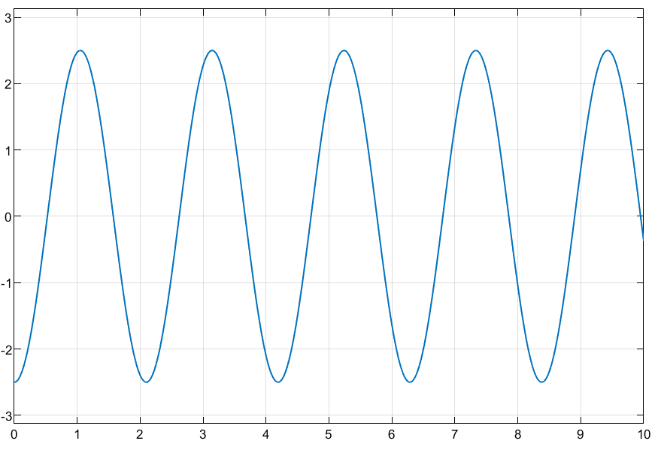
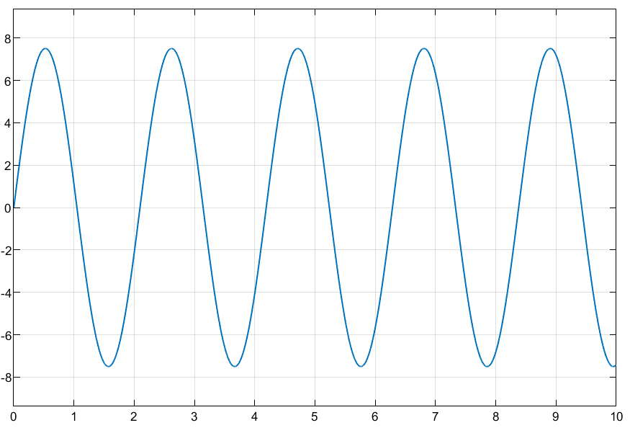
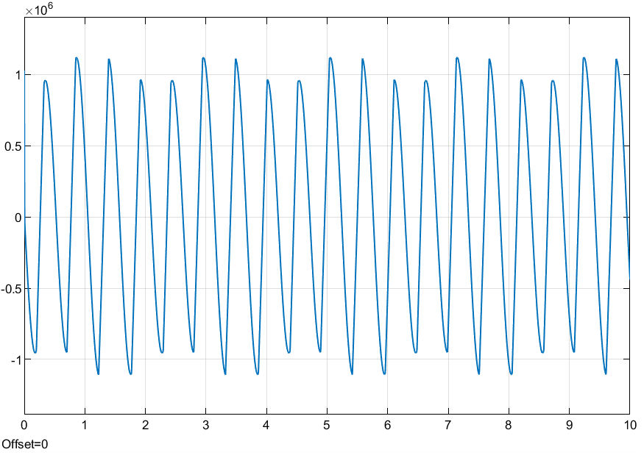
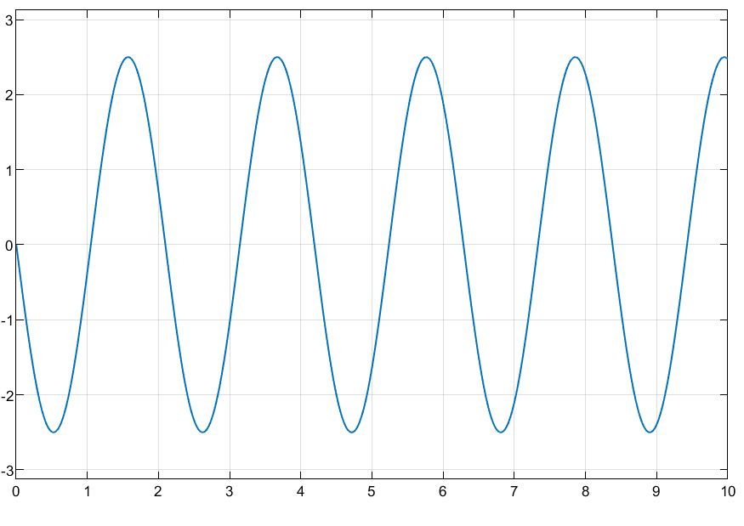
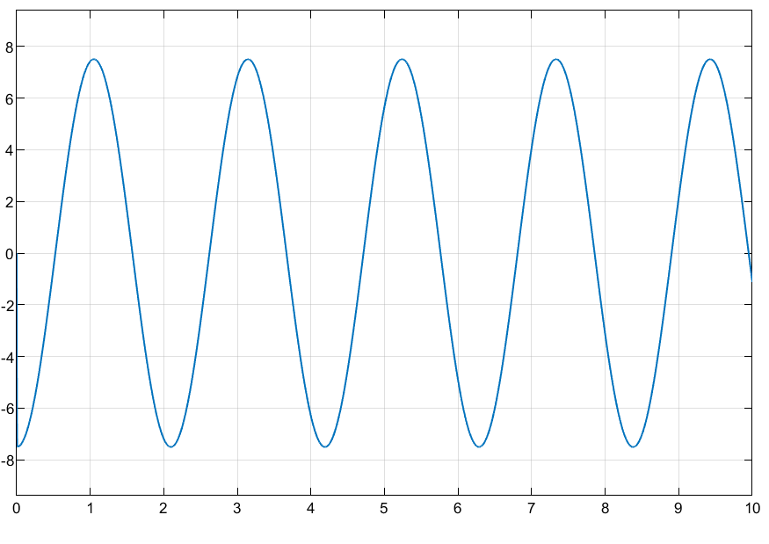
Plot Analysis
Done with the help of PS-Simulink connectors and Scope blocks
The motion of sliders is oscillating.
Slider 1 Position
Slider 1 Velocity
Slider 2 Position
Slider 2 Velocity
Connecting Rod
Torque

Slide 6
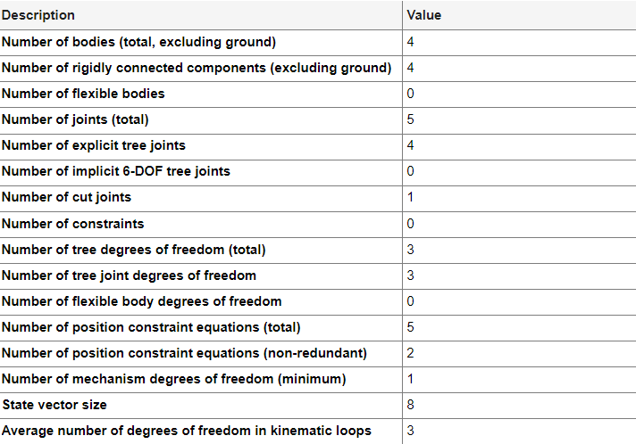
Model
Details

