Slide 1
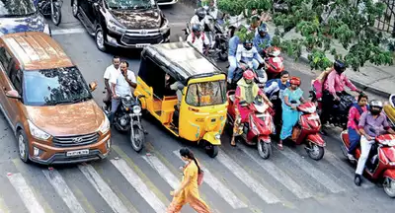

IOT BASED INTELLIGENT TRAFFIC MANAGEMENT SYSTEM
Abhey Singh (203002002)
Abishek Jeremy Vasanth (203002003)
Aditi Kannan (203002004)

Slide 2
MOTIVATION
Traffic violations pose safety risks, cause congestion, and increase law enforcement costs in urban areas. Real-time detection and efficient solutions are crucial to reducing violations.
OBJECTIVE
This project's objective is to develop a reliable system that improves traffic management, and enhances the overall quality of life in urban areas by detecting violations in real-time and promoting responsible driving behavior using RFID and Raspberry Pi .

Slide 3
WORK DONE
The work involves placing RFID detectors at traffic junctions to read unique ID values during red signals. Violators who run a red signal or park in the pedestrian crossing have their RFID captured and updated in a database. An SMS alert is sent to the violator's phone number associated with the RFID.

Slide 4
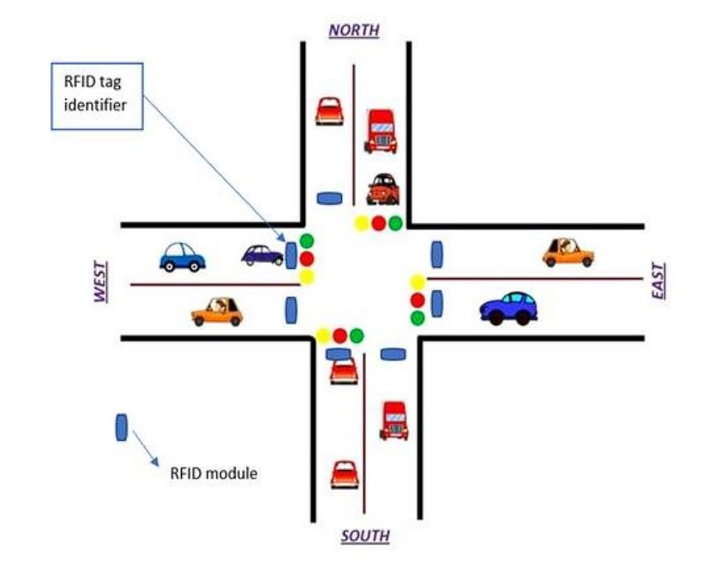
SCHEMATIC DIAGRAM

Slide 5

Flowchart
Store Vehicle Info
RFID Data
Detect and Decide
Is Traffic Signal Red?
Yes
Yes
Raspberry Pi 4B
No
No
Traffic Flow Monito-ring

Slide 6
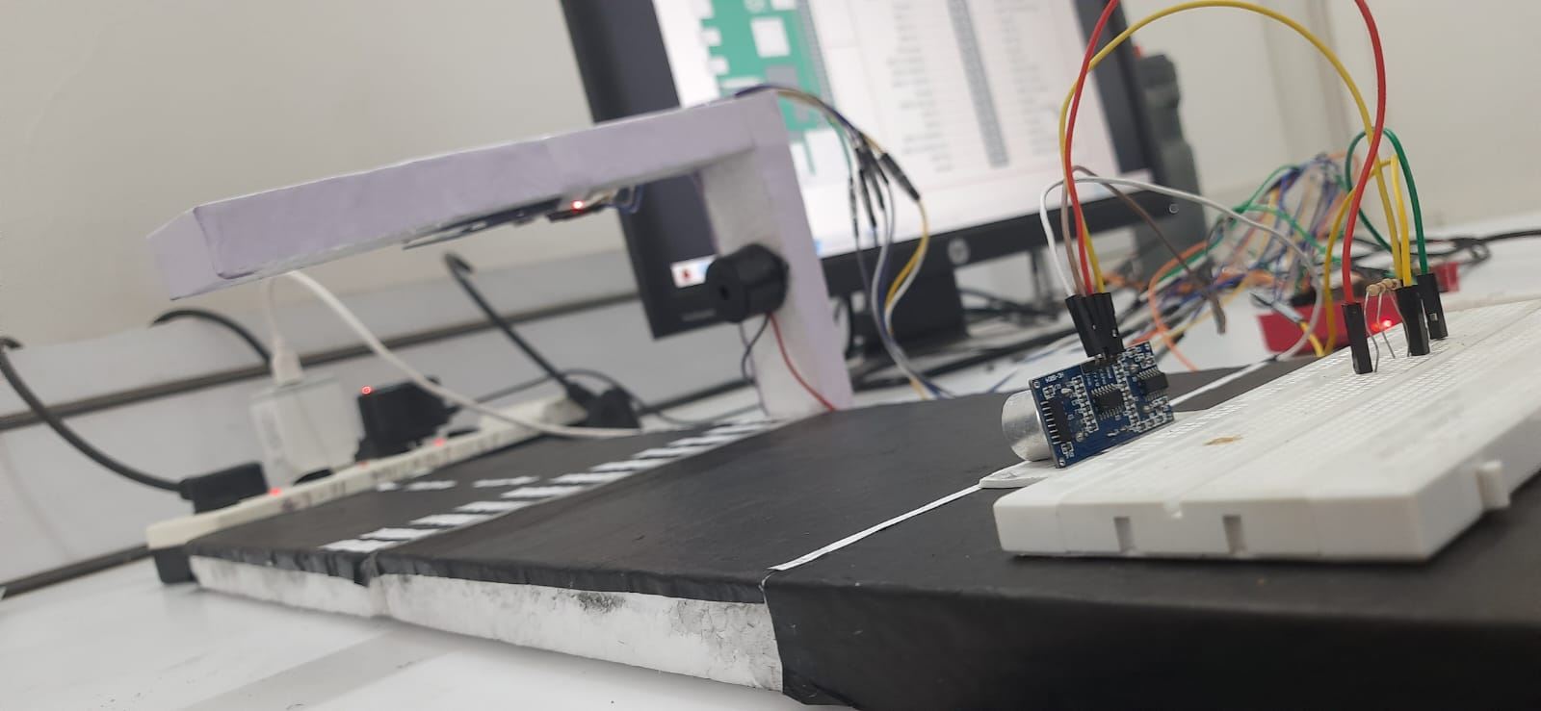
CONNECTION SETUP
Fig 1: Picture of the model proposed

Slide 7
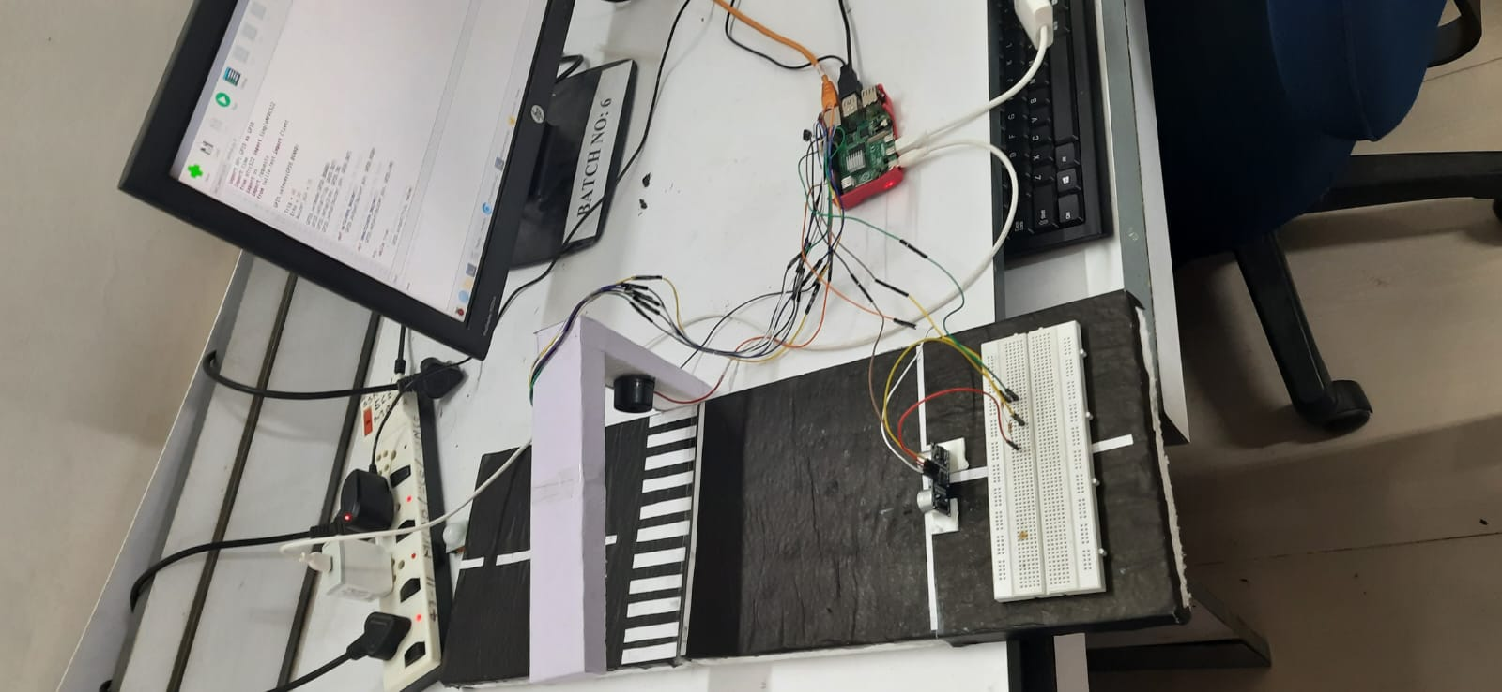
Fig 2: Top view of the model showing the connection setup

Slide 8
ESTIMATED PARAMETERS
S.No | Sensors | Estimated / Obtained Parameters | Use
1 | MFRCC522 RFID Detector | Unique ID of Vehicles | To obtain violator's data
2 | Ultrasonic Sensor | Distance of Vehicles from red light | To differentiate between signal jumping and pedestrian lane cutting

Slide 9
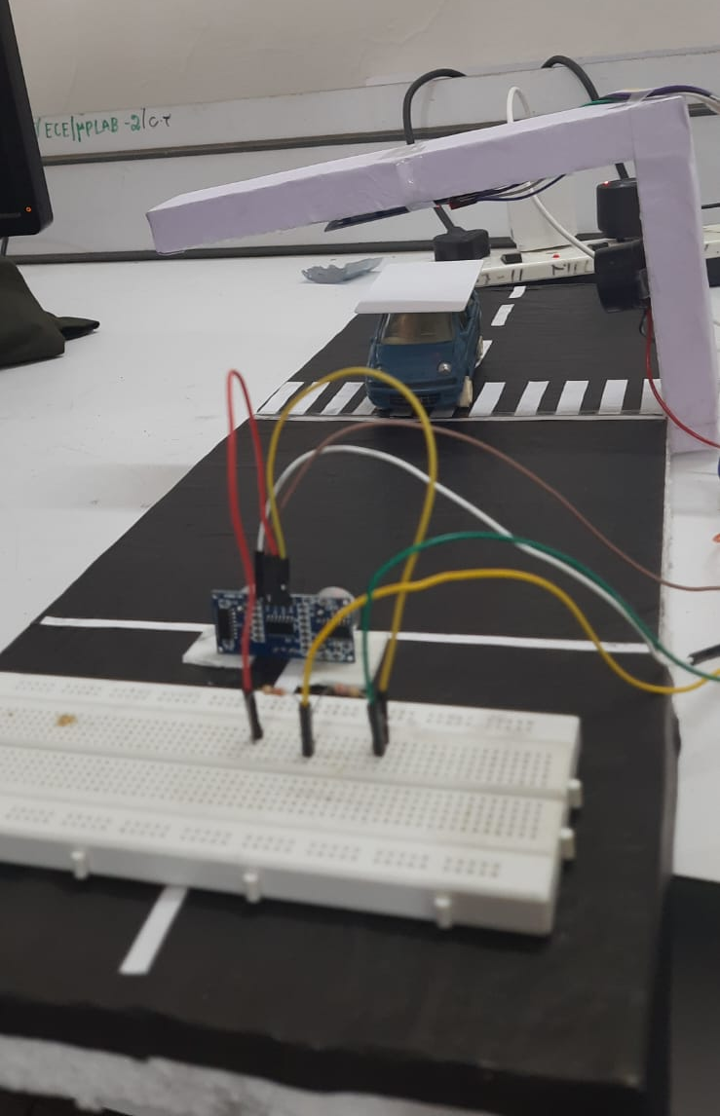
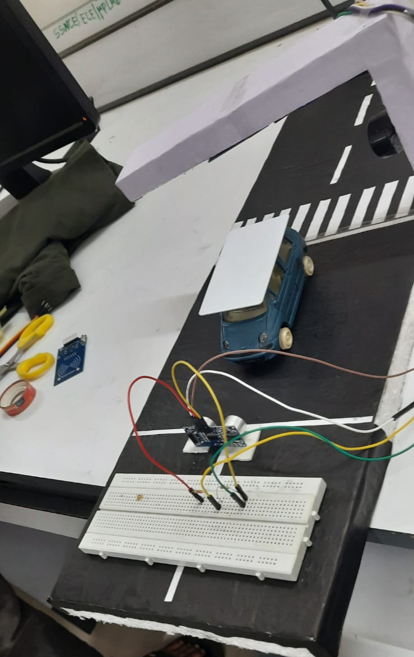
RESULTS
Fig 3: Signal Jumping
Fig 4: Pedestrian lane obstruction

Slide 10
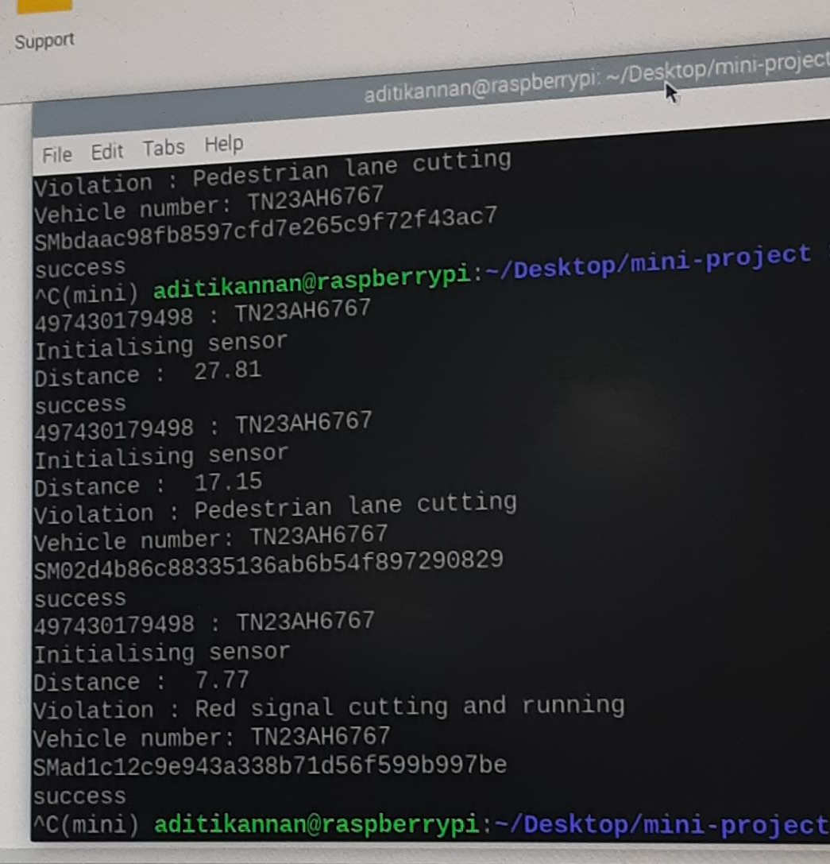
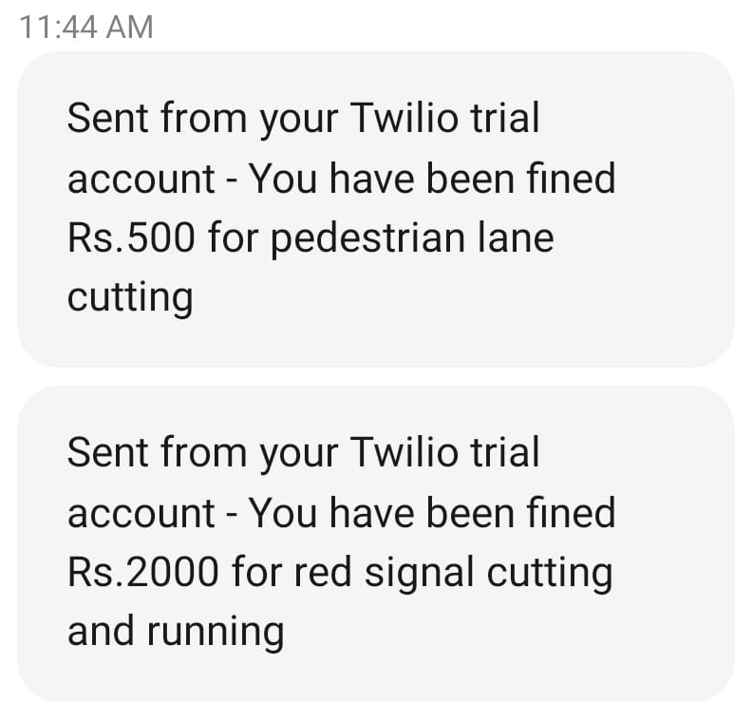
Fig 5: Message sent to violator
Fig 6: Result displayed on system

Slide 11
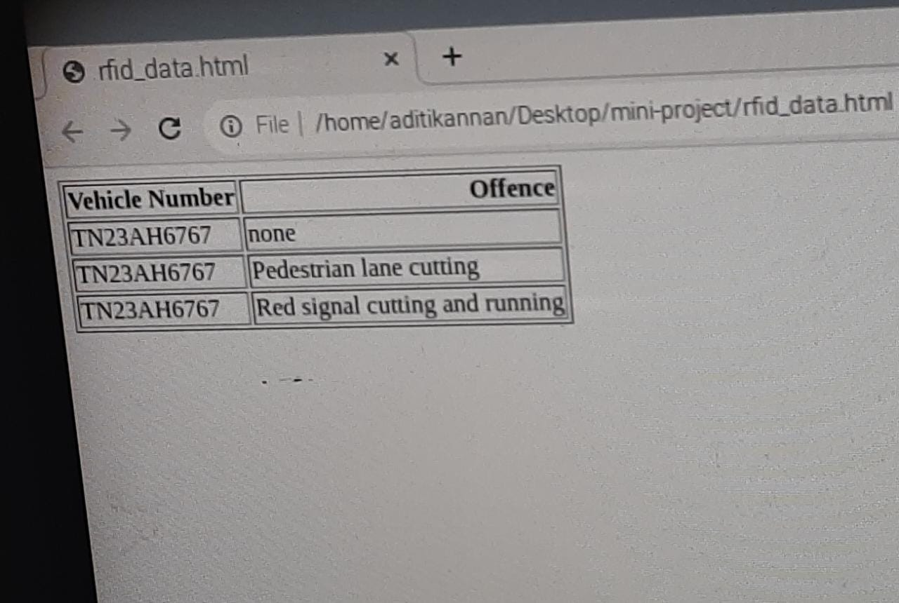
Fig 7: Database update

Slide 12
CONCLUSION AND FUTURE WORK TO BE DONE
Thus, an intelligent IoT-based traffic management system was developed that detects violations in real-time using RFID technology and Raspberry Pi. The system sends SMS alerts to violators and promotes responsible driving behavior, improving traffic management and enhancing public safety. Ultrasonic sensors were found to be inefficient during busy hours due to interference. This project provides a foundation for further research in traffic management and safety, for example, detecting vehicles that cross the speed limit.

