Slide 1

School of E & TC Engineering (SEE)
Project Design Sem III/SY B.Tech.
Project Title : Voice Control Interactive Learning System for Children
202301070136
202301070043
202301090002
202301090043
Student 1 Name : Aditi Patil
Student 2 Name : Bhakti Suryawanshi
Student 3 Name : Shrawani Kanse
Student 4 Name : Aditi Gargade
GUIDED BY
Prof. Vipin Yadav
Guide

Slide 2
Contents
Corrections for Suggestions from Review-1(Last)
2. Literature Review
3. Project Design
4. Component selection
5. Circuit Diagram
6. Circuit Simulation
7. System test parameters

Slide 3

Idea of project
The idea of the project is to use AI , Speech recognition and NLP technology to make a system that engages children in interactive learning process through various games and educational content . This system helps to reduce the screen time of children and encourages children to continue exploring and learning.

Slide 4
Problem Statement
To generate a interactive learning system for kids
using voice control technology.

Slide 5
Proposed Title
Voice Control Interactive Learning System for Children
Voice Control : This indicates that the system relies on speech recognition technology .
Children will interact with the system primarily through spoken commands .
For this we are using TTS , STT technologies and NLP techniques.
Interactive Learning System : The system will deliver educational content in an interactive manner possibly through games and quizzes . This is the tool that provides learning with fun platform.
For Children : This highlights that the system is designed for engagement of children. The content and interactions will be age-appropriate and designed to be accessible and enjoyable for children.

Slide 6
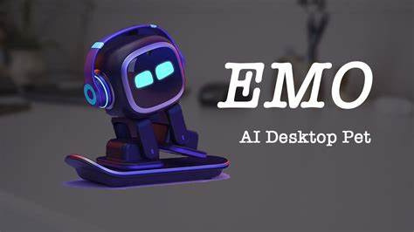
Feasibility Check
We all have seen the EMO robot who works on the voice control system . Similarly by using the voice recognition technology along with TTS , STT and NLP we will achieve this idea . Successful implementation will depends on effective integration of these technologies.

Slide 7
Scope of Project [SY Sem III & IV]
SY Sem III
Electronic circuit designing using VC02.
SY Sem IV
Gemini integration using ESP32, PCB implementation and 3D modelling.

Slide 8
Proposed Block Diagram (Primary Stage)
INPUT VOICE
Microphone
VC02 Module
ESP32 Micro-controller
Gemini API
ESP32
VCO2 MODULE
Speaker

Slide 9
Block Diagram (Sem 4 / Final Stage)
STT /
GOOGLE CLOUD BASED STT
INPUT VOICE
Microphone
ESP32 Micro-controller
ESP32 Micro-controller
Gemini API
GOOGLE CLOUD TTS
Speaker

Slide 10
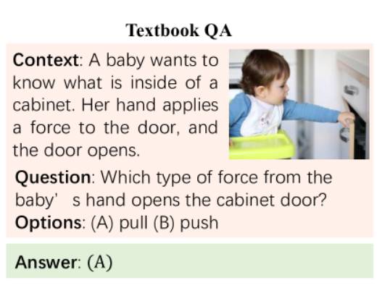
Literature Review
Survey of Natural Language Processing for Education
Abstract:
Natural Language Processing (NLP) aims to analyze text or speech via techniques in the computer science field
Review of Techniques:
Introduction:
Natural Language Processing (NLP) refers to the branch of computer science, that empowers computers the ability to understand text and spoken words as the way human beings can. It serves real-world scenarios. For example, NLP can help in healthcare applications. A wide range of NLP techniques are being utilized to anticipate the treatment process of the patients.

Slide 11
Literature Review
Voice Recognition Technology
Research Paper Title: "A Comparative Study of Speech Recognition Techniques"
Summary:
"This paper compares different ways to convert speech into text, which is exactly what we’re doing with the VC02 module in my project. The paper talks about how some systems, like the one we’re using, process voice commands offline, meaning they don’t need internet access to understand basic commands. That’s helpful because it ensures faster responses and works well when there’s no internet. It’s a beneficial educational tools where kids need quick answers without waiting for long processing times."

Slide 12
Literature Review
AI in Education Systems
Research Paper Title: "Artificial Intelligence in Education: Promises and Challenges"
Summary:
"This paper is all about how AI is changing the way we teach and learn. It highlights how virtual assistants and AI chatbots can help students by answering their questions and guiding them through lessons—exactly what my project is doing. In our case, the ChatGPT API acts as the ‘brain’ of the robot, helping kids get answers to their questions in a conversational way. It shows how tools like these can make learning more interactive and personalized."

Slide 13
Project Design
Input and Processing:
Microphone: A highly sensitive microphone that converts analogue signal to digital signal. It is typically used in applications requiring high-quality audio capture.
ESP32 Micro-controller: A powerful microcontroller with built-in Wi-Fi and Bluetooth capabilities. It serves as the brain of the robot, handling tasks such as processing audio data, communicating with other components, and executing the overall control logic.

Slide 14
Project Design
STT/Google Cloud Based STT: A cloud-based speech-to-text service that uses advanced algorithms to transcribe spoken language into text. It leverages machine learning expertise to achieve high accuracy.
NLP: A field of artificial intelligence that deals with the interaction between computers and human (natural) languages. In this context, NLP algorithms are used to understand the meaning and context of the transcribed text, enabling the robot to respond appropriately.

Slide 15
Project Design
Output Generation and Delivery:
Google Cloud TTS: A cloud-based text-to-speech service that converts text into human-like speech. It utilizes sophisticated voice synthesis techniques to produce natural-sounding audio.
VCO2 Module: A specialized hardware or software component that can modify the synthesized speech to enhance its quality, naturalness, or expressiveness. It may involve techniques like speaker customization, noise reduction, or audio effects.
Speaker : A loudspeaker that converts the amplified electrical signal into sound waves, producing the audible output.

Slide 16
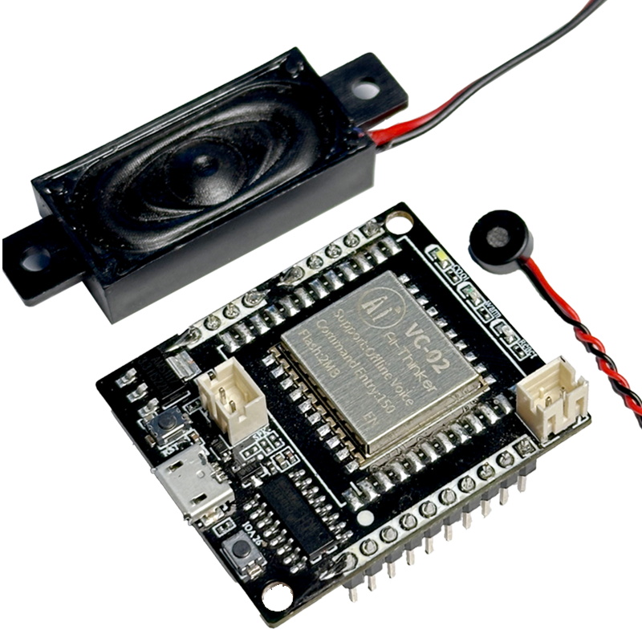
Component selection(Platform/Software)
VCO2 (Primary Stage)
It is a sensor or communication module in embedded systems, IoT, or automation.

Slide 17
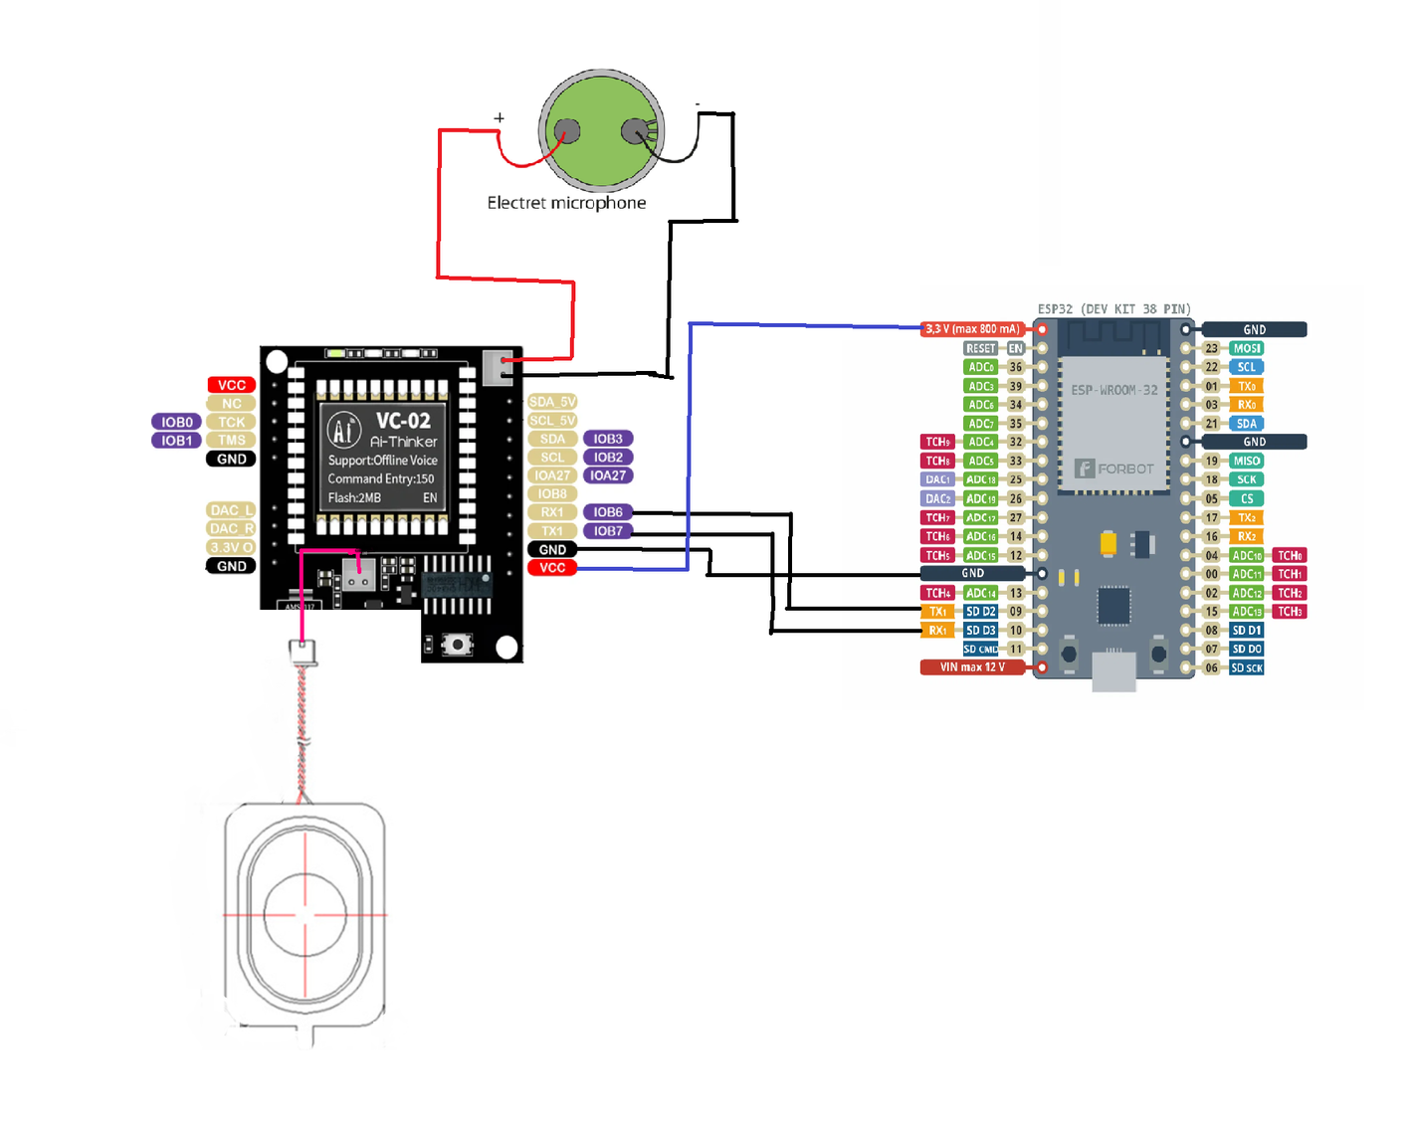
Circuit Diagram (Primary Stage)

Slide 18
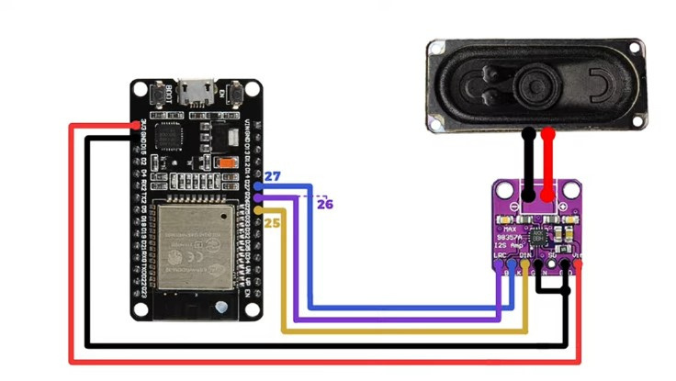
Circuit Diagram

Slide 19
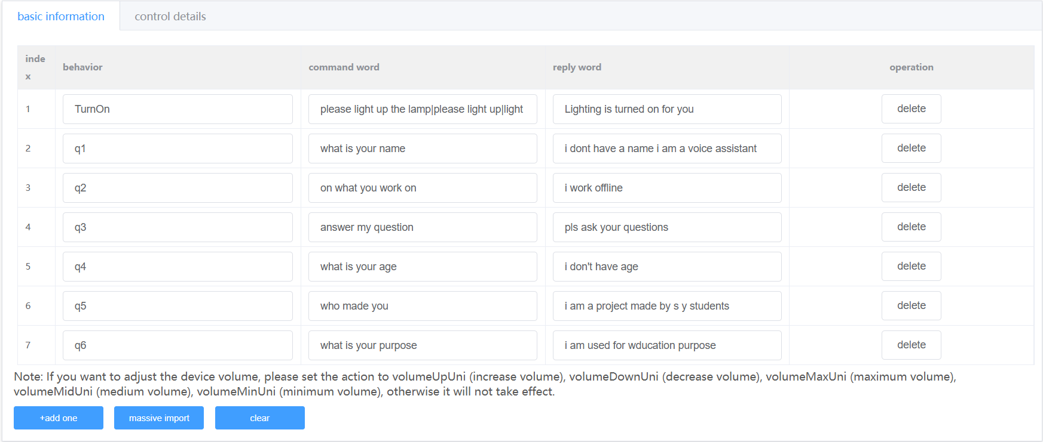
VC02 Programing

Slide 20
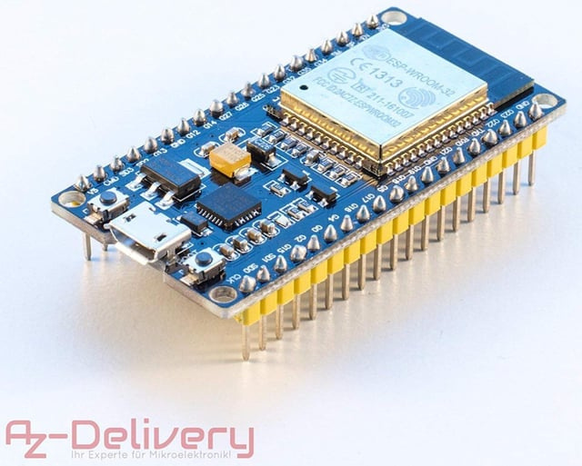
Component selection(Platform/Software)
ESP32
The ESP32 is a powerful and versatile microcontroller chip that is widely used in IoT and embedded systems applications.

Slide 21
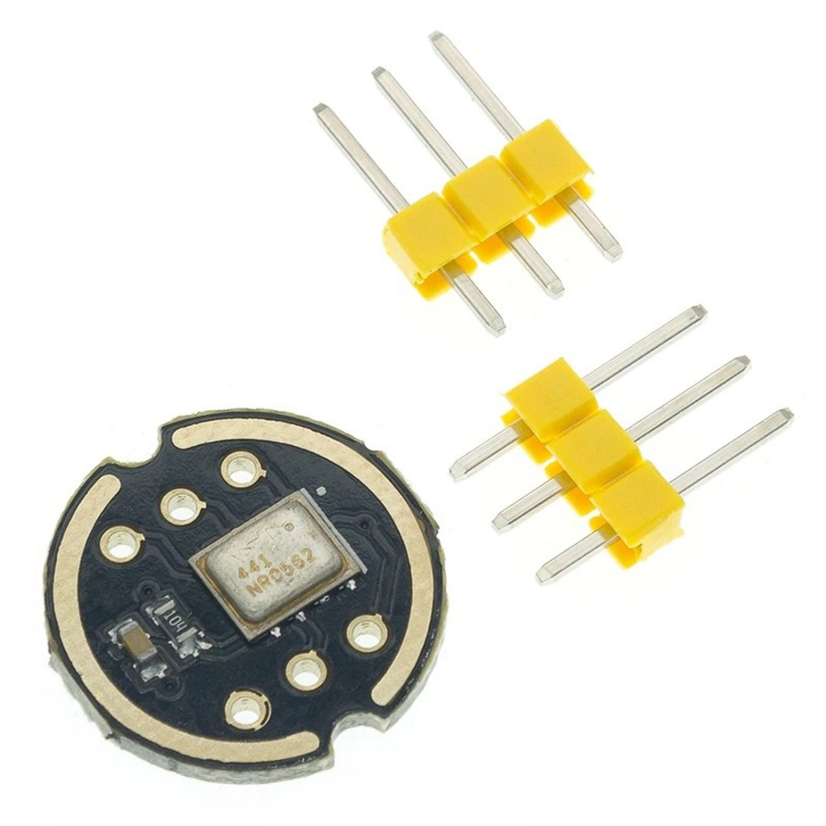
Component selection(Platform/Software)
INMP441 MEMS Microphone
The INMP441 is a high-performance, low-power, digital output, omnidirectional MEMS microphone with a bottom port.

Slide 22
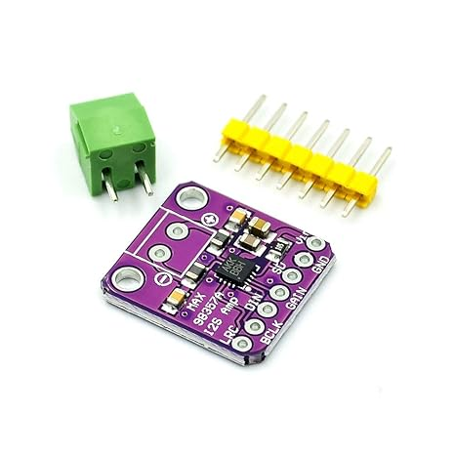
Component selection(Platform/Software)
MAX98357 I2S Amplifier
The I2S digital audio amplifier board is suitable for Raspberry Pi. Accepts digital audio through the I2S interface, converts it to an analog output signal and amplifies it to allow direct speaker connection. It combines an I2S D/A converter with an audio amplifier on one board.

Slide 23
Component selection(Platform/Software)
Smarter Responses: Uses Google’s powerful AI for accurate, real-time answers.
Context Handling: Maintains conversation flow naturally.
Cost-Effective: ~₹8.50 per 1000 tokens (cheaper than ChatGPT).
Google Integration: Works well with Firebase, Android, and other Google services.
Multimodal Support: Understands text, images, and more (in advanced versions).

Slide 24
System test parameters
Range Test (Input): upto 1 meter
Range Test (Output): 2 to 3 meters

Slide 25
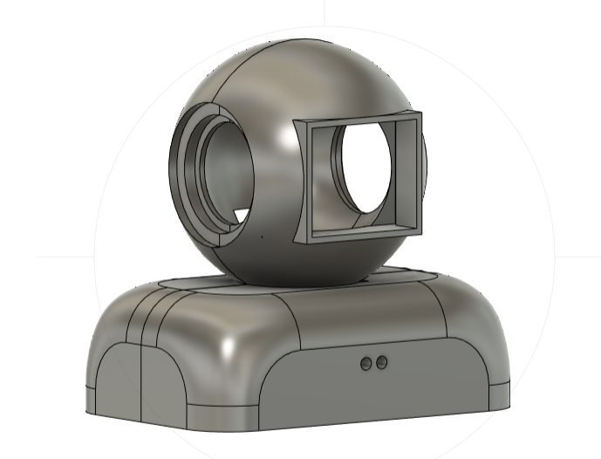
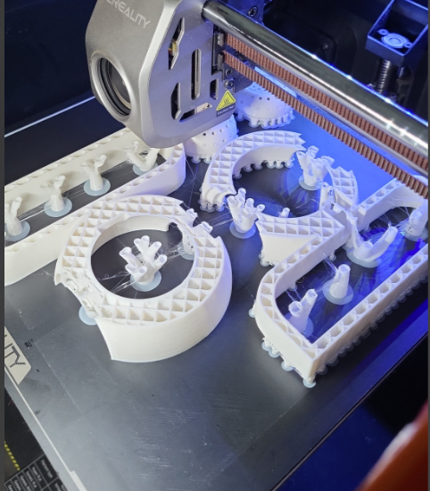
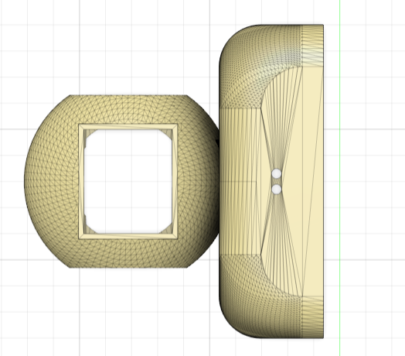
Stages Of Progress
Designing
Implementing
3D Printing

Slide 26
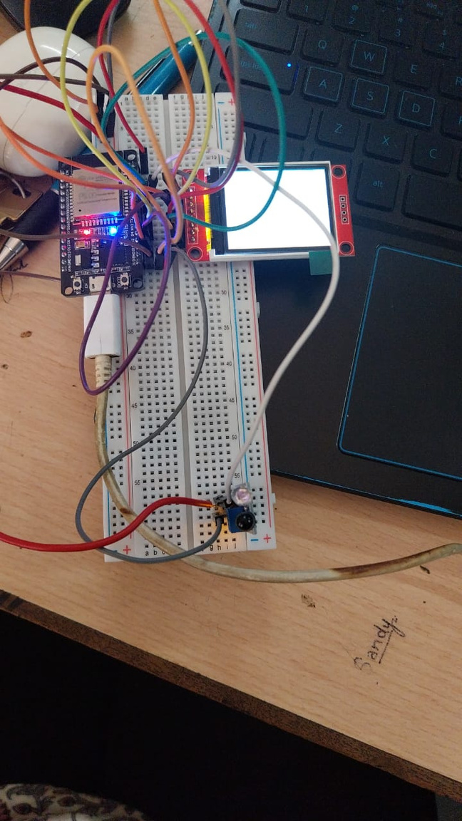
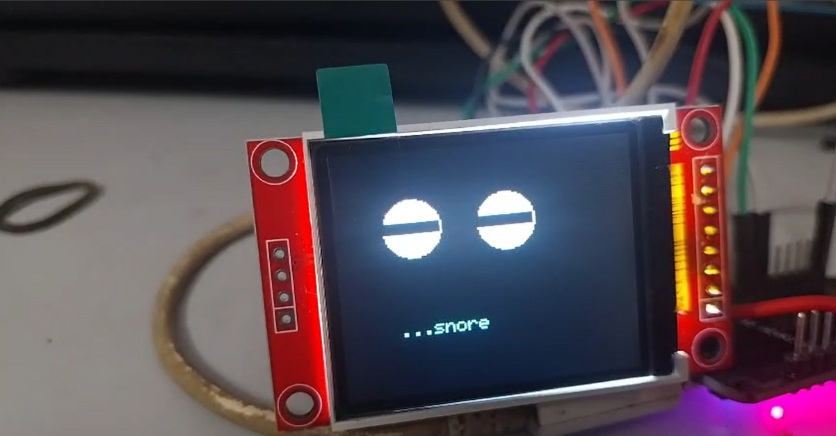
Stages Of Progress
Screen Interfacing
Connections

Slide 27
References
Survey of Natural Language Processing for Education: Taxonomy, Systematic Review, and Future TrendsJustin23456543. (2024). ESP32. arXiv. Retrieved from https://ar5iv.labs.arxiv.org/html/2401.07518
A Systematic Literature Review on the Applications of Robots and Natural Language Processing in Education Justin23456543. (2024). ESP32. MDPI. Retrieved from https://www.mdpi.com/2079-9292/12/13/2864
Deshmukh, R. R. (2015). Speech recognition techniques: A review. ResearchGate. https://www.researchgate.net/publication/281901068_Speech_Recognition_Techniques_A_Review
Luckin, R., Holmes, W., Griffiths, M., & Forcier, L. B. (2019). Artificial Intelligence in Education: Promise and Implications for Teaching and Learning. Retrieved from ResearchGate.

