Slide 1


Course Code/PR-II Med Help
Team Members :
Guided By :Dhara Solanki
Vanara Aditi - 23CS101
Siroya Keshvi - 23CS095

Slide 2
Content of the Presentation
Introduction
Idea/Approach Details
Need of System
Design and Development Process
Database Design
Flow Diagram/ Flow Chart of System
Technical Deliverables
Department of Computer Science & Engineering ,CSPIT

Slide 3
Introduction
Purpose:
To provide an easy-to-use platform for users to find hospitals and doctors in different cities.
Features:
1. User and doctor login using location.
2. List of hospitals based on the selected city for user.
3. Detailed information about hospitals and their doctors.
4. Specialization-wise doctor listing.
5. Users can check doctor availability before visiting to avoid unnecessary travel,and doctors can update their availability.
6. Contact information for direct appointment booking.
7. Reviews and ratings for hospitals and doctors from previous patients.

Slide 4
Idea/Approach Details
Idea:
Finding hospitals and specialists in a city can be time-consuming. Our solution simplifies this process through an interactive website.
Approach:
Frontend: HTML, CSS, JavaScript for an engaging UI.
Backend: Database to store hospital and doctor details.
Integration: Dynamic data fetching for real-time updates.
Availability Tracking: Doctors' schedules and availability will be updated regularly.
Search & Filters: Users can filter hospitals by specialty, ratings, and location.

Slide 5
Need of System (Functions it can perform)
1. Centralized platform for hospital and doctor details.
2. Easy accessibility for users to find healthcare services.
3. Efficient information retrieval based on location.
4. Helps patients avoid unnecessary visits by checking doctor availability online.
5. Allows users to choose hospitals based on reviews and ratings.
6. Reduces long waiting times through prior appointment booking.

Slide 6
Database Design
A well-structured database is crucial for managing large volumes of data efficiently. It helps store, retrieve, and update information accurately, ensuring smooth functionality and performance of the system.
Tables:
Users: UserID, Name, Email, Password, Location.
Hospitals: HospitalID, Name, City, Address, Contact, Ratings.
Doctors: DoctorID, Name, HospitalID, Specialty, Availability, Ratings.
Appointments: AppointmentID, UserID, DoctorID, Date, Time, Status.
Reviews: ReviewID, UserID, HospitalID/DoctorID, Rating, Comment.

Slide 7
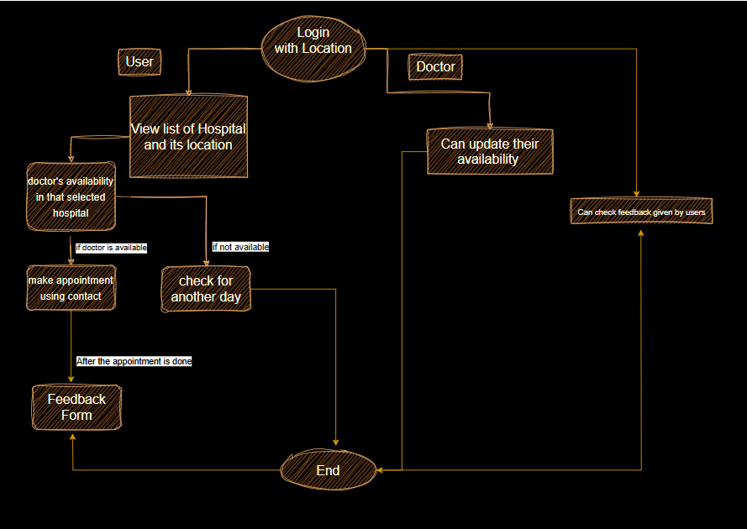
Flow Diagram/ Flow Chart of System

Slide 8
conclusion
This project aims to simplify hospital and doctor discovery, making healthcare access easier for users in Rajkot and Bhavnagar. The added availability feature helps patients plan their visits efficiently, saving time and effort. Additional features like reviews, ratings, and appointment booking enhance user experience and streamline the healthcare process.

