Slide 1

LogEx : Log extraction and shipping for clients
Team- Aditi Hande & Maitraya Kakade.
Under guidance of – Mr. Siddharth Barman & Mr. Bhaskar Kulkarni

Slide 2
Objective
A system for collecting logs in a distributed software solution and run rules defined by users to extract matching lines, redact sensitive information and store these into a destination location.
The destination storage should have a pluggable interface whereby the extracted content can be sent to local disk or Cloud using interfaces like SFTP or S3.

Slide 3
Workflow Simplified
Collect logs
Index logs
Query indices
Export
results

Slide 4
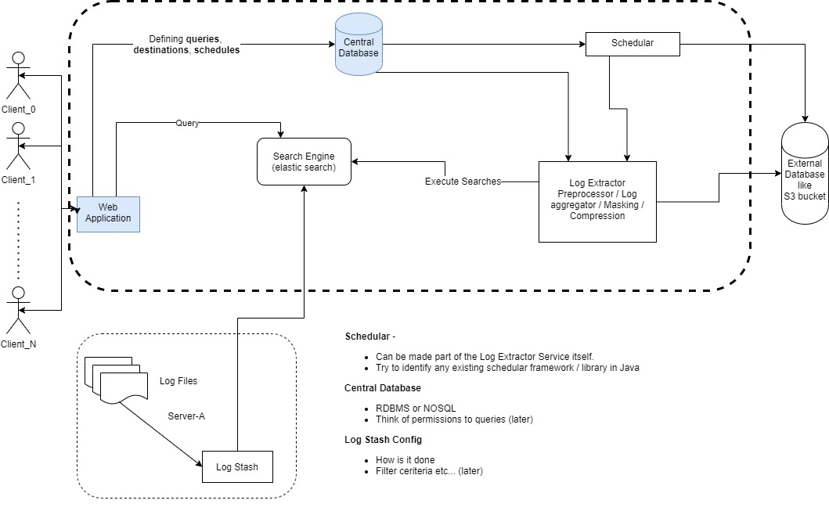
Modules
Collecting log files centrally
Collecting matching records
Masking confidential data
Defining log shipping

Slide 5
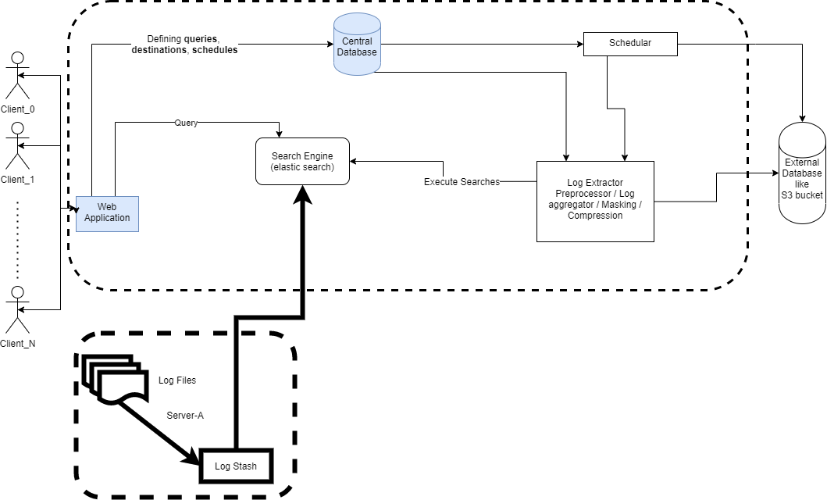

Collecting log files centrally
Tool/software- Logstash
Aggregator : Pulling data from various sources
Push event : Loglines are pushed into elastic clusters.

Slide 6
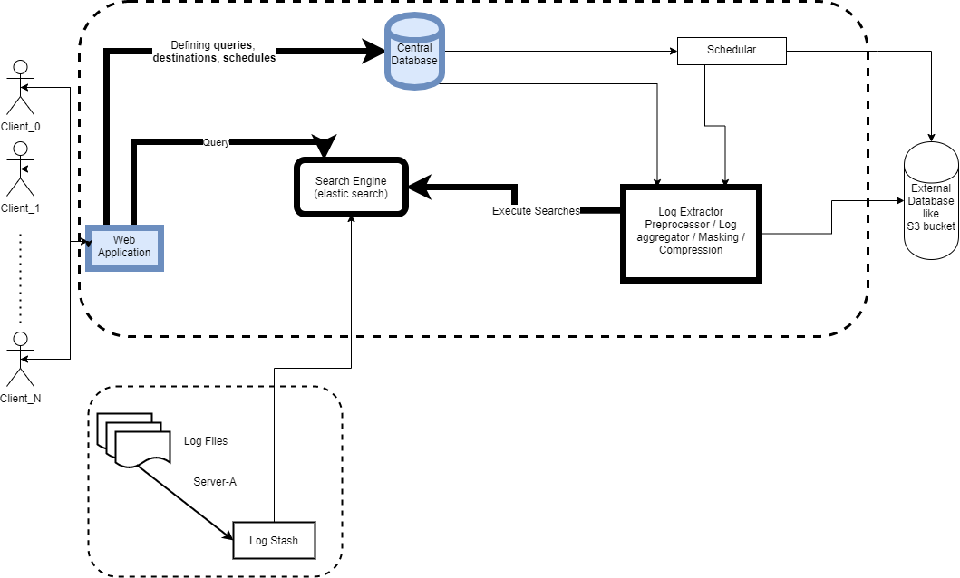

Running rules
Tool/software- Elasticsearch and LogEx API
Define Query/Rule : done through LogEx Api.
Run Schedular : Collection of matching records.

Slide 7

Masking of sensitive data
Tool/software- LogEx API
Define Mask : Done through LogEx Api by providing regex pattern and masking text.
Actual Masking : Processing of result record set to mask sensitive data such as IP address.

Slide 8
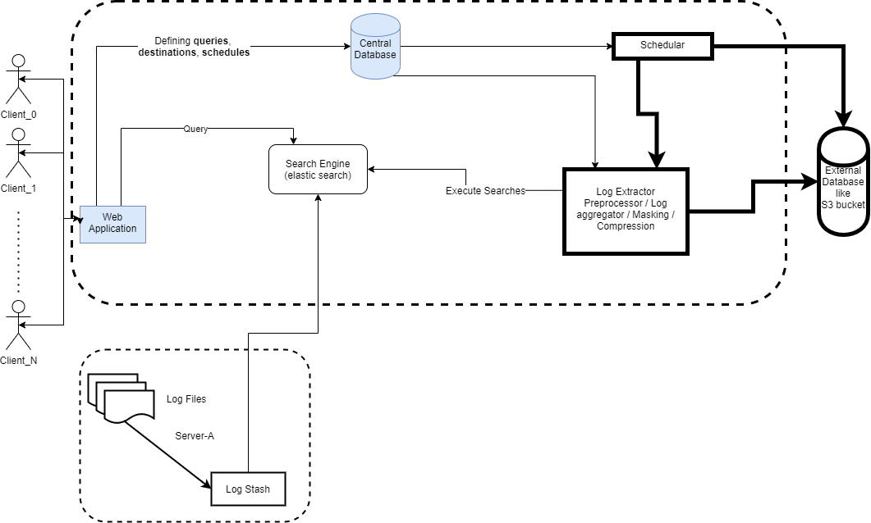
Log Shipping
Tool/software- LogEx API
Zipping : A zip file named as timestamp, having CSV and text format results is created.
Shipping of this file to specified destination through SFTP.

Slide 9




Techstack
Frontend
Web Portal (Angular 10)
Backend Services
LogEx REST services –Spring Boot
Elastic Search services – Spring Boot
Database
Mongo DB
Elastic Search

Slide 10



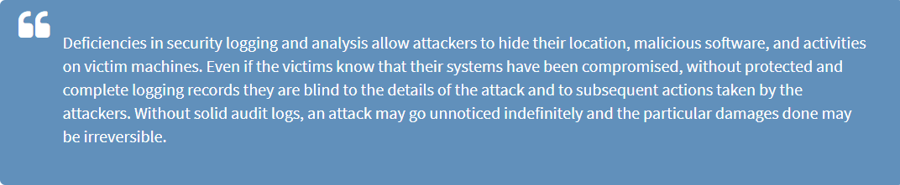
Primary Use Case
CLIENT
SOLUTION
PURPOSE-SECURITY INSIGHTS

Slide 11
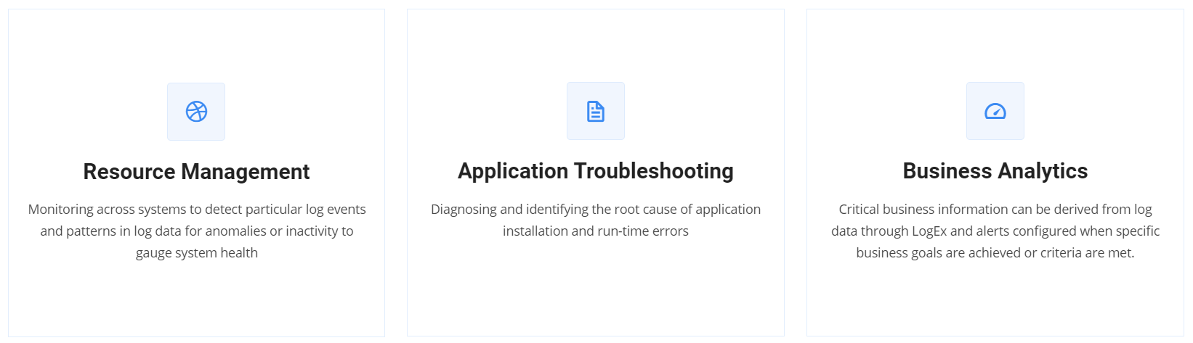

Additionally Enabled Use Cases

