Slide 1
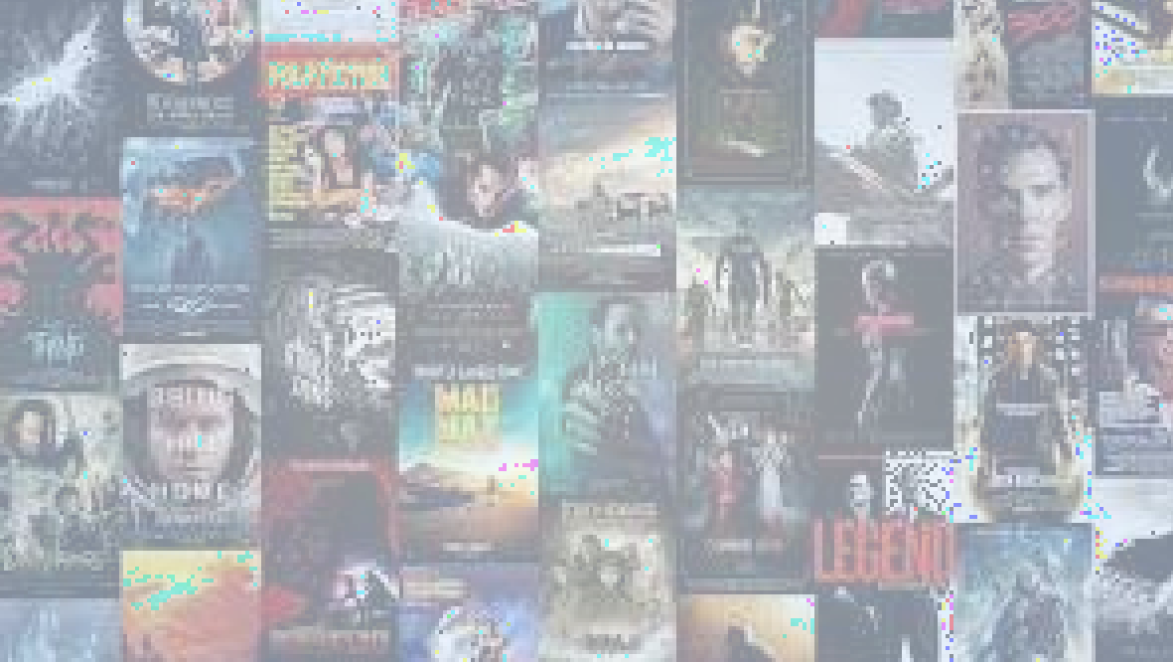

Power BI Project
IMDB MOVIE
SALES ANALYSIS
Presented By :- Aditi Khade
Batch No. :- 393

Slide 2

PROJECT OVERVIEW
Project Goal is Analyse an IMDb movie dataset to uncover insights related to genres, durations, languages, directors, and budgets.
Objectives is Understand the distribution of these features (genres, durations, etc.) & Examine their impact on IMDb scores.
This analysis to identify patterns and trends that contribute to movie success.

Slide 3



APPROACH
Data Cleaning :- Removed rows with missing values in key columns.
Genre Analysis :- “Exploded” the genres column so each genre is analysed separately and computed descriptive statistics for IMDb scores by genre.
Revenue Analysis :- Identified movies with the highest profit margins (revenue minus budget).
Rating Analysis :- Compared IMDb score, rating, and vote count for high-profit vs. low-profit films.
BACKGROUND

Slide 4

BACKGROUND
TOOLS & TECHNOLOGIES :
Power BI Desktop – Visualizations & DAX Power
Query – Data transformation
Excel/CSV – Raw dataset source
DAX – Measures & calculated columns
KEY VISUALS :
Total Revenue by Year (Stacked Bar Chart)
Revenue by Genre (Stacked Column / Donut Chart)
Trend of movies by rank ,metascore (Area Chart)
KPI for Revenue earned by movies (KPI)
Count of movies by Genre(Pie Chart)

Slide 5
KEY FEATURES
Summary Cards: Count of titles, genres, actors, directors, and average runtime.
Time Analysis: Revenue trends over the years (2006–2016).
KPI Tracking: Target vs. actual revenue, including % overachievement.
Genre Distribution: Pie chart of title count by genre and bar chart of revenue by genre.
Performance Trends: Line chart combining revenue, Metascore, and rank.
Filters: Year, Genre, and Director slicers for deep dive analysis.

Slide 6
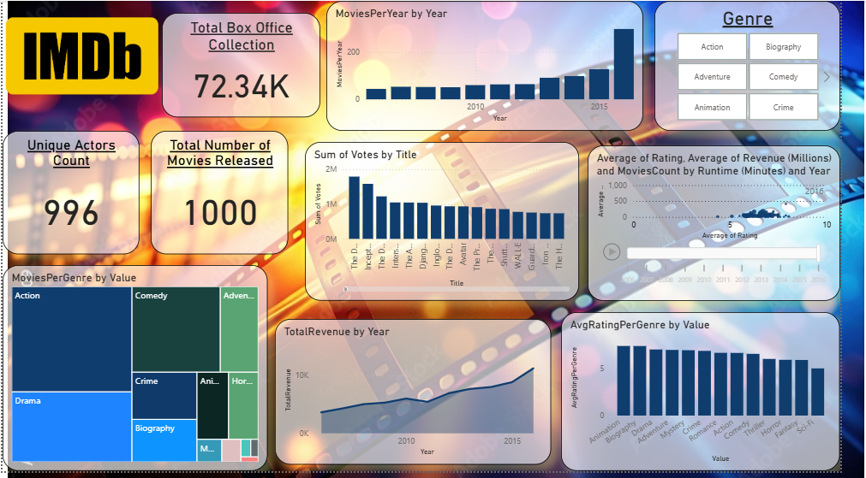
DASHBOARD

Slide 7

SUMMARY & INSIGHTS
Time Trends :- No strong correlation between movie duration and IMDb score.
Genres :- Action & Drama are popular with consistent scores.
Ratings :- A weak positive correlation exists between rating and revenue , indicating higher-scoring movies tend to earn more.
Top Movies Performance :- “The Dark Knight” ($17M), “Inception” ($15M).
Revenue :- Budget and revenue show a strong positive correlation While high‑budget movies can lead to high gross earnings, the relationship is not strongly correlated.
Votes :-The number of user votes is strongly correlated with both budget and box office gross, yet vote quantity doesn’t necessarily mean higher average ratings.

Slide 8

CONCLUSION
This analysis provides a comprehensive understanding of factors influencing movie ratings on IMDB.
The findings can guide future movie productions in choosing genres, directors, and budgeting to optimize success.
Ongoing analysis and additional factors such as marketing, release timing, and audience demographics can further refine these insights.

Slide 9
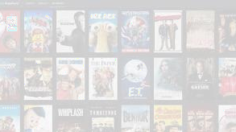


THANK YOU

