Slide 1

NEXTHIKES IT SOLUTIONS
Scientific & Advanced Calculator
Submitted by
Aditi Kumar
Notes:
1

Slide 2
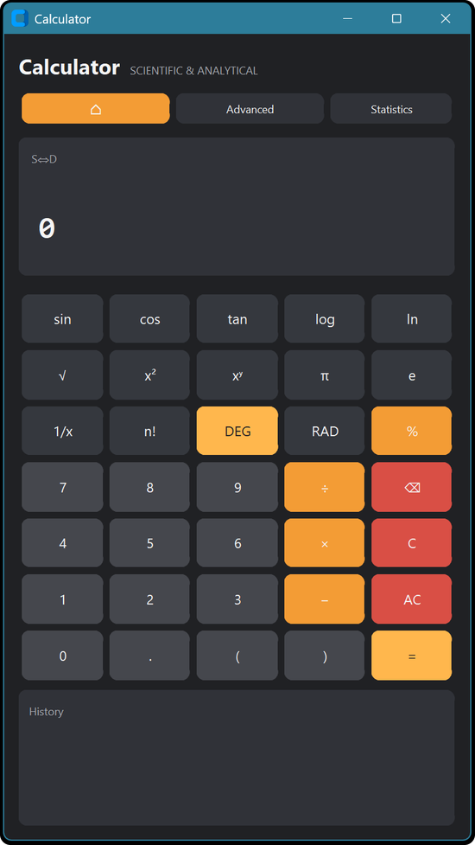
Objective
1
To build an advanced GUI calculator that goes beyond basic arithmetic.
2
Designed or students and data analysts who wants to do graphic, statistical analysis, and advanced math in a single, unified workspace.
3
It aims for mathematical accuracy and a layout that is easy to use.
Scientific & Advanced Calculator
2
Notes:
2

Slide 3
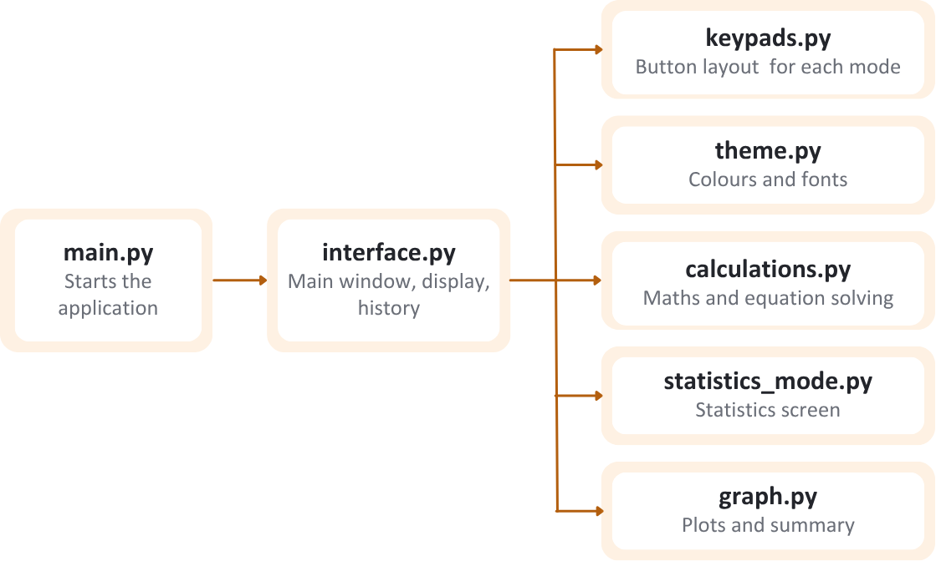
Tech-stack and Architecture
TECH STACK
ARCHITECTURE
keypads.py
Button layout for each mode
CustomTkinter: Builds the main window, keypad and layout of the application.
theme.py
Colours and fonts
SymPy: Solves equations and handles symbolic maths.
interface.py
Main window, display, history
main.py
Starts the application
calculations.py
Maths and equation solving
Matplotlib & NumPy: Draw the graphs and manage the numerical data supporting them.
statistics_mode.py
Statistics screen
AST (Python): Checks each expression before it is calculated, so only valid maths is evaluated.
graph.py
Plots and summary
Scientific & Advanced Calculator
3
Notes:
3

Slide 4
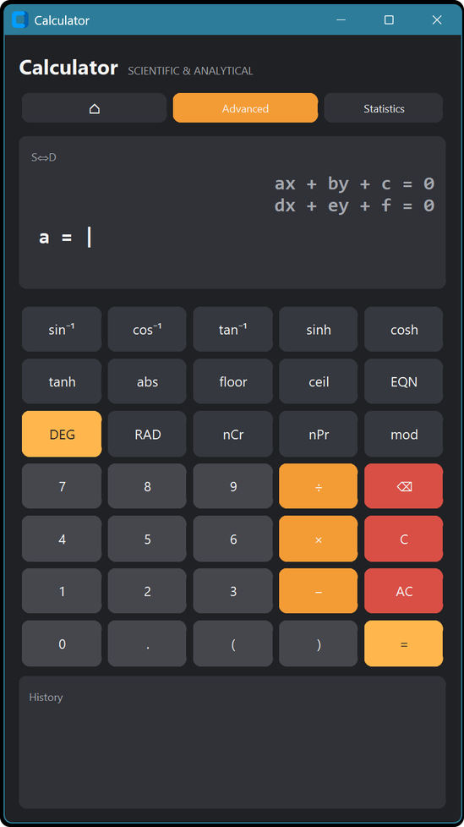
Core functionality
1
Scientific & Advanced Modes: Can perform trigonometric, logarithmic, power and root functions, along with nCr and nPr for combinations and permutations.
2
Equation Solver: Prompts for one coefficient at a time and solves linear, quadratic and cubic equations.
3
Statistics : Accepts a dataset and calculates the mean, variance, quartiles and regression.
4
Variables and history: Stores values like a = 5 so they can be reused. Keeps a record of calculations and can switch answers between fraction and decimal form.
Scientific & Advanced Calculator
4
Notes:
4

Slide 5
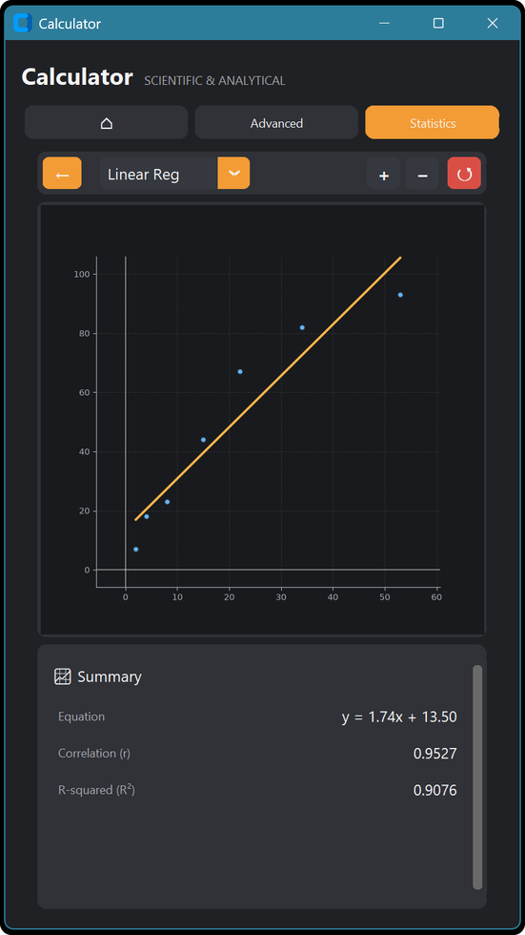
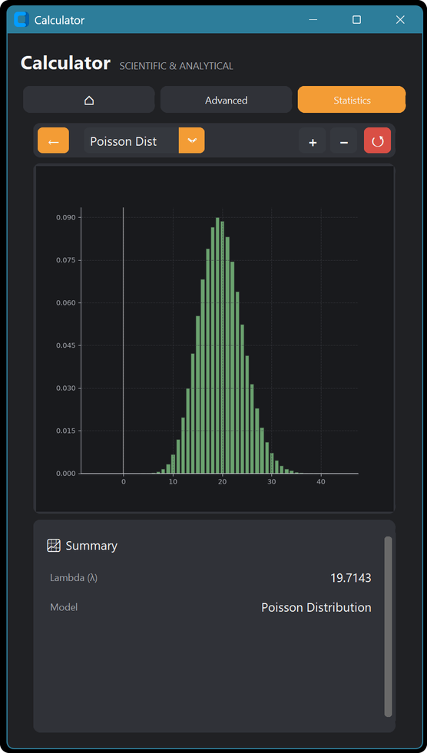
Statistics and Graphing
1
Summary below the graph: Displays the equation, correlation and R² directly below the graph for quick analysis.
2
Regression and Poisson: Draws a fitted regression line for paired data and a Poisson curve based on the mean of the data.
3
Zoom and pan: Allows zooming, panning and resetting the view to examine the graph in detail.
Linear regression
Poisson distribution
Scientific & Advanced Calculator
5
Notes:
5

Slide 6
Thank you
Aditi Kumar
NextHikes IT Solutions
Notes:
7

