Slide 1



Bike Sharing Demand Analysis
Bike Sharing
Demand Analysis
NEXTHIKES IT SOLUTIONS
Submitted by Aditi Kumar
01 / 17
Notes:
1.7.2013
1
‹#›

Slide 2
02 · INTRODUCTION
Project Objective & Dataset
OBJECTIVE
DATASET SCOPE
Analyzed hourly bike rental demand and examine its relationship with time, rider type, and weather-related factors, using Microsoft Excel.
45 days
Winter
Historical daily coverage
1 Season
FACTORS EXAMINED
Hour of day
Rider type (casual / registered)
1 Jan 2011 → 14 Feb 2011
Working day / non-working day
Weekday / weekend
Holiday status
Weather condition
Temperature & apparent temperature
Humidity
Windspeed
Bike Sharing Demand Analysis
02 / 17
Notes:
1.7.2013
2
‹#›

Slide 3
Excel Workflow
03 · WORKFLOW
1
2
3
4
Source Data
Cleaning
Merge & Append
Feature Preparation
The analysis started with three source workbooks: Dataset1, Dataset2, and Dataset3.
→
Power Query was used to fix data types, remove duplicates, and fill 11 missing values with the mean.
→
The datasets were merged using the common 'instant' key and then appended to create one dataset with 1,000 hourly rows.
→
Lookup tables using VLOOKUP / INDEX-MATCH and IF formulas were used to add clear labels for weather, day type, and working day.
FINAL ANALYTICAL DATASET
Date / Time
Rider Type
Weather
Environment
Derived Fields
Date, hour, weekday, month
Casual, registered, total rentals
Weather condition, temperature, humidity, windspeed
Holiday, season code (constant)
Day type, working day, weather label (lookup-based)
Bike Sharing Demand Analysis
03 / 17
Notes:
1.7.2013
3
‹#›

Slide 4
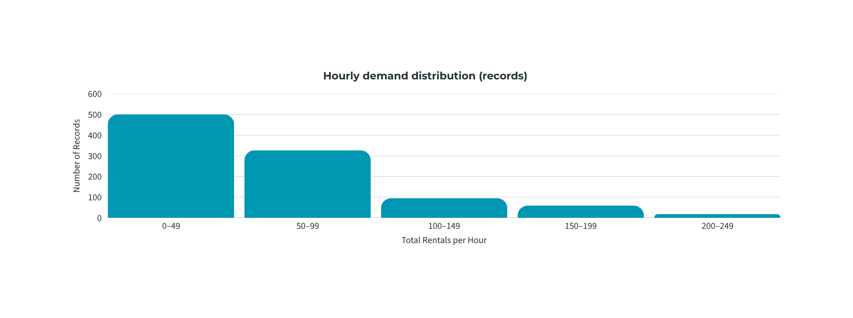
Distribution of Rental Demand
04 · OVERALL RENTAL DEMAND
Total rentals
Average hourly rentals
Minimum hourly rentals
Maximum hourly rentals
Standard deviation
58,304
58.3
1
249
50.99
DISTRIBUTION OF HOURLY DEMAND
Bike Sharing Demand Analysis
04 / 17
Notes:
1.7.2013
4
‹#›

Slide 5
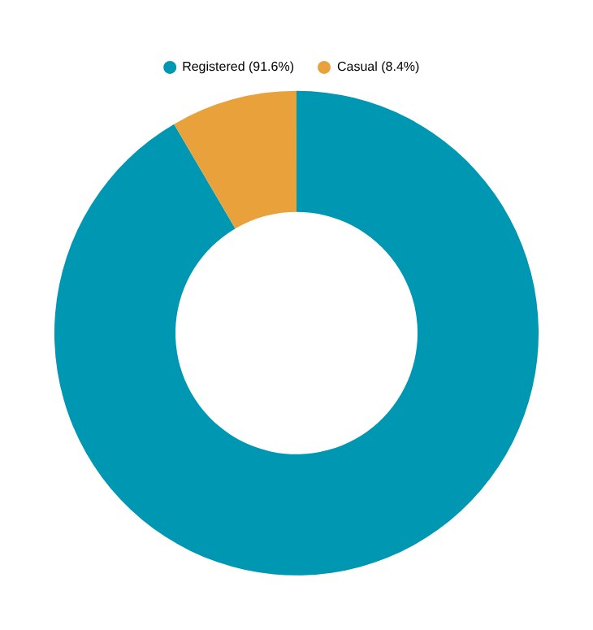
05 · RIDER COMPOSITION
Registered Riders Account for the Majority of Demand
RIDER BREAKDOWN
Registered rentals (91.6%)
Casual rentals (8.4%)
53,383
4,921
Total recorded rentals: 58,304
Registered rentals represent the large majority of recorded demand (91.6%), while Casual riders made up the other 8.4% of total volume.
Bike Sharing Demand Analysis
05 / 17
Notes:
1.7.2013
5
‹#›

Slide 6
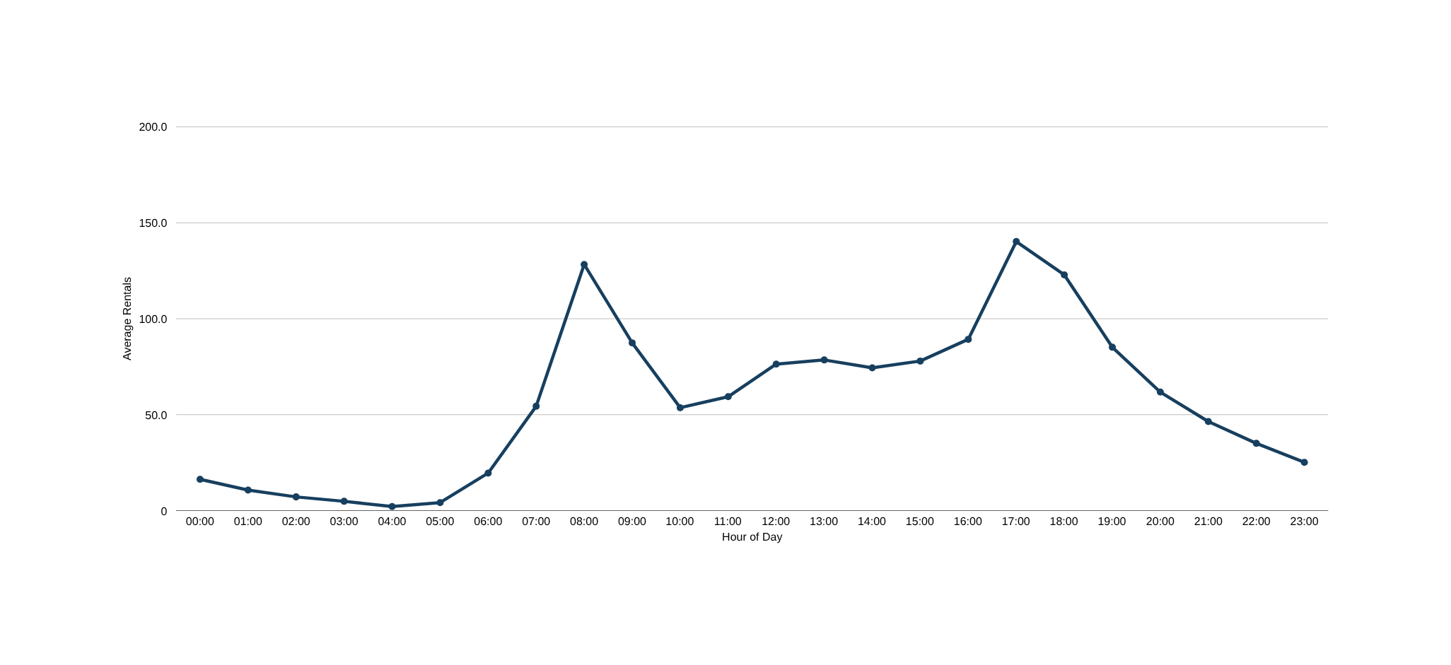
06 · TIME-OF-DAY ANALYSIS
Hourly Demand Peaks in the Morning and Evening
17:00 → 140.2
18:00 → 122.9
08:00 → 128.3
The average demand peaks at 5 p.m. and 8 a.m. In particular, the demand is very low in the early morning hours, with about 2.16 rentals at 4:00 AM.
Bike Sharing Demand Analysis
06 / 17
Notes:
1.7.2013
6
‹#›

Slide 7
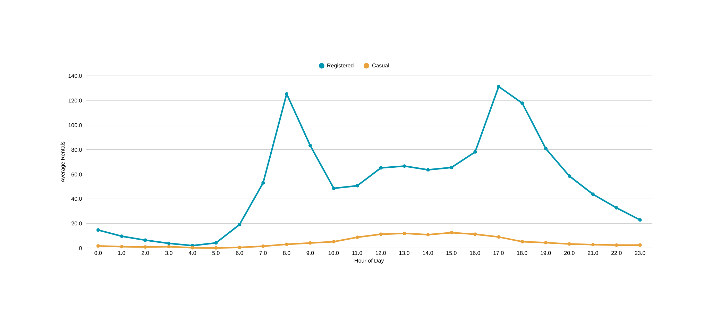
07 · RIDER BEHAVIOR
Casual and Registered Riders Follow Different Daily Patterns
Registered riders’ usage is primarily in the morning and evening, while casual riders’ usage is more common around midday and in the afternoon.
Bike Sharing Demand Analysis
07 / 17
Notes:
1.7.2013
13
‹#›

Slide 8
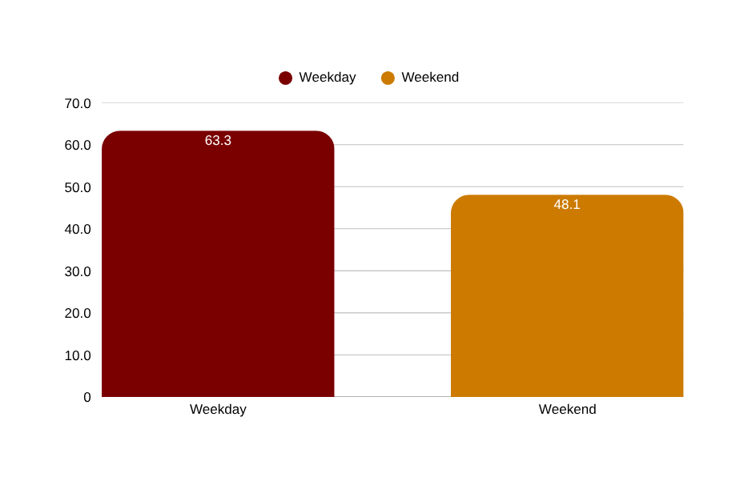
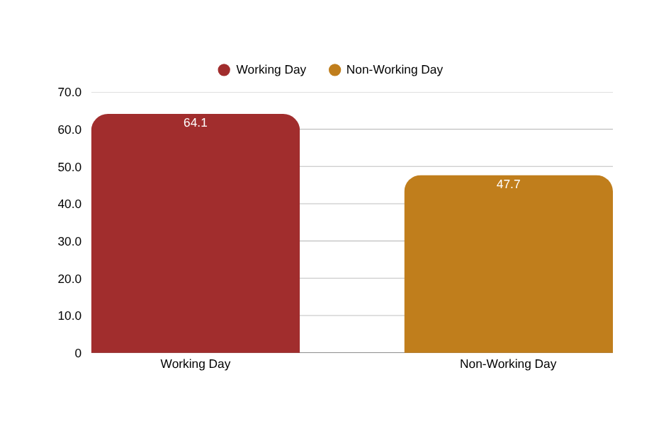
08 · TIME-TYPE ANALYSIS
Calendar Effects on Rental Demand
DAY TYPE COMPARISON
WORKING DAY COMPARISON
DAY OF WEEK & HOLIDAY SNAPSHOT
Thursday — highest day of week
Saturday — lowest day of week
Holiday avg (n = 24)
Non-holiday avg (n = 976)
67.66
46.67
41.67
58.71
Bike Sharing Demand Analysis
08 / 17
Notes:
1.7.2013
7
‹#›

Slide 9
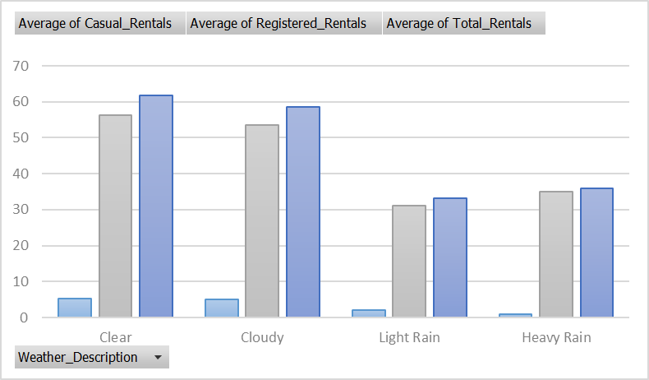
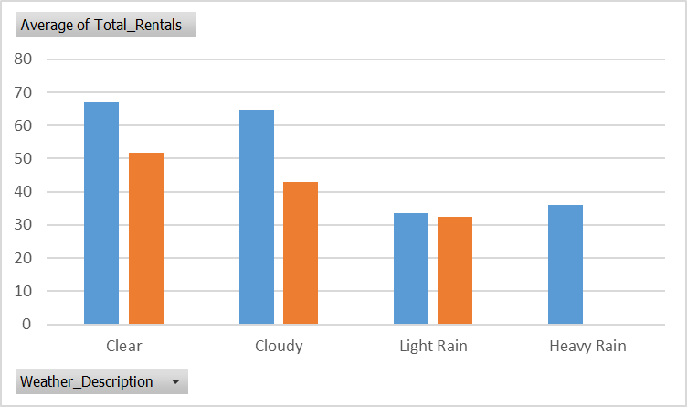
Weather Conditions and Rental Demands
9 · WEATHER ANALYSIS
AVERAGE RENTALS BY WEATHER
WEEKDAY VS WEEKEND, BY WEATHER
RECORD COUNTS
84
1
Clear
606
Cloudy
309
Light Rain
Heavy Rain
The average rentals increased with increase in the temperature range and were highest in the band of 0.3-0.4. Then the rentals started to drop. This shows that rentals do not always increase with temperature and other factors may impact them as well.
Bike Sharing Demand Analysis
09 / 17
Notes:
1.7.2013
9
‹#›

Slide 10
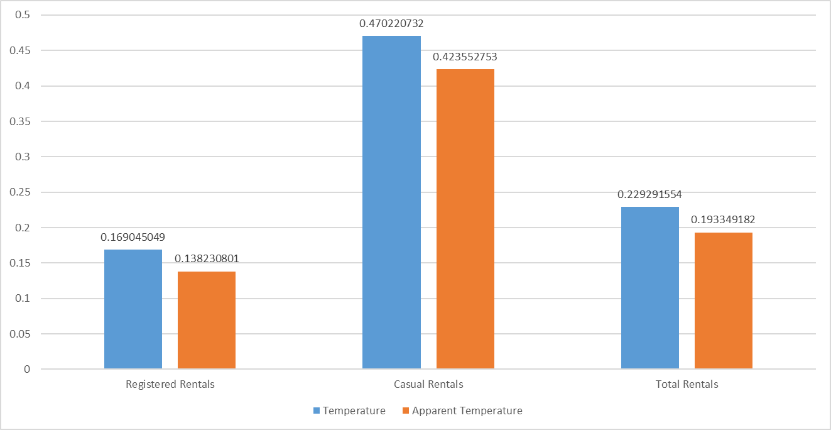
10 · CORRELATION ANALYSIS
Temperature Shows a Stronger Association with Casual Riders
Pearson Correlation Coefficient Between Temperature and Rentals
Rental demand has positive relationship with temperature (+0.229). The relationship is stronger for casual rentals (+0.470) than for registered rentals (+0.169). The same applies to the apparent temperature.
Bike Sharing Demand Analysis
10 / 17
Notes:
1.7.2013
10
‹#›

Slide 11
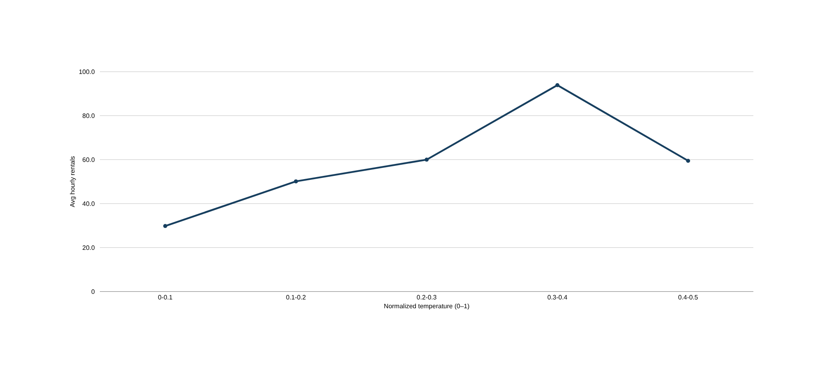
11 · GROUPED ANALYSIS
The Temperature–Demand Relationship Is Non-Linear
Demand rises across the lower temperature bands and reaches its highest average in the 0.3–0.4 band (93.88), then falls to 59.48 in the 0.4–0.5 band — showing the relationship is not a simple straight-line trend, without implying an optimal causal temperature.
Bike Sharing Demand Analysis
11 / 17
Notes:
1.7.2013
11
‹#›

Slide 12
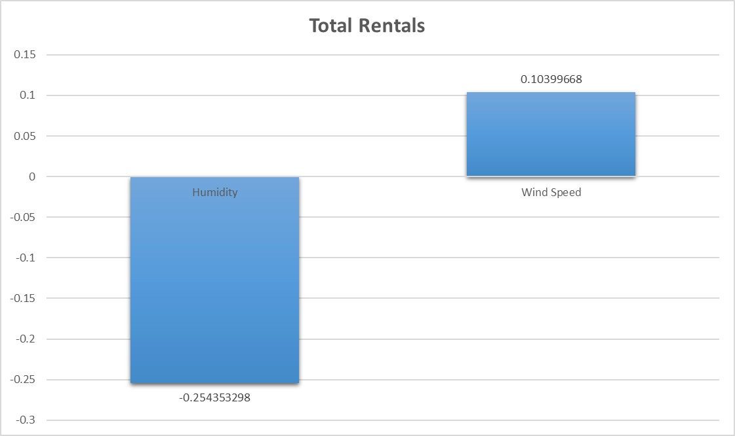
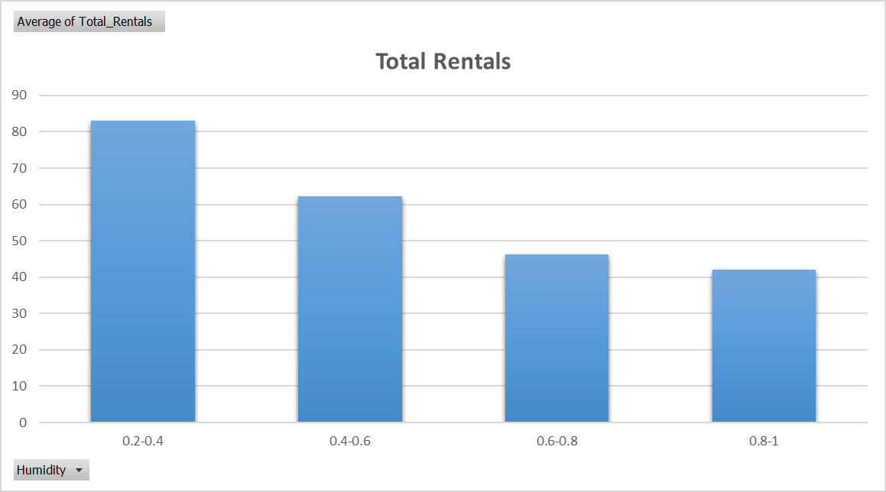
12 · ENVIRONMENTAL FACTORS
Humidity Shows a Negative Association with Demand
CORRELATION WITH TOTAL RENTALS
AVERAGE RENTALS BY HUMIDITY BAND
Humidity has a negative relationship with rentals (-0.254). With increase in humidity, average rentals decrease from 82.98 to 42.07. There is a weak positive relation between windspeed and rentals (+0.104).
Bike Sharing Demand Analysis
12 / 17
Notes:
1.7.2013
12
‹#›

Slide 13
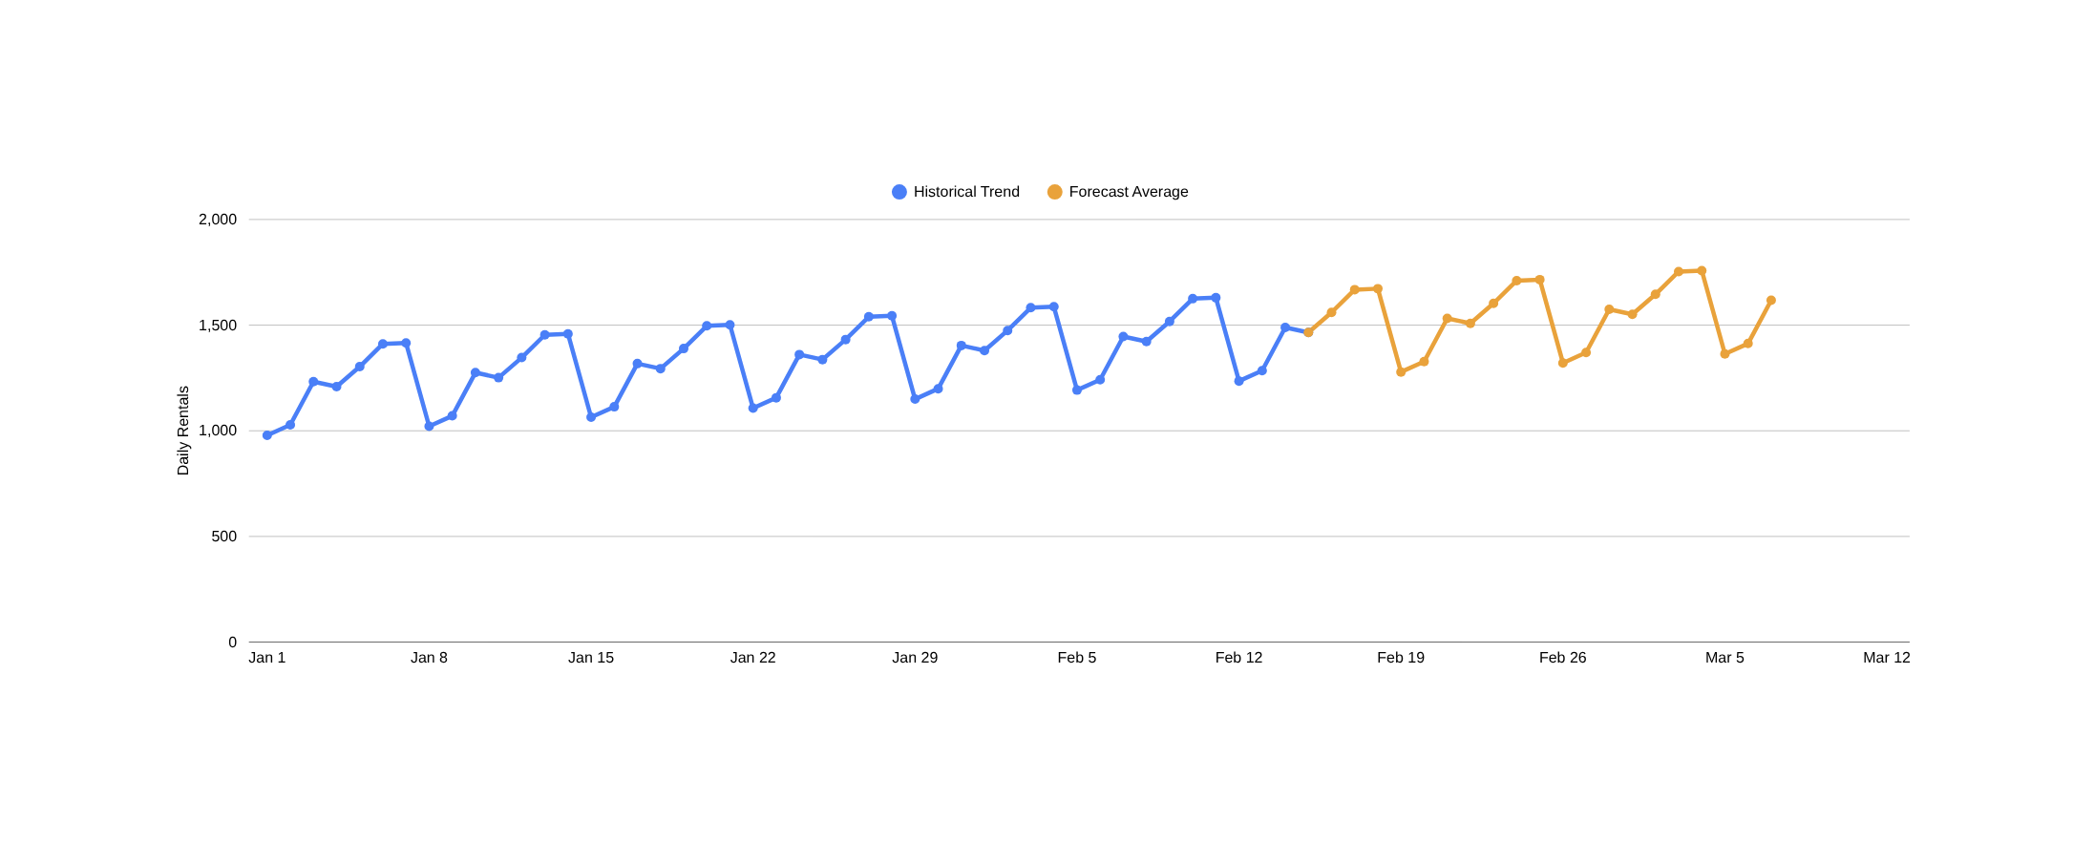
The Model Projects Demand Over the Forecast Period
13 · FORECAST ANALYSIS
Date
1,500.49 rentals/day
1,543.28 rentals/day
First 7 forecast days avg.
Full 21-day forecast average
Forecast period
15 Feb – 7 Mar
Excel FORECAST.ETS predicts around 1,500 rentals per day on average for the first 7 days. However, these are only estimates, and the actual number of rentals may be different.
Bike Sharing Demand Analysis
13 / 17
Notes:
1.7.2013
15
‹#›

Slide 14
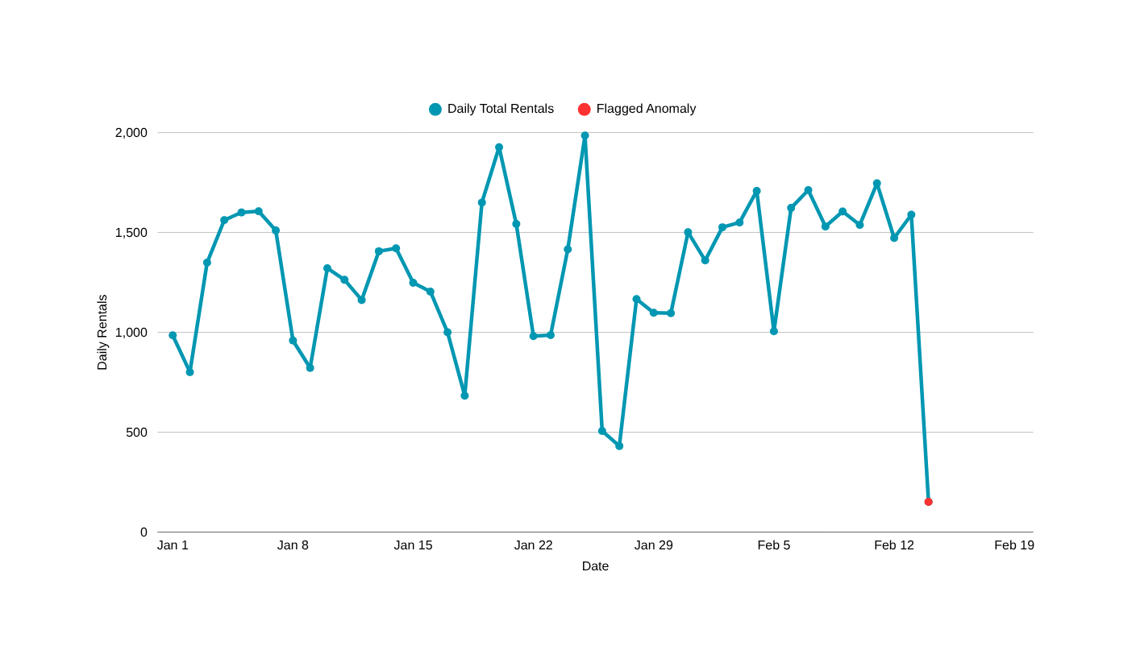
One Anomaly Flagged — 14 Feb, the Dataset’s Final Partial Day
14 · ANOMALY DETECTION (IQR METHOD)
IQR THRESHOLDS
Lower threshold
169.5
Upper threshold
2,397.5
Days flagged (0 High / 1 Low)
1 of 45
Flagged: 14-Feb-2011 — 151 rentals; the dataset ends at 07:00 that day.
The IQR method identified 14 February as a low-demand day, with only 151 rentals. However, the data for that day ends at 7:00 AM, so it is incomplete and should not be considered a real drop in demand.
Bike Sharing Demand Analysis
14 / 17
Notes:
1.7.2013
16
‹#›

Slide 15
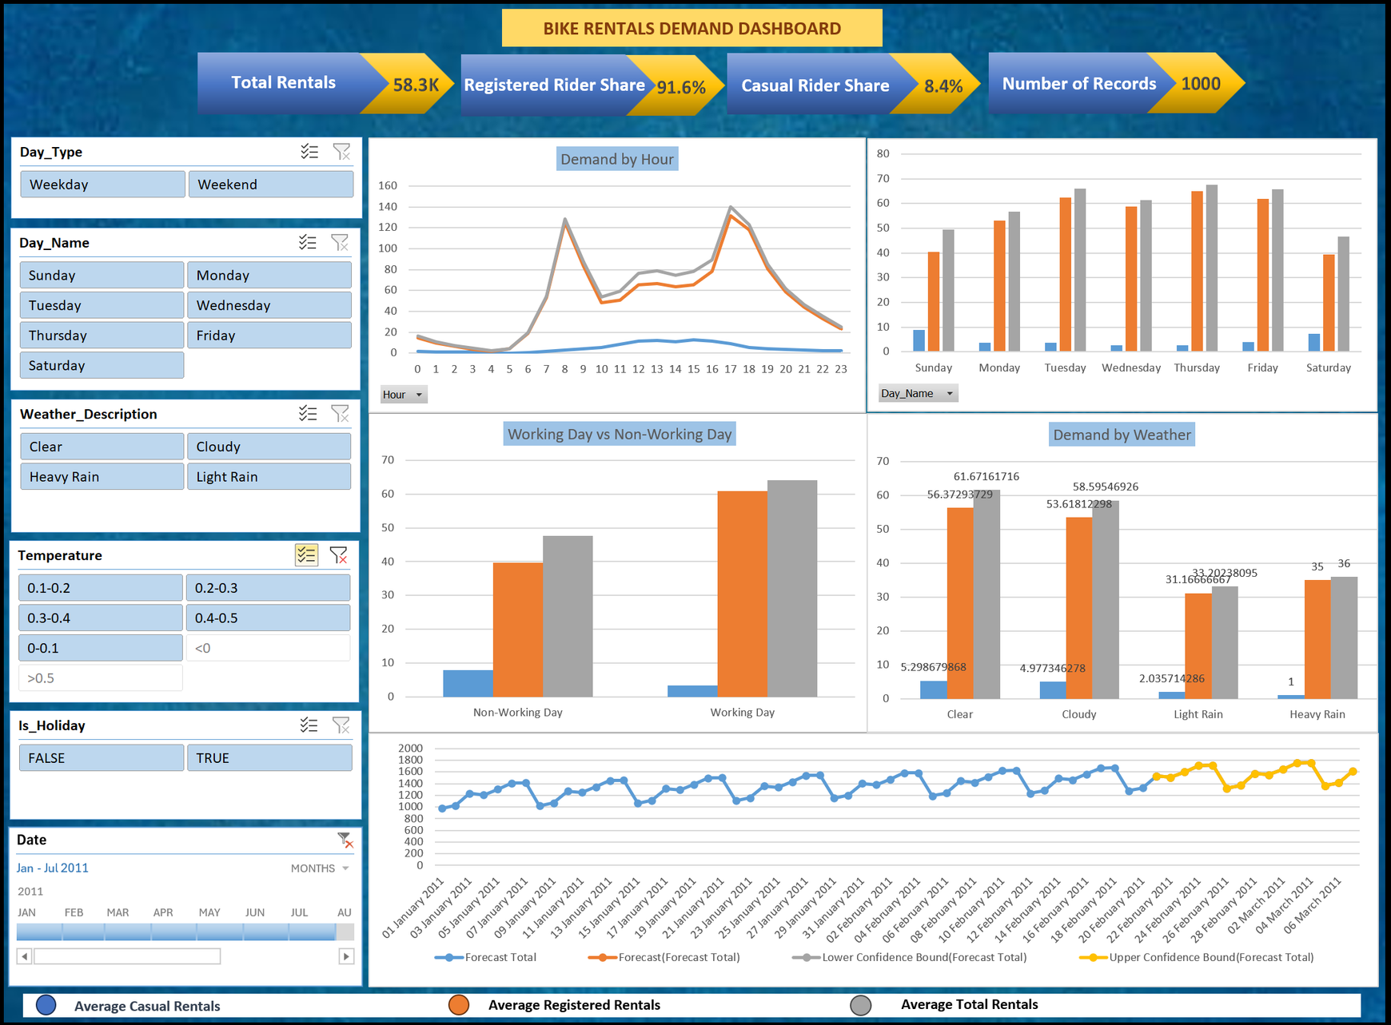
DASHBOARD OVERVIEW
15 · DASHBOARD
Demand Patterns
Compare rental demand by hour and day of week to identify high and low demand periods.
Rider & Calendar Analysis
Examine the difference between casual and registered riders by day type and day of week.
Weather & Forecast Insights
Compare rental demand under different weather conditions and review the short-term rental forecast.
Takeaway bar
All results are presented in one Excel dashboard. Slicers and a timeline within the workbook allow users to filter by day, weather, temperature and holiday.
Bike Sharing Demand Analysis
15 / 17
Notes:
1.7.2013
14
‹#›

Slide 16

Findings, Limitations & Recommendations
16 · SUMMARY
KEY FINDINGS
SNAPSHOT
There were 58,304 rentals across 1,000 hourly records, with 91.6% from registered riders and 8.4% from casual riders.
Registered share
Peak hourly avg (5 PM)
Rentals were highest around 08:00 and 17:00, reaching 140.2 per hour at 17:00. Working days averaged 64.14 rentals, compared with 47.65 on non-working days.
91.6%
140.2
Rental demand was higher in clear weather (61.67 rentals/hour) than during light rain (33.20 rentals/hour).
Working-day average
Forecast avg (rentals/day)
Temperature had a stronger relationship with casual rentals (+0.470) than registered rentals (+0.169).
64.14
Higher humidity was linked to lower rental demand (−0.254 correlation).
1,500
The forecast predicts an average of 1,500.49 rentals per day for the first 7 days.
LIMITATIONS
RECOMMENDATIONS
• Covers only 1-Jan – 14-Feb 2011; February is partial
Commuter peaks: Rentals are at their height around 8am and 5pm, so there should be more bikes available during that time.
• Only one season (winter) is present in the data
  Correlation does not prove cause and effect.
Low demand periods: Adjust bikes on weekends and during rainy weather, when fewer people use the service.
• Heavy Rain category has only 1 observation
Forecast planning: Make plans based on weather forecasts, then verify the predictions using data from different seasons to see if they still hold.
• The 14-Feb anomaly is a partial day (data ends at 07:00)
Bike Sharing Demand Analysis
16 / 17
Notes:
1.7.2013
17
‹#›

Slide 17
Bike Sharing Demand Analysis
Thank You!
Bike Sharing Demand Analysis
By Aditi Kumar
17 / 17

