Slide 1
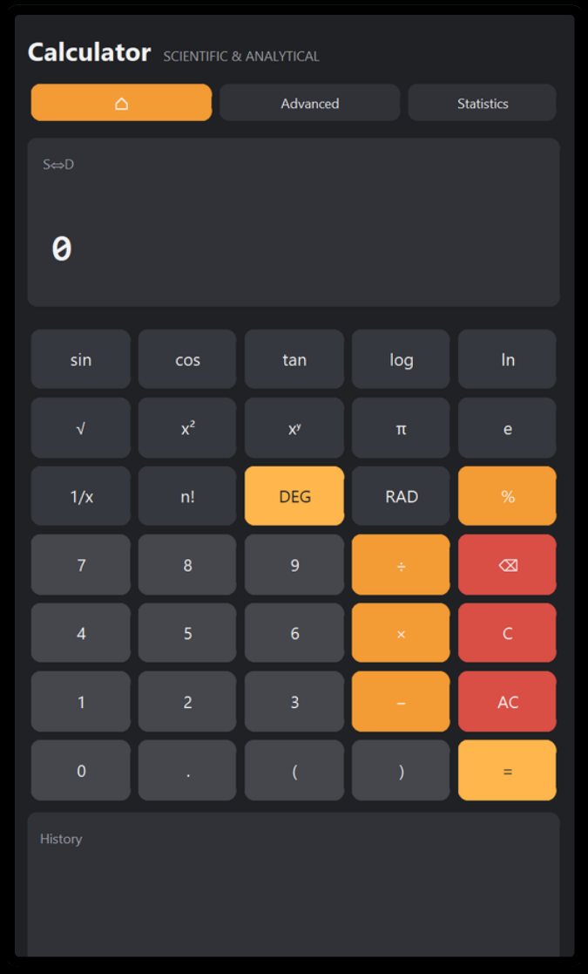


NEXTHIKES IT SOLUTIONS
Numera
Scientific & Advanced Calculator
Presented by
Aditi Kumar
Notes:
1

Slide 2
Objective
1
To build an advanced GUI calculator that goes beyond basic arithmetic.
2
Designed for data analysts who want to do graphing, statistical analysis, and advanced math in a single, unified workspace.
3
It aims for mathematical accuracy and a layout that is easy to use.
Numera | Scientific & Advanced Calculator
2
Notes:
2

Slide 3
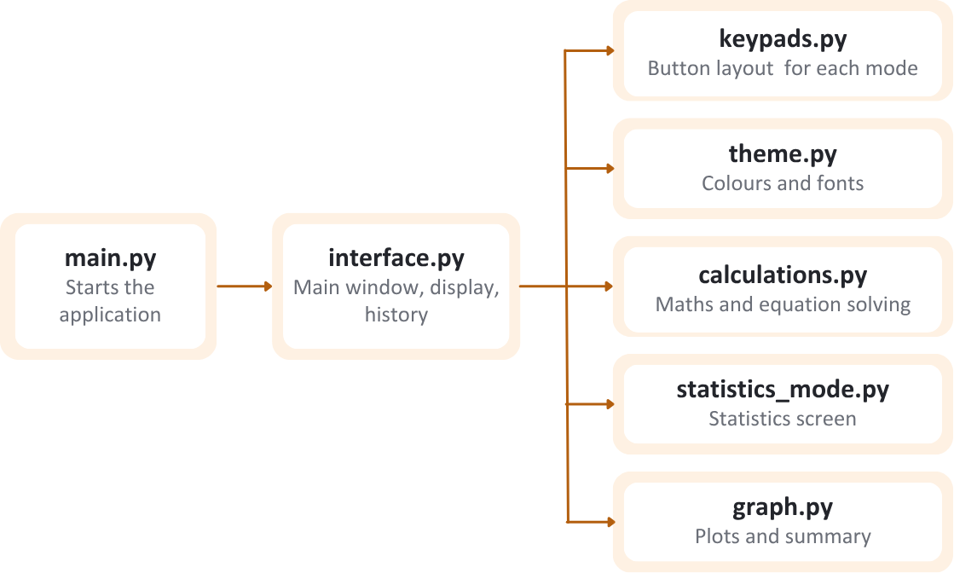
Tech-stack and Architecture
TECH STACK
ARCHITECTURE
keypads.py
Button layout for each mode
CustomTkinter: Builds the main window, keypad and layout of the application.
theme.py
Colours and fonts
SymPy: Solves equations and handles symbolic maths.
interface.py
Main window, display, history
main.py
Starts the application
calculations.py
Maths and equation solving
Matplotlib & NumPy: Draw the graphs and manage the numerical data supporting them.
statistics_mode.py
Statistics screen
AST (Python): Checks each expression before it is calculated, so only valid maths is evaluated.
graph.py
Plots and summary
Numera | Scientific & Advanced Calculator
3
Notes:
3

Slide 4
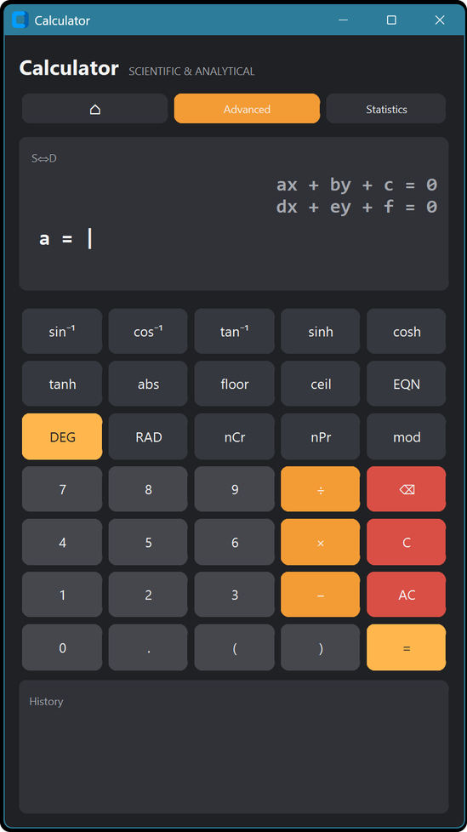
Core functionality
1
Scientific Mode: Handles foundational math including trigonometric, logarithmic, power, and square root functions.
2
Advanced Mode: Expands into analytical math like combinations, custom logarithms, and a step-by-step solver for linear, quadratic, and cubic equations.
3
Statistics Mode: A dedicated workspace that instantly calculates data metrics like mean, variance, quartiles, and linear regression.
4
Graphing Module: Visualizes data with interactive graphs like linear regression, normal curve, histogram, and Poisson distributions.
5
Calculation History: Tracks your recent calculations for easy review. Entries older than one hour expire to maintain a clean workspace.
Numera | Scientific & Advanced Calculator
4
Notes:
4

Slide 5
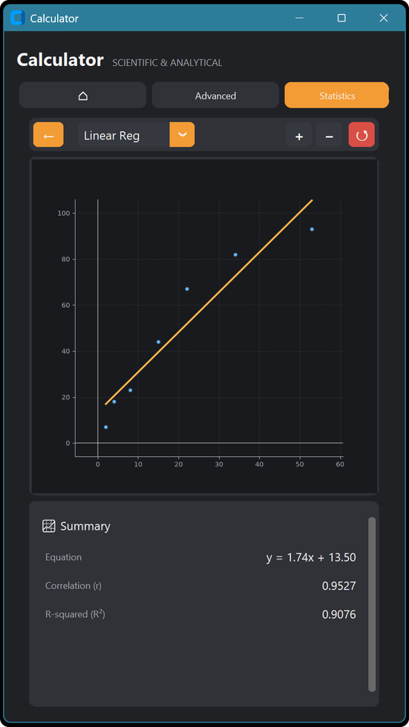
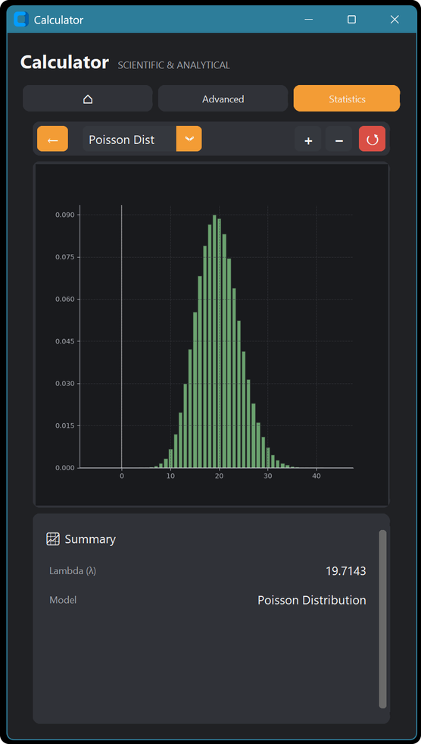
Statistics & Graphing
1
Summary: Displays the equation, correlation and R² directly below the graph for quick analysis.
2
Regression and Poisson: Draws a fitted regression line for paired data and a Poisson curve based on the mean of the data.
3
Zoom and Pan: Allows zooming, panning and resetting the view to examine the graph in detail.
Linear regression
Poisson distribution
Numera | Scientific & Advanced Calculator
5
Notes:
5

Slide 6
Development Challenges & Future Scope
Challenges Encountered
Solutions Implemented
Future Enhancements
Ensuring the app safely calculates math without allowing malicious code to run.
Developed a secure mathematical parser to strictly block unauthorized code.
Adding a CSV import feature to load large datasets instantly.
Preventing the calculator from freezing when users enter massive numbers.
Added manual limits to the math engine to stop huge calculations from freezing.
Developing 3D graphing capabilities for complex, multivariable math functions.
Designing a responsive interface that works smoothly across different screen sizes.
Organized the interface into separate modules with flexible layouts for each mode.
Introducing a dark and light mode toggle to customize the visual experience.
Managing incomplete or invalid user inputs without closing the entire app.
Implemented error handling that displays clear messages instead of crashing the app.
Adding an export option that allows users to save their graphs as PDF files.
Numera | Scientific & Advanced Calculator
6
Notes:
2

Slide 7
References
1
CustomTkinter
https://customtkinter.tomschimansky.com/
5
Python ast
https://docs.python.org/3/library/ast.html
2
SymPy
https://docs.sympy.org/
6
Python statistics
https://docs.python.org/3/library/statistics.html
3
Matplotlib
https://matplotlib.org/
7
Python fractions
https://docs.python.org/3/library/fractions.html
4
NumPy
https://numpy.org/
8
Source code
https://github.com/Aditi020/Numera
Numera | Scientific & Advanced Calculator
7
Notes:
2

Slide 8
Thank you
Aditi Kumar
NextHikes IT Solutions
Notes:
7

