Slide 1

MISM 6406 Prescriptive Modeling
Using data to decide which lapsed PVA donors to mail, and how risky that plan is
Notes:
Introduce the team and the problem: PVA mails lapsed donors to win them back. Our job: predict who responds, decide whom to mail under a budget, and test how risky that plan is.

Slide 2

The data: PVA's lapsed-donor file
95,412
481 → 21
Cleaning steps
lapsed donors in the learning file
variables kept for modelling
Dropped WEALTH1/2 (46–47% missing)
Median-filled AGE, INCOME, TIMELAG; missing donors respond the same (4.9% vs 5.1%)
Recoded text flags to 0/1: star donor (PEP), female, homeowner
Ordered RFA amount codes by dollars: D ($5–9.99) → G ($25+)
Recency is 'L' for every donor, so it was excluded
5.08%
$13
responded to the 97NK mailing
median gift (mean $15.62)
Outcome: TARGET_B = 1 if a lapsed donor gave to the June 1997 mailing; TARGET_D = gift amount.
Notes:
Only 5% respond, so accuracy is useless (predicting 'nobody' is 95% accurate). We judge models by AUC and lift. Missing AGE/INCOME donors respond at the same rate, so median imputation is safe.

Slide 3
Frequent, small-dollar givers respond most
Best cell: 4+ gifts & $5–9.99 last gift → 9.5% Worst cell: 1 gift & $25+ → 3.0% Demographics: age, gender, homeownership ≈ no effect
Notes:
RFA codes: frequency = number of recent gifts; amount band D=$5-9.99 up to G=$25+. Response doubles from one-time to frequent givers and falls as gift size grows. Demographics barely move response (age 4.1% for <=40 vs about 5.2% otherwise, gender none).

Slide 4

…but big givers raise twice as much per letter
D $5–9.99
9.4% respond
$5.84 avg gift
G $25+
3.6% respond
$31.10 avg gift
A response model alone ranks the cheapest donors first, so we optimize on expected dollars: response × gift − cost.
Notes:
Key tension that links Phase 1 to Phase 2: likely responders give the least. Per letter, G donors raise $1.11 vs $0.55 for D donors.

Slide 5
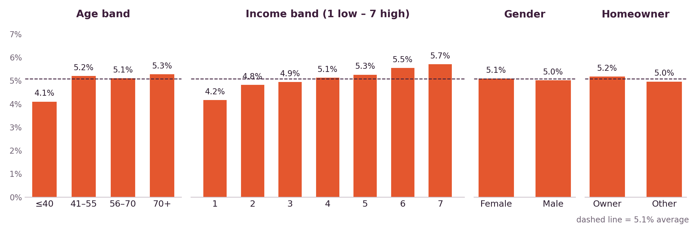
Demographics barely move response
Top donors (gave $25+, 782 people) vs other responders
Income band 4.4 vs 4.0
Lifetime gifts 7.9 vs 12.2
Last gift $28 vs $13
Star donors 40% vs 63%
Notes:
Answers 'who are the top donors by demographics?'. Response rises gently with income (4.2% to 5.7%) and is lower for donors 40 and under (4.1%); gender and homeownership make almost no difference. Top donors look demographically similar to other responders; they differ by giving style: rarely, but big.

Slide 6
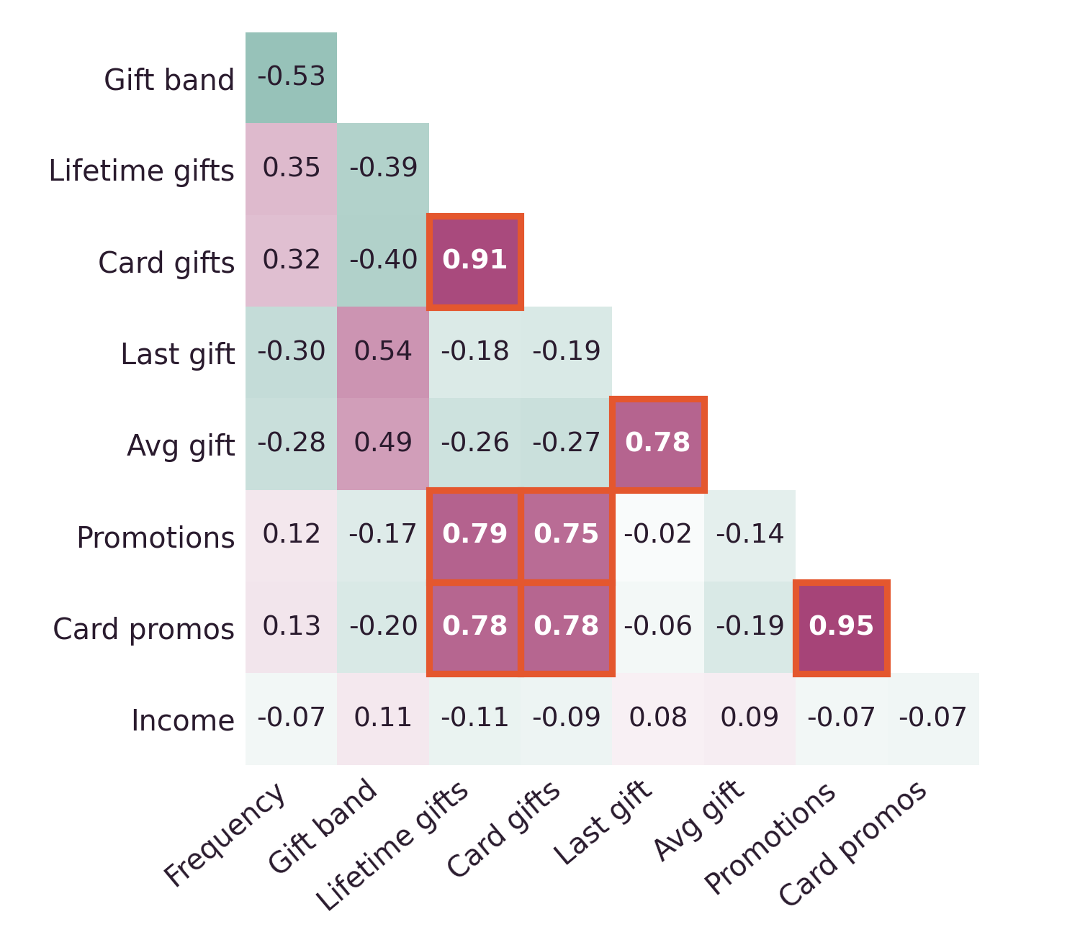
Four models tested, stepwise logistic wins
Correlation between candidate predictors
A
Parsimonious logistic
0.603
AUC
B
Full logistic
0.606
AUC
8 variables: frequency, gift band, star donor, lifetime & card gifts, last & avg gift, age
16 variables: A + max gift, income, gender, homeowner, 3 promotion counts, hits
→ Baseline built from the strongest EDA signals
→ Only +0.003; overlapping variables flip signs
C
Decision tree
0.500
AUC
D
Stepwise logistic
0.607
AUC
12 variables, max depth 4, looking for cut-offs
Starts from B, keeps 8: frequency, gift band, star donor, lifetime & card gifts, income, 2 promotion counts
Orange boxes: pairs with r ≥ 0.75 (promotion VIFs 16–23, gift counts ≈ 8.5). This overlap is why stepwise, which drops repeats, wins.
→ No split: with 5% givers it predicts 'no gift' for all
★ Drops repeated $ variables: best AUC, simplest
Notes:
All four were fit on the same 70% training split and scored by AUC on the held-out 30%. The heatmap is from our EDA: lifetime and card gifts (0.91) and the promotion counts (0.95) overlap heavily, which makes Model B's coefficients unstable. Stepwise selection (both directions, AIC) removed the repeats and kept the best AUC with half the variables. The tree never split because no group is majority-responder.

Slide 7
Model D splits donors into 10 ranked deciles
1.82×
top-decile lift: 9.2% vs 5.1% average
Variables kept
Recent frequency & gift band
Star donor flag (PEP)
Lifetime & card gifts
Promotions & card promotions
Income
Notes:
Test AUC 0.607. Response falls almost steadily from 9.2% in the top decile to 2.6% in the bottom. Mention the strongest coefficients from our R output: frequency positive, gift band negative (bigger last gift, lower response), star donor positive. Each decile holds about 9,541 donors.

Slide 8



Base optimization: which deciles to mail?
Decision variables
Objective
Constraints
x_d ∈ {0, 1}
Mail decile d (1) or skip it (0), for d = 1…10
Each decile ≈ 9,541 donors, mailed in full
max Σ x_d · N_d · (p_d · g_d − c)
p_d = response rate, g_d = avg gift (from Model D deciles)
c = $0.68 cost per piece
Cost ≤ $30,000
Donors mailed ≥ 20,000 (reach)
Expected responders ≥ 1,500
x_d binary
Why binary? PVA mails whole segments, so each decile is all-or-nothing. Solved in Excel Solver (Simplex LP with binary constraints).
Notes:
Objective is expected net donation. Each decile is an all-or-nothing choice. Inputs come from scoring donors with Model D and averaging response and gift within each decile. Budget, reach and responder minimums are our assumptions.

Slide 9
Optimal plan: mail D2, D3, D5 and D6
$7,056
38,165
expected net donation
donors mailed
$25,952
2,234
mailing cost
expected responders
Why skip D1? Highest response (9.2%) but $7.56 gifts, so only $176 net. D6 nets the most: $2,483.
Notes:
Budget allows about 44,000 letters, so at most 4 deciles. Solver picks the 4 with the highest net value. This confirms the EDA trade-off: the best responders are not the best value.

Slide 10
Uncertainty grounded in 18 past campaigns
Independent uniform ±30%
A
Our first Excel model: each decile draws its own response and gift
Shared shock, uniform ±30%
B
One draw per trial moves every decile together
Response: 10th–90th pct = 0.68× to 1.36× of median → ±30%
Avg gift: varied only 0.91× to 1.13×; we use ±30% (as in our Excel) to stay conservative
Every donor gets the same mailing, so a good or bad campaign moves all deciles together
Shared shock, triangular ★ preferred
C
Response & gift ±30%, most likely = model estimate
Notes:
Basis from the data: the file records each donor's gifts to 22 earlier promotions. Across the 18 large ones (P7-P24) response varied about plus/minus 30% around its median, which supports our 30% range. Average gift varied only about plus/minus 10%, so using 30% for gift too (as in our Excel model) is a deliberately conservative choice. Levels are higher than our 5% because donors were active then; we use the relative spread. Triangular puts the most weight on our model's estimate.

Slide 11
Scenario C: about an 11% chance of a loss
Scenario | P(loss) | 5th pct | Median | 95th pct
A Independent | 3.3% | $605 | $6,881 | $14,165
B Shared uniform | 20.4% | −$5,305 | $6,273 | $21,857
C Shared triangular | 10.8% | −$1,895 | $6,730 | $17,047
Worst
−$9,778
Likely
$7,056
Best
$29,831
Worst/best = response and gift both ∓30% together
Same average (≈ $7,000) in all three
A lets deciles cancel out, so risk looks tiny
Loses money only if response × gift falls > 21%
Notes:
Same plan (D2, D3, D5, D6) under three uncertainty models. A is our original Excel model; B and C use one shared random draw per trial, because a good or bad mailing affects every decile at once. We support C: it is realistic (one shared shock) and puts the most weight on our model's estimate, while keeping our conservative 30% ranges. Under C, 90% of trials fall between about -$1,900 and $17,000, and break-even needs response x gift to drop more than 21%. These are one run of 10,000 trials; reruns give P(loss) of about 10.6% to 10.9%.

Slide 12


Recommendation: mail four deciles, ranked by $
Base plan
If risk-averse
If budget rises $5k
Mail D2, D3, D5, D6
Mail D2, D3, D6 only
Add D7
38,165 donors · $25,952
≈ $7,000 expected net
≈ 11% chance of a loss
28,624 donors · $19,464
≈ $5,800 expected net
≈ 9% chance of a loss
+9,541 donors · +$6,488
+$1,210 expected net
Smaller gain per extra $
Principle: rank donors by expected dollars (response × gift), not by response rate alone.
Notes:
Risk figures use scenario C. The base plan gives the best expected net at a low loss risk. The 3-decile option frees $6,500 of budget for a small reduction in risk ($5,802 expected).

Slide 13
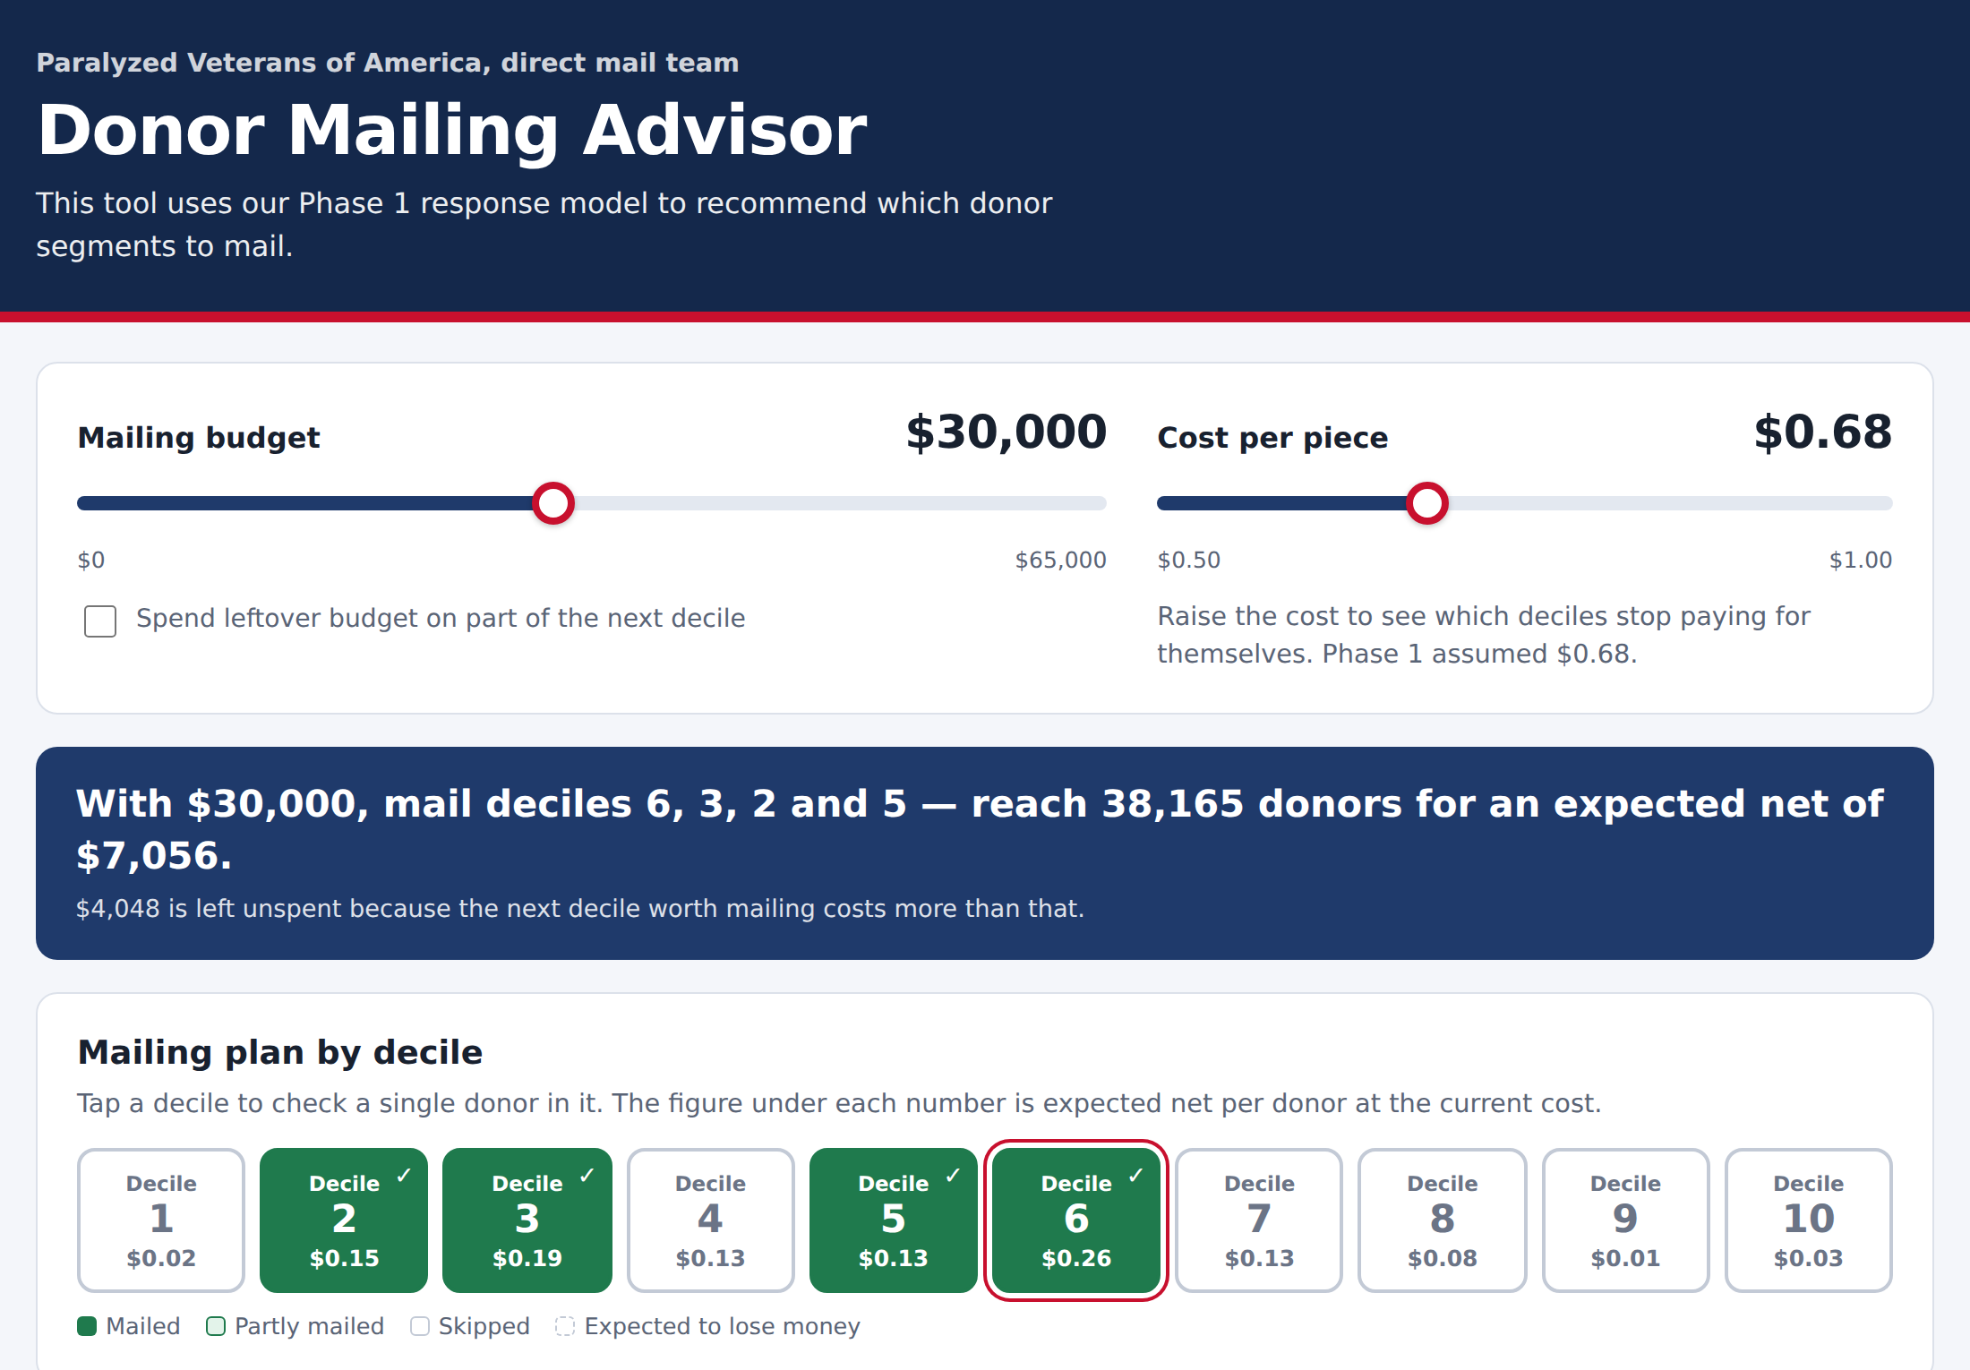



Our agent: the Donor Mailing Advisor
Inputs
Budget and cost-per-piece sliders, an option to mail part of a decile, and a decile to check one donor
How it decides
Ranks deciles by expected $ per donor (response × gift), then mails whole deciles until the budget runs out
Outputs
Deciles to mail, donors, cost, responders, expected net, a mail / don't-mail verdict per donor, and the reason for each decile
Live tool at $30,000 and $0.68: mail D2, D3, D5, D6 for $7,056, the same answer as Solver
Notes:
Demo idea: move the budget slider from $30k to $35k and the plan adds decile 7 (expected net $8,266), matching our sensitivity slide. Raise the cost per piece to show deciles turning red when they stop paying for themselves. Click a decile to show the single-donor verdict. Because every decile costs almost the same to mail, ranking by expected $ per donor and filling the budget gives the same answer as Solver. Next step: add the minimum reach and responder checks and the simulation risk from scenario C.

Slide 14

Challenges and next steps
Challenges
Next steps
Only 5% responders: the tree could not split, so we judged models by AUC and lift
RFA amount codes were reversed at first; recoded in dollar order
All-or-nothing deciles leave budget unspent
Independent draws understated risk; switched to a shared shock
Add risk (scenario C) and reach checks to the agent
Add scenarios B and C to the Excel simulation
Add the tested agent link to the report
Final report and files due Oct 23
Notes:
Close with the recommendation in one line: mail D2, D3, D5 and D6 for about $7,000 expected net with about an 11% chance of a loss. Then take questions.

