Slide 1

FLEETPULSE
IoT
Real-time IoT Fleet Monitoring System
FLEET
MONITOR
TEAM MEMBERS
Aditi Mukherjee
22051395
Subhamita Paul
22051639
Puja Kumari
22051446
Amrit Raj
22053486
Siddhi Shriya
22051631
Samannyo Pal
2228136
Guide: Dr. Himanshu Ranjan
KIIT Deemed to be University
School of Computer Engineering
Bhubaneswar, ODISHA 751024
April 2026
B.TECH · CSE

Slide 2
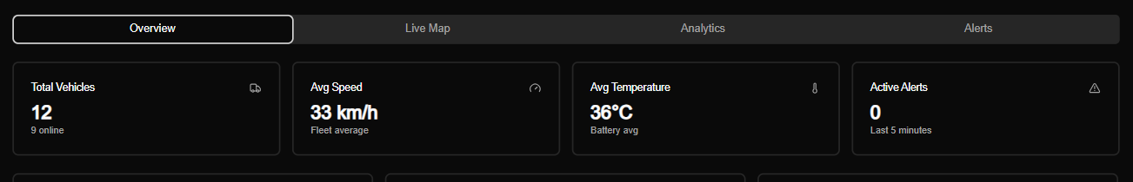
INTRODUCTION
WHAT IS
12
FLEETPULSE?
EV Vehicles
Full-stack real-time IoT fleet monitoring system
Tracks 12 Euler HiLoad EVs across Delhi NCR
Monitors SOC, speed, temperature, GPS — live
WebSocket-powered: no polling, no page refresh
Simulation engine — no physical hardware needed
2s
Update Interval
61%
Avg Fleet SOC
LIVE SYSTEM READING
0
Active Alerts
↑ Live dashboard reading: 12 vehicles active, 0 alerts firing

Slide 3
PROBLEM STATEMENT
THE CHALLENGE
CURRENT STATE
FLEETPULSE SOLUTION
No real-time vehicle tracking
Continuous telemetry streaming
Delayed fault/alert detection
Instant automated alerts
Batch-based, interval monitoring
WebSocket push — zero polling
No central visibility dashboard
Unified analytics dashboard
"Traditional systems fail to provide instant visibility of fleet health."

Slide 4






PROJECT OBJECTIVES
PROJECT
OBJECTIVES
Real-Time Telemetry
EV Metrics Monitoring
Automated Alert System
WebSocket push every 2 seconds per vehicle
SOC, speed, temperature, GPS — all live
Threshold-based: speed, temperature, SOC
Analytics Dashboard
Simulation Engine
Dual Storage
Recharts visualizations + KPI panels
Test without physical IoT hardware
PostgreSQL + in-memory fallback mode
"Combines monitoring, simulation, and analytics in a single platform."

Slide 5
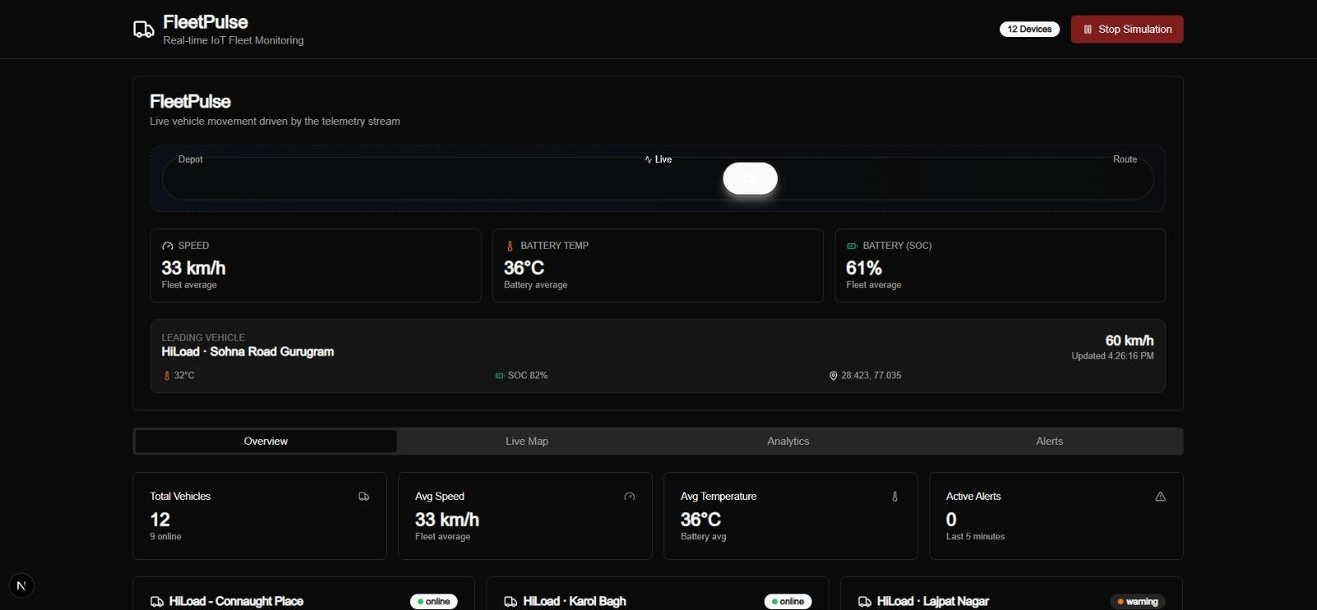
SYSTEM OVERVIEW
SYSTEM
OVERVIEW
VEHICLES
12 Euler HiLoad EVs
COVERAGE
Delhi NCR — 5 zone types
UPDATE RATE
↑ Live: 12 devices, 33 km/h avg, 0 active alerts
Every 2 seconds / vehicle
THRESHOLDS
Speed · Temperature · SOC
"Real-time dashboard running live with simulation engine active"

Slide 6
SYSTEM ARCHITECTURE
SYSTEM
ARCHITECTURE
PRESENTATION LAYER
React · Next.js · Tailwind CSS · Leaflet.js · Recharts
API LAYER
Next.js App Router · REST Endpoints · Zod Validation
REAL-TIME LAYER
Socket.IO 4.7.x · WebSocket · Room-based Broadcasts
DATA ACCESS LAYER
db-devices · db-telemetry · db-alerts · In-memory Fallback
PERSISTENCE LAYER
PostgreSQL 14+ · PostGIS 3.x · Connection Pool (pg)
"Single HTTP server handles REST APIs and WebSocket · Dual storage: PostgreSQL + in-memory fallback"

Slide 7
TECHNOLOGY STACK
TECHNOLOGY
STACK
FRONTEND
BACKEND
DATABASE
Next.js 15.2.4 (App Router)
Node.js 18+
PostgreSQL 14+
React 19.x
Next.js API Routes
PostGIS 3.x (Geospatial)
Tailwind CSS 3.4.17
Socket.IO 4.7.x
pg (node-postgres) 8.11.3
Radix UI + shadcn/ui
Custom HTTP Server (tsx)
In-memory Fallback Store
Leaflet.js + OpenStreetMap
Zod 3.24.1 Validation
LATERAL JOIN + DISTINCT ON
Recharts 2.12.0
React Hook Form 7.54.1
Connection Pool (max: 20)
"Modern full-stack technologies ensure scalability and real-time performance."

Slide 8
SIMULATION ENGINE
SIMULATION ENGINE
01
MOVEMENT
02
SPEED
03
TEMP
04
SOC
Gaussian drift · NCR bounds · Route-type multipliers
22 km/h downtown · 55 km/h highway · ±6 km/h variation
33°C ambient + speed×0.22 · Clamped 26–58°C
Drains w/ speed · Auto-recharge below 8% SOC
↑ Simulation running: 33 km/h avg · 36°C · 61% SOC
"Enables realistic EV fleet behavior without physical IoT hardware"

Slide 9
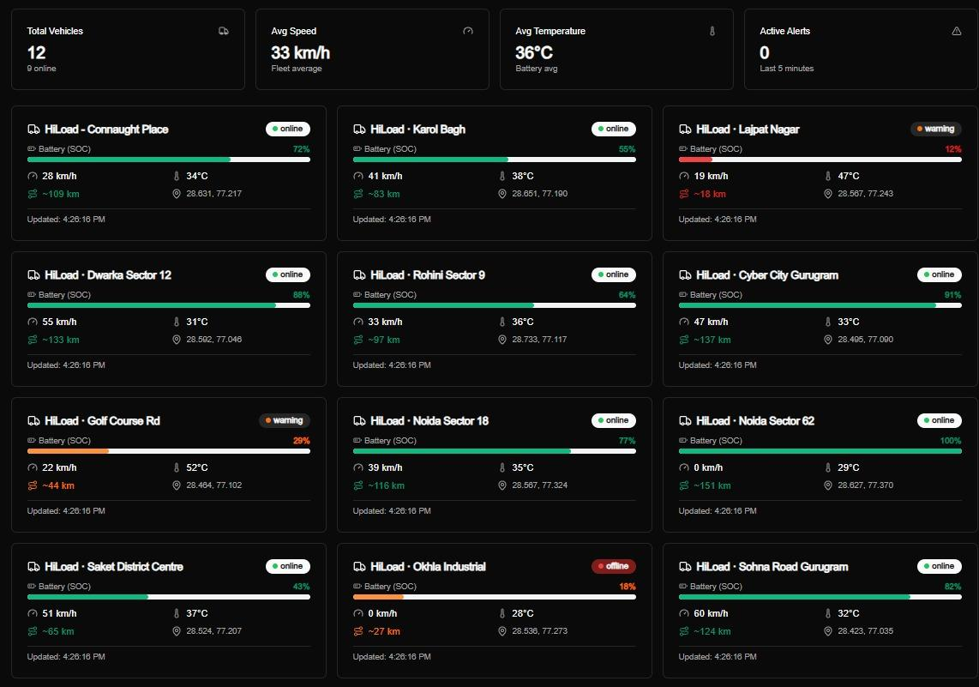
REAL-TIME COMMUNICATION
REAL-TIME COMMUNICATION
Socket.IO · WebSocket · Live Events
telemetry-update
New sensor readings → all clients + device room
alert
Threshold breach → all clients + device room
device-registered
New vehicle joins fleet → all clients notified
↑ 12 device cards updating live via Socket.IO
Server Push
Room-Based
60s Cooldown
No client polling
Per-device updates
Client-side dedup

Slide 10
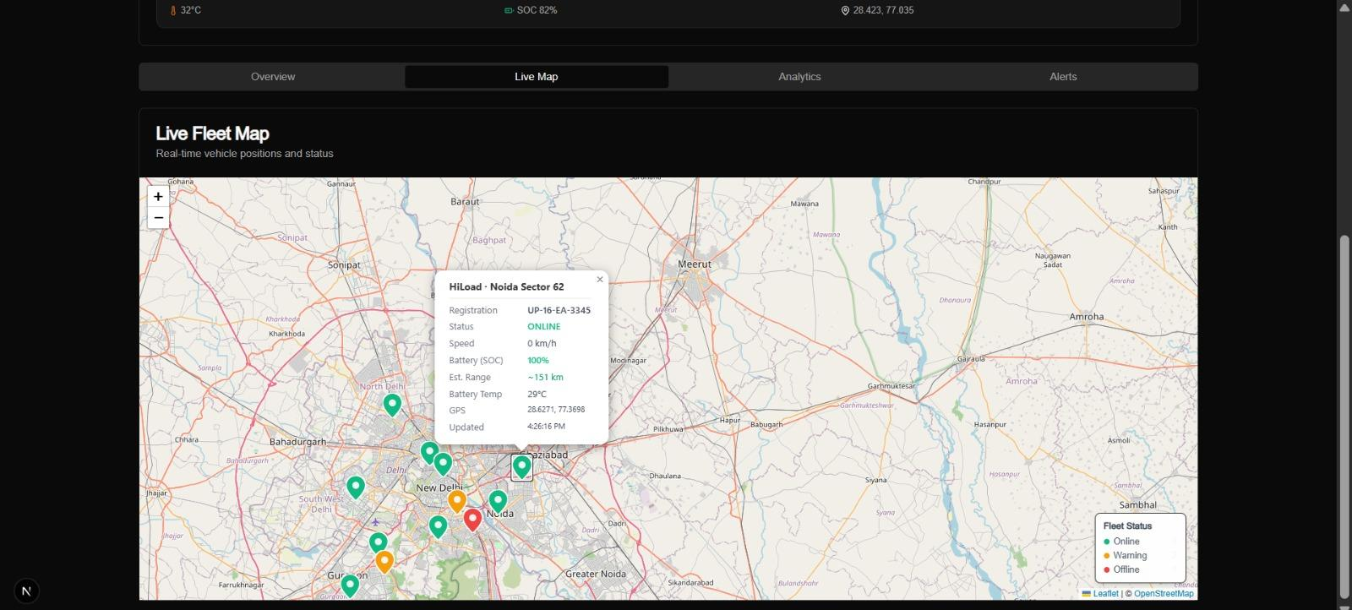
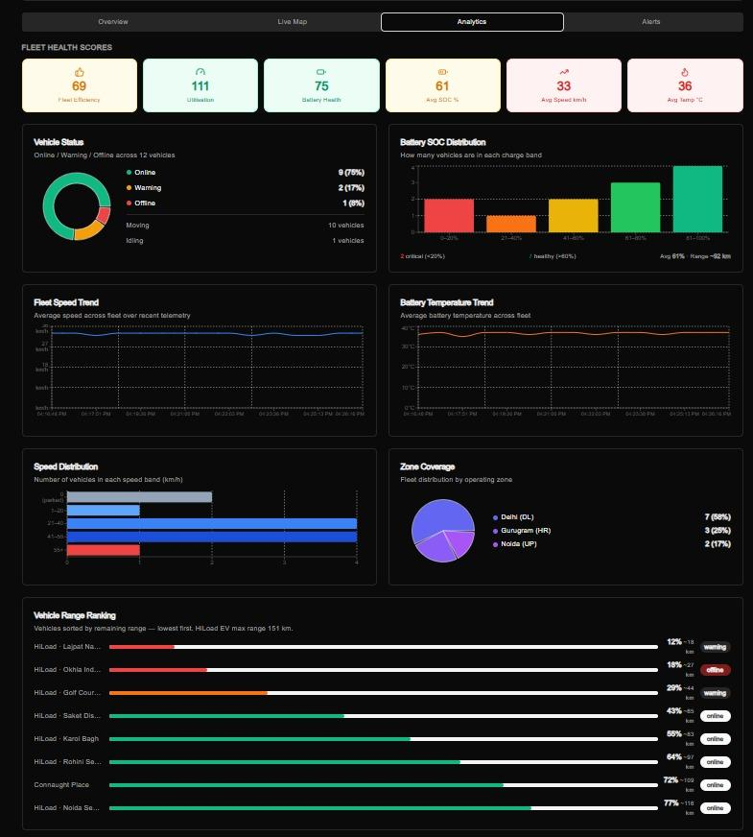
DASHBOARD & VISUALIZATION
DASHBOARD &
VISUALIZATION
↑ Live Fleet Map — color-coded markers + popup
Leaflet.js + OpenStreetMap tiles
Green/amber/red status markers
Popup: SOC, speed, range, GPS
↑ Analytics: Fleet health 69 · SOC bands · Speed dist.
"Real-time UI updates without page refresh · Two-panel view: Map + Analytics"
Fleet efficiency · SOC distribution chart
Speed & temperature trend lines
Zone coverage + vehicle range ranking

Slide 11
RESULTS — LIVE SYSTEM PROOF
LIVE SYSTEM
PROOF
75
Battery Health Score
Real-time fleet health index
61%
Avg Fleet SOC
2 vehicles in critical band (<20%)
9/12
Vehicles Online
75% fleet uptime — live
0
Active Alerts
All thresholds nominal
← All figures read directly from the live analytics dashboard

Slide 12
RESULTS & OUTCOMES
RESULTS &
OUTCOMES
FEATURE
STATUS
DETAIL
Real-Time Telemetry Updates
✓ Implemented
WebSocket push every 2 seconds
Automated Alert Generation
✓ Implemented
Speed, temperature, SOC thresholds
Interactive Fleet Map
✓ Implemented
Leaflet + live marker updates
Analytics Dashboard
✓ Implemented
Recharts KPIs + fleet health score
Simulation Engine
✓ Implemented
No hardware needed — EV behavioral model
Dual Storage Strategy
✓ Implemented
PostgreSQL + in-memory fallback
"System handled continuous real-time updates efficiently across all 12 simulated vehicles."

Slide 13
CONCLUSION & FUTURE SCOPE
CONCLUSION &
FUTURE SCOPE
CONCLUSION
FUTURE SCOPE
Full-stack real-time IoT platform — production aware
IoT Device Integration
Replace simulation with real hardware
Mobile Application
Dual storage: instantly demoable + database-ready
React Native app for drivers
AI Predictive Maintenance
Strong type safety: TypeScript + Zod validation
ML model on telemetry history
Geofencing Alerts
PostGIS infrastructure ready
Modular, scalable architecture with clean separation
Email / SMS Notifications
Twilio / SendGrid webhooks
"FleetPulse can evolve into a smart fleet management ecosystem."

