Slide 1
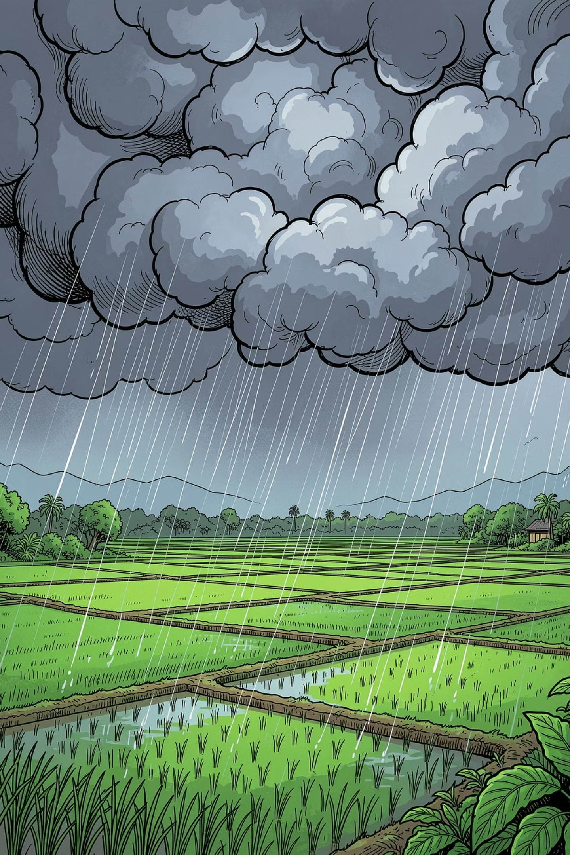
Indian Weather Rainfall Prediction
A Python and Data Science project that analyzes Indian weather data to identify rainfall patterns and support weather prediction using historical data.
Aditi | sanjna
J.C.D.A.V.College Dasuya
BCA

Slide 5
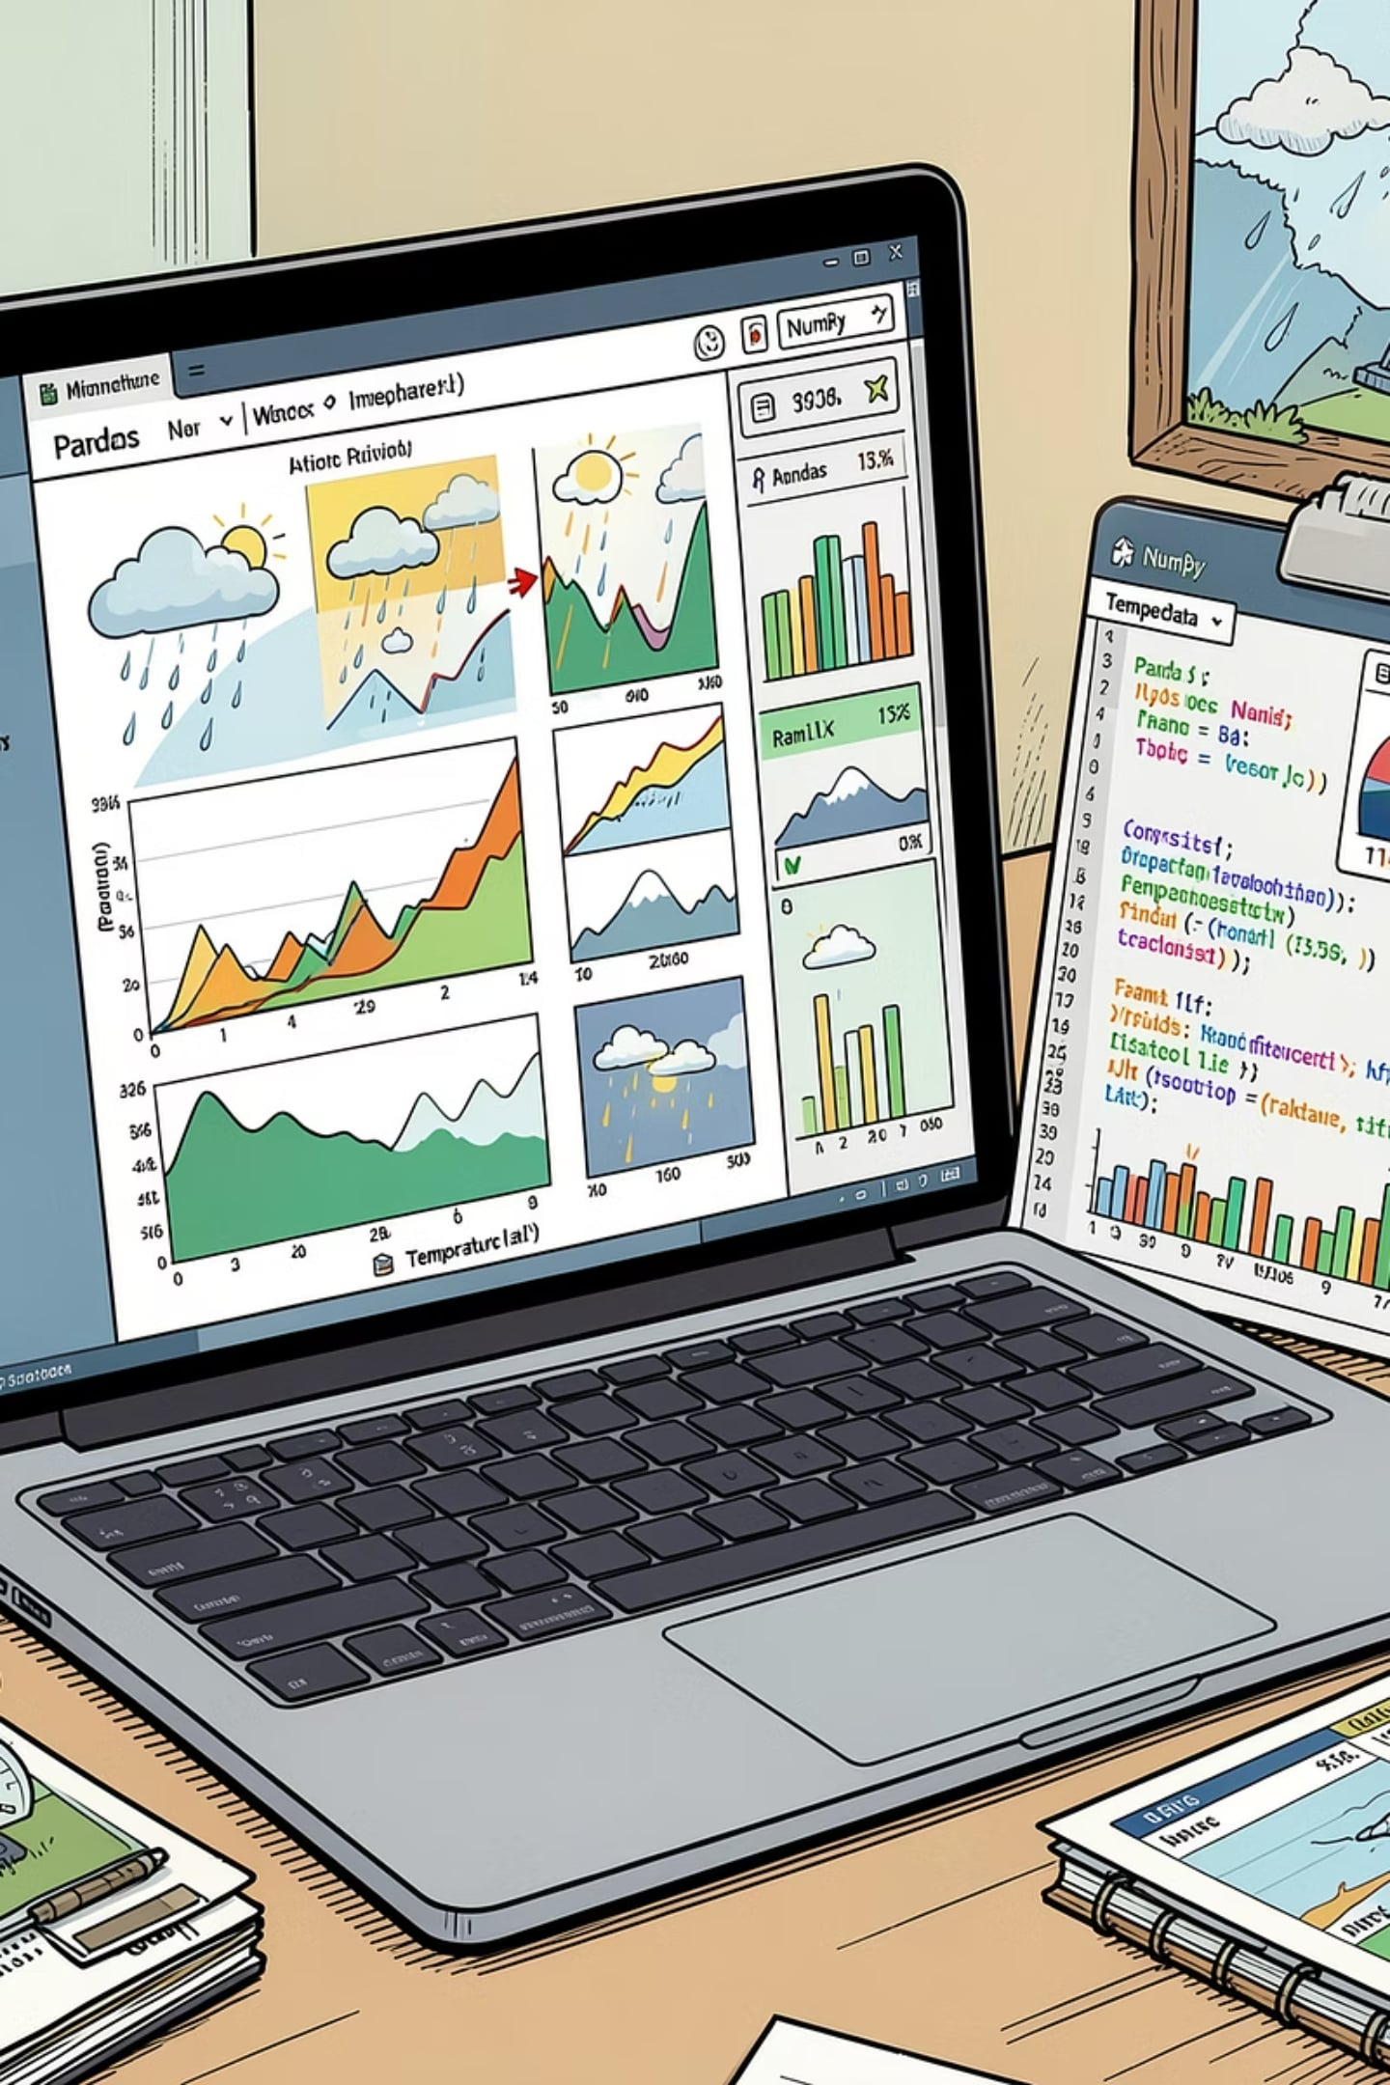
Project Overview
The Indian Weather Rainfall Prediction project is a Python and Data Science project that analyzes historical weather data from different regions of India. The dataset includes information such as temperature, rainfall, wind speed, air pressure, season, and location.
Using Python libraries like Pandas, NumPy, Matplotlib, and Seaborn, the data is cleaned, explored, and visualized to identify weather patterns and rainfall trends.
The project helps understand how different weather factors influence rainfall and demonstrates how data analysis can support weather forecasting and decision-making in areas such as agriculture and disaster management.

Slide 6
Objectives
1
2
3
To analyze historical weather data from different regions of India using Python and Data Science techniques.
To identify rainfall patterns across different states and seasons.
To perform Exploratory Data Analysis (EDA) using graphs and visualizations for better understanding of the dataset.
4
5
To support rainfall prediction by analyzing historical weather trends and identifying important influencing factors.
To develop practical skills in Python libraries such as Pandas, NumPy, Matplotlib, Seaborn for real-world data analysis.

Slide 7
Indian Weather Related Questions
Which are the top 10 Indian states with the highest average rainfall?
What is the relationship between temperature and rainfall?
How does rainfall vary across different seasons in India?
How can Python and Data Science be used to analyze and predict rainfall patterns?

Slide 8
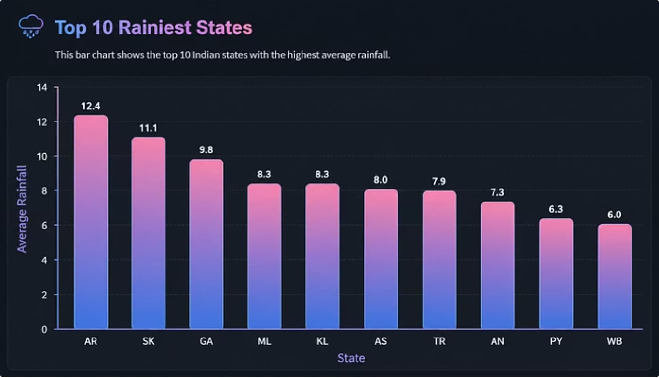
Which are the top 10 Indian states with the highest average rainfall?
According to the graph, Arunachal Pradesh (AR) receives the highest average rainfall, with a value of approximately 12.4mm. It is followed by Sikkim (SK) at about 11.1mm and Goa (GA) at around 9.8mm . Meghalaya (ML) and Kerala (KL) also record high rainfall levels, each with an average of roughly 8.3mm.
Other states and regions in the top ten include Assam (AS), Tripura (TR), Andaman & Nicobar Islands (AN), Puducherry (PY), and West Bengal (WB). Among these, West Bengal has the lowest average rainfall in the list, at approximately 5.9mm.
Overall, the graph indicates that northeastern states dominate the list of the rainiest regions in India, while coastal areas such as Goa and Kerala also experience significant rainfall due to the influence of the southwest monsoon and surrounding geographical features.

Slide 9
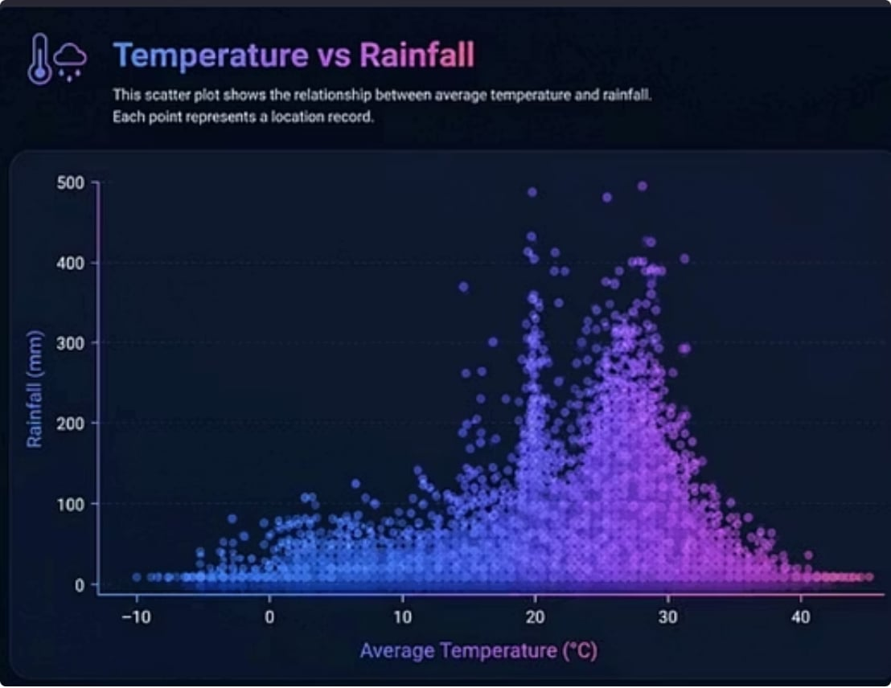
What is the relationship between temperature and rainfall?
The scatter plot indicates a weak negative relationship between temperature and rainfall. As temperature increases, rainfall tends to decrease slightly, although the points are widely scattered.
This suggests that temperature alone is not a strong predictor of rainfall, and other factors such as humidity, atmospheric pressure, and monsoon patterns also significantly influence rainfall.

Slide 10
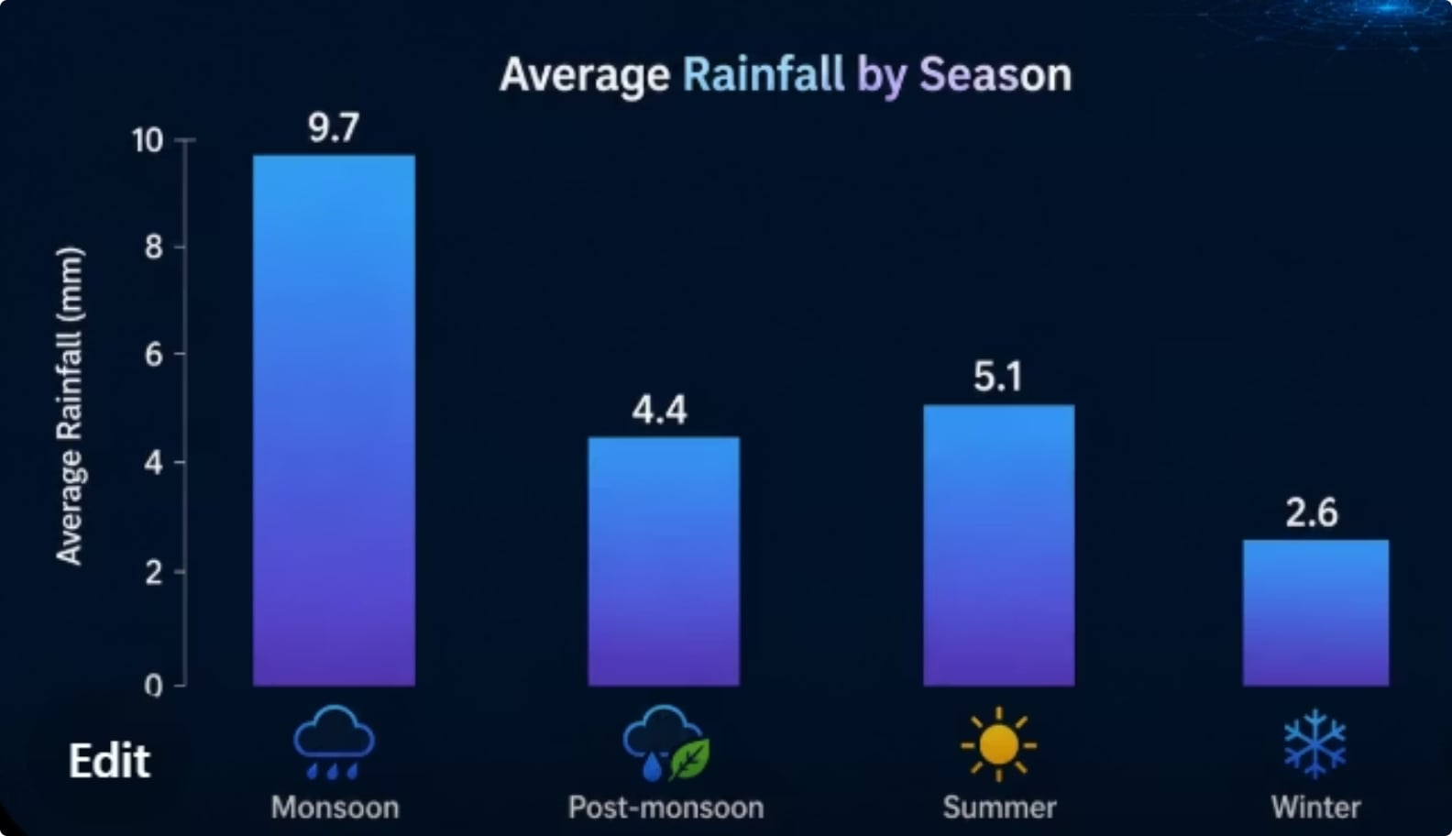
How does rainfall vary across different seasons in India?
The bar chart of average rainfall by season shows that rainfall varies significantly throughout the year. The Monsoon season receives the highest average rainfall, while the Winter season records the lowest rainfall. The Summer and Post-Monsoon seasons receive moderate rainfall, indicating that India's rainfall pattern is highly seasonal and primarily influenced by the southwest monsoon.

Slide 11
How can Python and Data Science be used to analyze and predict rainfall patterns?
Python and Data Science can be used to analyze and predict rainfall patterns by collecting, cleaning, and analyzing historical weather data such as rainfall, temperature, wind speed, air pressure, season, and location. Using Python libraries like Pandas, NumPy, Matplotlib, Seaborn, and Plotly, the data can be processed and visualized through charts and graphs to identify trends, seasonal variations, and relationships between weather factors. These insights help understand rainfall behavior and, when predictive models are included, historical data can be used to estimate future rainfall, supporting better decision-making in agriculture, water resource management, disaster preparedness, and climate planning.

Slide 12
Future Scope
1
2
3
Real-Time Weather Prediction
Integrate live weather data from online sources to provide real-time rainfall forecasts.
Advanced Machine Learning Models
Use advanced algorithms such as Random Forest, and Deep Learning models to improve prediction accuracy.
Mobile and Web Applications
Develop a user-friendly application that allows users to view weather forecasts and rainfall predictions.
4
5
6
Integration with IoT Sensors
Collect live temperature, humidity, and rainfall data using IoT-based weather monitoring systems.
Disaster Management Support
Use rainfall predictions to provide early warnings for floods, heavy rainfall, and other weather-related disasters.
Agricultural Decision Support
Help farmers plan irrigation, crop selection, and harvesting activities based on weather forecasts.

Slide 13
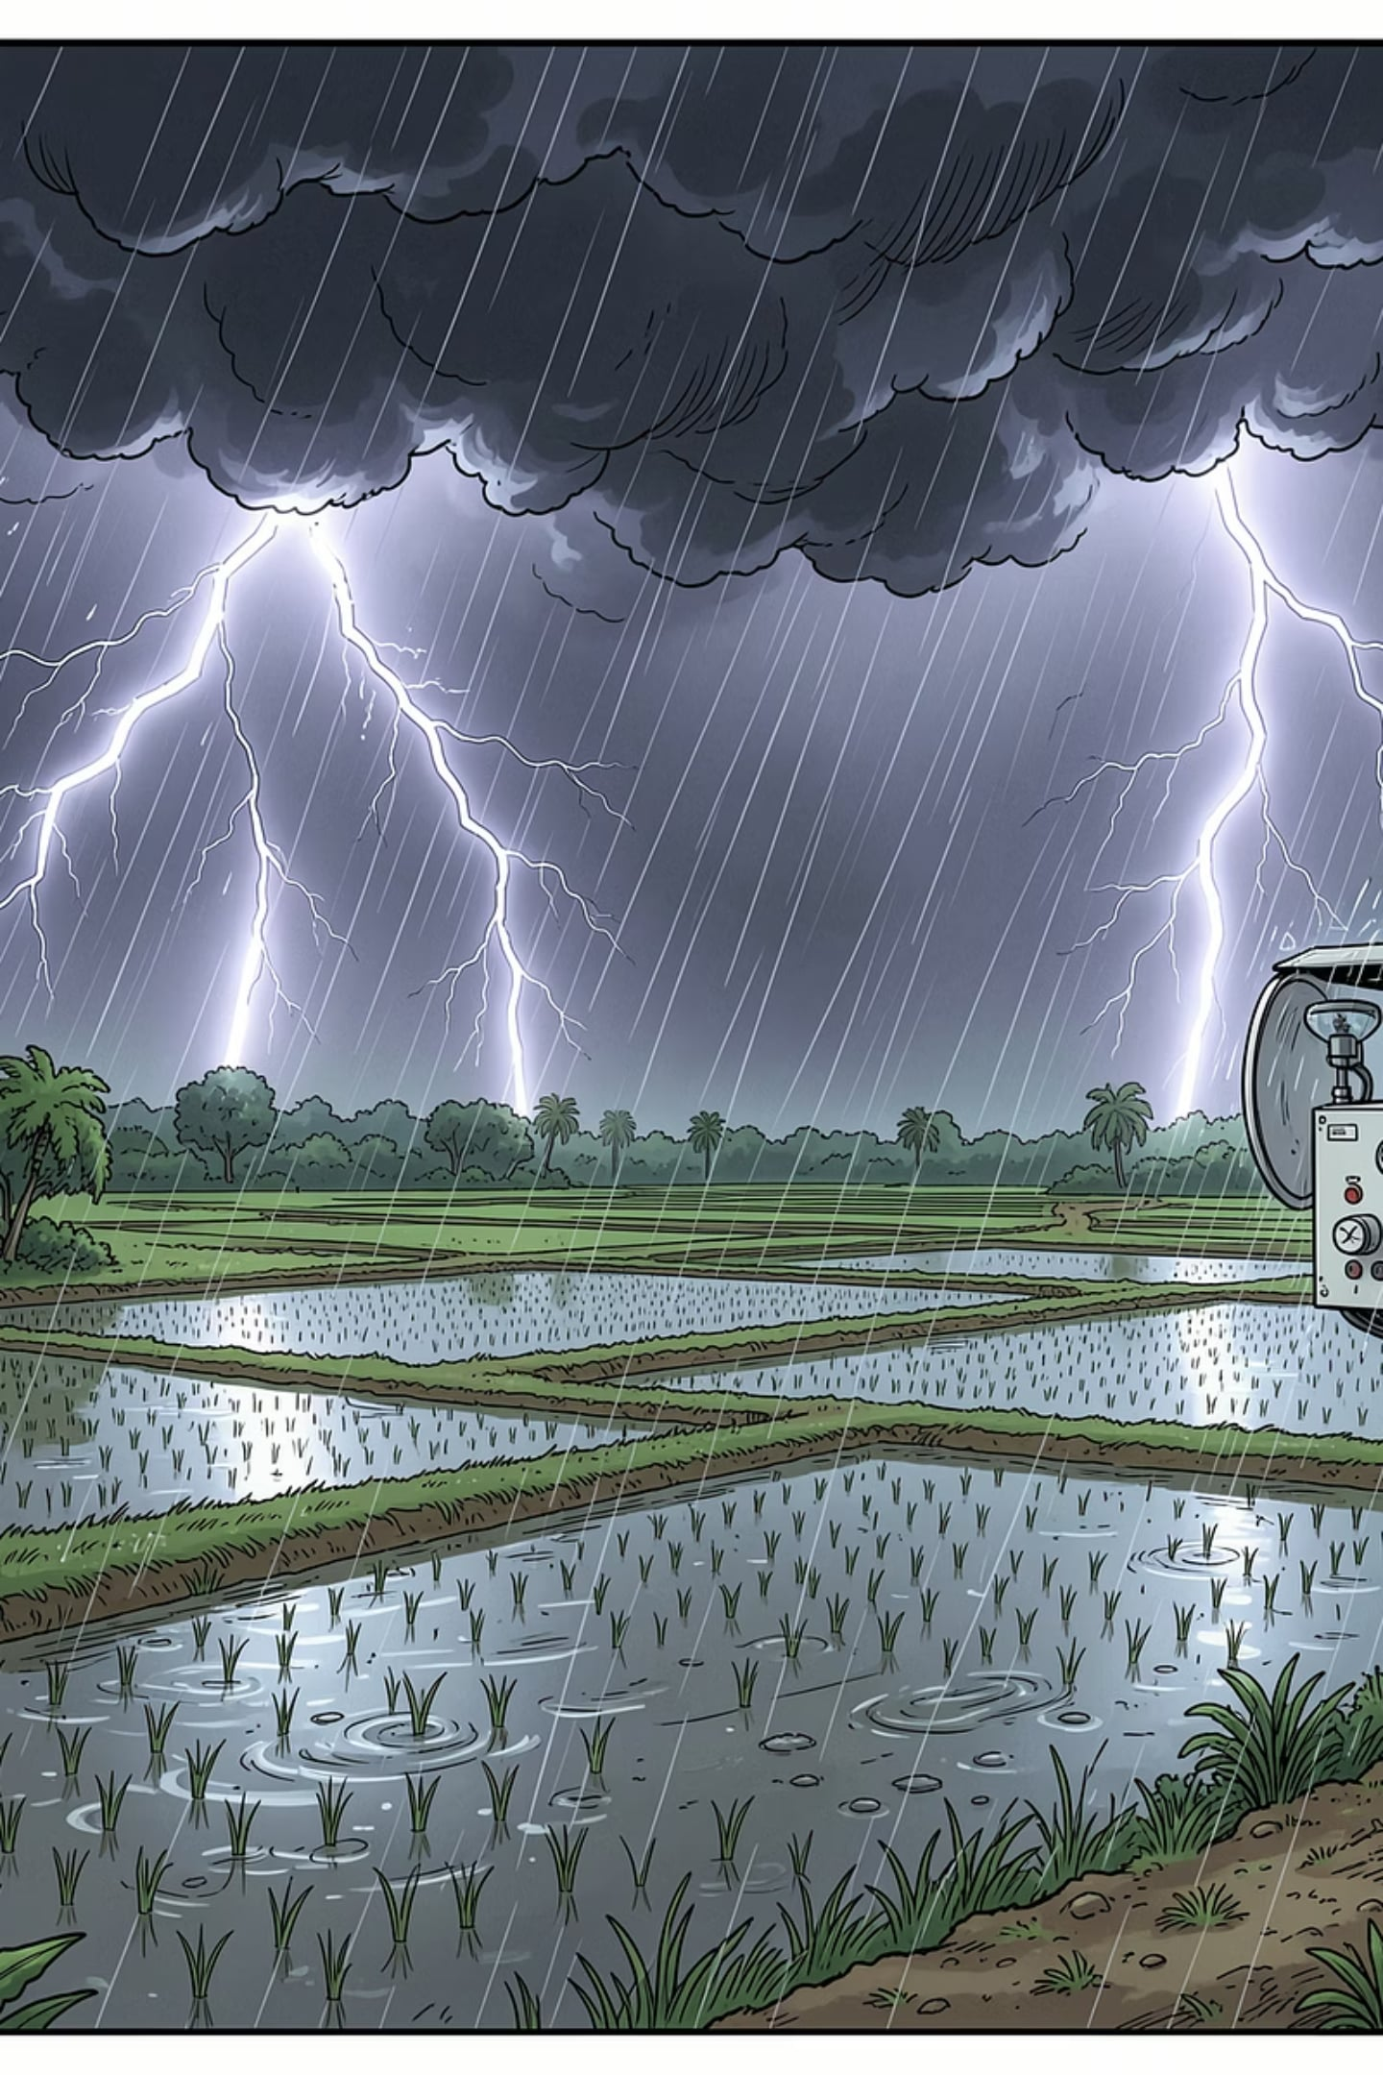
Conclusion
This project demonstrated how Python and Data Science can be effectively used to analyze historical rainfall data and identify important weather patterns across India. Using libraries such as Pandas, NumPy, Matplotlib, Seaborn, the data was cleaned, visualized, and analyzed to understand rainfall distribution across states, seasons, and weather conditions.
The analysis showed that rainfall varies significantly by region and season, with the monsoon season contributing the highest rainfall. It also indicated that temperature alone is not a strong predictor of rainfall, emphasizing the importance of considering multiple weather parameters for accurate prediction. Overall, this project highlights the value of data-driven techniques in supporting agriculture, water resource management, disaster preparedness, and weather forecasting, making rainfall prediction more reliable and informed.

Slide 14
Thank You
"Thank you for listening to our presentation. We hope our project helped demonstrate how Python and Data Science can be used to analyze weather data and understand rainfall patterns. We are happy to answer any questions."

