Slide 1

2024
Università degli Studi di Messina
"Multiclass Image Classification with Noise Reduction using Deep Learning"

Slide 2
Introduction
CNNs have demonstrated unparalleled success, achieving state-of-the-art performance in various domains. Their ability to automatically learn relevant features from raw pixel data makes them particularly effective for tasks involving visual recognition, including the intricate task of distinguishing between different rice varieties.
Impulse noise, on the other hand, introduces a dynamic challenge to the robustness of CNNs. Often encountered in real-world scenarios, impulse noise simulates sudden and random disturbances in image pixels, manifesting as sporadic bright and dark spots. Understanding how CNNs respond to images contaminated with impulse noise is crucial for assessing their practical applicability in scenarios where image quality may be compromised.
In this context, this project delves into the intersection of CNNs and impulse noise within the domain of rice image classification. By subjecting the model to test scenarios involving noisy images, the project aims to evaluate the network's resilience and adaptability in the face of real-world challenges. This exploration not only advances our understanding of CNNs but also underscores their potential for practical deployment in image classification tasks, even when images are marred by unpredictable and disruptive noise.
Salt & paper / Impulse Noise

Slide 3
Project Overview
The primary objective is to create a model capable of accurately identifying and categorizing various rice varieties.The dataset undergoes meticulous preprocessing, involving loading, organization, label encoding using LabelEncoder, and a strategic train-test split through train_test_split for effective model training and testing.
The model is compiled using categorical crossentropy loss and trained using the model.fit function. Evaluation on clean test images demonstrates impressive accuracy, precision, recall, and F1-scores across all classes, showcasing the model's reliability. The minimal loss indicates efficient learning.
A distinctive aspect involves testing the model on noisy test images with impulse noise at three levels (20%, 40%, 60%). The model exhibits remarkable performance, maintaining high accuracy, precision, recall, and F1-scores even in the presence of substantial noise. The low loss at each noise level indicates the model's adaptability and robustness. Comprehensive insights, including confusion matrices, provide a thorough understanding of the model's performance in both clean and noisy scenarios.

Slide 4
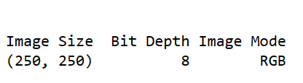

Class Labels:
Arborio
Basmati
Ipsala
Jasmine
Karacadag
The dataset is substantial, with clean or orginal images 75000 images & total 120,000 providing a diverse set for model training and evaluation.
Bit Depth and Image Mode:Images have a bit depth of 8, which is standard for RGB images.The RGB image mode indicates the color representation of the images.
Noisy Images 60,000 were used for each noise level, total 300000 images.
DataProcessing: Anaconda(Jupyter)
Model Train: As it is a large dataset I did the training part by using Kaggle.
Dataset Overview

Slide 5
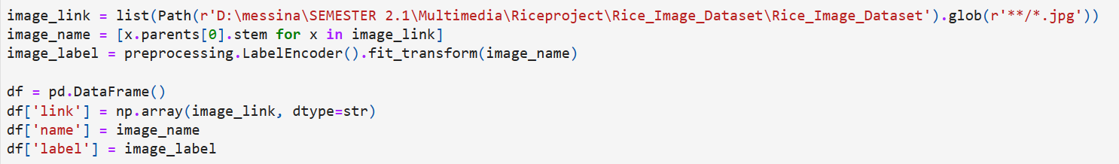
Data Preprocessing
Loading and Organizing the Dataset
- I have loaded the rice image dataset, consisting of images from different rice varieties.
- The dataset was organized into a structured format, enabling easy access and manipulation.
Image Labeling using LabelEncoder
- Utilized LabelEncoder from scikit-learn to convert textual labels into numerical format.
- This numeric representation facilitates model training.
- Proper data preprocessing lays the foundation for effective model training and evaluation.

Slide 6
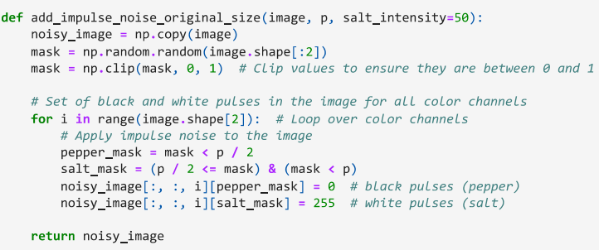
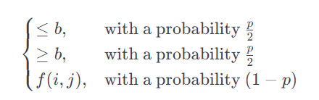
Impulse Noise Generation
The mathematical representation for impulse noise at pixel (i, j) in an image f is defined as follows:
The intensity of salt and pepper noise is controlled by the parameter b. In the provided code, b is represented as p/2
The function add_impulse_noise_original_size implemented in the code takes an input image and a probability p as parameters to introduce impulse noise.The algorithm generates a random mask with values between 0 and 1 and applies impulse noise to the image based on the defined probabilities.
The resulting noisy image contains black pulses (pepper) and white pulses (salt) with varying intensities.

Slide 7
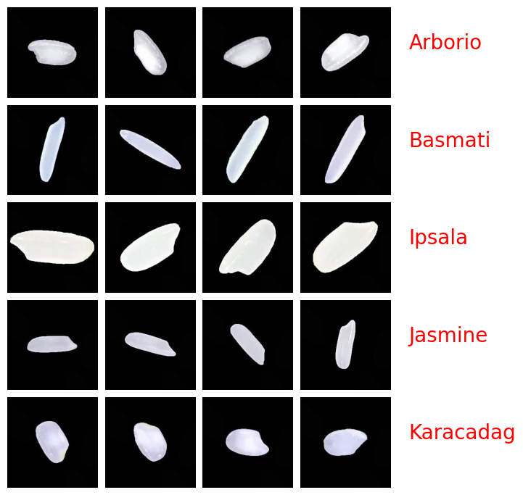
Orginal Images:

Slide 8
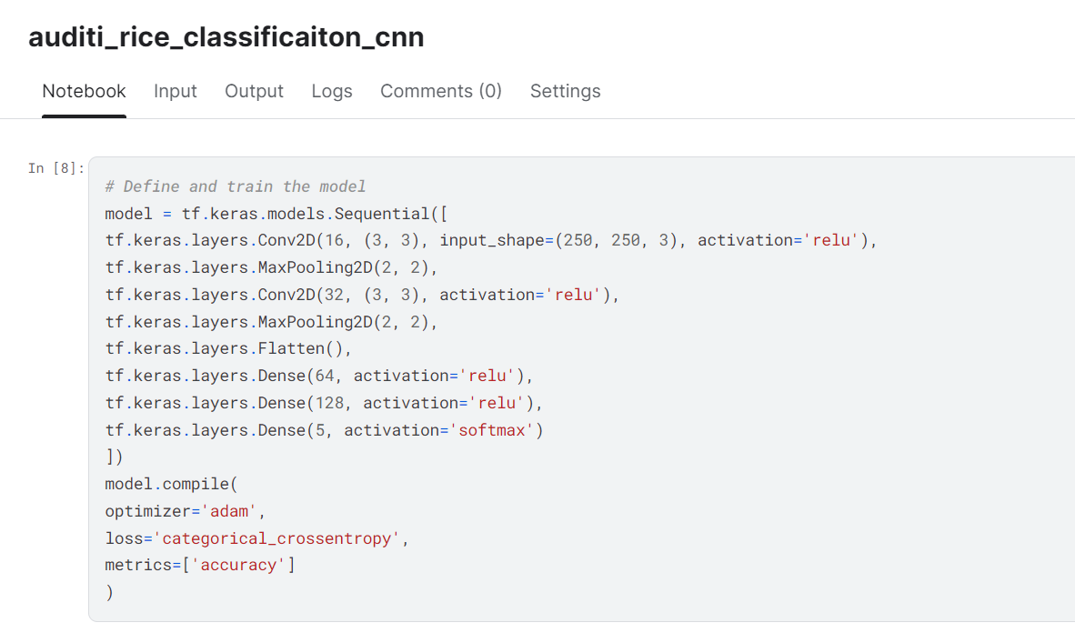
Model Architecture Overview
The architecture is designed to automatically learn hierarchical features from raw pixel data, making it particularly adept at image classification tasks. Here performed CNN Layers are:
Conv2D Layer: Performs spatial feature extraction by applying filters on input images, capturing essential patterns.
MaxPooling2D Layer: Reduces spatial dimensions, Retains crucial information & improves computational efficiency.
Flatten Layer: Pooled features into a one-dimensional vector, preparing the data for dense layers.
Dense Layers: Consolidate extracted features, facilitates intricate pattern recognition and classification.
Model Compilation and Training:The model is compiled using the Adam optimizer, a popular choice for gradient-based optimization algorithms.Categorical crossentropy loss is employed as the objective function, suitable for multi-class classification tasks.

Slide 9
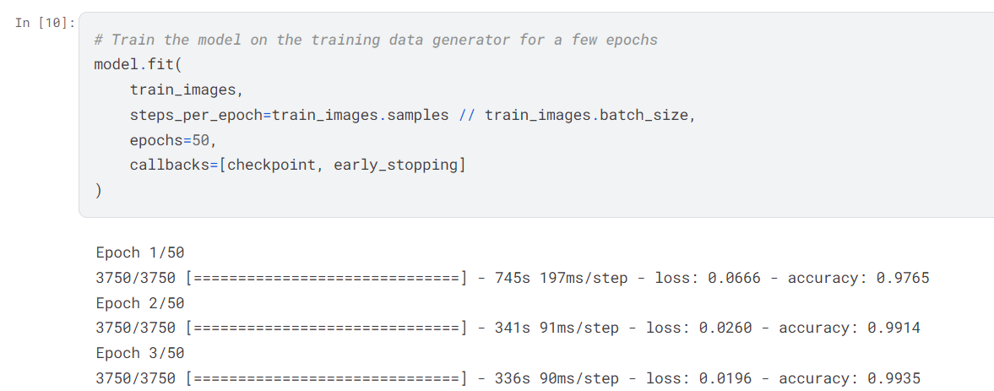
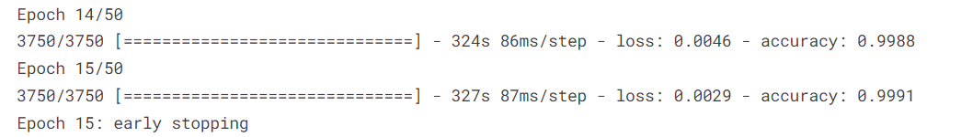
Model Evaluation
Here, I have trained the model for 50 epochs using the training dataset.Achieved significant accuracy improvements over the epochs and also used checkpoints for early stopping
Observations and Discussion:
High accuracy indicates the model's effectiveness in correctly classifying clean images.
Balanced loss values reflect the model's ability to minimize errors during training and testing.

Slide 10
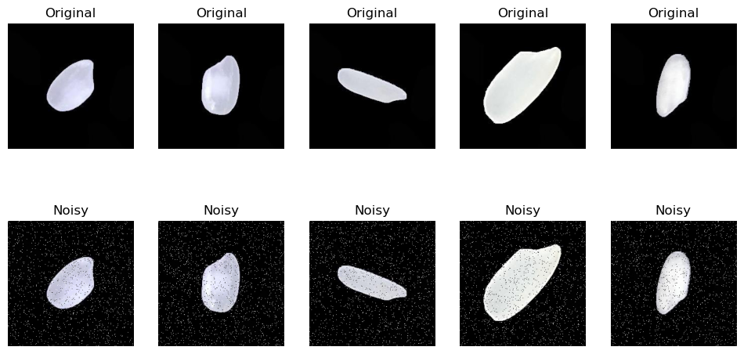
Noisy Test Images - Generation and Evaluation
In order to simulate real-world scenarios, noisy test images are generated by introducing artificial noise to the original images.The noise is applied using the impulse noise function, which introduces impulse noise to the images.These noisy test images are then used to evaluate the model's performance under conditions that replicate the challenges of a noisy environment.

Slide 11
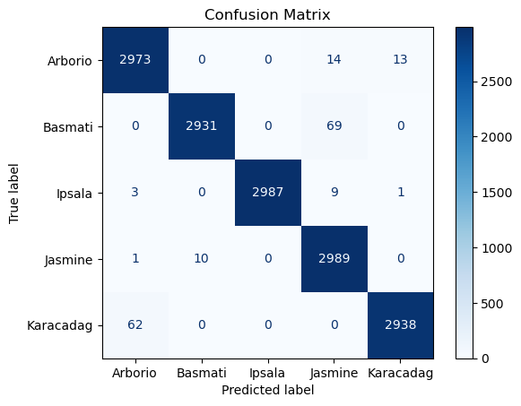
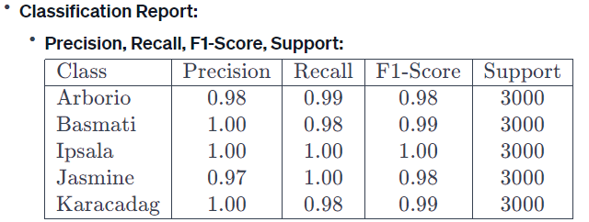
Confusion Matrix & Classification for Orginal image
The classification report presents the performance metrics for a multi-class classification model on a dataset with five classes. Precision measures the accuracy of positive predictions. The model exhibits high precision for all classes, ranging from 97% to 100%, indicating a low rate of false positives.Recall, or sensitivity, measures the ability of the model to capture all relevant instances of a class. The model demonstrates high recall across all classes, with values ranging from 98% to 100%. The F1-score is the harmonic mean of precision and recall. The model's F1-scores are consistently high, reflecting a balanced trade-off between precision and recall.Support, The number of instances (samples) for each class in the dataset.

Slide 12
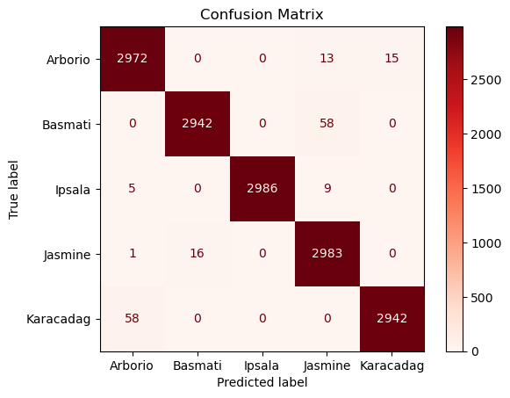
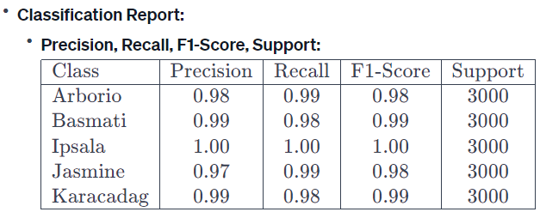
Confusion Matrix for noisy image
Here, High precision values (ranging from 0.97 to 1.00) indicate that the model has a low false positive rate for all classes, meaning that when it predicts a class, it is usually correct & High recall values (ranging from 0.98 to 1.00) suggest that the model has a low false negative rate for all classes, indicating that it captures a high percentage of the true positive instances. High F1-scores (ranging from 0.98 to 1.00) imply a good balance between precision and recall for each class.

Slide 13
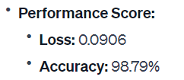
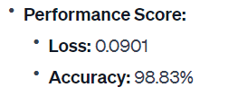
Accuracy on Orginal vs. noisy test images
Orginal Noisy
The model performs exceptionally well on clean images with an accuracy of 98.79%.
High precision, recall, and F1-scores across all classes indicate accurate and reliable predictions.
The low loss suggests efficient learning and adaptation to clean images.
The model maintains high accuracy even on noisy images with an accuracy of 98.83%.
Precision, recall, and F1-scores remain consistently high, suggesting robustness to noise.
The low loss indicates effective learning and adaptation to noisy conditions.
Overall,The model demonstrates remarkable performance on both clean and noisy images, showcasing its versatility. The low loss on both clean and noisy images indicates efficient learning and adaptation, contributing to reliable predictions.

Slide 14
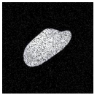
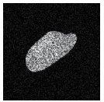
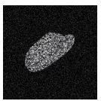
Enhancing Robustness through Multi-level Noise Evaluation
Till now I have trained an evaluated the neural network for a multi-class image classification task on a dataset containing different rice types. Now, If I obtain results for three noise probabilities (e.g., 0.2, 0.4, 0.6), it suggests that I am introducing noise to the test dataset by corrupting some of the images with different levels of noise (20%, 40%, 60%).
The noise levels can affect the model's performance, and evaluating the model on datasets with different noise levels helps to understand how robust our model is to noisy data. It allows to assess whether the model can still perform well under various conditions, which is important for real-world scenarios where the input data might not be perfect. Images are given below:
20%
40%
60%

Slide 15
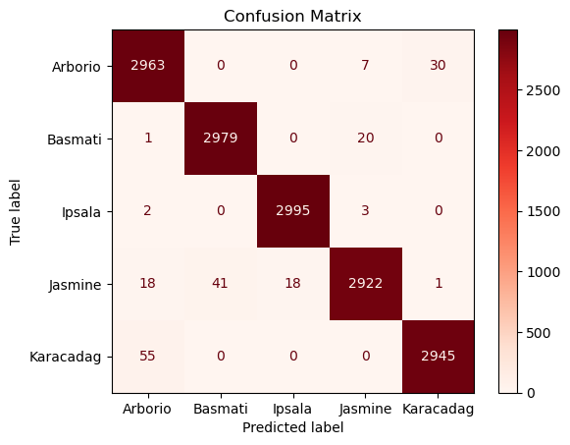
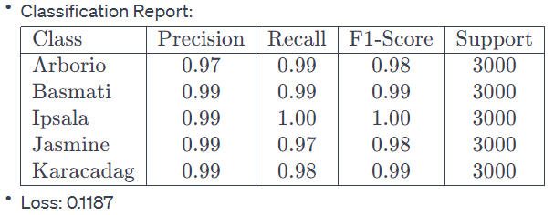

Noise Levels Experiment of 20%:

Slide 16

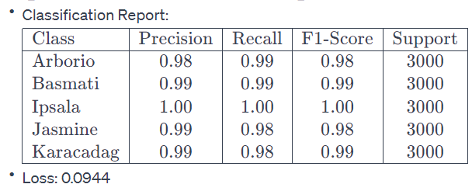
Noise Levels Experiment of 40%:

Slide 17

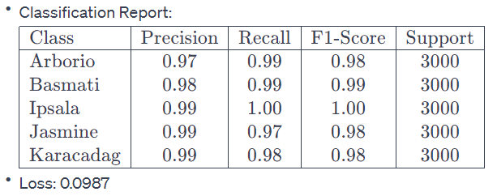
Noise Levels Experiment of 60%:

Slide 18
Model Performance Summary:
Lets discuss how the model performed across different noise levels:
Noise Level: 20%
- The model achieves impressive accuracy even with a 20% noise level, demonstrating robustness.
- High precision, recall, and F1-scores across all classes indicate accurate and reliable predictions.
- The minimal loss suggests efficient learning and adaptation to noise.
Noise Level: 40%
- The model maintains exceptional accuracy at a 40% noise level, showcasing resilience to increased noise.
- Precision, recall, and F1-scores remain high, suggesting consistent and reliable performance.
- The low loss indicates effective learning and adaptation to the higher noise level.
Noise Level: 60%
- The model continues to perform admirably at a 60% noise level, showcasing its adaptability.
- Precision, recall, and F1-scores remain consistently high, indicating reliable predictions.
- The model demonstrates robustness, maintaining a low loss even in the presence of substantial noise.
Overall,The model exhibits remarkable performance across various noise levels, suggesting its suitability for real-world scenarios.High accuracy, coupled with consistent precision, recall, and F1-scores, highlights the model's robustness.The model showcases efficient learning and adaptation, maintaining low loss even in challenging conditions.

Slide 19
Conclusion
In summary, The deep learning model, trained on a clean dataset, shows high accuracy and also show generalization on a noisy test dataset. The confusion matrix and classification report further illustrate the model's effectiveness in classifying different image categories. The overall work involves data preprocessing, model training, evaluation, and performance analysis, showcasing successful image classification for the given task.
Real-world applications often involve imperfect conditions where images may have noise distortions.Evaluating a model's performance under noisy conditions is crucial for assessing its robustness and reliability in practical settings.It helps identify how well the model generalizes to unseen data, especially when images deviate from the pristine conditions seen during training.This evaluation provides insights into the model's ability to make accurate predictions in scenarios where input data may not be ideal, enhancing the model's overall utility and applicability.

Slide 20
THANKS

