Slide 1
App And Website Analytics
Name – Aditi .V. Walke
Batch – D43
Topic – Promilo Internship Task

Slide 2
Problem Statement
Data Analysis and Insights for different page Optimization & How to get more user installation & Engagement from the App & Website.
Assignment Description:
As an intern in the Business Analytics team, your task is to analyze a provided dataset and generate actionable insights to optimize page performance for a fictional company called "XYZ Inc." The dataset contains user data from various regions, customer demographics, product information, and marketing campaign details. Your objective is to identify critical factors influencing Data Analysis and Insights for different page Optimization & How to get more user installation & Engagement from the App & Website" User and propose recommendations for improving performance.

Slide 3
Data contrariety
There exists an unidentified category in the gender report; it should be evident from the gender columns.
Data is specified in the town/city column (not set) of the Citiwise report.
unidentified age group category.
Data is defined in pages and screen reports (not set).
Data user according to age:

Slide 4
26342 users, 22872 new users
Gender-specific data user:
23422 users, 22872 new users
Its values ought to be the same.
After taking the disparity in data into account

Slide 5
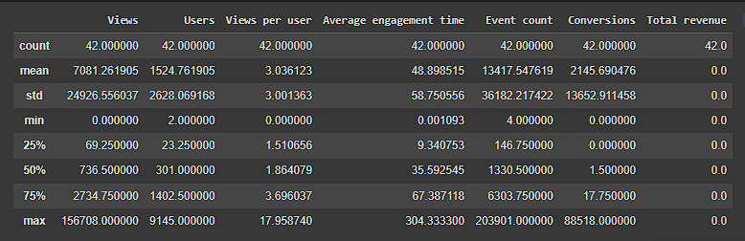
User Installation & Engagement Performance Analysis: Pages and screens report
The top ten screens and pages based on views. With 1,56,708, Flutter is the highest. At 44,326 is the second major activity, and at 18,514, the third.

Slide 6
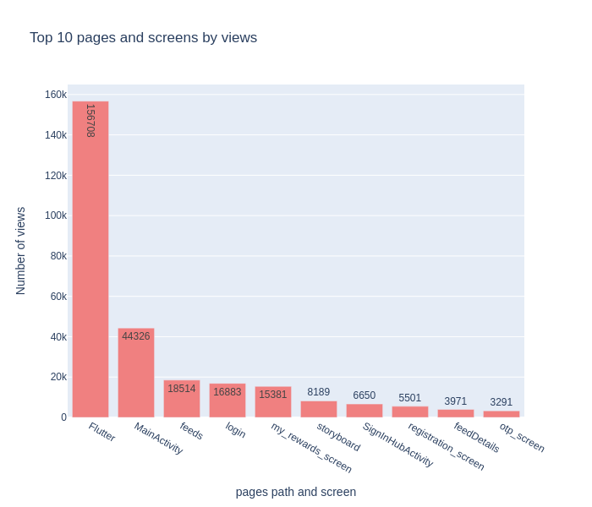
By views, the bottom ten pages and screens. This ought to be optimised or under control. Cam image picker, camera view controller, and UI alert controller are the least. The user experience may be negatively impacted by excessive alert usage, thus utilise UIAlertControllers sparingly. As an alternative, choose for less obvious, more covert means of sending alerts or signals. Make the process of choosing images as efficient as possible to improve the user experience. Use picture compression to guarantee quicker loading times and smaller file sizes. A seamless experience can be achieved by optimising the camera interface. Offer features that are easy for users to utilise, such as focus adjustment, grid lines, and flash control.

Slide 7
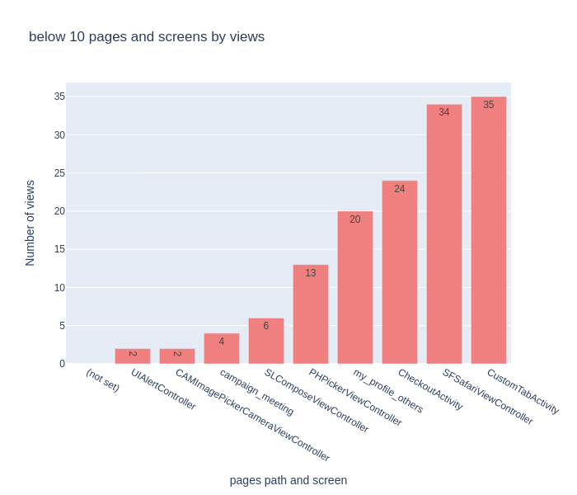

Slide 8
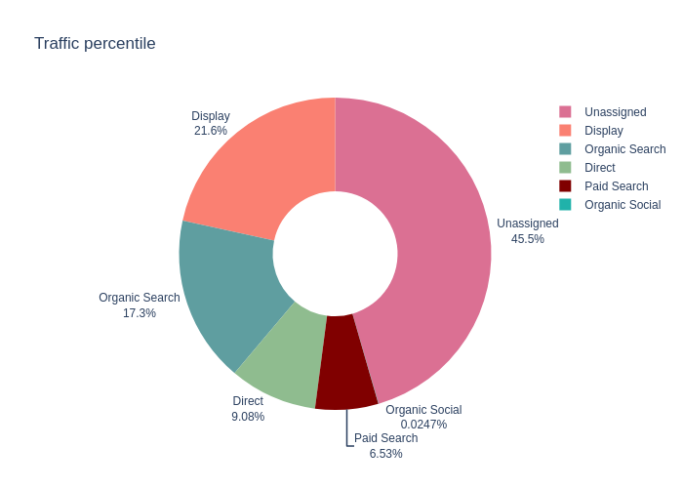
Traffic source
Traffic source percentages: direct 9.08%, organic search 17.3%, display 21.6%, paid search 6.53%, and organic social 0.024%. The percentage of unassigned traffic is 45.5%. It's critical to identify and track the source of unassigned traffic. To increase display and organic search results, spend money on SEO and targeted display ads. In order to increase direct traffic, strengthen brand recognition. To fully utilise paid search efforts, make social media involvement a priority and optimise them. To achieve sustainable growth and success, keep an eye on the sources of traffic and adjust your plans as necessary.

Slide 9
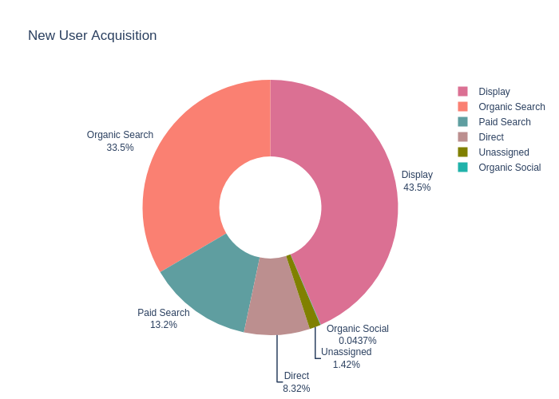
User Acquisition
With 43.5% of all new users acquired through this channel, display has proven to be the most effective method of user acquisition. With 33.5% of new people, organic search comes in second, suggesting a strong organic presence. Optimised ad campaigns and keyword targeting, however, could further increase the 13.2% paid search acquisition rate. Although there is some brand familiarity in direct acquisition (8.32%), this can be increased by putting loyalty or referral programmes in place. In order to comprehend and maximise this traffic source, improved tracking and attribution techniques are required, as seen by the unassigned category (1.42%). Untapped potential can also be found in organic social (0.0437%); by building a stronger social media presence, producing interesting content, and working with influencers, it is possible to improve the platform's performance and draw in more new users. As a whole, constant

Slide 10
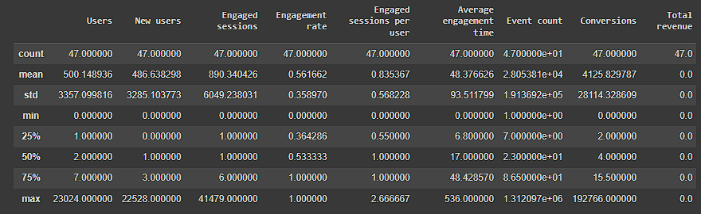
Demographic report
In terms of both new and active users, India ranks first with 23024 and 22528, respectively. In other words, it indicates that the application is intended for Indians and, secondly, for Americans (272-213).

Slide 11
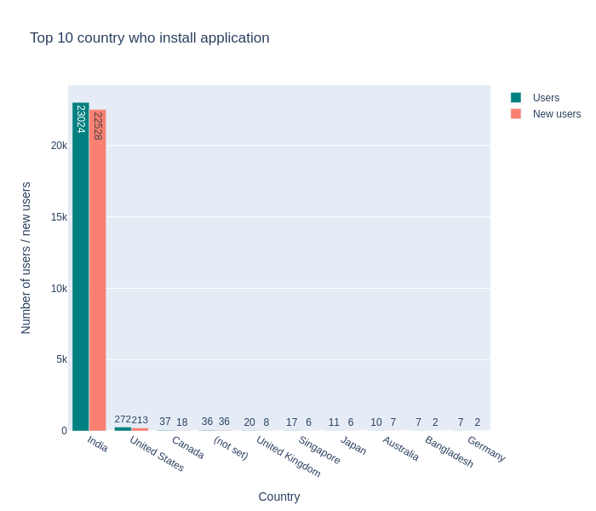

Slide 12
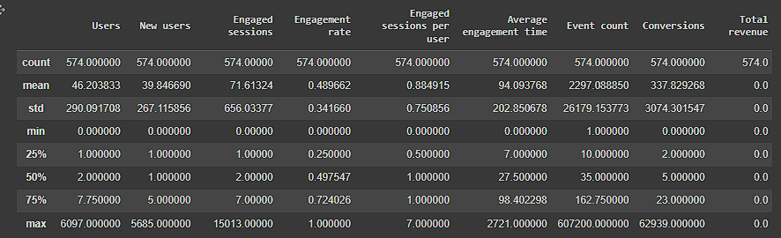
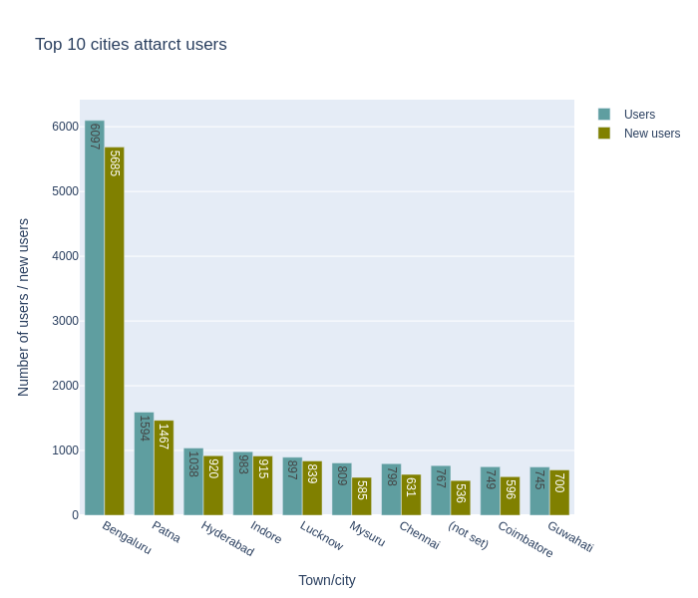
Citiwise report

Slide 13
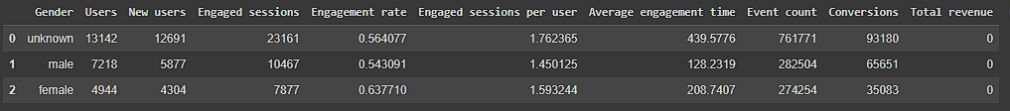
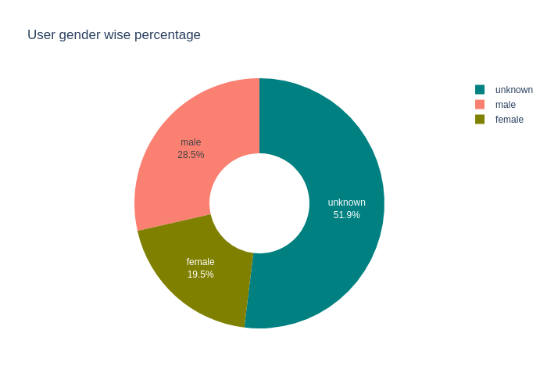
Gender Report

Slide 14
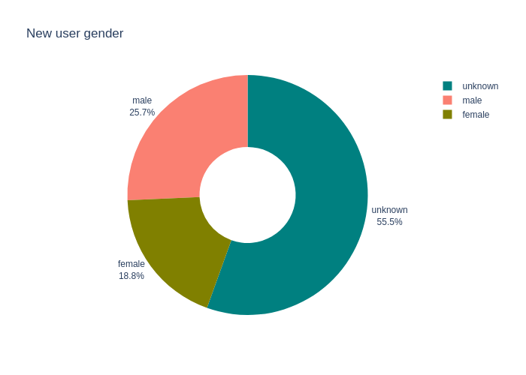
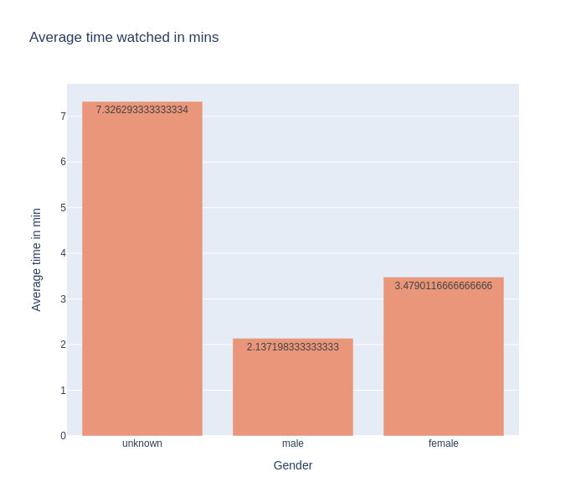
Average time spent

Slide 15
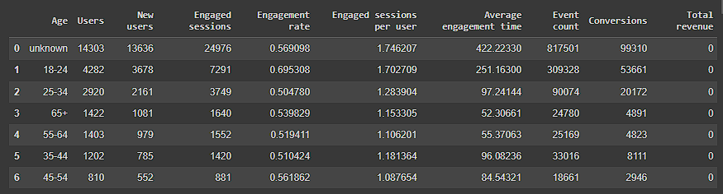
Users by age
According to the data that is currently available, the "unknown" category seems to have the greatest amount of users (14,303) and new users (13,636). Additional research and data analysis are required to comprehend and categorise this group more accurately.
With the exception of the "unknown" category, a noticeable influx of new users and users from the 18–20 age range has been seen. For the platform, this group of people constitutes a sizable potential audience.
Take into account the following ideas to take advantage of this chance and enhance user acquisition from this age group:
User onboarding, target marketing, social sharing, and user surveys.

Slide 16
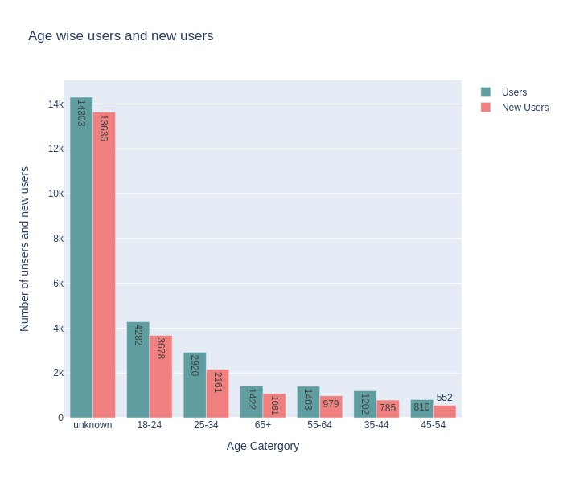
There is a significant user base from unknown age groups, as evidenced by the "unknown" category's high number of engaged sessions (24,976) and event counts (817,501). It is important to track and correctly assign people to their age groups using user surveys, account choices, or user profiles in order to better understand this category. Among the age categories that have been discovered, the 18-24 age group shows a promising amount of participation, with 309,328 event counts and 7,291 participating sessions. With 90,074 event counts and 3,749 engaged sessions, the 25–34 age group demonstrates a respectable level of interest. Continually assess user input, behaviour, and analytics to adjust content and methods to suit the varying demands of every age group. enhancing user satisfaction generally and mobile platform optimisation

Slide 17
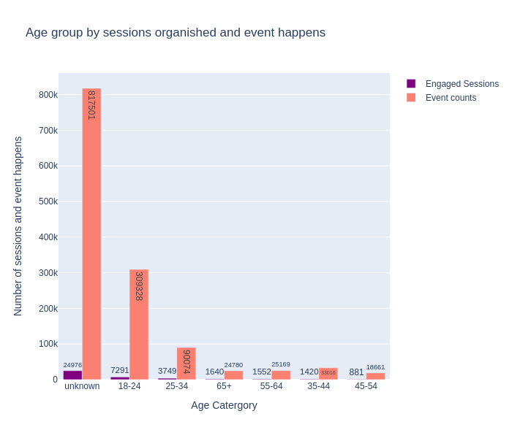
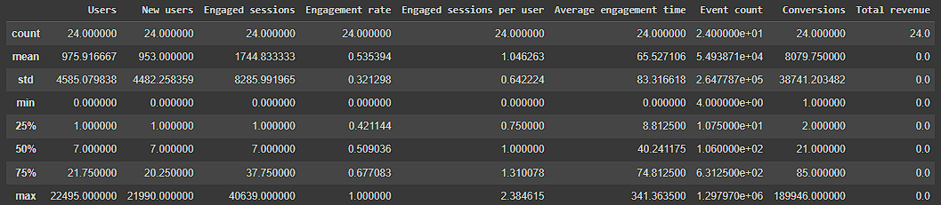
User by language

Slide 18
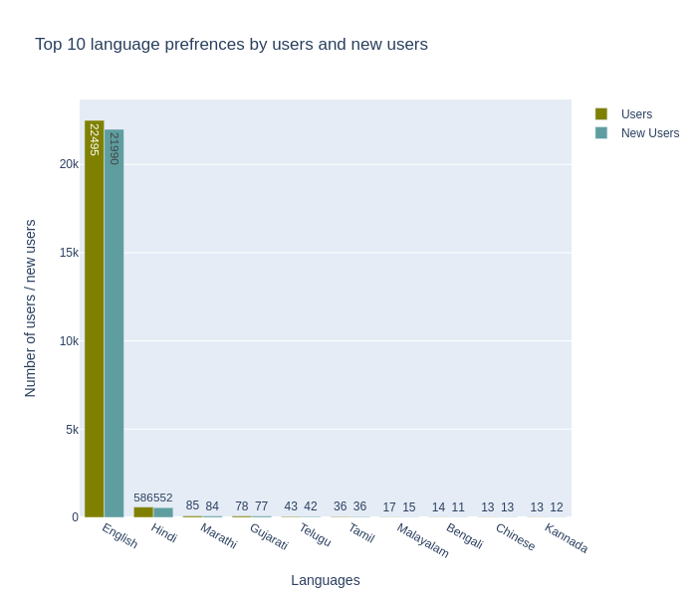
For existing and new users alike, English is the most widely used language. Thus, we must set English as the default language for our application.

Slide 19
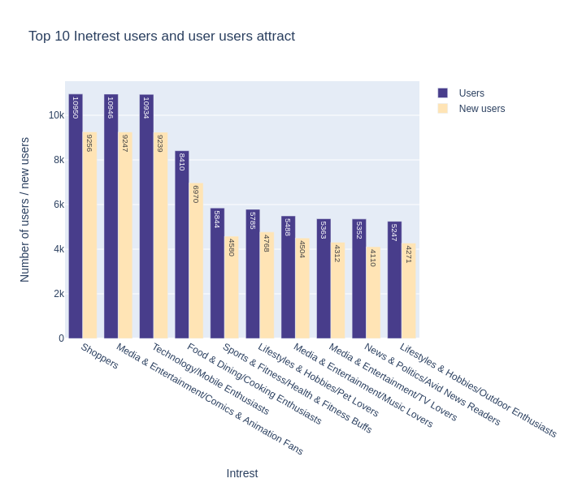
We can maintain or make improvements to the user's area of interest. Fans of comics and animation, technology, and commerce make up the majority of users and new users on the app.

Slide 20
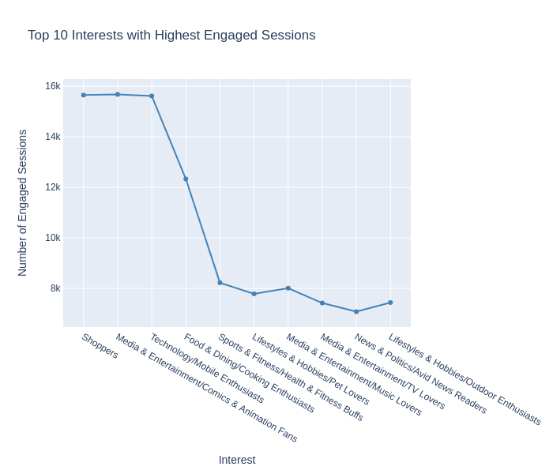
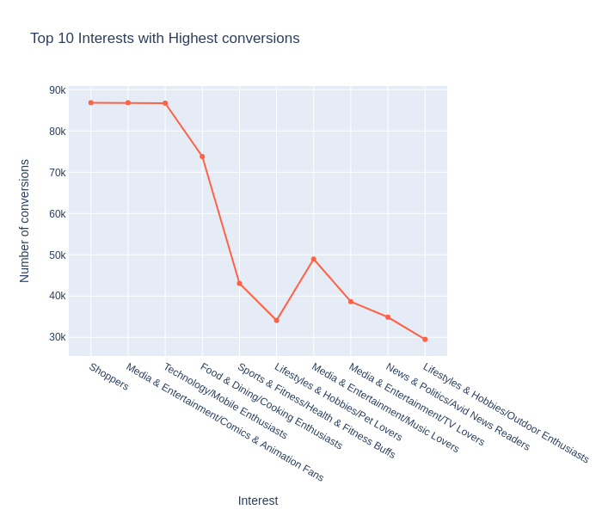
The top ten user’s conversion-causing interests.

Slide 21
Thank You

