Slide 1
INTRODUCTION
Name-Aditi Bhardwaj
Year- 3rd (5 Semester)
Roll No- 2110990078
Group – G5
INSTRUCTOR-Lavish Arora

Slide 2
Pages
Homepage | Products | SignUp | Masic beauty
Menu | Scented candles | Payment | Location
Reviews | Beauty and wellness | Contact us | Blogs
Customers | Bath and body | Deals | Faq’s
Order tracking | Perfumes | Orders | Payment

Slide 3
All About MASIC BEAUTY
Masic beauty is a self care website that provides customers a platform to indulge in luxury fragrances and dreamy delightful candles.
One can easily go through all the pages and build their self care routine.
This website is easy , efficient and smooth to use.
The subtle color palate is used to make the website look more appealing and soothing to the customer.
It has various themes and options covered within it.
It is made with the help of HTML,CSS,Java & Bootstrap.

Slide 4
WHY MASIC BEAUTY
I chose my theme of website as because I wanted to create a simple yet elaborate platform to shop.
One can have a luxurious shopping experience while sitting comfortably at home.
Also it is made attractive via using CSS ,JAVASCRIPT AND BOOTSTRAP.
Websites have a lot of content to be covered.
The simple and subtle color coding matches with the brand’s core values.

Slide 5
Number of pages
It has around 20 pages.
The main page is the Homepage.
Next we have the shop candles and shop perfume pages.
Then we have login, SignUp, SignIn, Payment, ContactUs pages.
Also we have Package ,Review , Blogs ,Faq’s page.

Slide 6
What have been done?
We have used- HTML,CSS,JAVASCRIPT & BOOTSRAP TO BUILD THESE PAGES.
This consist of 20 pages.
Every page is different from other in many ways.
We have devided all the divs into Header,Sections and Footer to make it easy to understand code.
The website is Responsive.
It’s a website and cover all the necessary pages needed.

Slide 7
Challenges
Amount of Content was a big problem. Making 20 pages on different themes was task.
But I managed to cover it via thinking about important things needed so I don’t add unnecessary information.
A perfect blend of all four types HTML,CSS,JAVASCRIPT AND Bootstrap was also must.
A proper color theme and linking so many pages together was also a bit confusing but enhanced my managing skills.

Slide 8
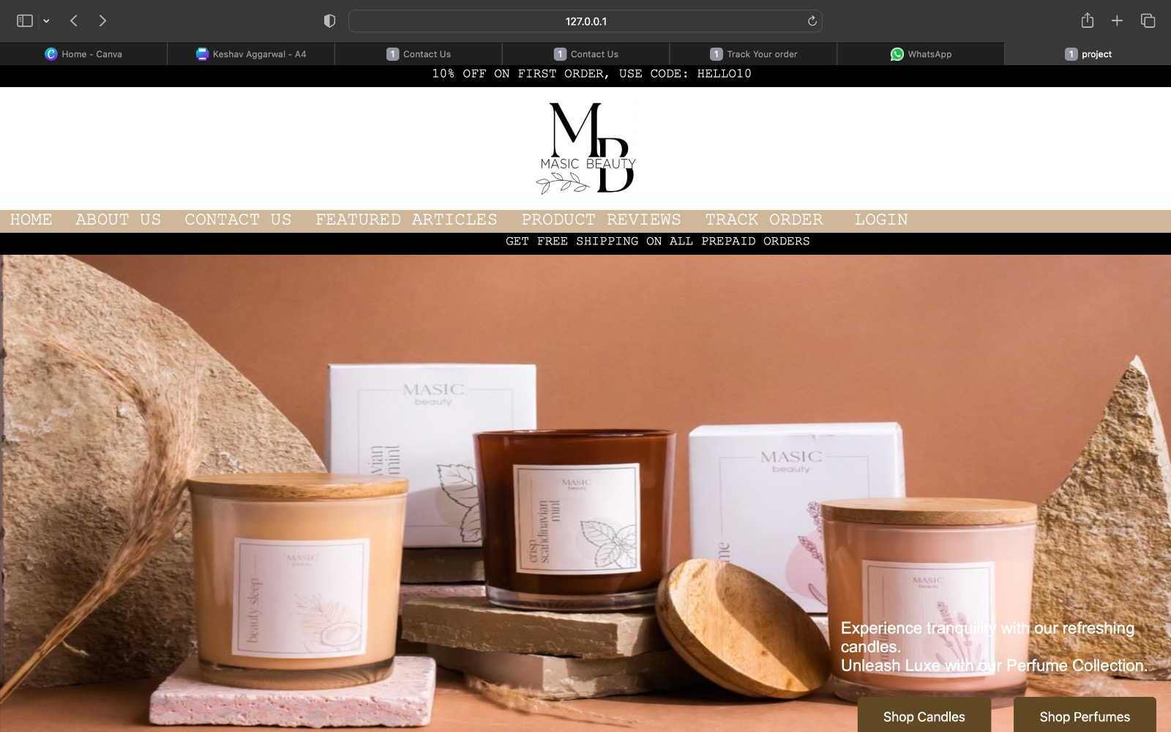
Masic Beauty

Slide 9
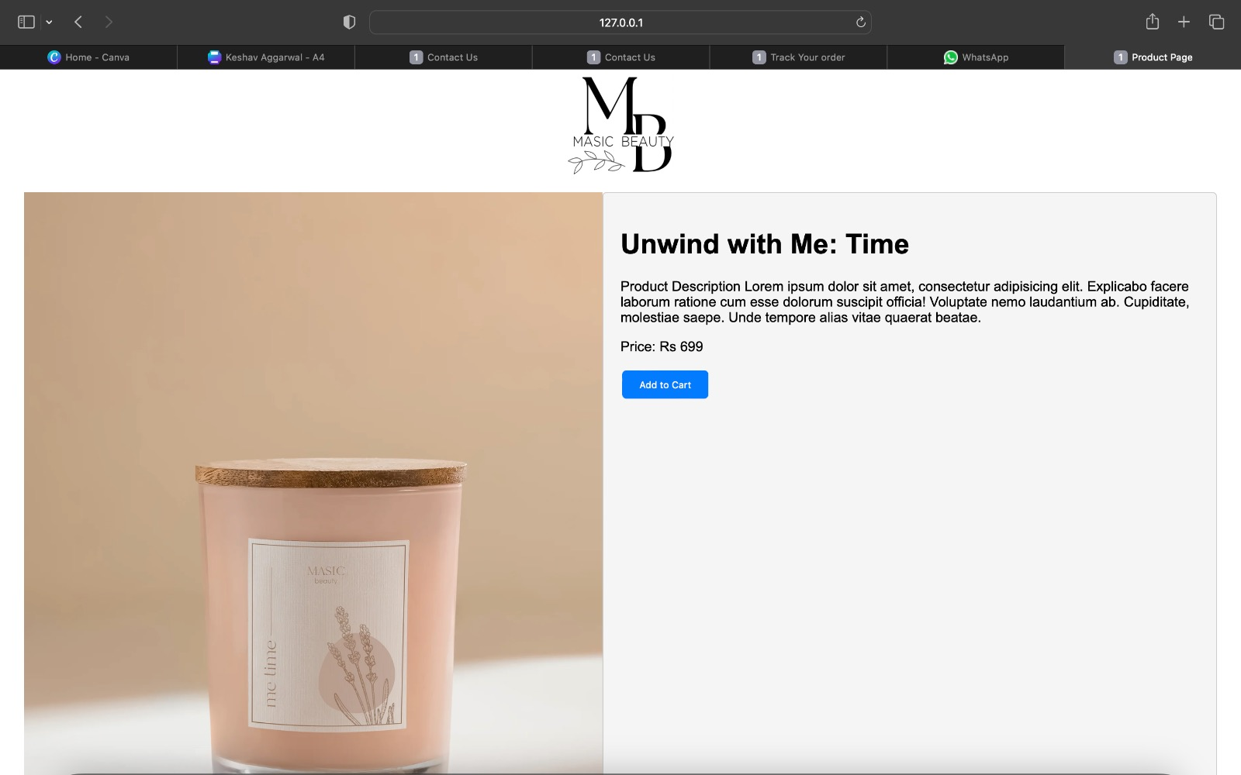
MASIC BEAUTY PRODUCT PAGE

Slide 10
Future
The future of these webpages will give a theme to build new websites related to such theme. I tried to build something nice by collaborating my ideas and getting few from online resources. This can be a simple and user friendly shopping platform.
Everything Is kept very simple yet very modern approach is followed. I tried to keep a versatility alive among different pages. I almost covered all the parts Like java, Html, CSS and bootstrap in a good amount to complete the projects demand.

