Slide 1

NodeJS
Server side coding with Javascript!

Slide 2
Let’s talk me!
Experience in IT: 10+
Experience in NodeJS: 4+
Production Experience: 10+
Objective of this course: To learn and understand the fundamentals of NodeJS

Slide 3
Course outline
Basics
Inside of Node
V8
JS basics
Events
Asynchronous code
Http
NPM
Express
JSON and databases

Slide 4
Jargon Buster – CLI
CLI stands for ‘Command Line Interface’
There are many different CLIs – Node, Git, Command prompt to name a few
Windows power shell

Slide 5
Microprocessors, Machine language and C++
Microprocessors
Machine language
IA-32
X86-64
ARM
MIPS
Every code that you write is eventually converted to machine code. Processors only understand machine code
Machine Language > Assembly language > C/C++ > Javascript

Slide 6
Nodejs – under the hood
Node is written in C++
V8 – the engine that converts JS to machine language is written in C++
We will keep looking back into C/C++ and see how things work

Slide 7
Javascript and ECMAscript
ECMASCRIPT – it is the standard that Javascript is based on
Why is a standard required?

Slide 8
V8 – The javascript engine
V8 is an open source engine
Implements ECMAScript as specified in ECMA – 262, 5th edition
Runs on – Windows, Linux, Mac
It can be run as stand alone or can be embedded into any c++ application

Slide 9
Adding features to javascript
Javasrcipt
C/C++
Machine language

Slide 10
Client and server
Client
Asks for service
Server
Performs services
REQUEST
RESPONSE
Client-server model

Slide 11
Browser and web-server
BROWSER
WEB-SERVER
http
Ruby/PHP/C#
Javascript
REQUEST
RESPONSE
Javascript
http

Slide 12
What does JS lack as a web server?
Better ways to organize our code in reusable files
Ways to deal with files
Ways to deal with databases
Ability to communicate over the internet
Ability to accept request and send responses (in standard format)
Way to deal with work that takes a long time

Slide 13
The c++ core
Let’s look at the nodeJS source code and see what’s happening there
Deps folder
Node.h

Slide 14
The javascript core
Let’s look at the source code again
Lib folder
Util.js

Slide 15
Let’s get node
Goto nodejs.org and download the copy > run
Check if it has been installed properly: node –v
Let’s write some JS code inside the Node console
Let’s run an external JS code
Debugging with VS code

Slide 16
Before moving ahead
Modules
Functions in Javascript are first-class
Function expression
Let’s create our first module
Require
Export

Slide 17
Objects and object literals
Object literals and different notations
‘This’
Prototypical inheritance
Function constructor

Slide 18
Pass by …
Primitives – Pass by value
Objects – Pass by reference

Slide 19
IIFE – Immediately Invoked Function Expression
Used to isolate modules
Used to protect data
Used to preserve scope

Slide 20
JSON – The data exchange format
Javascript/V8 engine has the capability to take an object literal and convert it to an actual Javascript object

Slide 21
Multiple requires
Packaging solutions
Let’s look at some code

Slide 22
Module patterns
Replacing the empty exports with a function
Adding a property name to exports object
Modules with constructor
If I create multiple instances, will it override or create new instances?
Caching in require
Constructor module without caching
Revealing module pattern – based on closure

Slide 23
Export and module.export
Pass by reference quirks
Mutate the export object instead of changing it
Which one to use - Exports or module.exports?

Slide 24
Native modules and require
Native modules do not require a path
Some modules are available globally while some need to be included
Example - util

Slide 25
Modules and eS6
Export and import

Slide 26
Events
Two types of events
System events | C++ core (libuv)
Examples: I finished reading the files, I finished writing to files
Custom events | Javascript core (event emitter)

Slide 27
Object properties, First class functions
Different ways to access object properties
Pushing functions into an array

Slide 28
Event emitter
Let’s build a custom, simple event emitter
Using nodejs event emitter
Let’s look at lib/events.js
Let’s use the in-built emitter
Magic string and handling it through config

Slide 29
Object.create and prototypes
Object.create on object literals and prototypical inheritance: protoInheritance.js

Slide 30
Inheriting from event emitter
Inheriting with util and Event emitter
Passing data to the event

Slide 31
Node, es6 and template literals
V8 does not need a babel transpiler. It supports ES6 features
Jsconfig file
Template literals
Side note: Call and apply
Inheriting non-prototype properties with .call(this)
ES6 classes
‘Use strict’
Inheriting from event emitters – the classes way
Super instead of call

Slide 32
Javascript, synchronous Op and Callbacks
Node is asynchronous, V8 is not.
V8 does things synchronously
What is asynchronous?
What is a callback?
Passing data in callback
Call back comes from libuv, but V8 will wait till the old processes are complete
Its called non-blocking IO since the JS code keeps running till libuv completes the core operations like fetching from DB, connecting to the internet, accessing a file
Libuv.org

Slide 33
Libuv, event loop and asynchronous IO
V8
Queue
OS
Event
Done
Request
Callback
Event loop
libuv

Slide 34
Streams and buffers
Buffer
A temporary spot for holding data that is being moved from one location to another
Stream
A sequence of data made available over time
Difference between downloading and streaming

Slide 35
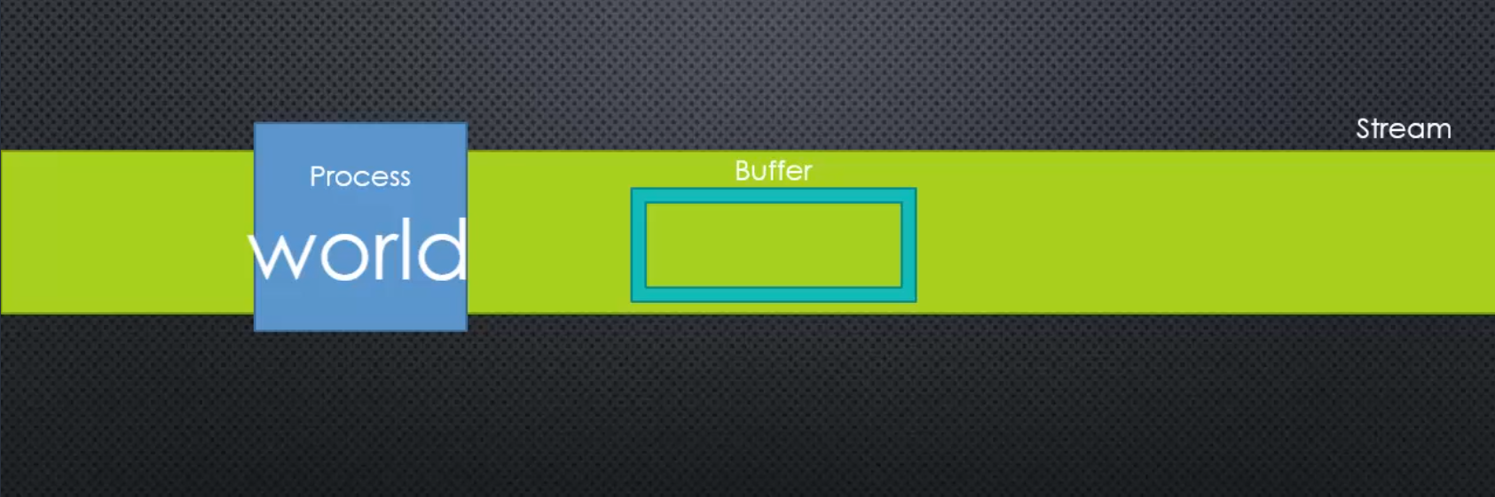
Stream + buffer

Slide 36
Binary data, character sets and encoding
HELLO
Character set (Unicode)
104 101 108 108 111
Character Encoding (UTF -8)
01101000 01100101 01101100 01101100 01101111

Slide 37
Buffer
Setting up a buffer object
Converting it back to string
Converting it to JSON object
Buffer object behaves like an array
Writing data to buffer

Slide 38
Files and fs
Read file synchronously
Disadvantages
Read file asynchronously
Error first pattern
Issue with buffer size
Addressing the issue with stream. Let’s look at stream.js and check how it uses event emitter

Slide 39
Streams
Check stream.js
It uses event emitter
Streams are abstract class
If stream is writable, node can send data to the stream
If stream is readable, node can get data from the stream
Getting data in chunks
Writing data in the same stream

Slide 40
Stream – Browser and web server
BROWSER
WEB-SERVER
Readable
Ruby/PHP/C#
Javascript
REQUEST
RESPONSE
Javascript
Writable

Slide 41
Pipes
Readable stream can be piped
Chaining the pipes
Gzip example

Slide 42
tcp/ip
IP
209.85.128.0
Standard format
REQUEST
Client
Asks for service
Server
Performs services
Standard format
Socket
http, ftp, smtp
Packets
TCP
RESPONSE
Standard format
IP
74.125.224.72
TCP – Transmission Control Protocol, IP – Internet Protocol

Slide 43
port
Web server
Browser
REQUEST
443
Node
Email
FTP

Slide 44
HTTP
Request headers
Response data
MIME types

Slide 45
Let’s create a web server
Return a text
Return an html file
Let’s change and see if the file still runs
Template
Read the file as stream instead of file
Outputting JSON
Routing

Slide 46
NPM and Node package managers
Package manager is a utility/tool to allow you to maintain versions of the packages
Dependency management – It allows you to deal with dependencies
Semantic versioning – SEMVER
Major.minor.patch
For more info: semver.org
NPM and NPM registry
Npm –v
To check the registry – npmjs.com

Slide 47
Let’s start a project and install a package
Npm init
Npm install moment –save
--save let’s you make an entry in package.json
Npm modules are used for client side code as well
‘^’ – update me to anything within this major release
‘~’ – Update me only patches, not even minor updates
We ship without the folder – node_modules. Simply run npm install with package.json
If we say require without a path, it looks within node core and then node_modules

Slide 48
nPM packages contd …
Dev dependencies
Npm install jasmine-node --save -dev
Global dev dependencies
Npm install –g nodemon
Location of the module in the specific user in windows
Check how dependencies are managed
Npm update

Slide 49
Express and web server
Installing express
Port number from environment variable
App.get
App.listen
Middleware with .use
Creating a custom middleware
More middlewares, check the resources section of express website: cookie parser and passport
Templates

Slide 50
Database connections
MySQL DB – node install mysql –save
MongoDB – node install mongoose --save

