Slide 1
CUSTOMER SHOPPING BEHAVIOR ANALYSIS
END-TO-END ANALYTICS
From raw transactions to business decisions
A complete workflow connecting Python data cleaning, Oracle SQL modeling, and Power BI executive reporting.
Customer Analytics Practice · Enterprise Data Architecture
Transaction cohort study across 3,900 customer records
Notes:
Introduce the portfolio project: taking 3,900 retail transactions through Python cleaning, relational SQL analysis in Oracle, and executive dashboards in Power BI to drive targeted merchandising and retention decisions.

Slide 2



The project connects three layers of analysis
Prepare
Analyze
Visualize
PYTHON & PANDAS
ORACLE & SQL
POWER QUERY & POWER BI
Load, inspect, clean, and enrich the shopping data.
Load the cleaned CUSTOMER table into Oracle and answer ten business questions with SQL.
Connect Oracle to Power BI through Power Query for interactive reporting.
02
Notes:
Walk the three technical layers: data preparation in Python Pandas, analytical modeling and querying in Oracle SQL, and business visualization in Power BI.

Slide 3
DATASET PROFILE
3,900 purchase records create a usable customer view
Dataset
Signals
Data quality
3,900
demographics, products, purchase amounts, discounts, shipping, subscriptions, and review ratings
37
rows across 18 columns
missing review ratings, handled without dropping records
03

Slide 4
DATA ENGINEERING
Cleaning turned raw fields into analysis-ready features
Filled missing review ratings with category-wise medians
Standardized column names for Python and SQL use
Converted purchase-frequency labels into day intervals and removed redundant promo-code information
Created four age groups: Young Adult, Adult, Middle-aged, and Senior
04
Notes:
Explain the four key data-cleaning transformations: category-wise median review ratings, standardized column names for Python and SQL, four age groups, and purchase-frequency labels converted into day intervals with redundant promo-code information removed.

Slide 5
Ten SQL questions translate transactions into business signals
Revenue by gender, subscription status, and age group
Discounted customers who still spend above the average
Top-rated products, discount-dependent products, and category leaders
Shipping economics, customer segments, and repeat-buyer subscription behavior
05

Slide 6



The analysis is built to compare value, behavior, and friction
Value
Behavior
Friction
Average spend and total revenue across genders and subscription statuses
New, Returning, and Loyal customer segments based on purchase history
Average purchase amount by Standard versus Express shipping
06
Notes:
Present the three analytical lenses: Value, Behavior, and Friction. Walk through each lens with its corresponding business takeaway as requested in the outline instruction.

Slide 7



Customer segmentation creates a path from purchase history to action
New
Returning
Loyal
Identify first-purchase patterns and onboarding opportunities.
Understand repeat behavior and the bridge to subscription.
Use purchase depth to inform retention and loyalty programs.
07

Slide 8
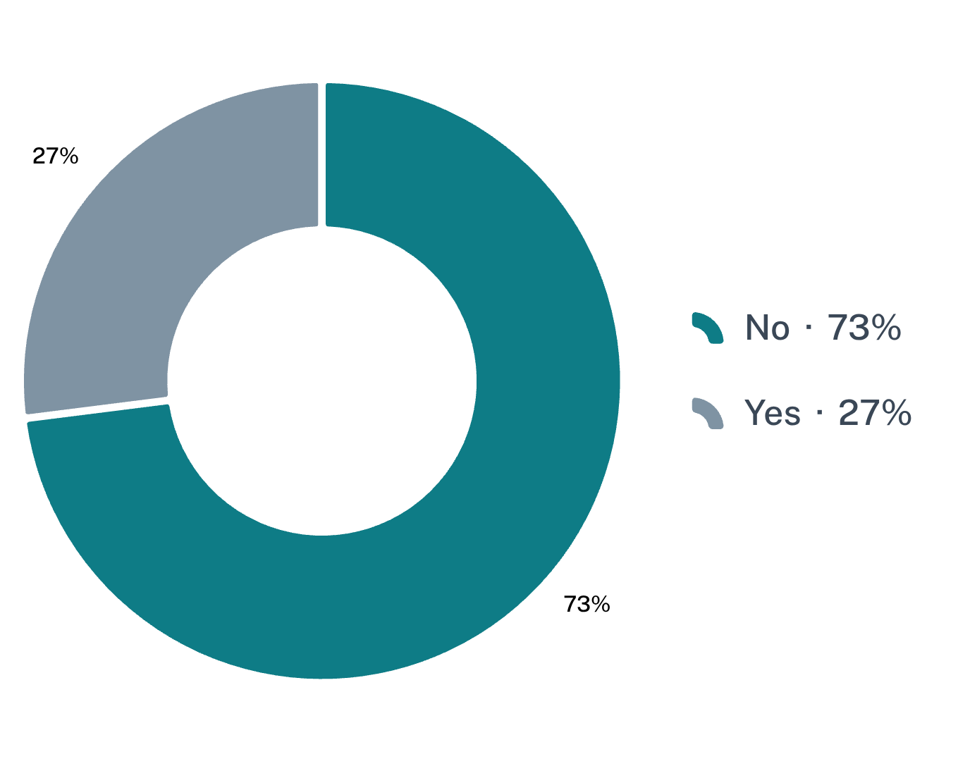
Power BI turns the analysis into an interactive reporting layer
AVG. PURCHASE
AVG. RATING
CUSTOMERS
$59.8
3.75
3.9K
Subscription status
Category ranking
Clothing
Accessories
Footwear
Outerwear
Most customers are not subscribed, highlighting retention upside.
08
Notes:
KPI tiles establish the baseline, while the subscription split and category ranking show where retention and merchandising opportunities sit. Values shown are from screenshot-2026-09-28-235734-a85bc12q.

Slide 9
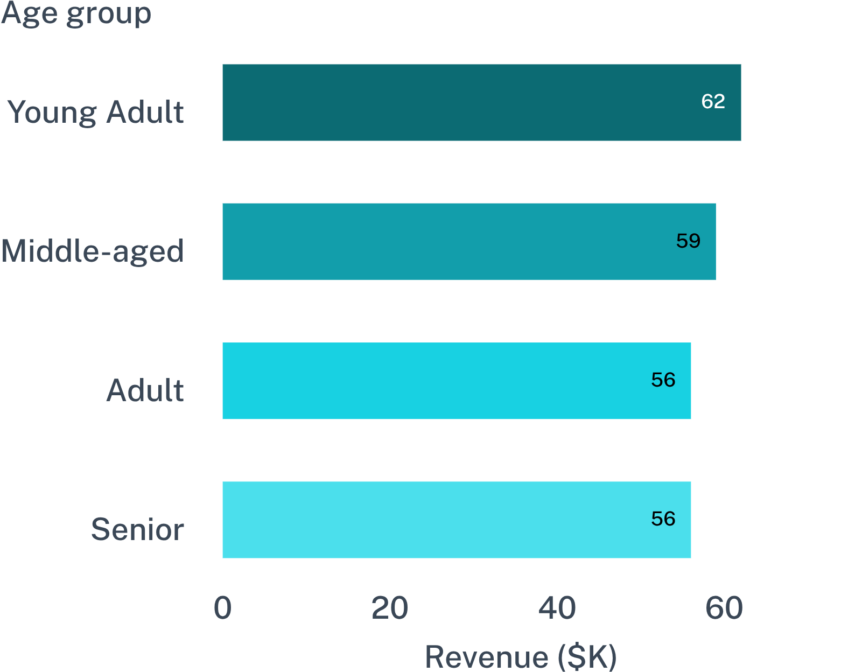
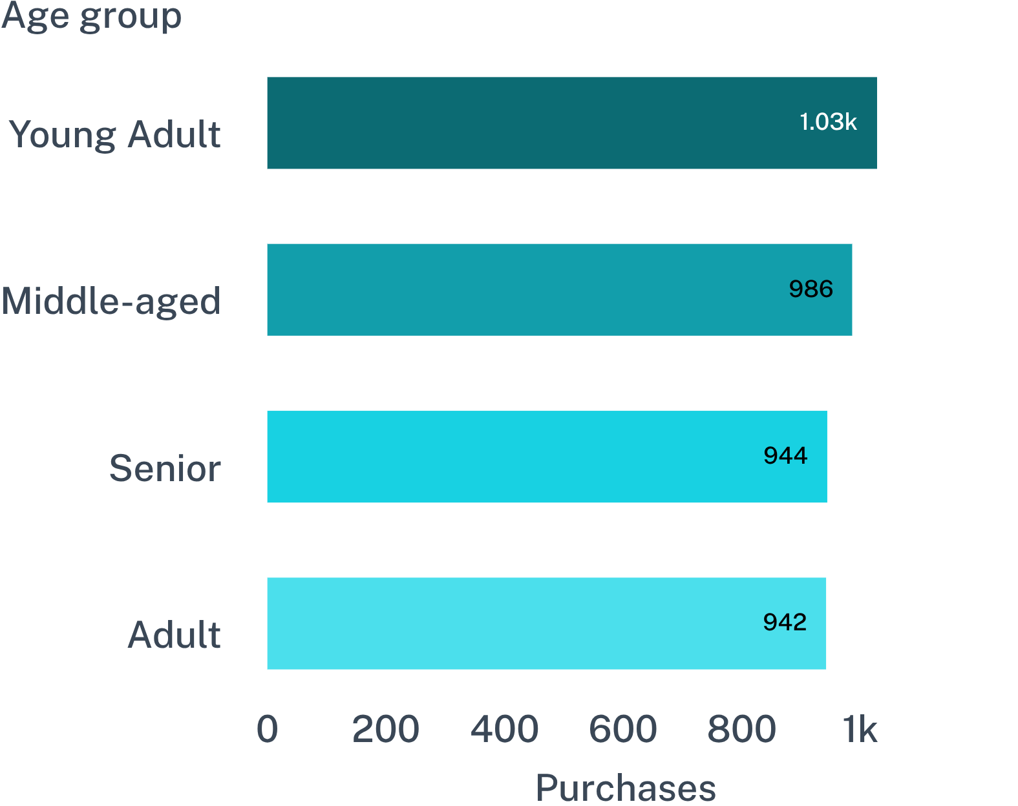
Age-group views reveal revenue and purchase volume
Revenue by age group
Sales by age group
Young Adults lead revenue; the other groups cluster closely.
Purchase volume follows the same broad age-group pattern.
09
Notes:
Use the paired age-group charts to show that Young Adults lead both revenue and purchase count, while the remaining groups are comparatively close. Values shown are from screenshot-2026-09-28-235734-a85bc12q.

Slide 10
Five recommendations follow directly from the analysis
Make subscription benefits more relevant to repeat customers
1
Use loyalty programs to encourage repeat purchases
2
Balance discount-driven sales with profitability
3
Feature highly rated and frequently purchased products in campaigns
4
Use age-group and shipping findings to target marketing and service decisions
5
10

Slide 11
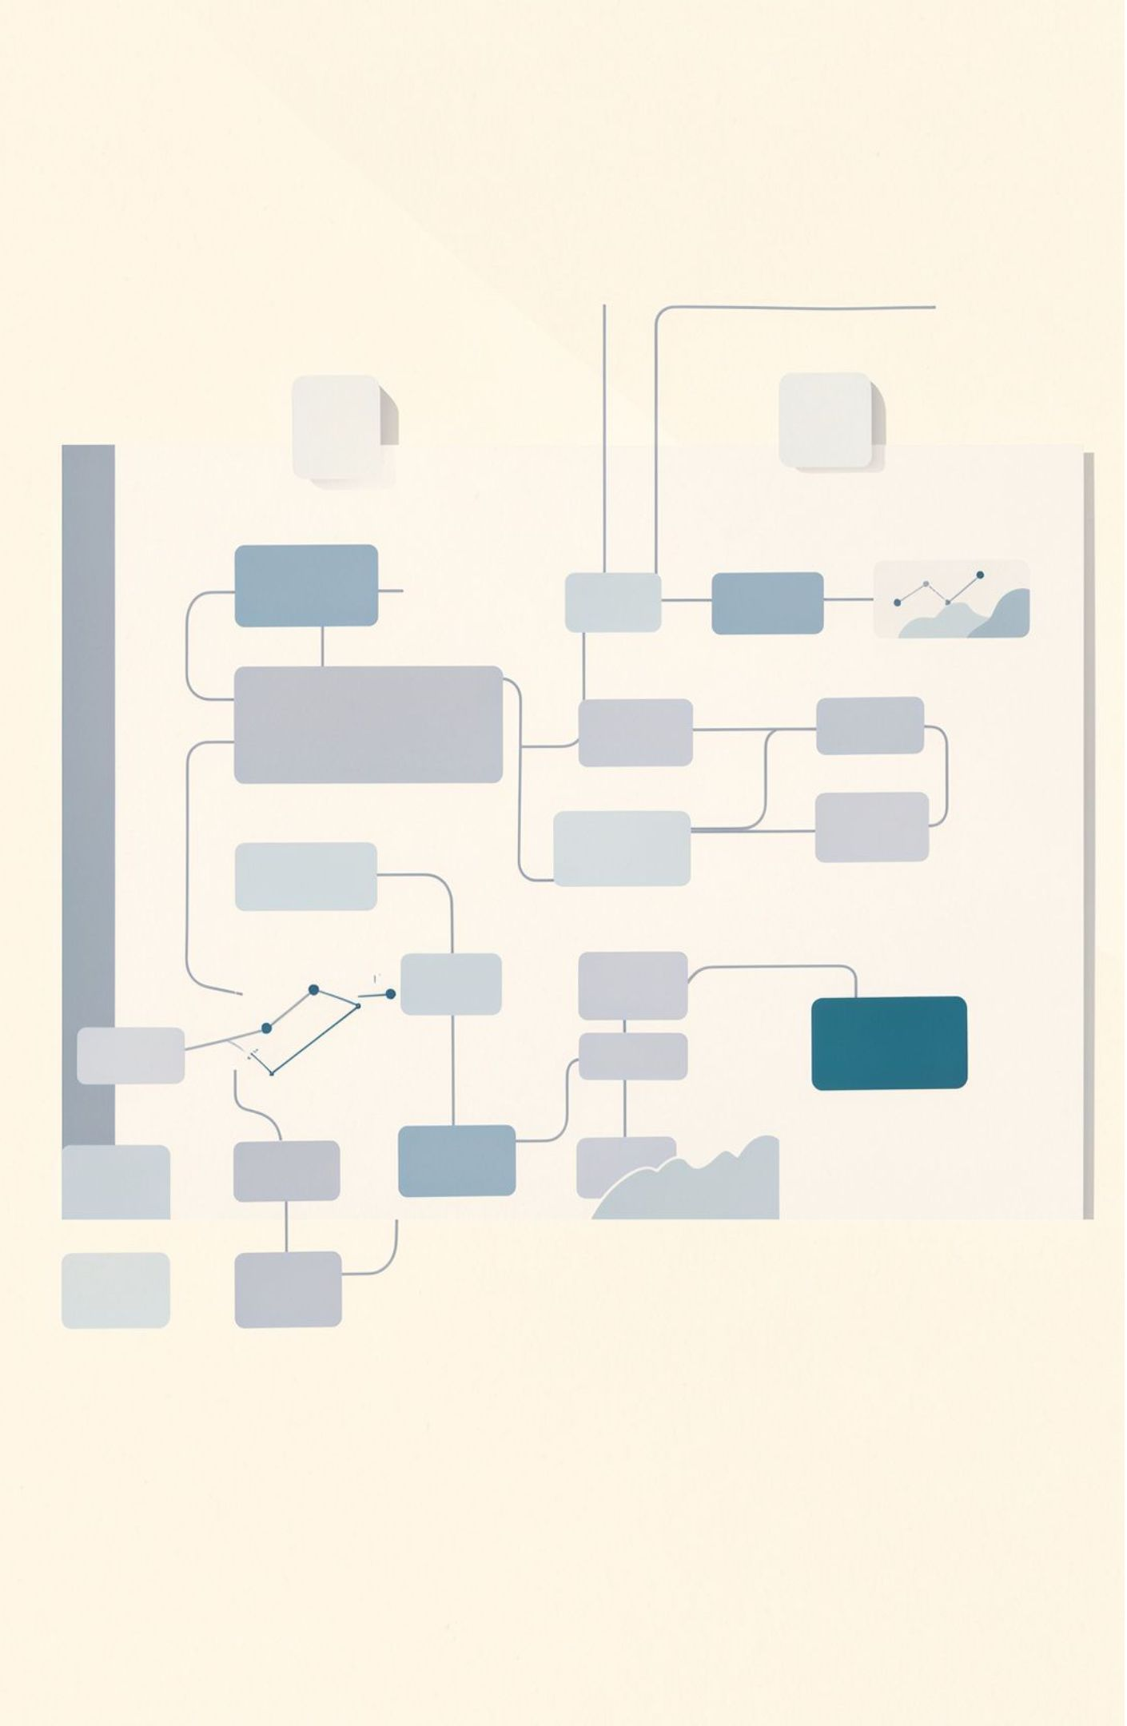
A complete analytics pipeline turns shopping data into action
01
02
Python and Pandas prepare the data
Oracle stores the cleaned CUSTOMER table
03
04
SQL frames the business questions
Power BI makes the findings usable for decisions
11

