Slide 1


CoinCanvas
Presented By: 21RH1A0502 – AAYUSHI HOTTA
21RH1A0515 – B.SNEHA 21RH1A0550 – C.ADITI
21RH1A0552 – D SRI SINDHU

Slide 2

Problem Statement
Efficient financial management is often hindered by disorganized records, missed opportunities, and a lack of real-time insights. Traditional manual methods for tracking income, expenses, and maintaining a structured financial record prove time-consuming and error-prone. Existing financial management tools often lack user-friendliness and immediate updates, making it challenging for individuals to make informed financial decisions.

Slide 3
Proposed solution
User-Friendly Interface
Transaction Categorization
Dynamic Doughnut Charts
Transaction History
Real-time Balance Tracking

Slide 4
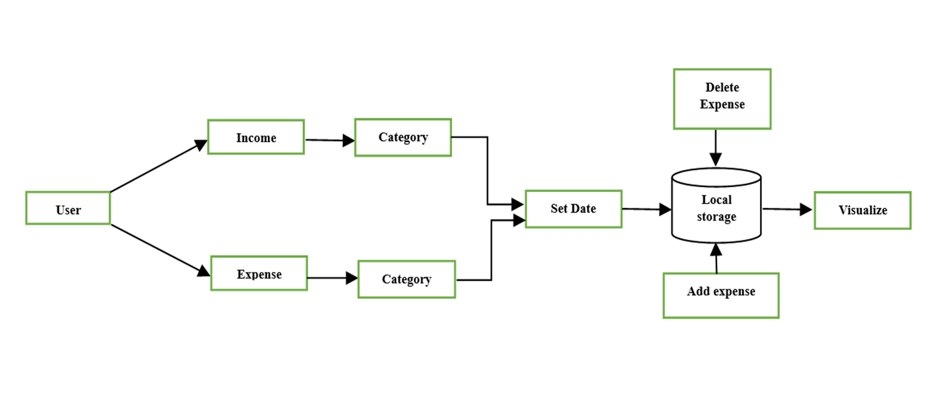
Block diagram

Slide 5

TECHNOLOGIES used

Slide 6
MODULES

Slide 7
App Component (App.js):
Layout and organization of the application.
Utilizes Material-UI's Grid components.
Includes columns for income and expense details.
Main content represented by the Main component.
Displays income and expense information through the Details component.
Styles Module (styles.js):
Exports a function created using makeStyles from Material-UI's styles.
Generates custom styles for components using theming and responsive design.
Styles adapt based on screen size and breakpoints defined in the theme.
Provides a consistent and visually appealing layout for the application.
useTransactions Hook (useTransactions.js):
Custom hook for managing and calculating financial transaction data.
Designed to handle "Income" or "Expense" categories.
Accumulates category totals and prepares data for rendering charts.
Used within the application to provide insights into financial transactions.
Assets:
Includes an image file (money.png) in Portable Network Graphics (PNG) format.
Package.json:
Manages project metadata and dependencies in a Node.js application.
Defines scripts for tasks like starting the development server, building the production version, running tests, and ejecting from Create React App.
Specifies project configurations, including ESLint and browserslist.

Slide 8
Components
Details Component:
Displays transaction details with Material-UI styling and a doughnut chart.
Appearance and behavior depend on data fetched by useTransactions.
Main Component:
Nested components include Form, List, Snackbar, and InfoCard.
Integrates elements to create a comprehensive interface for managing and tracking expenses.
Fetches and displays the total balance, enables input of new transactions, and presents a list of recorded transactions.
Form Component:
Responsible for creating and inputting financial transactions.
Dynamic category selection based on the chosen transaction type.
Provides user feedback through a snackbar notification.
List Component:
Renders a list of financial transactions with options to delete each transaction.
Uses Material-UI components for styling and animation effects.
Retrieves data from the ExpenseTrackerContext and utilizes the deleteTransaction function.
Snackbar Component:
Enhances the user experience with clear and visually appealing notifications.
Displays notifications for events like successfully creating a transaction.
Follows best practices for displaying notifications.
InfoCard Component:
Provides suggestions for entering financial transactions.
Randomly generates details for income or expense with basic styling.
May be used for instructional or testing purposes.

Slide 9
Constants
Categories:
Defines and exports sets of categories and associated colors for income and expenses.
Provides a function to reset amounts associated with these categories.

Slide 10
Context
context:
Sets up context and state management for the expense tracker application.
Uses React's useReducer and createContext features.
Defines initial state, actions for managing transactions, and a balance calculation function.
Provides the context to the application's component tree.
contextReducer:
Defines a contextReducer function for managing state changes related to financial transactions.
Handles actions for deleting a transaction and adding a new transaction.
Ensures consistent management and persistence of transaction data in localStorage.

Slide 11
Utils
formatDate:
Exports a JavaScript function for formatting dates into a standard string format (YYYY-MM-DD).
Provides a utility for formatting dates commonly used in databases, APIs, or user interfaces.

Slide 12
OUTPUT

Slide 13
USE CASES OF THE PROPOSED SOLUTION​
Monitor cash flow and budget effectively.
Optimize financial performance for business growth.
Track progress toward long-term financial objectives.
Plan budgets and savings goals.
Personal Finance Management:
01
Track income and expenses for personal financial organization.
Set budgets and financial goals.
Analyze spending patterns for informed decision-making.
Small Business Finance:
02
Manage income and expenses for small business operations.
Financial Planning and Analysis:
03
Create comprehensive financial profiles.
Analyze past spending patterns for financial decision-making.

Slide 14
Future Scope
Expense Reminders
Advanced Budgeting Tools
Integration with Financial Institutions
Investment Tracking
Enhanced Security
Uder Feedback and Integeration

Slide 15
Conclusion
In summary, this ReactJS expense tracker project demonstrates a modular and well-organized architecture, leveraging key React concepts such as components, state management, and hooks. The integration of Material-UI enhances the visual appeal, while responsive design principles ensure a seamless user experience. The use of local Storage provides data persistence, and the clear feedback mechanisms contribute to overall usability. With a focus on encapsulation, reusability, and modern React patterns, the project showcases a thoughtful and efficient approach to building a functional and user-friendly financial tracking application.

Slide 16
THANK YOU

