Slide 1
Learning an American Put Exercise Boundary
Numerical reference, Longstaff–Schwartz regression and neural exercise policies
Aditi Joshi, Helen Siavelis, Jaskaran Kalra, William McDonnell · Baruch MFE, Scientific Computing in Finance
Notes:
Draft deck. Parts 1-3 are complete; Parts 4-5 are placeholders. The reference is our own grid solver until the supplied reference_solver.py arrives.

Slide 2
How accurately must a boundary be learned?
Price an American put with three proportional dividends; compare a reference, LS and a neural policy
K = 100
T = 3/4
r = log 1.05
strike
years to maturity
continuous rate
σ = 0.30
δ ∈ {0, 1.25%}
N ∈ {180, 360}
volatility
dividend fraction
exercise intervals
Dividends at d = 5/24, 11/24, 17/24 (plot markers u = T − t = 13/24, 7/24, 1/24). Jump S → (1−δ)S, then exercise decision.
Notes:
All numbers use the risk-neutral measure. Calendar time runs right to left on every boundary plot because the horizontal axis is time remaining.

Slide 3
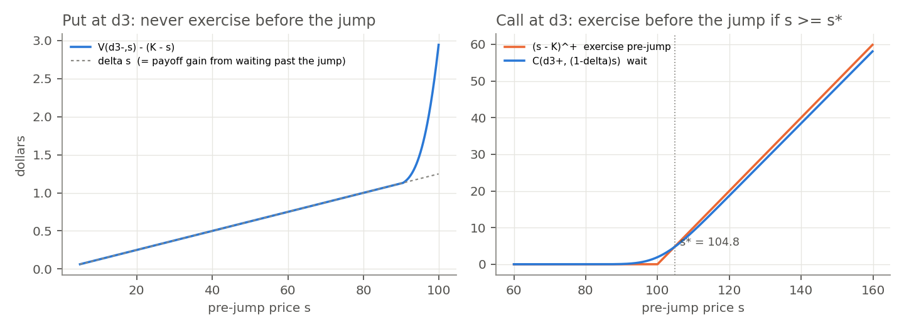
Put: jump first. Call: decide first.
Part 1, items 1 and 4 — which side of the dividend to exercise on
Put: V(d⁻, s) = V(d⁺, (1−δ)s) ≥ (K − s) + δs, so pre-jump exercise is never optimal.
Call: C(d⁻, s) = max{(s−K)⁺, C(d⁺, (1−δ)s)}; the max binds above s* (104.8 before d₃).
Call value at S₀=100: correct 10.4198, put-style ordering 10.4029, European 9.9037.
Our own grid solver, N = 180, δ = 0.0125. The put-style call exercises one grid step early and loses interest K(1 − e^(−rh)).
Notes:
For the put, exercising just after the jump pays delta*s more with no time elapsed. For the call the intrinsic value falls at the jump, so the call must test exercise before applying the dividend.

Slide 4
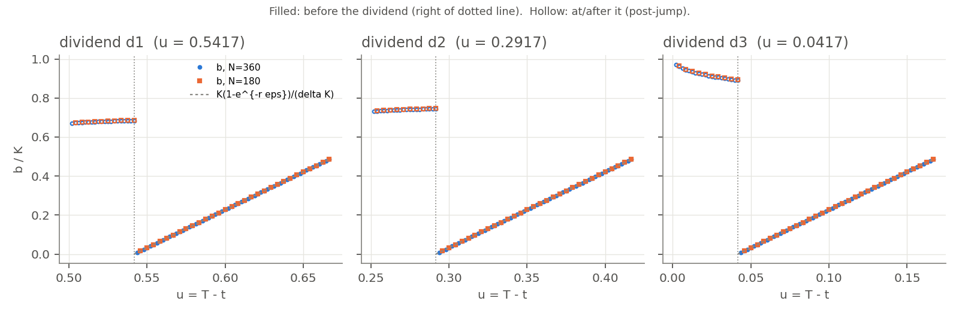
Near a dividend, the boundary rides the cap
Part 1, item 2 — b(d − ε) ≤ K(1 − e^(−rε)) / δ → 0
≈ 3.9 K / yr
1.63 → 0.81
0.69, 0.75, 0.89 K
slope rK/δ of the straight segments in Cox–Rubinstein's figure
one-step cap K(1−e^(−rh))/δ, N = 180 → 360: positive, → 0 with h
b just after d₁, d₂, d₃: the upward jump in calendar time
Notes:
Waiting until d+ and exercising gives V >= K e^{-r eps} - (1-delta) s. For small s exercise at d+ is nearly certain, so the bound is attained: the boundary lies on the cap for about 0.13 years before each dividend.

Slide 5
Dividends can only help the put
Part 1, item 3 — V₀.₀₁₂₅ ≥ V₀ and b₀.₀₁₂₅ ≤ b₀, equal after d₃
1
Couple: same Brownian increments, S^δ = S⁰(1−δ)^n ≤ S⁰
0 %
paths with Q_δ < Q₀ under one common τ (coupled MC, 20,000 paths)
2
Common stopping time τ ⇒ (K − S^δ_τ)⁺ ≥ (K − S⁰_τ)⁺ on every path
12.4 %
3
Take expectations, then sup over τ ⇒ V_δ ≥ V₀
paths violating it when each model uses its own stopping rule
4
V_δ = K − s ⇒ V₀ = K − s: exercise regions nested ⇒ b_δ ≤ b₀
A = B = F = 0
reference ordering diagnostics, N = 180 and 360
Notes:
The second stat shows why the proof fixes a common stopping time before comparing payoffs. The reference diagnostics are exact zeros; after d3 the two problems are identical.

Slide 6
Refinement vs changing N
Part 2 — the reference is precise to ~1e-5 $; changing N changes the problem itself
Change | Max price change ($) | Max boundary change ($)
Spatial dx/2, dx/4 | 1.6e-5 | 1.3e-3
Time integration h/2, h/4 | 7.2e-9 | 1.6e-6
Wider domain / kernel tails | 0 | ≤ 3e-12
N = 180 → 360 | 2.2e-3 | 0.305
Placeholder reference
Our own solver: exact Gaussian step on a log grid, dividend = exact 10-node shift, dx²/6 variance correction. European check ≈ 2e-5 $. Replace with the supplied -verify output.
≈ 1e-5 $
≈ 0.3 $
reference price precision (largest refinement change)
boundary shift from N = 180 → 360: a different problem
A claimed accuracy gain smaller than the reference's own precision (~1e-5 $ in price, ~1e-3 $ in boundary) cannot be resolved.
Notes:
Time refinement barely moves anything because the kernel integrates the lognormal step exactly. More exercise dates raise the value by ~1e-3 dollars and move the boundary by ~0.3 dollars, two orders of magnitude above the refinement changes.

Slide 7
Exact simulation passes the martingale check
Part 2 — (mean S_T − S₀e^(rT)(1−δ)³) / SE on the final S₀ = 100 sample
+0.12
+0.62
+1.96
+0.23
case 0: N = 180, δ = 0
case 1: N = 180, δ = 0.0125
case 2: N = 360, δ = 0
case 3: N = 360, δ = 0.0125
Exact lognormal step, dividend applied on arrival at an integer dividend index; a start at a dividend date is post-jump.
Training mixture A: log-uniform on [0.001K, K] or uniform on [0.2K, 1.2K], each with probability 1/2.
All four z-scores lie inside ±2; case 2 sits at the edge (1.96), which is plausible for one of four draws.
Assumed draw order (README.md not yet available): coin, log-uniform, uniform per path, then the path normals.
Notes:
The draw order must be checked against the supplied README before submission; changing it changes every Monte Carlo number but not the method.

Slide 8
Longstaff–Schwartz, turned into a threshold
Part 3 — 32,768 paths from S₀ ~ A, targets in time-zero dollars
1
Regress
2
Clip
3
Threshold
4
Cap & update
Y on 1, x, x², x³ over ITM rows (SVD least squares)
c_j ∈ [0, K e^(−r t_{j+1})] ⇒ H₀ > 0
largest +/− crossing of H on s = 0.1ℓ
b_j = min(U_j, candidate); exercised paths get e^(−r t_j)(K − S_j)
Case | Fallbacks | Multi-crossing dates | Capped dates | Replay max|Q−Y|
0 | 0 | 179 / 180 | 0 | 0
1 | 0 | 142 / 180 | 85 | 0
2 | 0 | 360 / 360 | 0 | 0
3 | 0 | 264 / 360 | 149 | 0
Notes:
The clip upper bound is the most any continuation can be worth in time-zero dollars, since the next exercise is at t_{j+1} and pays at most K. Replaying the frozen rule reproduces the backward targets exactly.

Slide 9
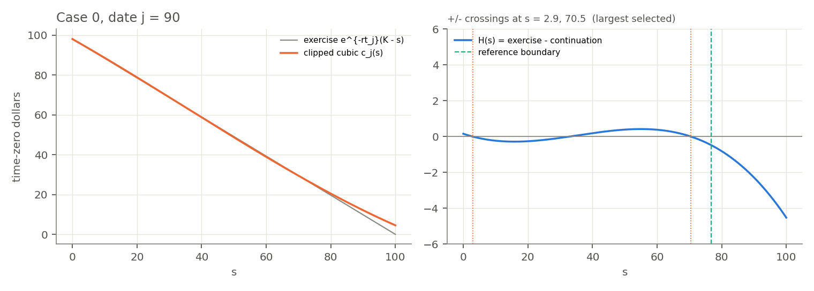
Why the largest crossing is the right one
A cubic over [0.001K, K] cannot follow the curvature: H dips below zero near s ≈ 3
Case 0, date j = 90. Selecting the largest crossing gives one exercise interval (0, b] and discards the spurious continuation pocket around s ≈ 3–33.
Notes:
Nearly every date has two positive-to-negative crossings. The rule defines a single interval containing all smaller prices, which is the correct economic shape even though the polynomial itself says otherwise.

Slide 10
A neural boundary under the cap
Part 4 — b_θ(t_j) = U_j · sigmoid(f_θ(t_j)); the cap is built in, the network learns the shape
1
Architecture. δ = 0: one net on [0, T]. δ > 0: four nets on [0,d₁), [d₁,d₂), [d₂,d₃), [d₃,T]. Each Linear(1,8) → tanh → Linear(8,1), input x = (t−α)/(β−α).
Randomised stopping
p_j = 1{S_j<K} · sigmoid((b_θ(t_j) − S_j)/(εK)), p_N = 1
w_j = p_j · Π_{k<j} (1 − p_k)
R_θ = Σ_j w_j e^(−r(t_j − t_J)) (K − S_j)⁺
w_j is the probability of stopping first at t_j, so R_θ is the path-conditional expected payoff of a randomised rule: smooth in θ, and equal to the hard rule as ε → 0 (checked to ≤ 1e-6 $).
2
Warm start. 1,000 full-grid Adam steps (lr 0.01) onto the LS thresholds → checkpoint 0.
3
Payoff stage. 2,400 Adam steps (lr 0.003), batches of 512 from 8,192 random-start paths; ε = 0.01 → 0.002 after 400.
4
Selection. Hard rule on 4,096 validation paths at checkpoints 0, 400, …, 2,400; best mean wins, ties → earliest.
Notes:
Becker et al. (2019): one network per date, stop/continue relaxed to a logistic probability, trained backward one date at a time to maximise expected reward; lower bound plus dual upper bound. Bühler et al. (2019): semi-recurrent networks for the hedging strategy, trained with Adam on simulated paths to minimise a convex risk measure (e.g. expected shortfall) under transaction costs. We train one threshold jointly over all dates for expected payoff.

Slide 11
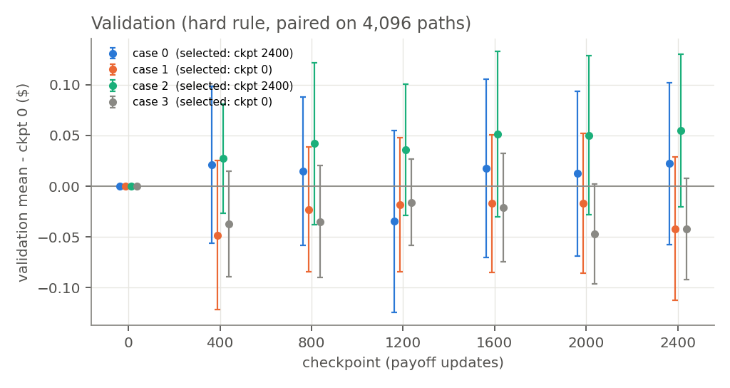
Validation cannot tell the checkpoints apart
Paired validation gains vs checkpoint 0 are all within ~2 SE
Case 0: ckpt 2400
E_mean 0.065 → 0.078
Case 1: ckpt 0
E_mean 0.019 → 0.019
Case 2: ckpt 2400
E_mean 0.056 → 0.023
Case 3: ckpt 0
E_mean 0.043 → 0.043
Case 2: payoff training more than halved the boundary error. Case 0: the selected checkpoint drifted to b ≈ 0.49K near t₀, which few validation paths visit.
Notes:
Validation uses random start dates, so dates near t0 carry little weight. Case 0's selected checkpoint has a worse boundary than checkpoint 400 and loses 0.87 dollars at S0 = 60 in the fixed-start evaluation.

Slide 12
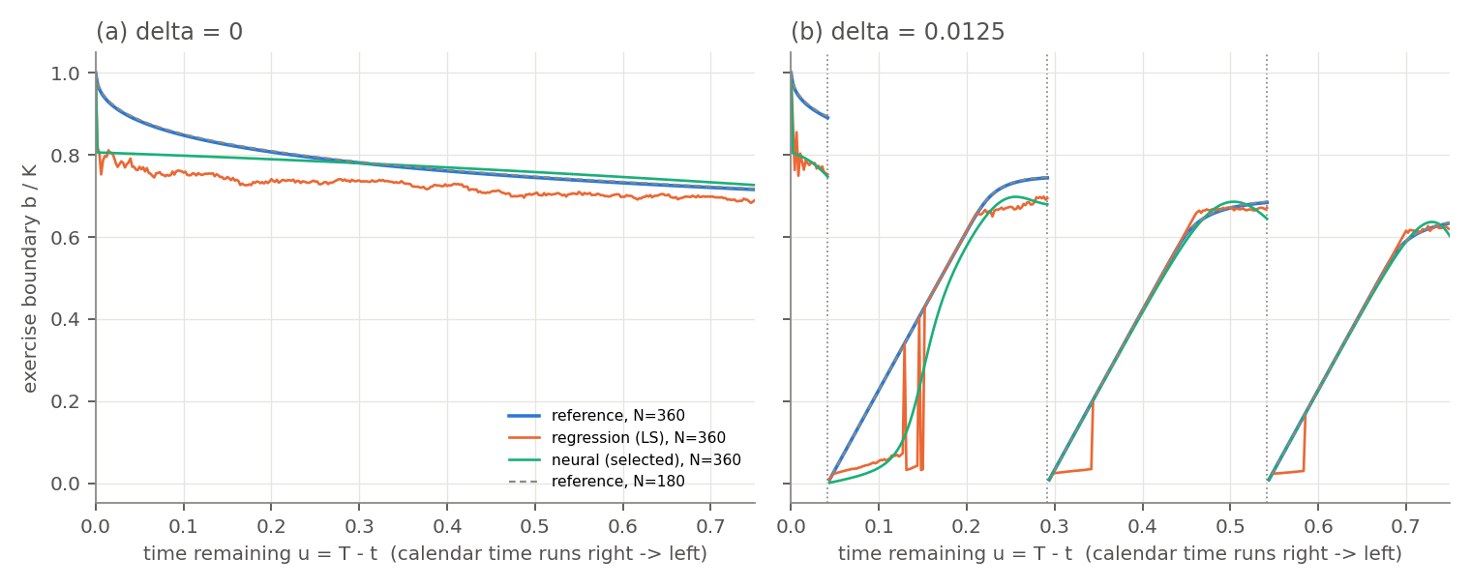
Three boundaries (N = 360)
Figure 1 — reference (blue), LS (orange), selected neural policy (green), N = 180 reference dashed
Notes:
The NN smooths the LS noise and removes its downward spikes before dividends, but inherits LS's low level unless payoff training moves it (case 2 did, case 3 selected checkpoint 0).

Slide 13
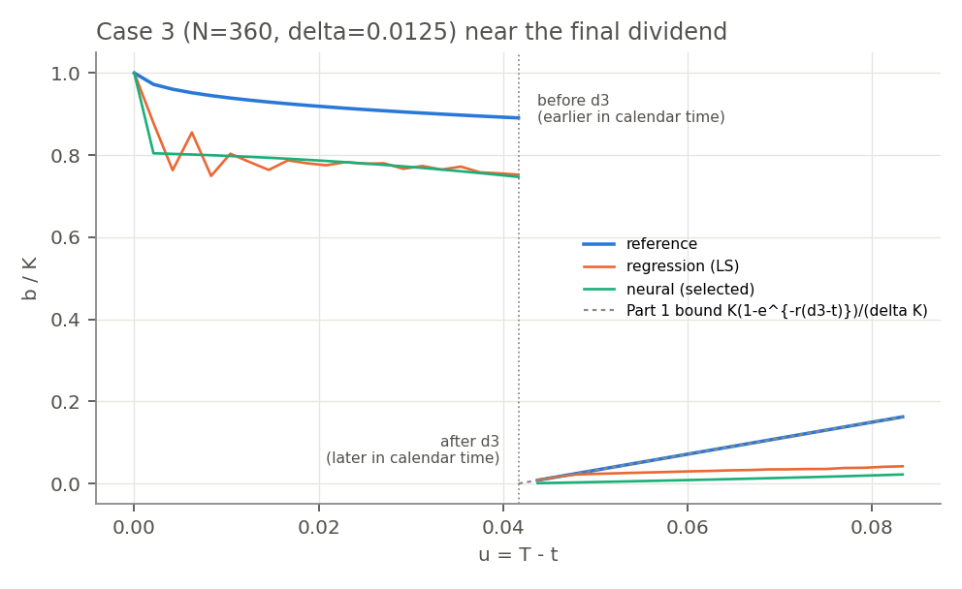
Around the final dividend
Figure 2 — case 3, |t − d₃| ≤ 1/24
Right of the dotted line = before d₃ in calendar time: the reference sits exactly on the Part 1 bound.
LS and NN stay below the cap there: the premium δs − K(1 − e^(−rε)) is only cents.
Left = after d₃: no dividend remains and the boundary rises to K; both fits are biased low (~0.15K).
Notes:
The cap supplies the known pre-dividend behaviour; the fitted functions only determine the shape below it.

Slide 14
Large boundary error, small price error
Part 5 prices — 50,000 independent paths per start, common paths across policies, float64
Case | S₀ | Reference | LS (SE) | NN (SE)
0 | 80 | 20.8688 | 20.653 (0.056) | 20.584 (0.056)
0 | 100 | 8.8078 | 8.648 (0.050) | 8.760 (0.046)
1 | 80 | 22.1095 | 21.997 (0.063) | 22.010 (0.063)
1 | 100 | 10.1264 | 10.029 (0.055) | 10.033 (0.055)
2 | 80 | 20.8710 | 20.660 (0.054) | 20.822 (0.042)
2 | 100 | 8.8091 | 8.612 (0.049) | 8.688 (0.046)
3 | 80 | 22.1102 | 22.070 (0.063) | 22.065 (0.062)
3 | 100 | 10.1270 | 10.073 (0.055) | 10.073 (0.055)
3–7 % | 2–8 %
mean boundary error E_mean of K: LS | NN
0.02–0.19 $
paired LS price loss vs the reference boundary rule (same paths)
S₀ = 60 omitted: LS and the reference exercise at once (value 40); the NN loses 0.87 $ (case 0) and 0.03 $ (case 1) there. Smooth pasting makes price error roughly second order in boundary error.
Notes:
Every mean lies at or below the reference value, as it must: a frozen policy cannot beat the optimum. The perturbation study (a = ±0.02) is still to do.

Slide 15
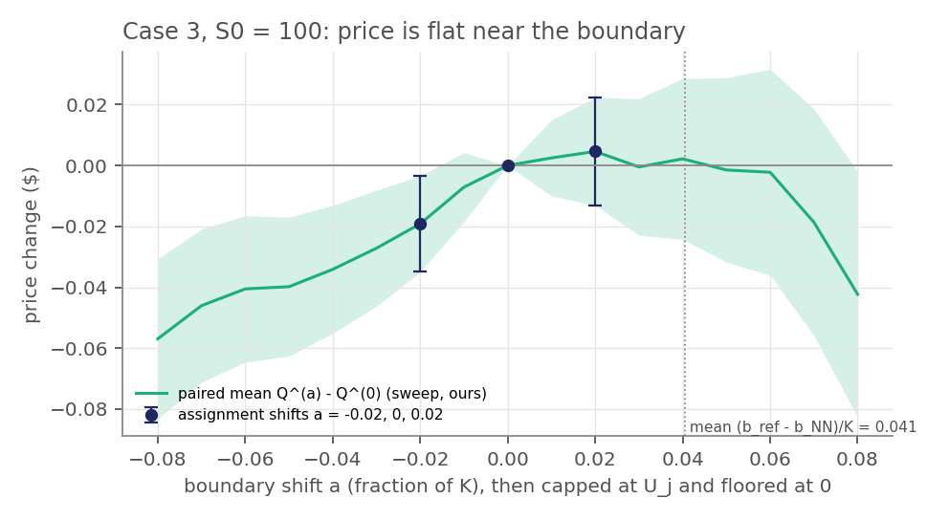
Moving the boundary barely moves the price
Part 5.3 — case 3, S₀ = 100: shift the NN boundary by aK, cap at U_j, floor at 0
-0.019 $
a = −0.02: SE 0.008; 17% of paths now exercise later
+0.005 $
a = +0.02: SE 0.009; cap binds on 147 of 360 dates
Only paths that enter the shifted band change decision. The cap absorbs most of an upward shift (applied mean shift 0.014K). The NN sits ≈0.04K below the reference, so moving down hurts and moving up lands on the flat part.
Dots: the assignment's shifts (95% paired intervals). Line and band: our finer supplementary sweep on the same 50,000 paths.
Notes:
The optimal boundary itself moves by only 0.26% of K between N = 180 and 360, 10 to 100 times less than the fitted errors, so changes of a fitted policy with N are learning error.

Slide 16
How accurately must the boundary be learned?
1
Less than it looks 2–8% mean boundary error costs cents: the value is flat near the optimal threshold (smooth pasting).
2
Except where paths go a small error at a heavily visited state (case-0 NN at t₀, S₀ = 60) costs 0.87 $.
3
Structure beats fitting the Part 1 cap gives the pre-dividend boundary exactly; both learners only fill in the rest.
4
Selection is noisy validation cannot separate checkpoints (all within ~2 SE); no fitted price exceeds the reference (max z = -0.65).
Reference: our own validated grid solver (the supplied reference files were not available); draw order documented in the code.

