Slide 1
Sales and Profit Analysis: Q[Quarter/Year]
This presentation analyzes sales and profit data for Electronics, Furniture, and Stationery categories. We will explore key performance indicators to understand the contribution of each category to overall revenue.

Slide 2
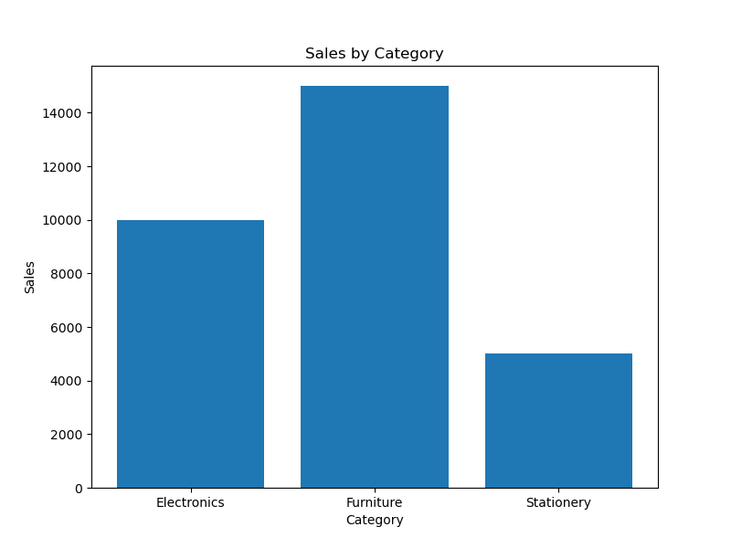
Sales Performance by Category
Electronics: $10,000 in sales
Furniture: $15,000 in sales
Stationery: $5,000 in sales

Slide 3

Profitability by Category
Electronics: $2,000 profit
Furniture: $3,000 profit
Stationery: $1,000 profit

Slide 4
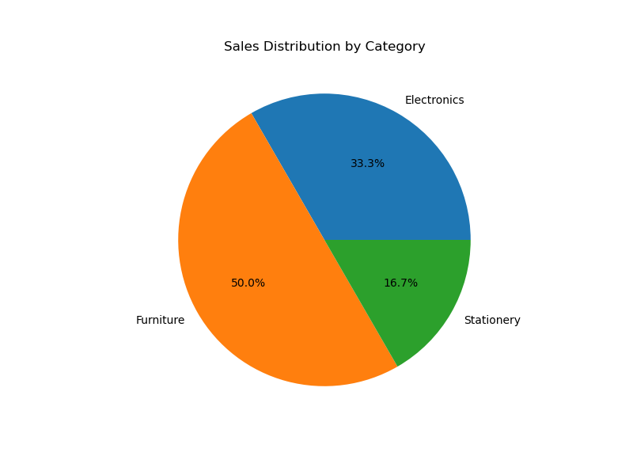
Sales Distribution by Category
This pie chart shows the percentage contribution of each category to the total sales.

Slide 5

Profit Distribution by Category
This pie chart showcases the proportional contribution of each category to the overall profit.

Slide 6
Key Findings and Recommendations
Based on the data analyzed, strategic adjustments can be implemented to optimize overall performance and maximize profitability across all categories. Further analysis should be conducted to identify contributing factors to the observed performance and inform future business decisions.
Furniture is the highest-performing category in both sales and profit.
Further investigation is needed to understand the lower profit margin in Electronics despite higher sales volume.
Strategies to improve Stationery sales and profitability should be considered.

