Slide 1
Title Slide

Slide 2
Sales Performance Overview
This presentation analyzes sales and profit data for three product categories: Electronics, Furniture, and Stationery. We will visualize this data using bar and pie charts to highlight key performance indicators.

Slide 3
Sales Data

Slide 4
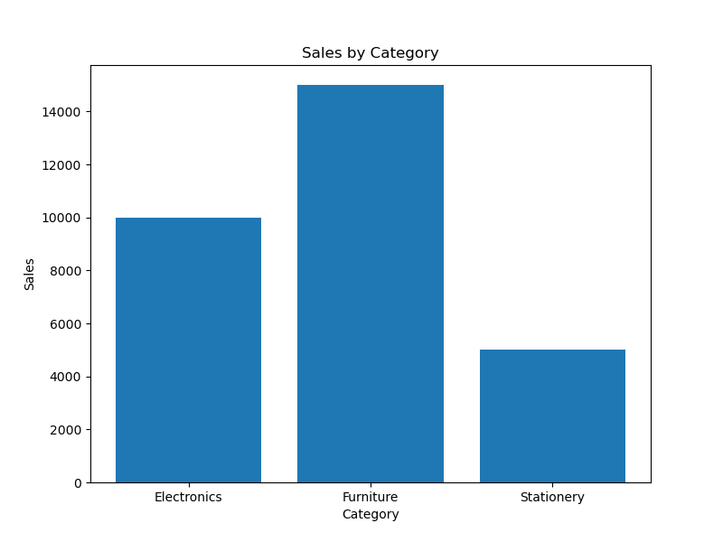
Sales Performance by Category
Electronics: $10,000 in sales
Furniture: $15,000 in sales
Stationery: $5,000 in sales

Slide 5
Profit Data

Slide 6

Profitability by Category
Electronics: $2,000 profit
Furniture: $3,000 profit
Stationery: $1,000 profit

Slide 7
Sales Data Visualization

Slide 8
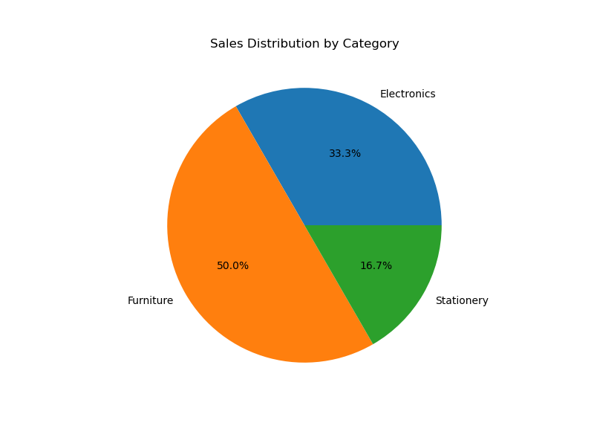
Sales Breakdown - Pie Chart
This pie chart provides a visual representation of the sales distribution across the three product categories. Furniture represents the largest share of sales.

Slide 9
Profit Data Visualization

Slide 10

Profit Breakdown - Pie Chart
This pie chart illustrates the proportion of profit generated by each category. While Furniture has the highest sales, it also generates the highest profit.

Slide 11
Conclusion

Slide 12
Key Findings and Recommendations
This analysis provides valuable insights into the sales and profit performance of each category, informing future business decisions and resource allocation.
Furniture is the highest performing category in both sales and profit.
Further investigation into Electronics' profit margin is recommended despite its high sales.
Strategies to boost Stationery sales and profitability should be explored.

