Slide 1
Breast cancer detection
By aditi malladi, EEL 6825

Slide 2
Topic introduction
Cancer is a widespread concern, taking hundreds of lives every year.
The data is a information collected from individuals who have had cancerous growths which could be either Malignant or Benign.
This project aims to Diagnose based on the dataset whether a given growth is Malignant or Benign.
The data provided has 31 features, including one unnamed feature, and finally a 32nd one which is the output Diagnosis.
The problem proves to be a non-linear classification problem, with the data providing many insights.
Steps followed in this study:
Data Visualization
Feature Extraction and Multiple Classification methods
Detailed Comparison Analysis.

Slide 3
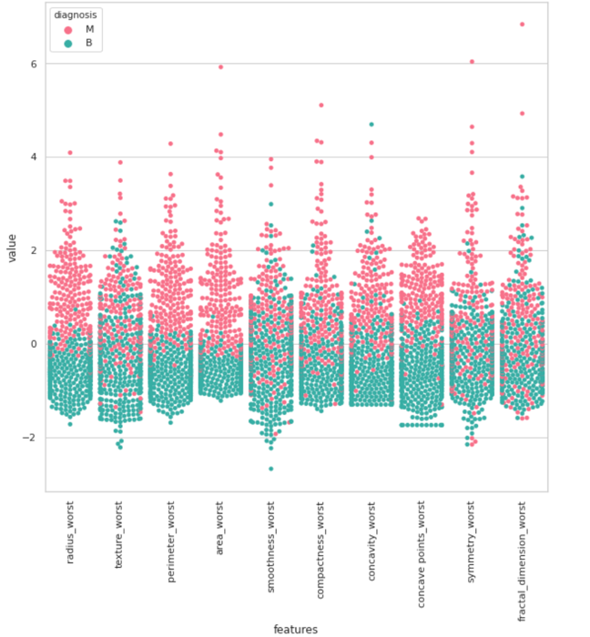
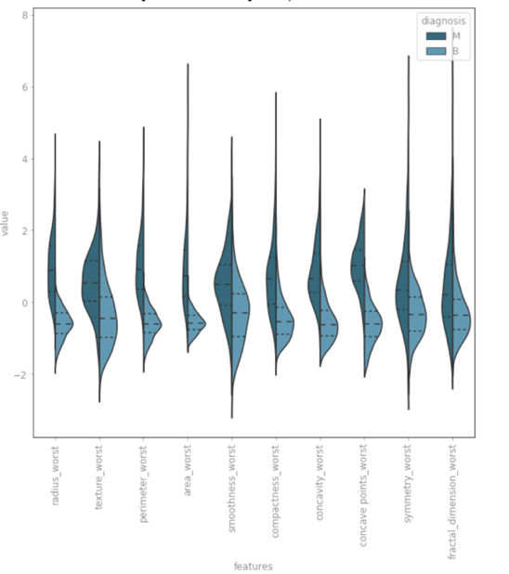
Data visualization
Violin plot and swarm plot were used to understand the dataset
These plots showed showed up which features could potentially be the best ones for classification
These are later validated through the experiments.

Slide 4
Classification methods explored
Naïve Bayes Method
Random Forest Classifier
k-Nearest Neighbors
Logistic Regression
Support Vector Machines
Artificial Neural Networks
Single Layer Perceptron
Multi Layer Perceptron

Slide 5
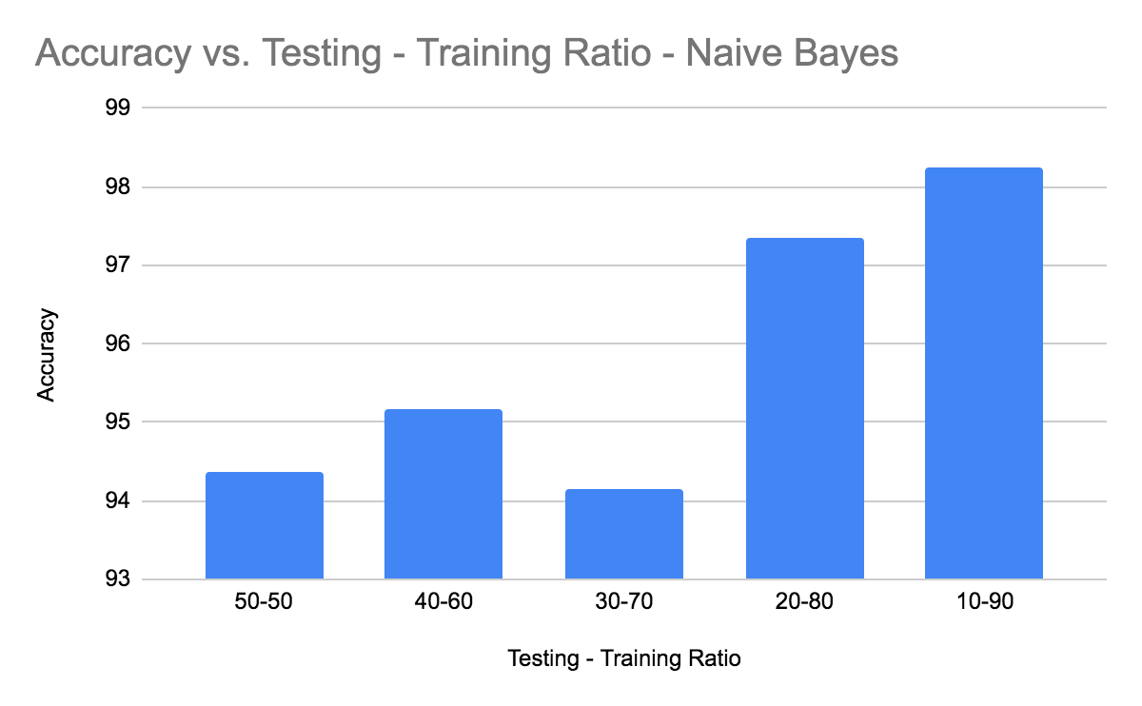
NAIVE BAyes
A simple approach based on training a conditional probability model
p(C_{k}|x)=p(C_{k}) / p(x|C_{k})p(x), where k = 2
Implemented the help of the sklearn package
Best accuracy achieved was 95%

Slide 6
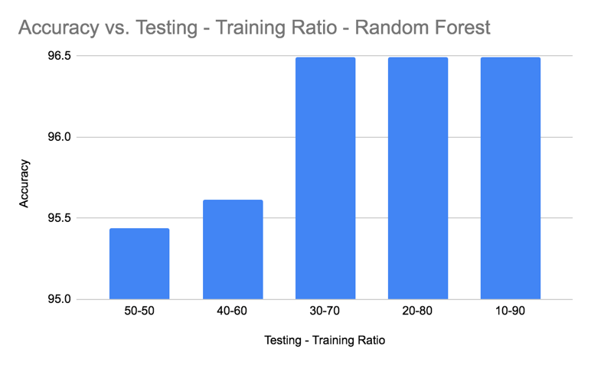
Random forest classifier
Running simple Random Forest Classifier (using all of the features) produced a resulting accuracy of 97.08%. (for a test ratio of 30%).
Ranking top features using SelectKBest Function. Re-Running the classifier now, with only these 5 features resulted in an accuracy drop, bringing it down to 96.49%.
Recursive feature Elimination, to understand the optimal number of features required. Dropping the rest of the features and retaining the optimal number of features brought the accuracy back up to 97.07%. Giving a great insight on the suitable number of features to use and accuracy.
Best Features:
concave_points_mean
radius_worst
perimeter_worst
area_worst
concave_points_worst

Slide 7
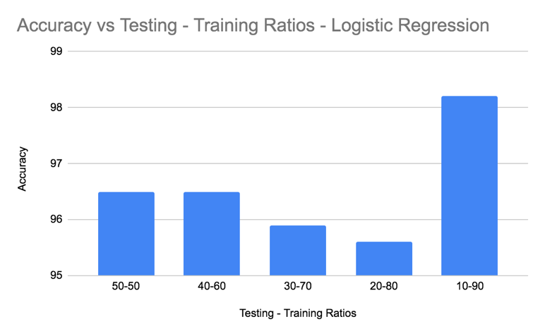
Logistic regression
From the dataset it is clear that a linear approach would not be ideal
Selecting the best features found using the Random Forest Approach was used and logistic regression was run, giving a result of accuracy of 96.5%.

Slide 8
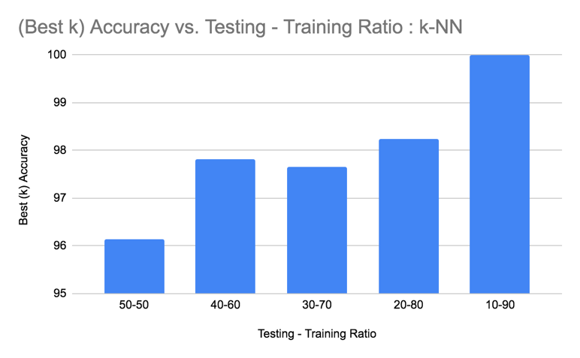
K- Nearest neighbors
Various metrics were tested, Euclidean, Manhattan and Minkowski
Using all features, the best accuracy obtained was 97.66%, beating any other accuracy achieved.
Applying PCA before to test the k-NN gave sub-par results are reduced the accuracy greatly, dropping it to less than 91%. Multiple number of components of PCA failed to increase these results.

Slide 9
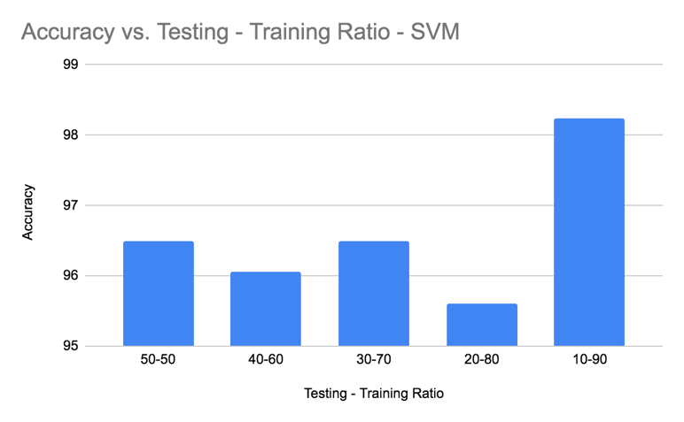
Support vector machine
Running SVM on the data gave an initial accuracy of 95%
Tuning the training and test set improved this score to 96.49%

Slide 10
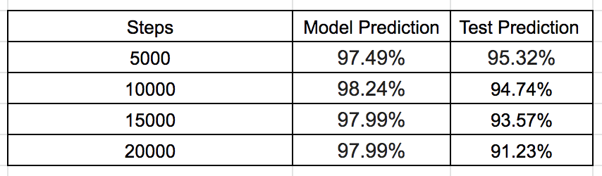
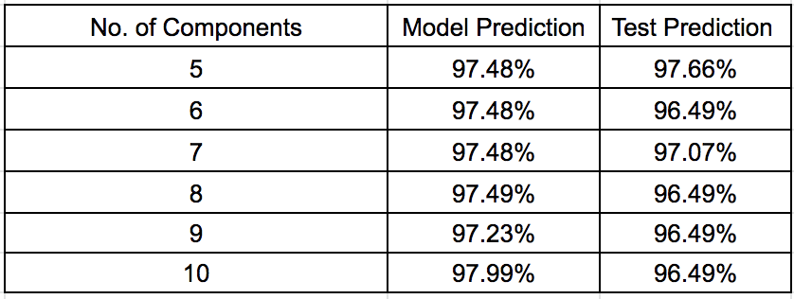
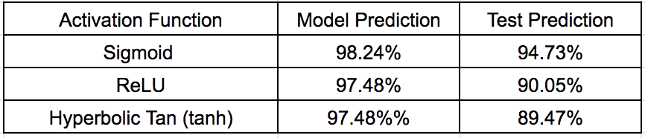
Artificial neural networks
Cost was computed using Sigmoid Cross Entropy which weighs the probability error in discrete classification tasks in which each class is independent and not mutually exclusive
Single Layer Perceptron gave a best result of 95.32%
Single Layer Perceptron with PCA gave a result of 97.07%.

Slide 11
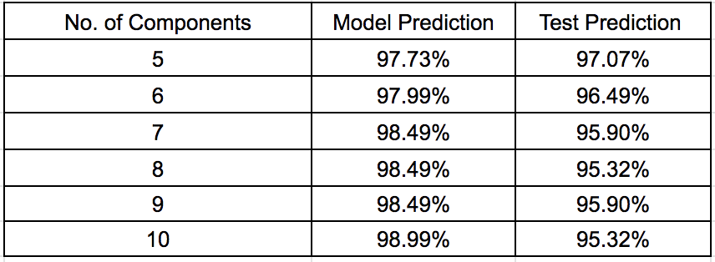
Artificial neural networks contd.
Multi layer perceptron with PCA gave the same results as the SLP, an accuracy of 97.07%

Slide 12
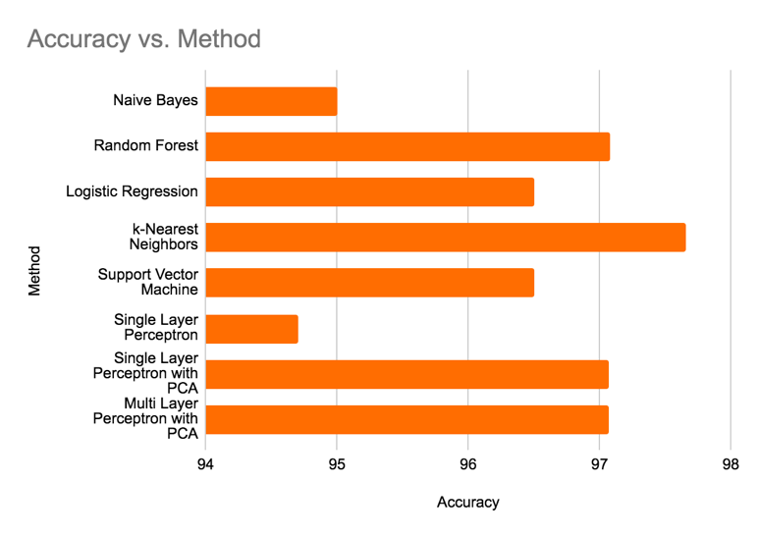
Final analysis
k-Nearest Neighbors gives us the best results in an accuracy of 97.66%.
The next method was using the Random Forest Approach, Single Layer and Multi Layer Perceptron with PCA with an accuracy of 97.08% and 97.07%.
Analysis on the ‘ideal’ training and testing set after multiple iterations run across classification methods.

Slide 13
Difficulties faced
The main difficulty observed in this study was the collection of data. Medical data is not always widely available due to copyright reasons as well as the pre-processing required that makes such data usable by the scientific community.

