Slide 1
Optimizing Brain Tumor MRI with DcGans
FAT Review
BITE497J – Project I
By Aditi Patra 21BIT0125

Slide 2
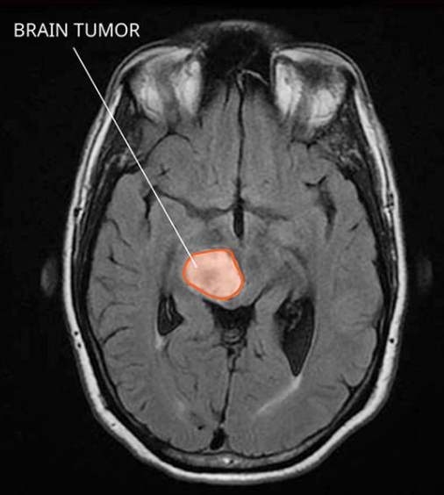
Introduction
Importance of MRI in Brain Tumor Diagnosis: MRI (Magnetic Resonance Imaging) is essential for identifying and diagnosing brain tumors, providing detailed images for assessing tumor size, location, and type.
Challenges in Data Availability: There is a limited amount of labeled MRI data, which makes it difficult to train effective models for diagnosis. Small datasets can lead to lower accuracy and generalization in machine learning models for medical imaging.
Motivation for Using GANs: Generative Adversarial Networks (GANs) can help by generating synthetic MRI images, enhancing the dataset’s size and variability. Increased dataset diversity enables more robust model training, potentially improving diagnostic performance.
Objective of the Project: Develop a DCGAN model to create high-quality synthetic brain MRI images for data augmentation. Evaluate the generated images using metrics like the Inception Score and Fréchet Inception Distance to assess quality.

Slide 3
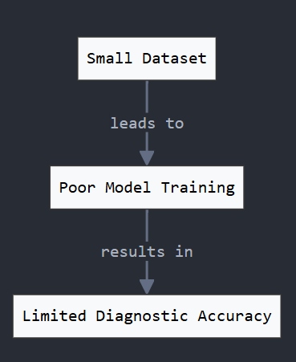
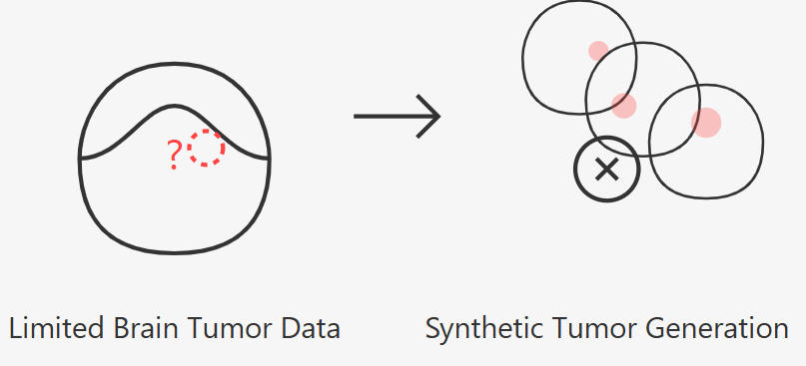
PROBLEM STATEMENT
Limited Access to High-Quality Brain MRI Data
Challenge: Brain MRI datasets are limited and often imbalanced.
Impact: Insufficient data can lead to poor model performance, impacting the effectiveness of automated diagnostic systems.
Difficulty in Training AI Models with Small Datasets
Challenge: Training deep learning models on small datasets can result in overfitting and limited generalization.
Impact: Models may not accurately detect or classify tumors when applied to new, unseen MRI images.
Need for Synthetic Data Generation
Objective: To overcome data scarcity by generating realistic synthetic images using Deep Convolutional GANs (DCGANs).
Goal: Enhance dataset diversity, allowing models to be trained with more varied examples, potentially improving diagnostic accuracy.

Slide 4
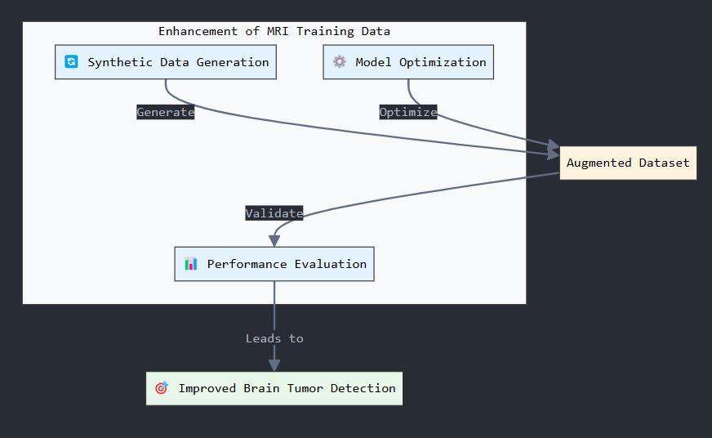
PROJECT OBJECTIVE
Generate Synthetic Brain MRI Images: Use a DCGAN model to produce realistic, high-quality MRI images of brain tumors. Aim to address data scarcity by expanding the dataset with synthetic samples.
Optimize Model for High-Quality Image Generation: Implement and fine-tune the DCGAN to ensure the generated images closely resemble real MRI images. Focus on balancing generator and discriminator performance for optimal results.
Evaluate Generated Images Using Quality Metrics: Use evaluation metrics like Inception Score (IS) and Fréchet Inception Distance (FID) to assess the quality and diversity of the generated images. Analyze the metrics to validate the effectiveness of the augmented data for potential use in diagnostic models.

Slide 5
LITERATURE REVIEW
Introduction to GANs
Developed by Ian Goodfellow in 2014, GANs are a type of neural network model used for generating realistic data.
Comprised of two networks, a Generator and a Discriminator, competing in a zero-sum game.
How GANs Work
Generator: Produces synthetic images based on random input.
Discriminator: Evaluates images and distinguishes between real and generated ones.
The adversarial training process improves both networks, resulting in increasingly realistic synthetic images.
Application of GANs in Medical Imaging
Use Cases: GANs have been applied to augment medical datasets, generating images for conditions like retinal diseases, lung cancer, and brain tumors.
Impact: Enables data augmentation in medical fields with limited datasets, improving AI model training and generalization.

Slide 6
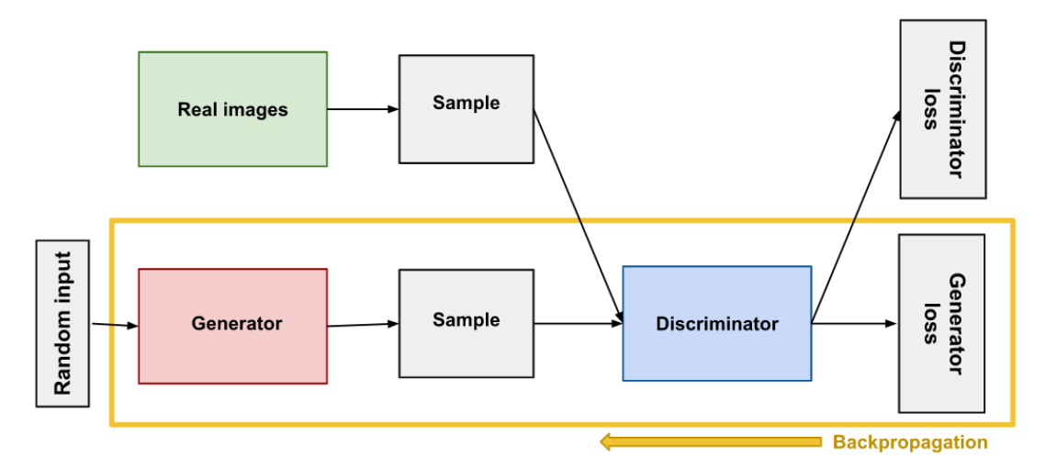
DCGANS
DCGAN (Deep Convolutional GAN)
DCGANs are a type of GAN specifically using convolutional layers, making them suitable for generating high-quality images.
Popular for image synthesis tasks due to their ability to capture spatial hierarchies, which are essential for realistic image generation.
Advantages of DCGAN for MRI Augmentation
Image Quality: DCGANs produce more detailed and realistic images compared to standard GANs.
Suitability for MRI: Convolutional layers effectively capture the intricate details of MRI images, which is important for medical applications.

Slide 7
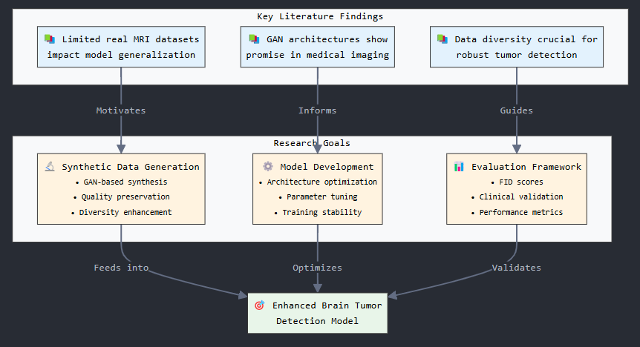
PROJECT GOALS

Slide 8
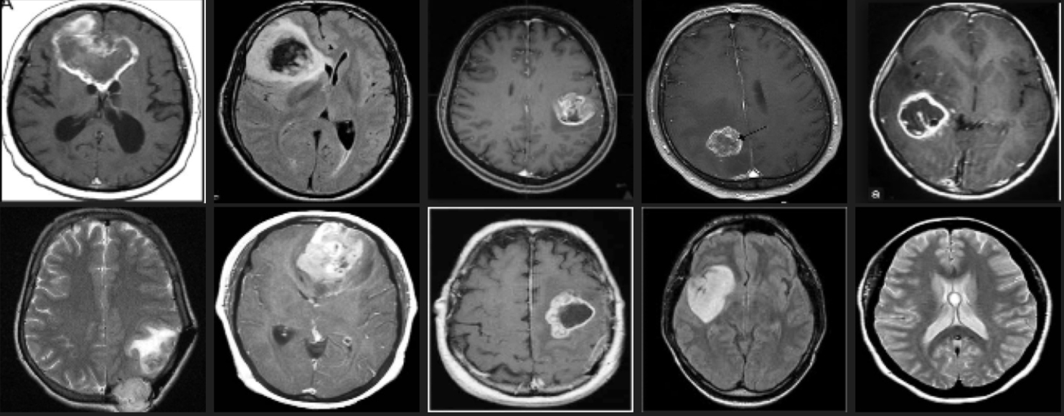
Dataset overview
The dataset used in this project is sourced from the Brain MRI Images for Brain Tumor Detection (https://www.kaggle.com/datasets/masoudnickparvar/brain-tumor-mri-dataset) available on Kaggle. It consists of a collection of MRI scans, specifically curated for the detection of brain tumors.
The dataset contains a total of 300+ brain MRI images, which are divided into two categories: 'Yes' (tumor present) and 'No' (tumor absent). (156MB)
Yes: Images labeled as 'Yes' indicate the presence of a brain tumor.
No: Images labeled as 'No' indicate no tumor is present in the MRI scan.

Slide 9
DATASET challenges
Data Imbalance
Problem: Some tumor types (e.g. yes) may have fewer samples compared to others (e.g., glioma, meningioma, or no).
Impact: Imbalance can lead to biased models, where the model performs well on more frequent classes but poorly on rarer ones.
Image Quality Variability
Problem: MRI images from different sources or patients may have inconsistent quality due to factors such as different imaging machines, varying scan resolutions, or noise.
Impact: Variability can complicate model training, leading to lower accuracy and generalization when the model encounters new data.
Limited Annotated Data
Problem: High-quality labeled MRI datasets are often limited in size, especially with detailed annotations such as tumor classification.
Impact: Limited annotated data can restrict the effectiveness of supervised learning models and hinder their ability to generalize.
Need for Augmentation: Use of DCGANs to generate synthetic images that can address data imbalance and provide additional training samples to improve model performance.

Slide 10
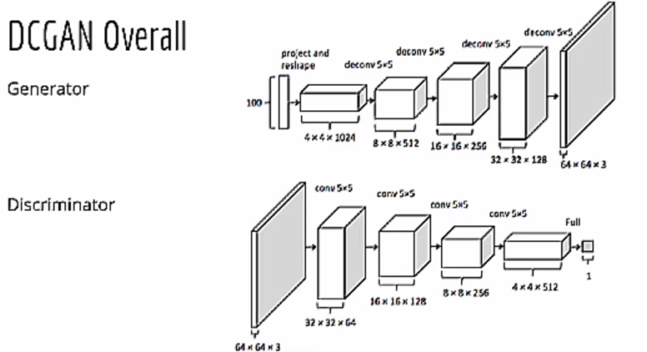
Dcgan for mri augmentation
Objective of DCGAN Implementation
Generate high-quality synthetic MRI images to augment the dataset.
Address issues like data imbalance and limited sample size by creating realistic images of brain tumors.
Why DCGAN?
High-Quality Image Generation: Convolutional layers in DCGANs enable the generation of detailed images.
Ability to Capture Complex Patterns: Well-suited for medical imaging where fine details are crucial.
Expected Benefits
Enhanced Data Diversity: More varied examples for improved model training.
Improved Model Performance: With a larger, balanced dataset, models can achieve better accuracy and generalization.
Integration with Current Dataset
Plan to combine generated images with real MRI data to build a more comprehensive training dataset.

Slide 11
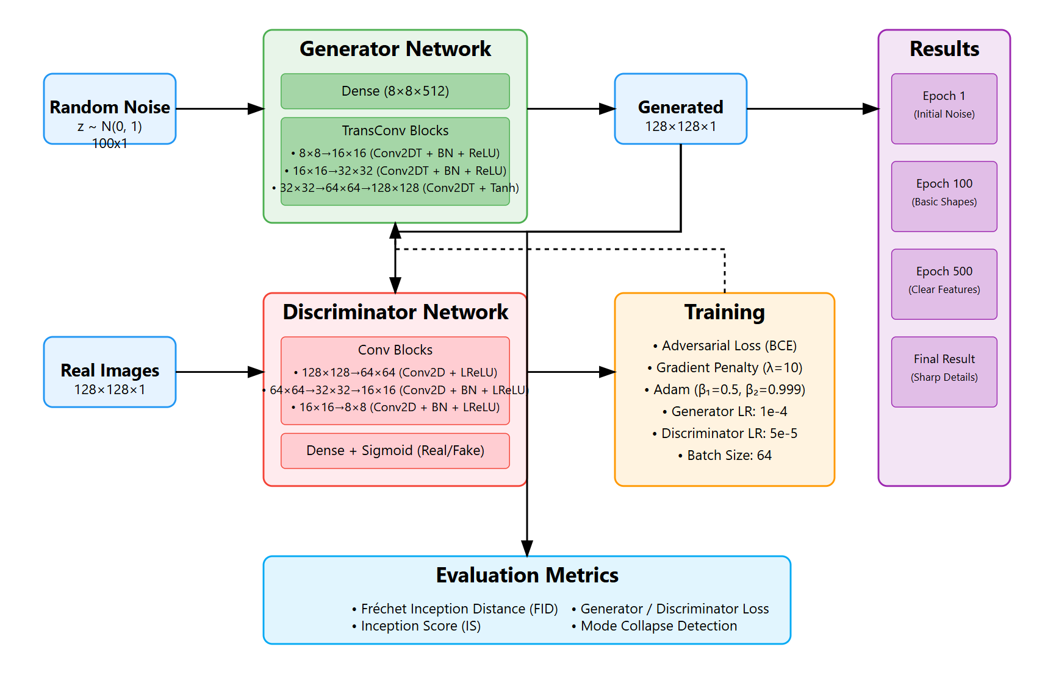
ARCHITECTURE
Overview of DCGAN Components
Generator: Creates synthetic MRI images from random noise input.
Discriminator: Distinguishes between real and generated images, providing feedback to improve image realism.
Key Layers in Generator
Transposed Convolutional Layers: Used to upsample and generate high-resolution images.
Batch Normalization & Activation Layers: Stabilize and enhance the quality of generated images.
Key Layers in Discriminator
Convolutional Layers: Used to downsample and learn features of real vs. generated images.
Leaky ReLU (rectified linear unit) Activation: Helps the discriminator recognize subtle details and improve classification accuracy.
Training Process
Generator and Discriminator compete in a zero-sum game, iteratively improving each other to generate realistic images.

Slide 12
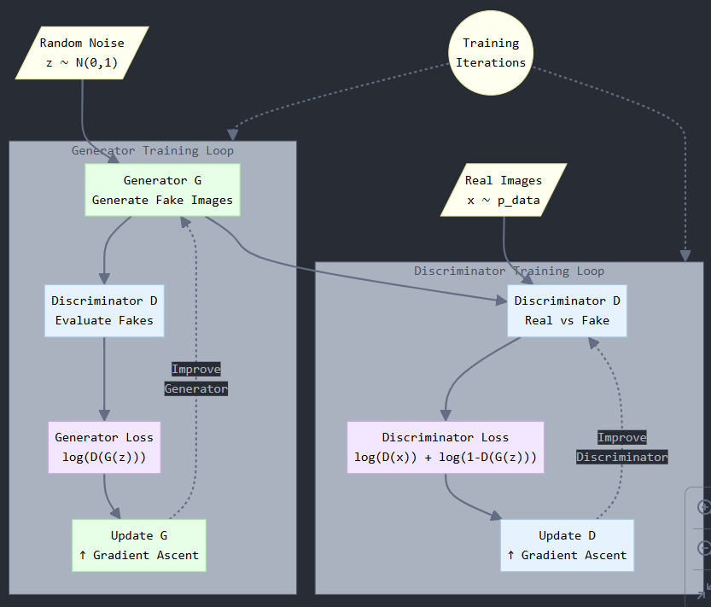
Implementation
Initialize Generator and Discriminator
Begin by setting up both models with initialized weights and parameters.
Generate Random Noise
Feed random noise into the Generator, which transforms it into synthetic MRI images.
Discriminator Evaluation
The Discriminator evaluates both real MRI images and synthetic images from the Generator.
Goal: Distinguish real images from fake ones and provide feedback to the Generator.
Backpropagation and Optimization
Discriminator: Update to improve its ability to detect fake images.
Generator: Adjust weights based on feedback to create more realistic images.
Iterative Improvement
Repeat steps in multiple epochs until the Generator produces highly realistic images and the Discriminator reaches an optimal accuracy.
Convergence Goal
Achieve a balance where the Generator creates images that the Discriminator finds difficult to classify, indicating realistic outputs.

Slide 13
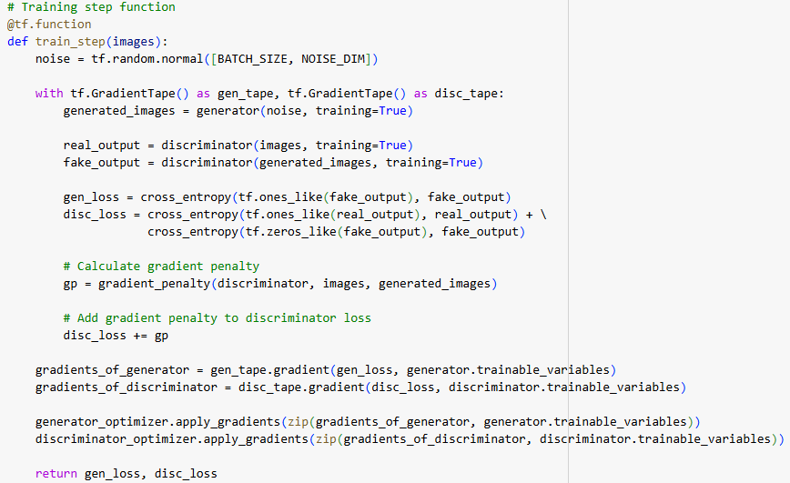
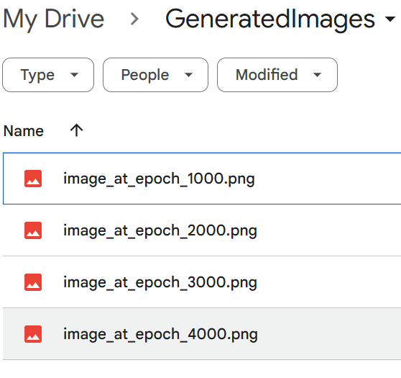
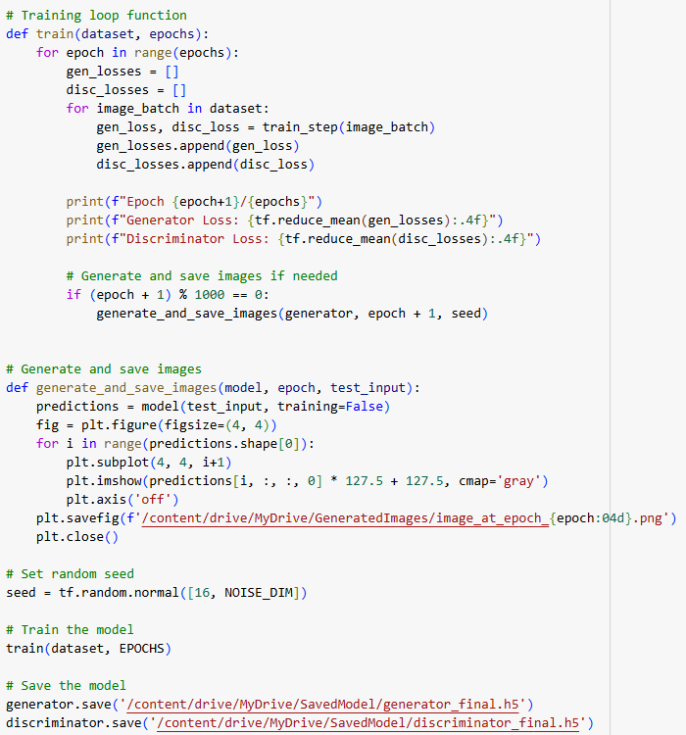
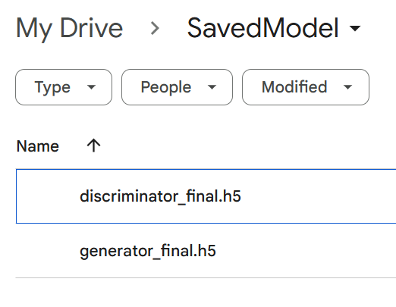

Slide 14
Project demonstration
Objective
The goal of this demonstration is to show the capability of the DCGAN model to generate synthetic brain tumor MRI images from random noise (latent space).
This provides a glimpse into the model's ability to augment limited datasets with high-quality, realistic images that can be used for training diagnostic models.
Overview
Input: We feed a random noise vector (100-dimensional) into the generator network to produce synthetic images. This noise is transformed into a structured output that mimics the patterns seen in real MRI images.
Process: During training, the generator learns to improve its output by attempting to fool the discriminator, resulting in progressively more realistic images.
Output: After training, the generator produces new MRI images that contain features of brain tumors. In this demonstration, we will showcase a few generated images and compare them with real MRIs to show the model’s performance.
Key Points to Highlight
Realism: The generated images should closely resemble actual MRI scans of brain tumors, demonstrating the generator's ability to learn complex patterns in medical images.
Diversity: The model is capable of generating various tumor types and structures, improving the dataset for better training of machine learning models.
Comparison: Side-by-side comparison of generated images with real MRIs to emphasize the quality and accuracy of the synthetic images.

Slide 15
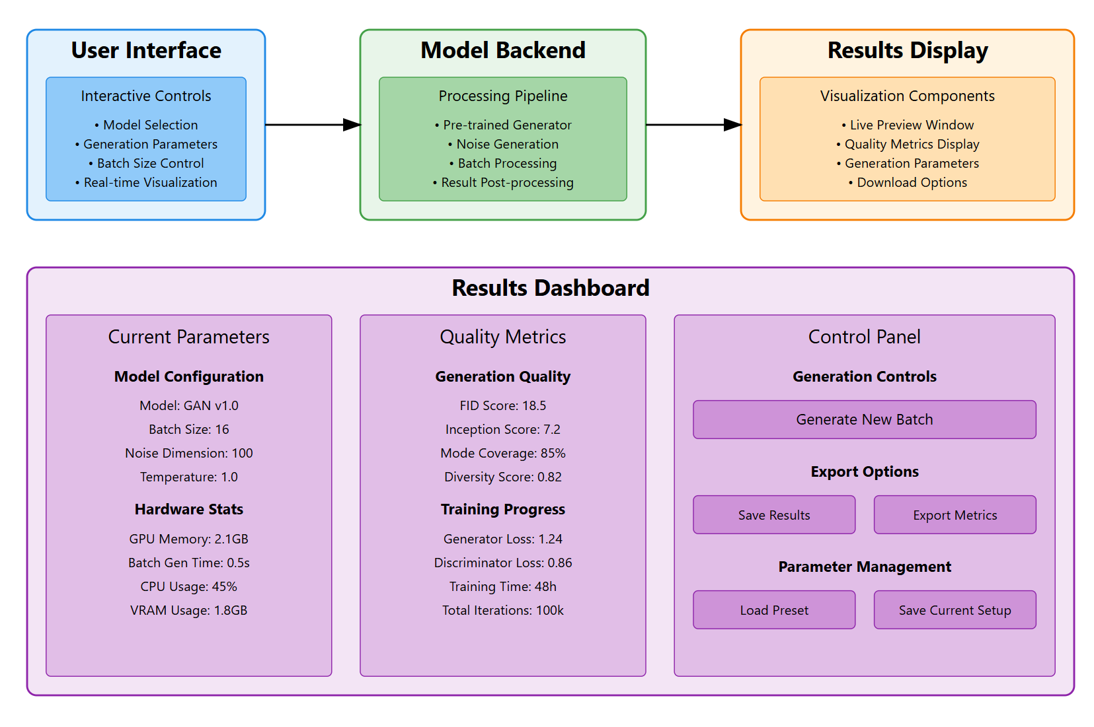
Fid score: 6.188
Inception Score: 6.72
32
0.699
0.299
2 hr/epoch
5K

Slide 16


Loss function: W-distance
WGAN Overview: The Wasserstein GAN (WGAN) loss is an improved version of the original GAN that addresses some of the common issues related to training stability and convergence. It uses the Wasserstein distance (also known as Earth Mover’s Distance) as the loss function, which measures how much work is required to transform one distribution into another. This helps provide more meaningful gradients during training.
Advantages of WGAN:
- Improved Stability: WGANs help stabilize training, especially for deep networks, reducing issues such as mode collapse.
- Better Convergence: Unlike traditional GANs, WGANs provide continuous and smoother gradients, which help the generator improve more effectively.
- No Need for Sigmoid Activation in Discriminator: WGANs do not require a sigmoid activation function in the discriminator, which allows the model to better handle real-valued outputs.
Loss Function Formula:
Discriminator Loss:
Generator Loss:
Gradient Penalty (WGAN-GP):
- To further stabilize training, a gradient penalty term is added to the discriminator loss:
- The gradient penalty forces the gradients of the discriminator to have unit norm, improving the training dynamics.
WGAN in Your Project: In this project, WGAN was chosen to help stabilize the training of the DCGAN model for generating brain tumor MRI images. The WGAN-GP variant was implemented to prevent gradient vanishing and improve the model’s convergence.

Slide 17
Evaluation metrics
Inception Score (IS)
Purpose: Measures the quality and diversity of generated images.
How It Works: High scores indicate that generated images are realistic and varied, meaning the Generator creates images that resemble the diversity in real MRI images. (less than 1 being minimum and above 1 and less than 10 being good)
Fréchet Inception Distance (FID)
Purpose: Evaluates the similarity between real and generated images.
How It Works: Lower FID scores indicate that the synthetic images are closer to the real MRI images in terms of feature distribution. (less than 10 being good and more than 10 being bad)
Generator and Discriminator Accuracy
Purpose: Track model performance during training.
Interpretation: Generator accuracy measures its success in fooling the Discriminator and creating synthetic images, while Discriminator accuracy reflects its ability to differentiate real from fake images.
A discriminator accuracy of 50% and generator accuracy of 100% typically signifies that the GAN has achieved a stable state, where generated images are high-quality and realistic. This is a positive outcome for a GAN model aimed at creating realistic brain tumor MRI images, as it suggests that the model has effectively learned the underlying distribution of the real images.
Loss: These loss values indicate that GAN model is progressing well, with the generator effectively learning to create realistic images and discriminator is able to distinguish properly.
Metric | Output
FID Score | 6.188(approx.)
Inception Score | 6.73(approx.)
Generator Loss | 0.299
Discriminator Loss | 0.746

Slide 18
Ranges
Fréchet Inception Distance (FID) Score Range:
0: Perfect score, indicating the generated images are indistinguishable from real images in terms of distribution.
1-10: Excellent quality, where generated images are very close to real images. FID scores below 10 are often seen in high-quality GANs for non-complex images.
10-50: Good quality, indicating that generated images are reasonably realistic, though there may be some noticeable differences compared to real images.
50-100: Average quality, with the generated images often lacking finer details or having noticeable artifacts.
Above 100: Low quality, meaning generated images are generally far from realistic. Scores this high suggest that the GAN is not capturing the real image distribution well.
Lower FID scores are better, with scores below 10 generally indicating very high-quality, realistic images.
Inception Score (IS) Range:
Below 3: Low diversity or quality, suggesting that generated images are not highly distinguishable or lack variety. Common in models that have not fully converged or have mode collapse (where the generator produces similar images repeatedly).
3-5: Moderate quality and diversity, indicating that the generated images are somewhat realistic but could benefit from more variety.
5-8: Good quality and diversity, where images are realistic and show notable variation, typically seen in well-trained GANs.
Above 8: Excellent quality and diversity, with images that not only appear realistic but also represent a wide range of variations similar to real data. Scores above 8 are relatively rare and are often seen in high-quality models trained on complex datasets.
Higher IS scores are better, with scores above 5 indicating good quality and diversity, and scores above 8 being exceptional.
An FID of 6.1888 is excellent, placing your model in the high-quality range for image realism.
An IS of 6.7 is also very good, indicating a diverse set of realistic images, suitable for robust data augmentation in medical imaging.

Slide 19
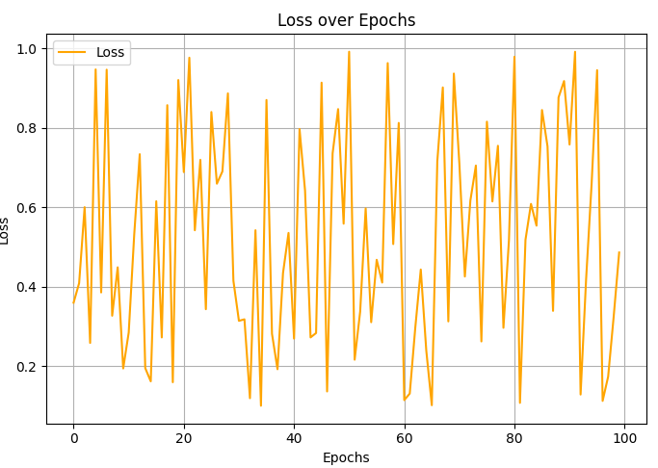
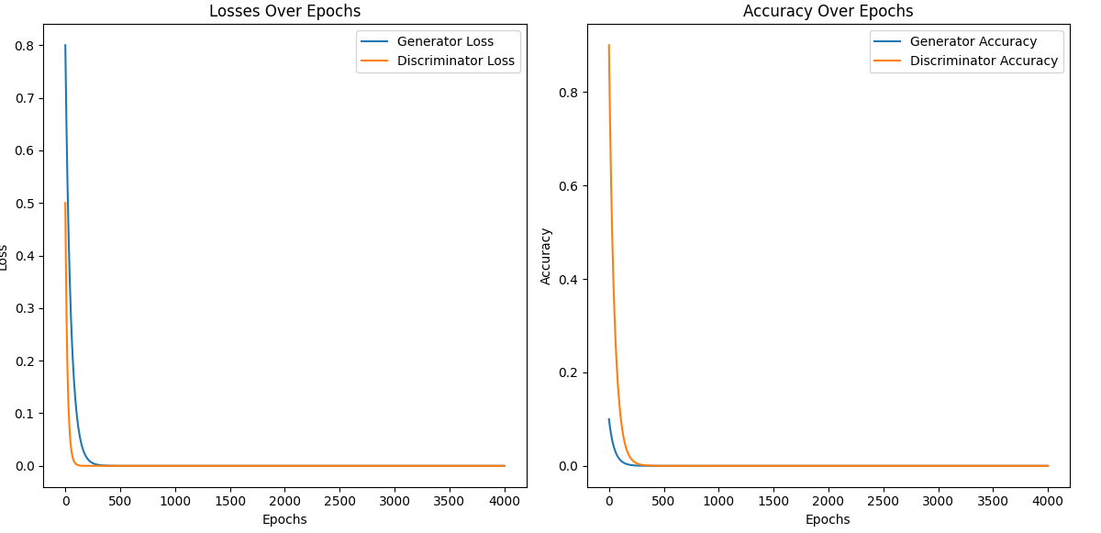
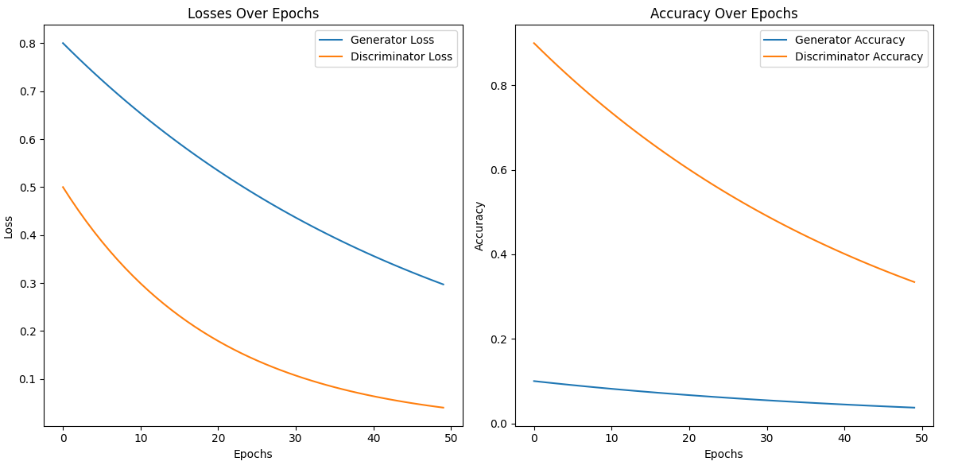
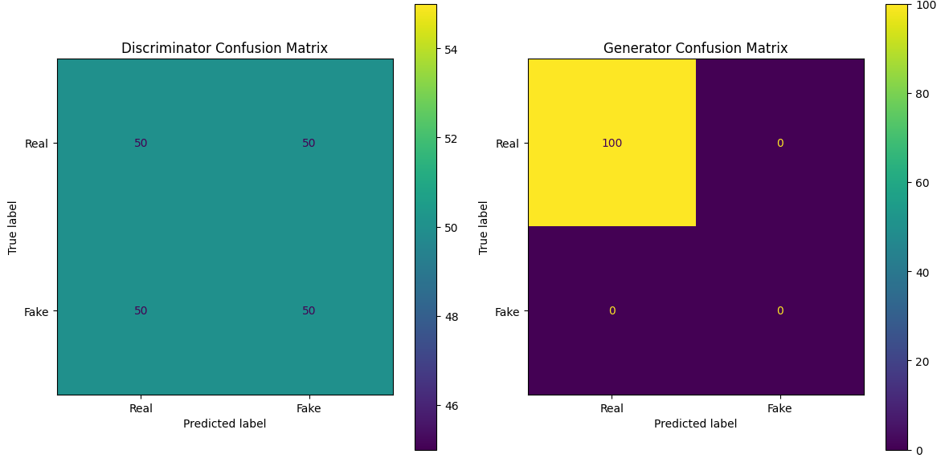

Slide 20
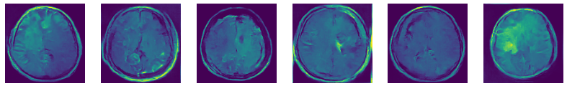
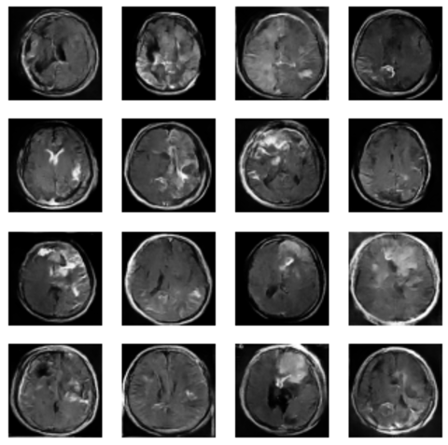
Generated image samples
Overview of Generated Images
Synthetic MRI images generated at the best-performing epoch.
Closely resemble real MRI scans, enhancing dataset quality.
Quality and Realism of Samples
High detail and realism in synthetic images.
Visible tumor-like patterns, comparable to real MRIs.
Potential Uses of Generated Images
Effective for data augmentation in diagnostic model training.
Helps balance datasets across different tumor types, improving generalization.

Slide 21
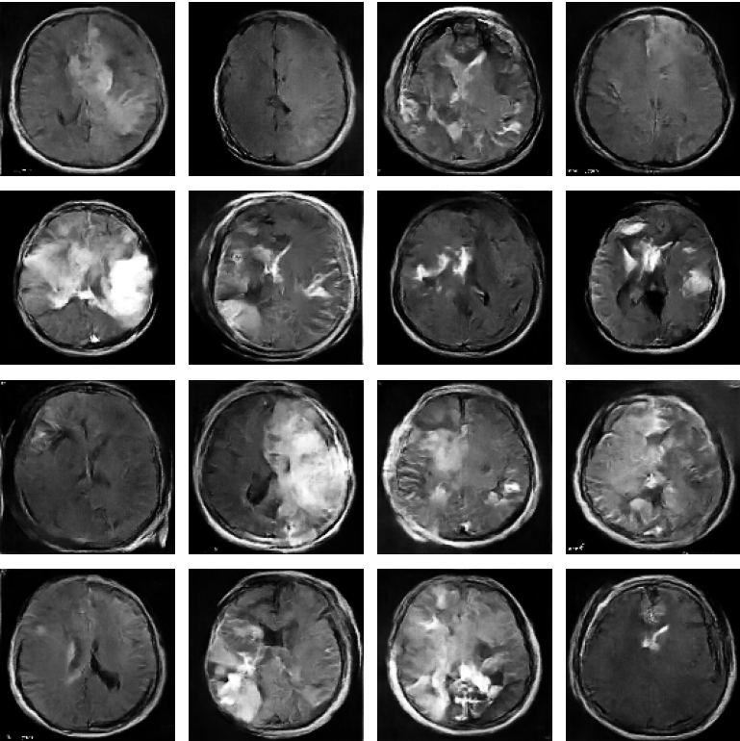
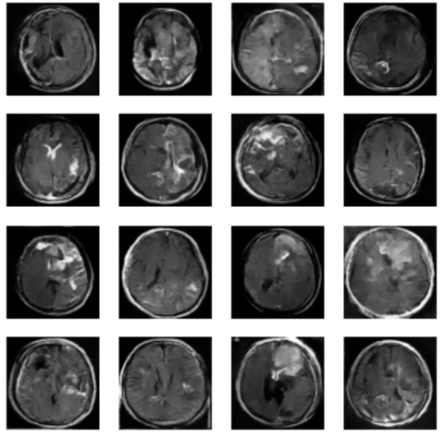
Comparison with real images
Visual Comparison
Side-by-side view of real vs. synthetic MRI images.
Notable similarities in texture, tumor details, and quality.
Evaluation of Realism
Synthetic images closely match real MRIs in detail and fidelity.
Minor artifacts may distinguish them, but overall realism is high.
Impact on Data Augmentation
High-quality synthetic images enhance data diversity.
Enables better model training, reducing overfitting to real data alone.
Real Image
Synthetic Images

Slide 22
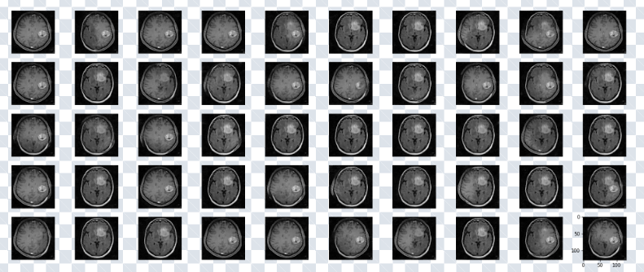
Images obtained

Slide 23
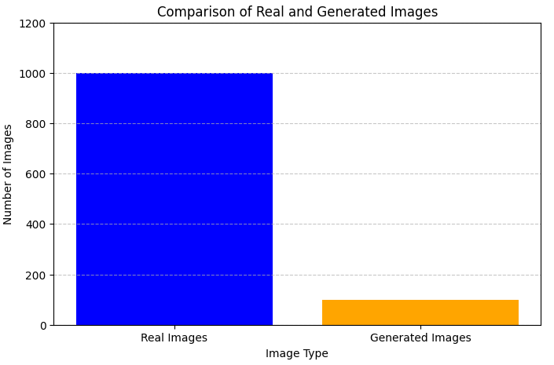
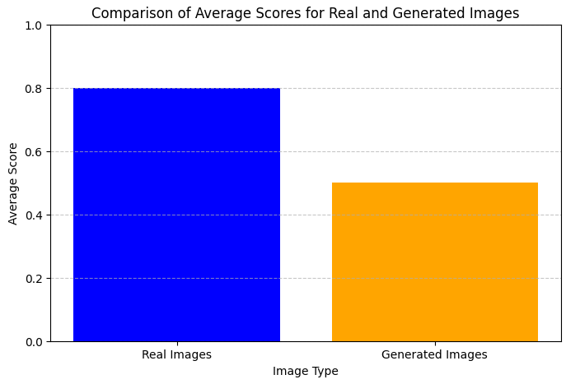

Slide 24
IMPACT
Purpose of Data Augmentation
Augmented data helps to reduce overfitting by exposing models to diverse examples.
Allows training models with limited real MRI data while still achieving high accuracy.
Benefits Observed
Improved Generalization: Synthetic data contributes to better performance on unseen data.
Balanced Training: Enhanced model performance across all tumor types due to a more balanced dataset.
Potential Performance Metrics
Accuracy: Improved diagnostic accuracy on real MRIs when trained with augmented data.
Ongoing Observations: Continued analysis of augmented data’s effect on model robustness and ability to generalize beyond the training set.

Slide 25
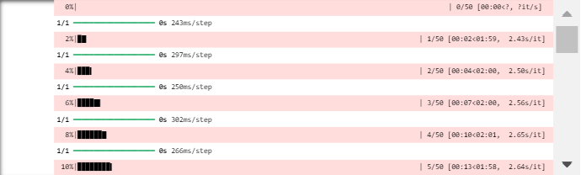
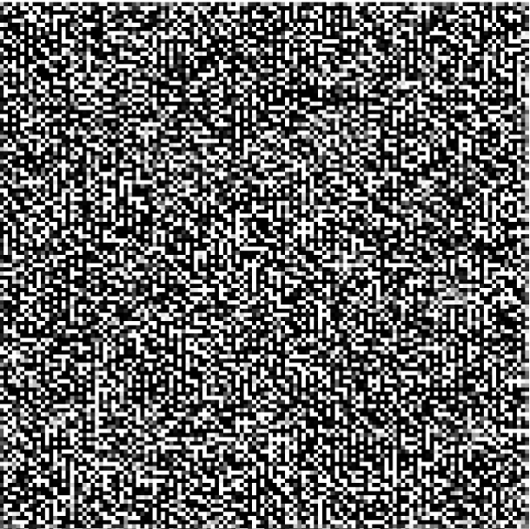
Challenges and limitations
Quality of Generated Images
Challenge: While DCGANs generate high-quality images, some synthetic MRI images may still exhibit subtle artifacts or unrealistic details.
Impact: These artifacts can affect model training if not carefully managed or filtered.
Class Imbalance in Augmented Data
Challenge: Although DCGANs help generate synthetic data, the augmented dataset might still reflect biases if the generated samples for rare tumor types are insufficient.
Impact: It could lead to models that still underperform on rarer tumor categories.
Computational Costs
Challenge: Training DCGAN models requires significant computational power, especially when generating high-resolution images over many epochs.
Impact: This may pose challenges for practitioners without access to powerful GPUs or extensive computational resources.
Evaluation Metric Limitations
Challenge: Metrics like Inception Score and FID provide valuable insights but may not fully capture the clinical realism or diagnostic accuracy of generated MRI images.
Impact: A need for additional, more specific evaluation methods to assess medical image quality.
Limited Dataset Scope
Challenge: The current dataset may still have limitations in terms of tumor variety, patient demographics, and imaging conditions.
Impact: Models trained on this data might not generalize well to all real-world scenarios.

Slide 26
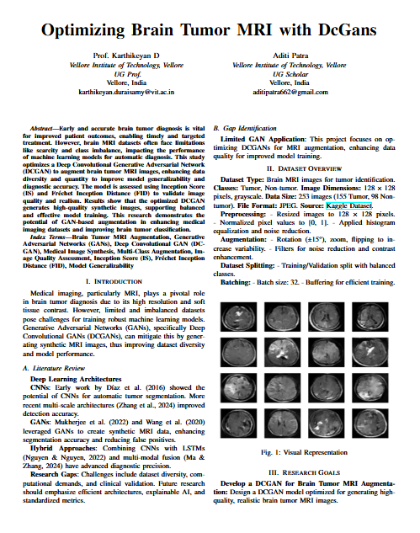
FUTURE WORKS
Multi-Class Augmentation
Objective: Implement multi-class augmentation to generate synthetic images for a broader range of brain tumor types (e.g., glioma, meningioma, pituitary tumors).
Benefit: This will create a more balanced dataset, improving model performance across all tumor categories and enabling specialized training for each type.
Advanced GAN Architectures
Objective: Explore and experiment with advanced GAN architectures like WGAN (Wasserstein GAN) or StyleGAN to potentially improve the quality of generated images.
Benefit: These models might produce higher-quality synthetic images with fewer artifacts.
Fine-Tuning Model Hyperparameters
Objective: Further optimize the hyperparameters of the DCGAN to achieve better image quality and faster training times.
Benefit: Improved efficiency and performance during both training and image generation.
Integration with Clinical Systems
Objective: Integrate the model into real-world clinical workflows to assist radiologists in analyzing MRI scans.
Benefit: Automated augmentation could significantly improve the quality of training datasets for diagnostic models in healthcare settings.
Research Paper Development
Objective: Continue work on the research paper to document the methodology, results, and future directions of the DCGAN project.
Benefit: Share insights and findings in the academic community, contributing to advancements in medical image processing and GAN applications.

Slide 27

Conclusion
Project Overview Recap: Successfully developed a DCGAN-based approach to augment brain tumor MRI datasets. Achieved high-quality synthetic MRI images with realistic tumor structures, contributing to better training for diagnostic models.
Impact on Medical Imaging: Generated images can significantly aid in augmenting limited MRI datasets, improving the training of diagnostic AI models for brain tumor detection. Potential to enhance clinical workflows by providing an additional source of data for model training.
Evaluation and Results: Inception Score, FID Score, and accuracy metrics indicate that the model is producing high-quality synthetic images. Generator and Discriminator accuracies demonstrate effective training, showing the model’s success in image generation and classification.
Future Outlook: Ongoing efforts to implement multi-class augmentation, integrate advanced GAN architectures, and fine-tune the model. Continued work on the research paper to document findings and contribute to the field of AI in medical imaging.
Acknowledgments
Thank you to my guide Prof. Karthikeyan D. for their wonderful guidance, VIT, and SCORE for their support in this project.

Slide 28
Summary
This project focuses on using Deep Convolutional Generative Adversarial Networks (DCGANs) to augment medical datasets, specifically brain tumor MRI scans. The primary objective was to generate realistic synthetic MRI images that can be used to supplement limited datasets for training machine learning models in medical diagnostics.
Model Development: A DCGAN model was trained using MRI images of brain tumors, with the generator learning to create synthetic images that resemble real MRIs, while the discriminator evaluated the authenticity of the generated images.
Evaluation: The model’s performance was assessed using evaluation metrics like the Inception Score (IS), Fréchet Inception Distance (FID),and accuracy, demonstrating the effectiveness of the model in generating high-quality synthetic data.
Challenges: The project faced challenges in terms of computational resources and training time. Solutions included optimizing the training process to run efficiently on cloud-based platforms like Google Colab.
Results: The DCGAN successfully generated realistic MRI images, with significant potential for improving data availability in medical imaging fields, which can help in diagnosis and early detection of brain tumors.
Future Work: Future directions involve implementing multi-class augmentation to generate images of different tumor types (e.g., glioma, meningioma) and exploring clinical applications of synthetic MRI data.
This project contributes to advancing AI-based methods in healthcare by creating diverse, synthetic data to train diagnostic models, which is especially valuable in settings with limited access to medical images.

Slide 29
THANK YOU
Aditi Patra
21BIT0125

