Slide 1
Bluetooth App Using App Inventer
Aditi Pawaskar
Lynelle Fernandes

Slide 2
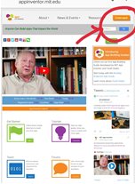
Steps:
To get started with MIT app inventor. Go to the site: ai2.appinventer.mit.edu
Click on Create app! as shown below:

Slide 3
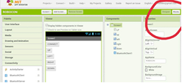
3. The next step is to login with your gmail ID.
4. After loging in, you will get a project page that looks like:
5. Start new project by clicking on the above mentioned button and start app making!

Slide 4
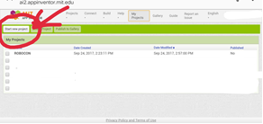
6. Create a new project with new name. And select OK.
7. Click on the name. The next page opens up, which is:

Slide 5
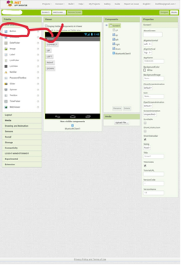
8. This is Screen 1.
Buttons can be selected
from the drop-down
lost on the left under
the title of layout.
9. The buttons are put on
the screen and
renamed with the list
on the right of the
screen.

Slide 6
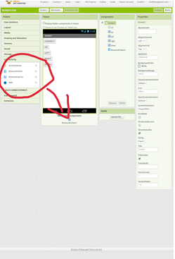
10. Bluetooth client is
added onto the app
from the connectivity
drop-down list on the
left side of the screen,
as shown above.
Also add a list picker.

Slide 7
11. The needed presentation can be modified
with the properties given on the right of the
screen.
Rename the buttons by changing their name
mentioned in components.

Slide 8
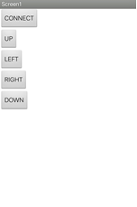
The interface of the app must look like this :

Slide 9
13. The Block mentioned on the upper-right
leads you to programming each button
used. One can perform control statements
and logic; it's basic programming with the
help of blocks.

Slide 10
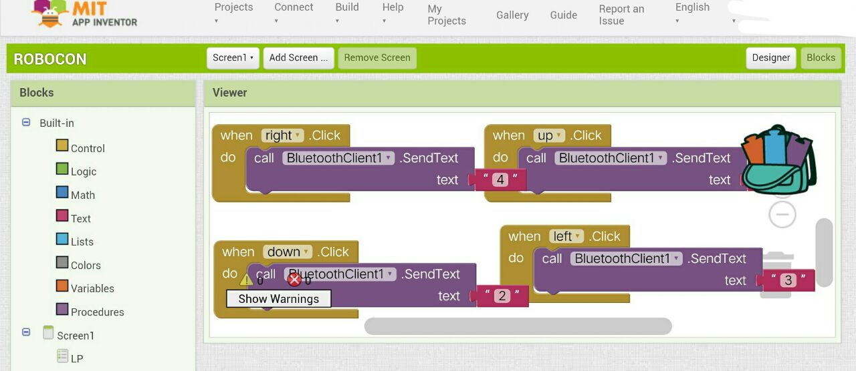
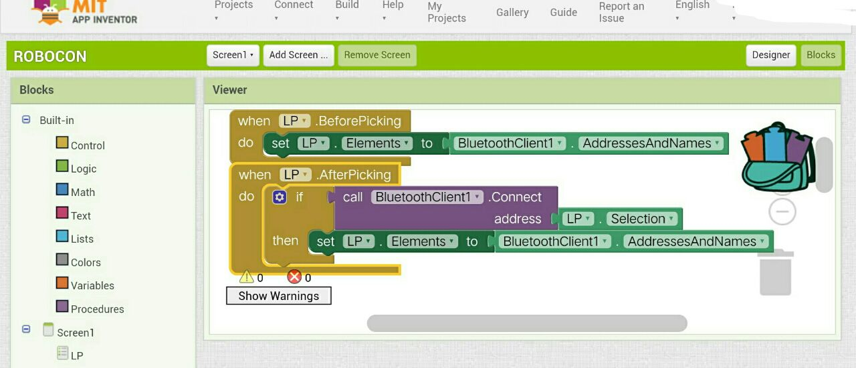
Add the appropriate blocks to result in the following code:

Slide 12
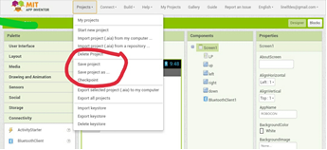
14. Save the program:

Slide 13
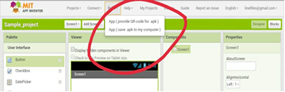
15. Build an apk, save it on your PC and transfer
or use the app to scan the QR code.

Slide 14
The application is created!
You can add media and other connectivity options that are present.
For further tutorials , refer:
http://appinventor.mit.edu/explore/ai2/tutorials.html

