Slide 1
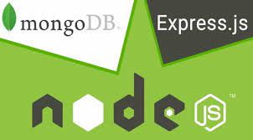

Application Using Node JS, Express and MongoDB
Submitted by Aditi Sau
NSTI(W) Salt Lake, Kolkata
Guidance by Mr. Lingaiah Boddu

Slide 2
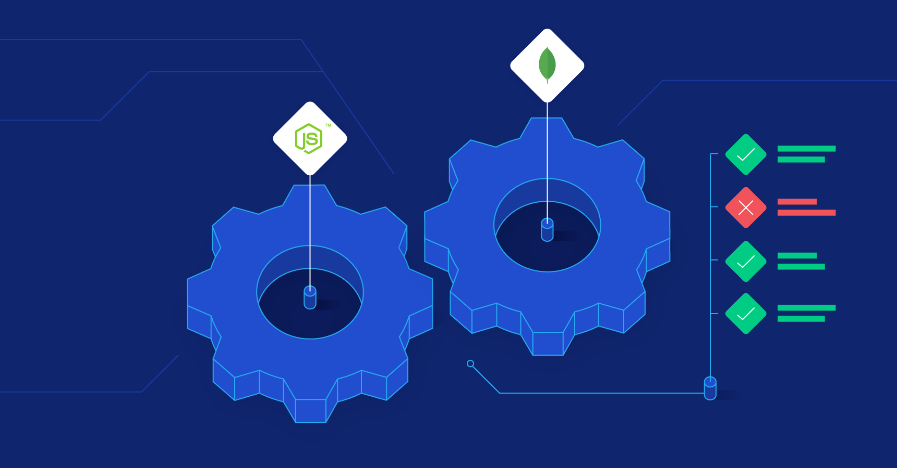
Agenda
Introduction
Services & Tools
Project Architecture
User Diagram
Project Demo
Conclusion

Slide 3

Introduction
Modules of Website:
Home
Overviews
Treatment
Contact Us
Login/Signup
This application is developed using NodeJS and the Express framework, when we want to interact with a MongoDB database by code. The purpose of this document is to describe the functionality and specifications of the design of a web application and to learn how to build a simple web-based application using Node Js and Mongo DB.

Slide 4
Services and tools required
Npm packages
Editor : VS Code
OS: Windows 10
Browser: - Chrome
Languages: HTML, CSS, JavaScript.
Runtime: - Node Js
Non-RDBMS: MongoDB
Library/Framework: Express, Mongoose, Bootstrap
Services
Tools
Technologies
Provide services, tools & technologies for own website are….

Slide 5
Project Architecture
BACKEND
Node js, Express
DATABASE
Using Mongo dB
Using Html,Css
FRONTEND
Frontend work gives the user interface and backend work is helps us to store the data of every users.
USER
ADMIN

Slide 6
User Diagram
User
Home
Overviews
Contact us
Treatments
Login/Signup
Here user have chances to access and generate their data.

Slide 7
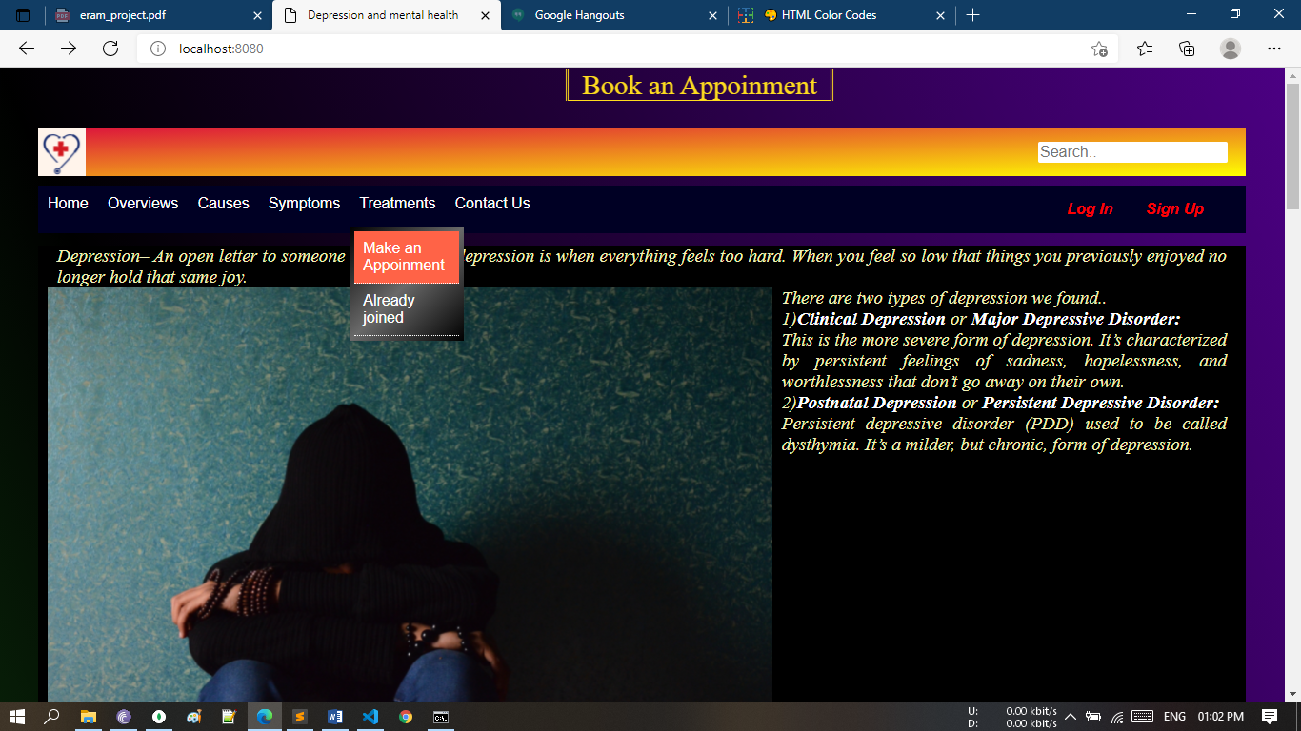
Project Demo
This pages are shown in the browser by codes.

Slide 8
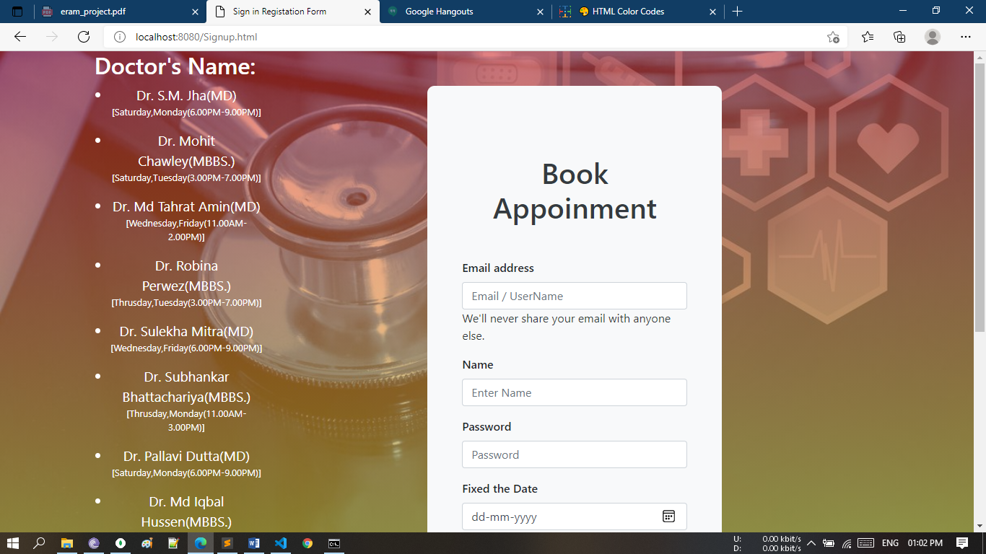
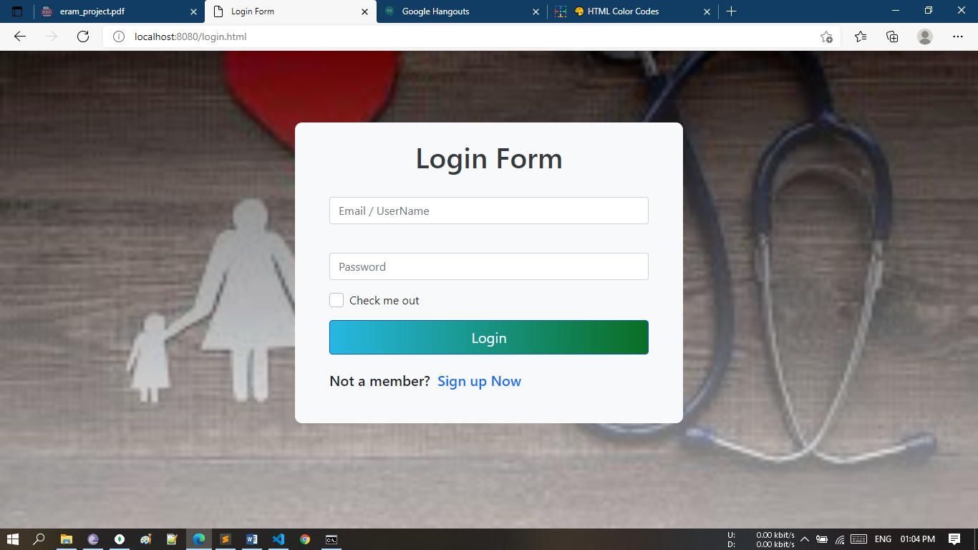
Sign up & take appointment

Slide 9
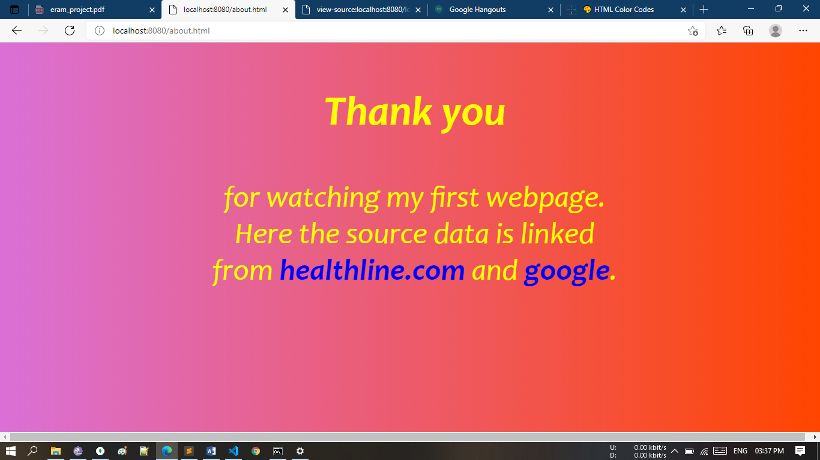
Conclusion
While building an application using NodeJS, Express and MongoDB, it’s important to make sure everything is installed and configured correctly. In this project, covered those key steps in the process.

Slide 10

Thank You

