Slide 1

KIET Group of Institutions
Course : Btech
Branch : CSEAI
Submitted to : Bikki Kumar

Slide 2
Stock Price Prediction
Predicting Next-Day Prices using Historical Data
Presented By : Group 5
Aashish Pandey(202401100300002)
Aniruddha Singh(202401100300044)
Akash(202401100300024)
Anshul Anand(202401100300056)
Aditi Singh(202401100300014)

Slide 3
Problem Statement
Predict next-day stock closing prices using historical data.
Automate the process for multiple stocks.
Visualize predicted vs actual prices
Evaluate model performance using standard metrics.

Slide 4
Introduction
Stock market prediction is essential for investors and financial planning.
Machine Learning, particularly regression, is used for short-term forecasts.
Focus on simple, interpretable models like Linear Regression.
Process handles multiple files from the Nifty50 dataset.

Slide 5
Tools and Libraries
Language : Python
Platform : Google Colab
Libraries :
Pandas, os – Data Handling
Matplotlib – Visualization
Sklearn – Regression & Evaluation

Slide 6
Data Preprocessing
Each stock file is read and checked for required columns.
New label Next_Close created using .shift(-1).
Null values are dropped.
Datasets with <10 rows are skipped.
Train-Test split without shuffling (time series integrity preserved).

Slide 7
Methodology Overview
Loop through each stock CSV file.
Use Close price to predict Next Close.
Train a Linear Regression model.
Evaluate using MSE and R² score.
Visualize predictions with line plots.

Slide 8
Algorithm : Linear Regression
Simple linear model trained on past closing prices.
Model equation: y = mx + c.
Interpretable and fast.
Applied independently to each stock file.
Good for identifying trend-based movement.

Slide 9
Error Handling in Code
Checks if Close column exists.
Skips files with insufficient data.
Catches ValueError during train/test split.
Ensures smooth execution across all stock files.
Makes the pipeline robust and scalable

Slide 10
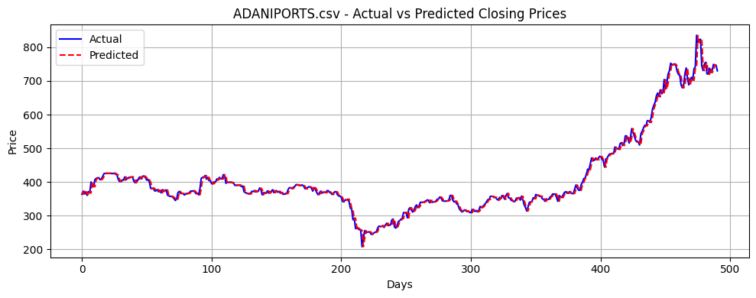
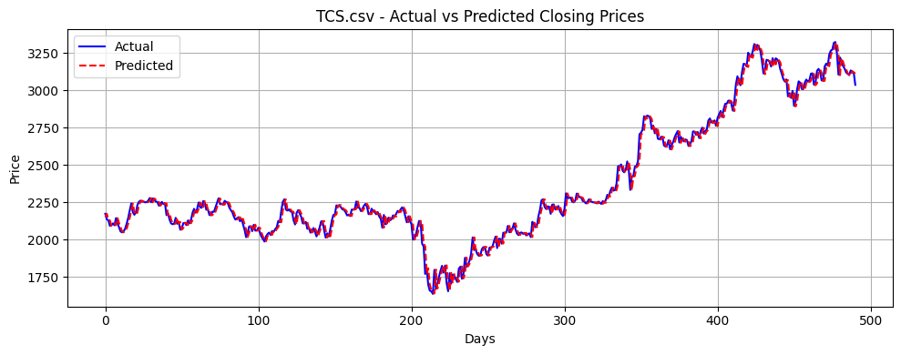
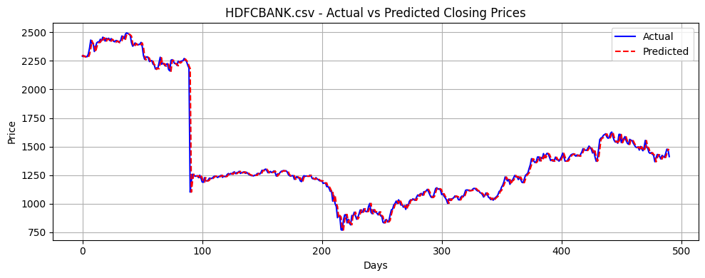
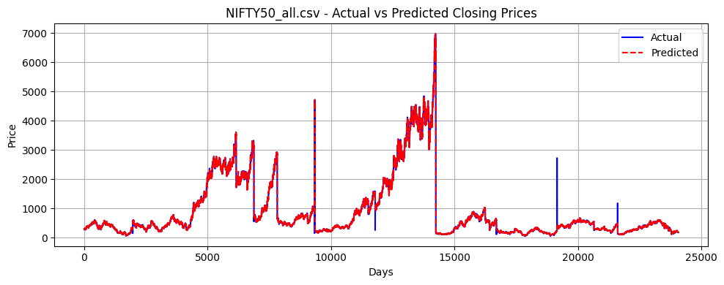
Visualization

Slide 11
Conclusion
Successfully built an automated prediction pipeline.
Linear Regression provides good baseline accuracy.
Model generalizes across different stocks.
Can be extended with more features or advanced models
(e.g., LSTM, ARIMA).

Slide 12
References
Kaggle Dataset:
[Nifty50 Stock Data](https://www.kaggle.com/datasets/rohanrao/nifty50-stock-market-data)
scikit-learn documentation.
Python official docs
Matplotlib and Pandas for visualization and data processing.

Slide 13
ThankYou

