Slide 1
SQL Project
Aditi Teli

Slide 2



Slide 3
Introduction
In this project, I and my uncle Jimmy just purchased Maven Movies, which is a DVD rental business. Uncle Jimmy has put up the money and I am the in-charge of the day-to-day operations.
As a new business owner, I need to learn everything I can about the business is the product, staff, customer purchase behaviour, etc.
I have the entire SQL Database for Maven Movies and I need to analyze everything on my own as the remaining employees are not able to give me much direction.
Objective
Access and explore the database and analyze how they relate with each other. Analyse all the aspects of the company’s data including transactions, customer, staff, etc.
( The diagram on the next slide gives the relationship between various tables)

Slide 4
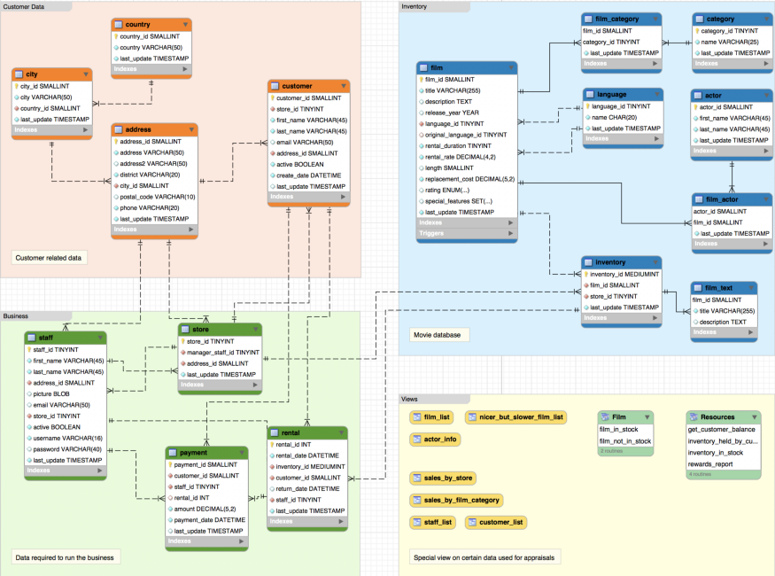

Slide 5
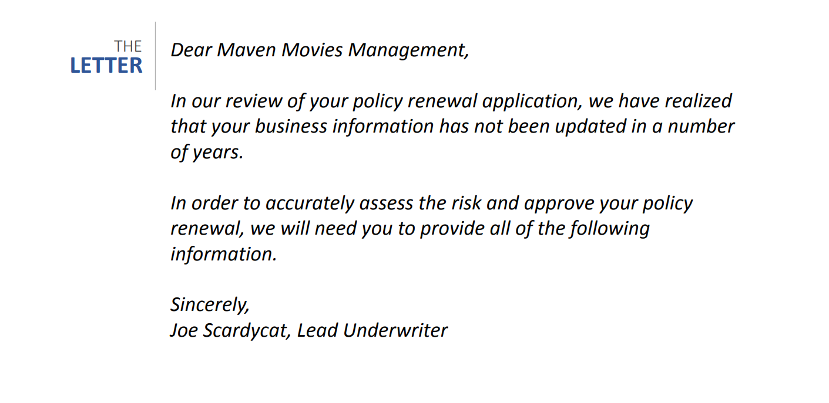

Slide 6
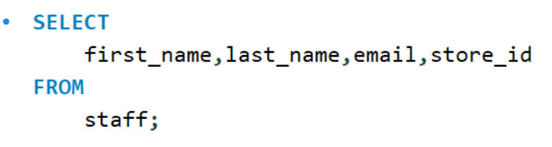

Request 1 We will need a list of all staff members, including their first and last names, email addresses, and the store identification number where they work.

Slide 7
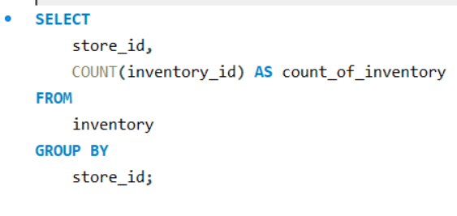

Request 2 We will need separate counts of inventory items held at each of your two stores.

Slide 8
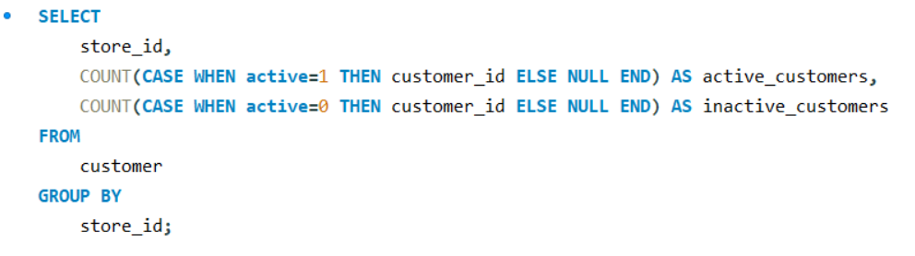

Request 3 We will need a count of active customers for each of your stores. Separately, please.

Slide 9
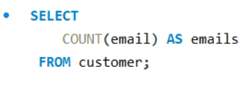

Request 4 In order to assess the liability of a data breach, we will need you to provide a count of all customer email addresses stored in the database.

Slide 10
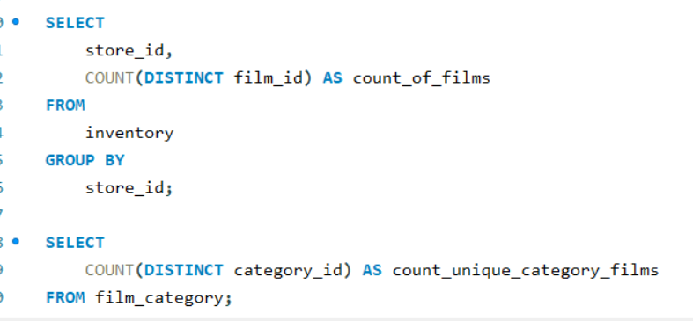


Request 5 Please provide a count of unique film titles you have in inventory at each store and then provide a count of the unique categories of films you provide.

Slide 11
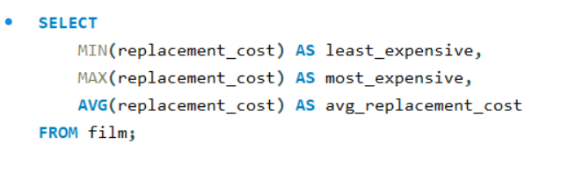

Request 6 Please provide the replacement cost for the film that is least expensive to replace, the most expensive to replace, and the average of all films you carry.

Slide 12
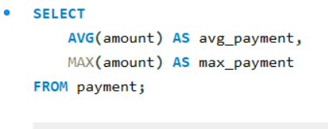

Request 7 Please provide the average payment you process, as well as the maximum payment you have processed.

Slide 13
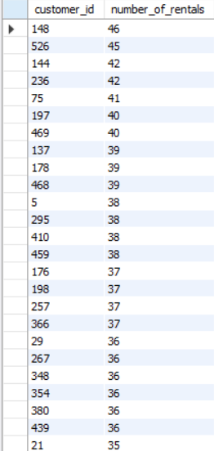
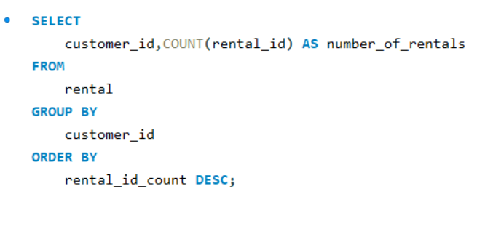
Request 8 Please provide a list of all customer identification values, with a count of rentals they have made at all-time, with your highest volume customers at the top of the list.

Slide 14
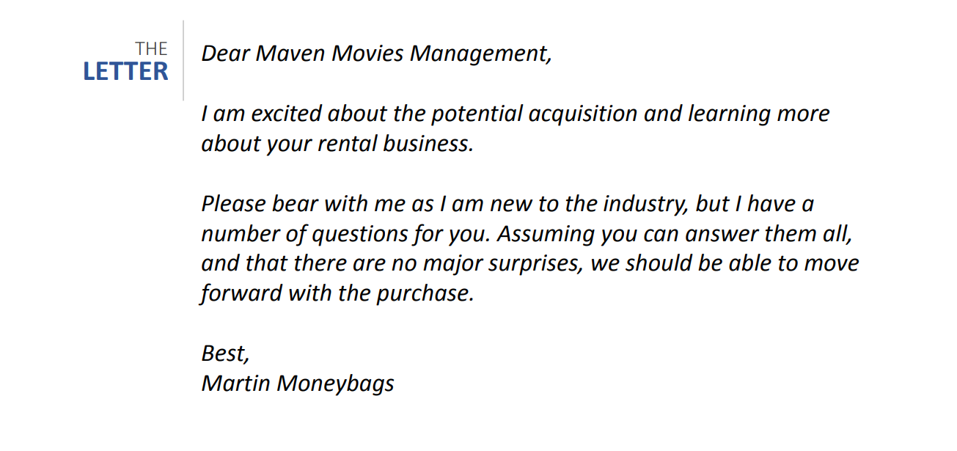

Slide 15
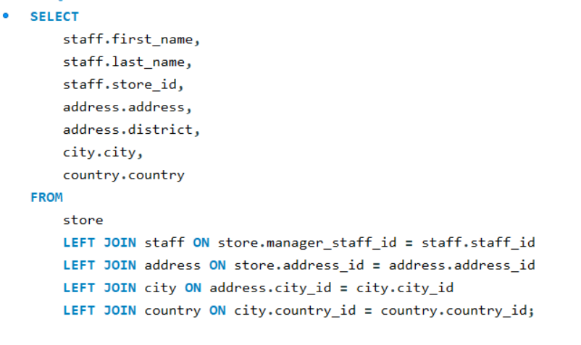

Request 1 My partner and I want to come by each of the stores in person and meet the managers. Please send over the managers’ names at each store, with the full address of each property (street address, district, city, and country please).

Slide 16
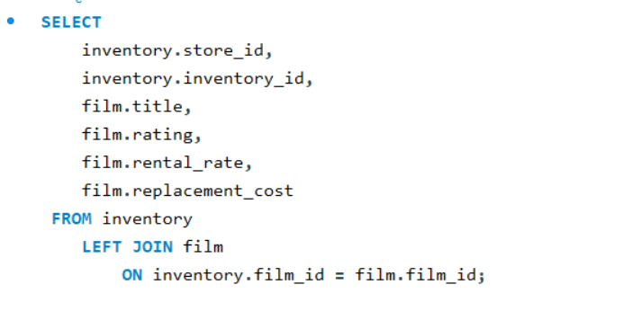
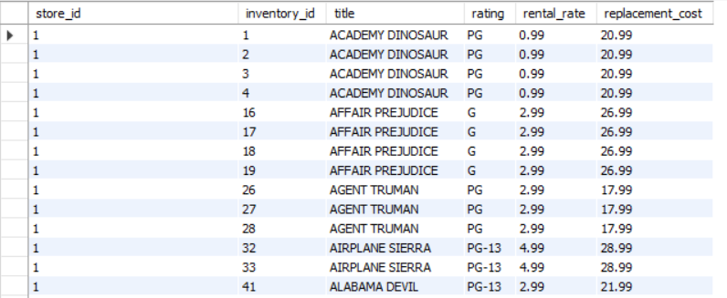
Request 2 Please pull together a list of each inventory item you have stocked, including the store_id number, the inventory_id, the name of the film, the film’s rating, its rental rate and replacement cost.

Slide 17
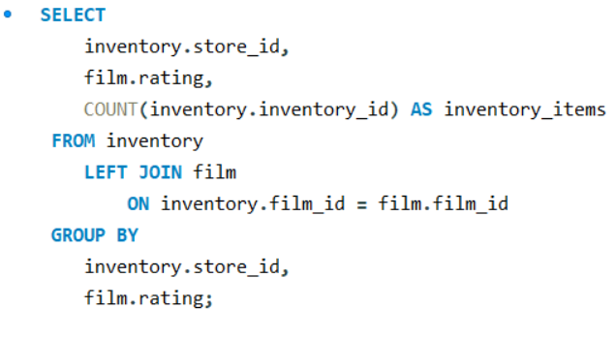
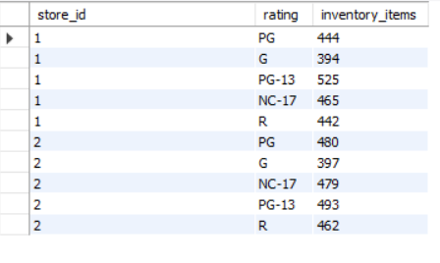
Request 3 From the same list of films you just pulled, please roll that data up and provide a summary level overview of your inventory. We would like to know how many inventory items you have with each rating at each store.

Slide 18
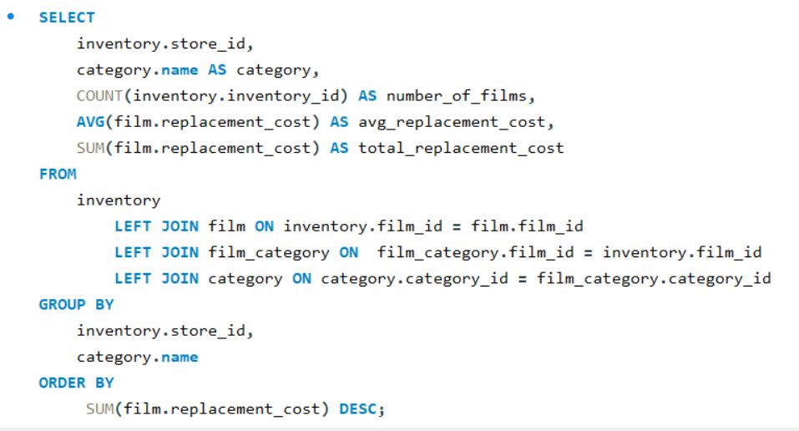
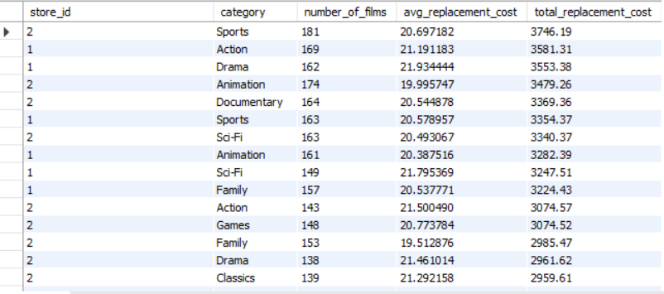
Request 4 We would like to see the number of films, as well as the average replacement cost, and total replacement cost, sliced by store and film category.

Slide 19
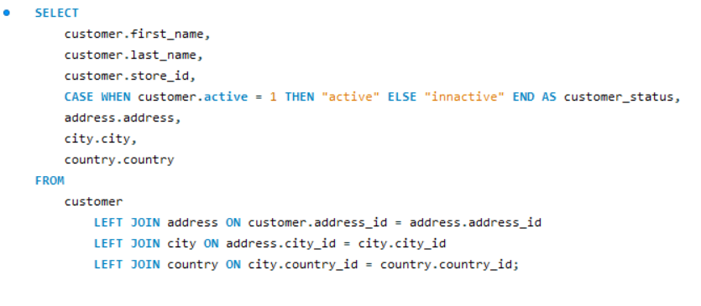
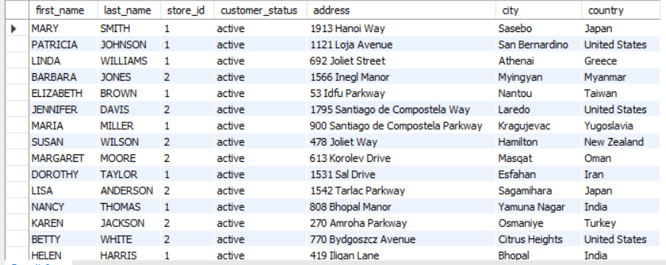
Request 5 Please provide a list of all customer names, which store they go to, whether or not they are currently active, and their full addresses – street address, city, and country.

Slide 20
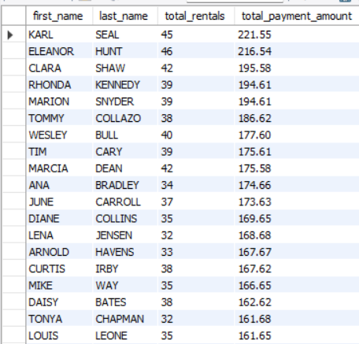
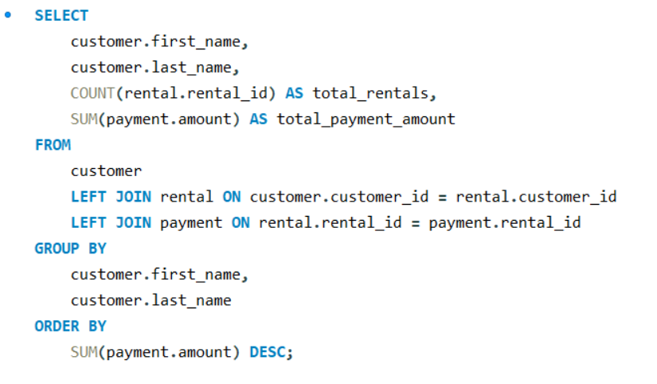
Request 6 Please pull together a list of customer names, their total lifetime rentals, and the sum of all payments you have collected from them. It would be great to see this ordered on total lifetime value, with the most valuable customers at the top of the list.

Slide 21
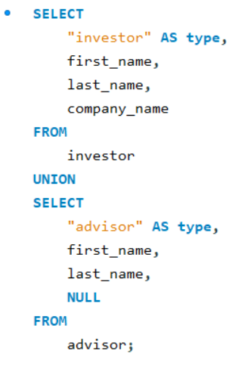
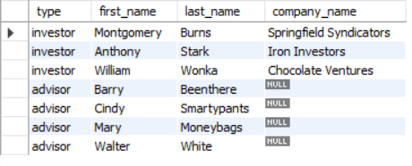
Request 7 Could you please note whether they are an investor or an advisor, and for the investors, it would be good to include which company they work with.

Slide 22
THANK YOU

